Slide 1
Game Design Fundamentals Workshop
Stone Librande
Creative Director, EA/Maxis

Slide 2
Overview
Parts of a game
Introductory exercises
Lunch break
Advanced exercises
Notes:
Overview

Slide 3
Exercises
Learn by doing
Play to learn, not to win
No computers
Fail early, fail often
Notes:
Exercises

Slide 4
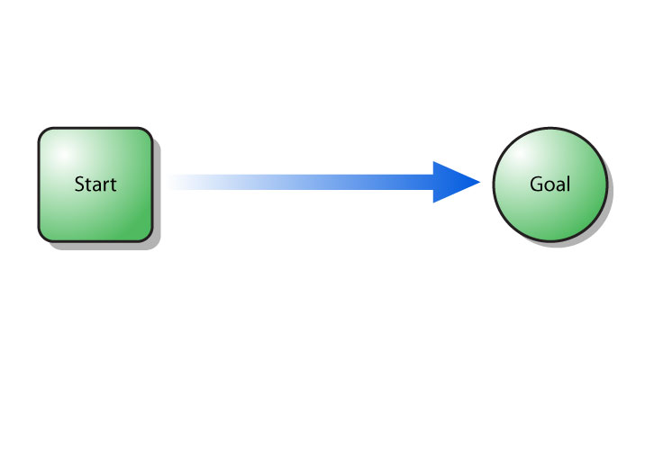
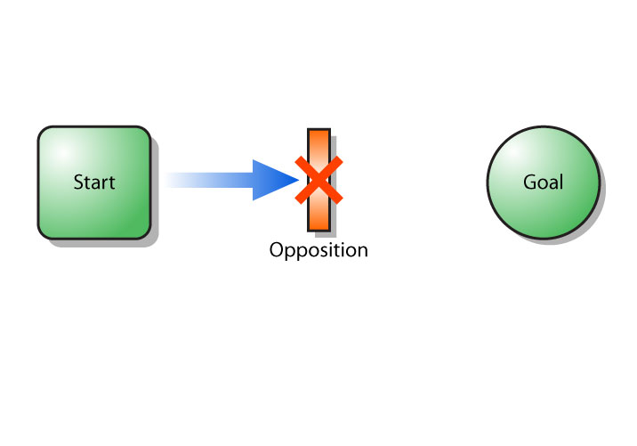
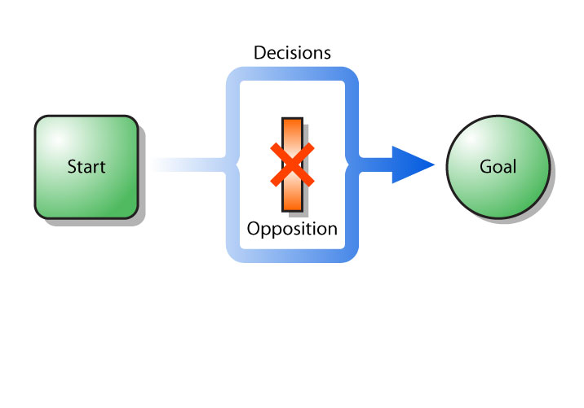
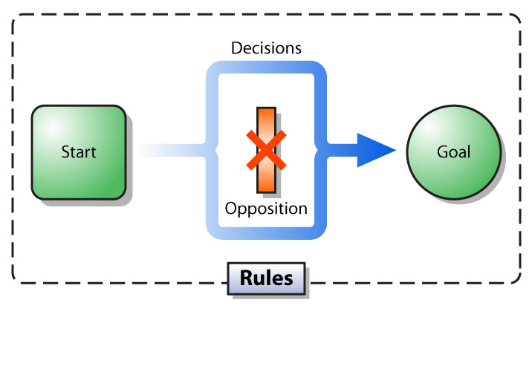
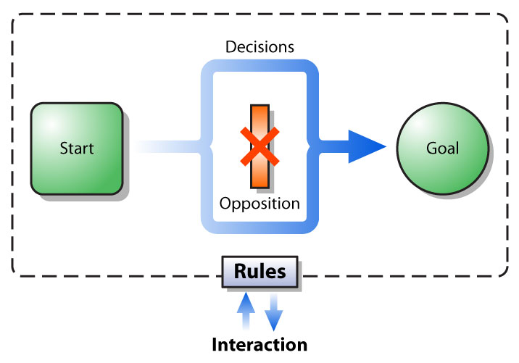
What is a Game?

Slide 5
Goals
Optimal Design:
Clear goal to strive towards
Measurable progress
Increase in dramatic tension
Goal is achieved at peak excitement level
Notes:
Goals

Slide 6
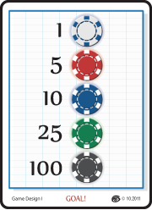
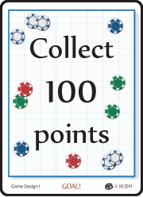
Exercise #1: Goals
Goal:
Collect the most “Goal” cards
Set Up:
Get in groups of 3
Take a bag of chips, goal cards, and boxes
Reveal a goal
Turn Order:
Take a chip from the bag.
Place it on the table with part of it off the edge.
Tap the chip (the “shooter”) onto the table.
If it is still partially off the table, hit it again.
If it falls off the table give it to the next player to put in his or her box.
If you “knock” into another chip you score it into your box.
If the knocked chip falls off the table, put it into the bag.
Repeat with next player.
Notes:
Goals Exercise

Slide 7
Goals
Ratio Goal (100 Points)
Interval Goal (Timed)
Fixed number of turns
Clock
Revealed vs. Hidden Goal
Negative Goal
Avoid a particular state
Multiple Goals
Complete any
Complete all
Changing
Individual goals per player
Meta goals
Notes:
Goals Summary

Slide 8
Opposition
Optimal Design:
Balance and fairness
Skill, not luck, triumphs
Challenge increases as skill improves
Skill improves as challenge increases
Notes:
Opposition

Slide 9
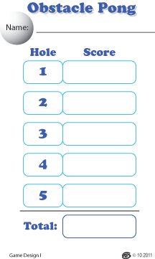
Exercise #2: Obstacles
Goal:
Make a par 5 hole
Set Up:
Get in groups of 3
Take a cup and a ping-pong ball
Hints:
Start with a par 1 hole
Add in obstacles one at a time
Ping-pong balls are unpredictable!
Obstacles do not need to be physical. Feel free to add special rules for your hole.
Playing:
Get a score card and play through all of the other teams’ holes. Low score wins!
Notes:
Obstacle Pong Exercise

Slide 10
Opposition
Helping vs. Hindering
Human opponents vs. In-game opposition
Direct competition vs. Indirect competition
Skill vs. Luck
Notes:
Opposition Summary

Slide 11
Rules
Optimal Design:
Easy to learn
A lifetime to master
Intuitive and consistent
Maximize positive interactions
Notes:
Rules

Slide 12
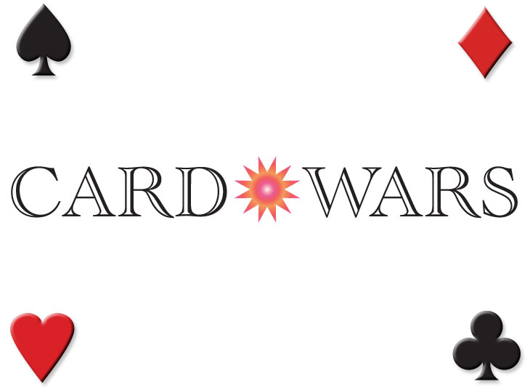
Exercise #3: Rules
Notes:
Card Wars Exercise

Slide 13
How to Play (Basic Version)
SET UP:
Each player starts out with a deck of 40 cards.
Shuffle your deck and then cut your opponent’s deck.
PLAY:
Both players flip over the top card from their decks.
The player with the highest card scores 1 point. (Ignore ties.)
Continue flipping cards until one player scores 10 points and wins!
Reshuffle your cards if you run out.

Slide 14
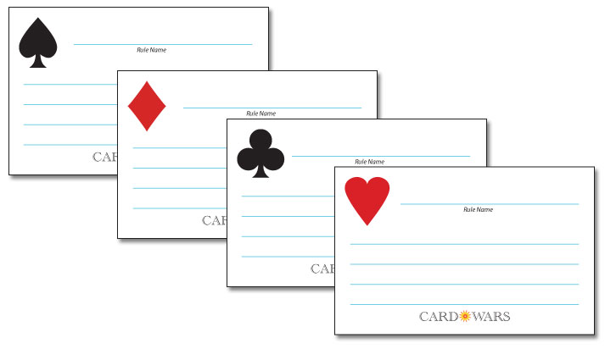
Get 4 Blank Rule Cards
One for each suit: Spades, Diamonds, Clubs, Hearts

Slide 15
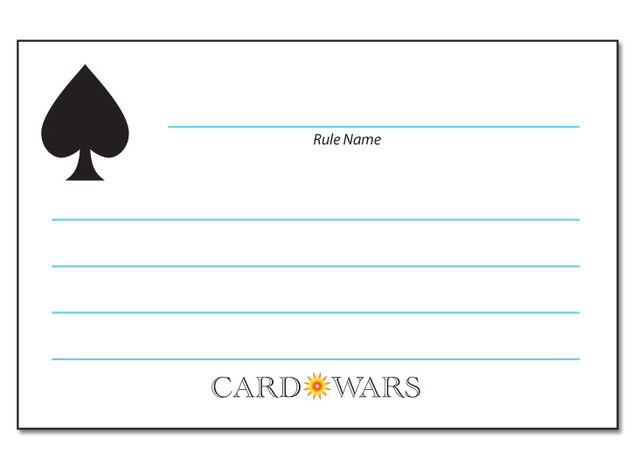
Spades
Arrow’s Flight
If your spade loses then immediately drop it on the floor from at least 1 meter. If it lands face up then it wins!
Flavor: Swords, Military Effect: Attack power

Slide 16
Diamonds
Buried Treasure
Cut your deck.
If you reveal a diamond put it on top of your deck and gain 1 point.
Flavor: Wealth, Riches Effect: Points

Slide 17
Clubs
Card Garden
Take the top card of your deck and put it in your hand. If you wish you may play cards from your hand instead of from the top of your deck.
Flavor: Staff, Nature Effect: Cards

Slide 18
Hearts
Consolation Present
If you lost this battle you may place your card on top of your opponent’s deck.
Flavor: Love, Emotion Effect: Giving

Slide 19
Flavor: Swords, Military
Effect: Attack power
Flavor: Wealth, Riches
Effect: Points
Flavor: Staff, Nature
Effect: Cards
Flavor: Love, Emotion
Effect: Giving

Slide 20
How to Play (Advanced Version)
SET UP:
Each player starts out with a deck of 40 cards.
Shuffle your deck and then cut your opponent’s deck to reveal a suit.
Your opponent plays with the rule card that matches that suit .
PLAY:
Both players flip over the top card from their decks.
A special rule triggers if your suit matches your rule card.
The player with the highest card scores 1 point. (Ignore ties.)
Continue flipping cards until one player scores 10 points and wins!
Reshuffle your cards if you run out.
REWARD:
Winning player takes the top card of the loser’s deck.

Slide 21
Rules
Use flavor to help immersion and memory
Every word is important; choose carefully
Place rules temporally into the Turn Order
Rules as independent modules vs. special cases or cross-references.
Notes:
Rules Summary

Slide 22
Lunch Break
Meet back here after lunch
Notes:
Break

Slide 23
Decisions
Optimal Design:
Interesting decisions
All options have merit and impact
One decision doesn’t negate another
Benefits rather than detriments
Notes:
Decisions

Slide 24
Exercise #4: Decisions
Notes:
100 Zombies Exercise

Slide 25
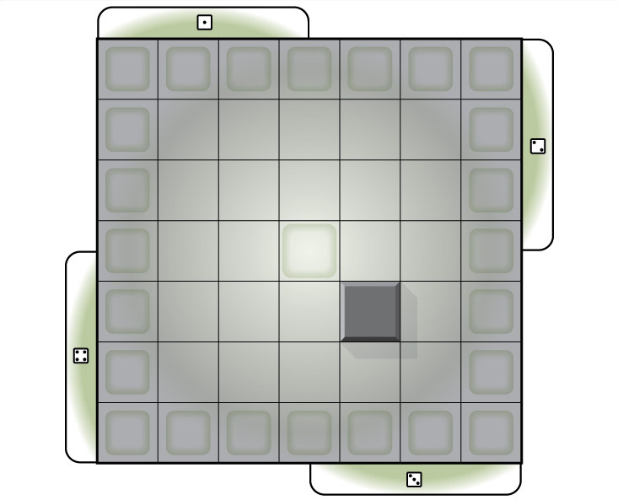

Slide 26
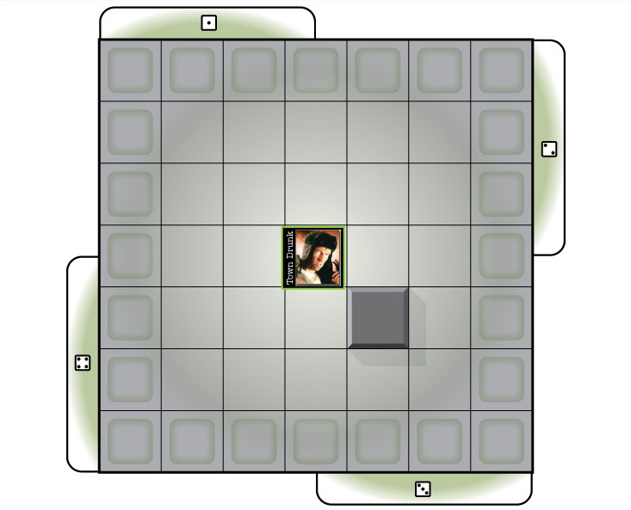

Slide 27
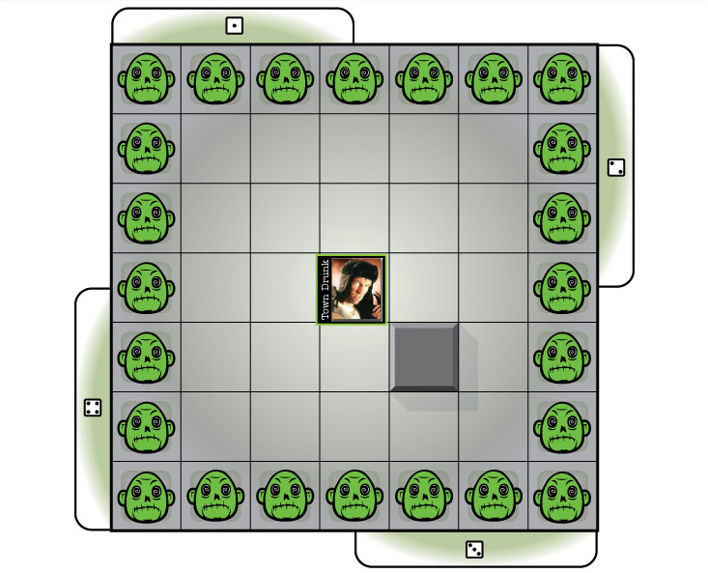

Slide 28
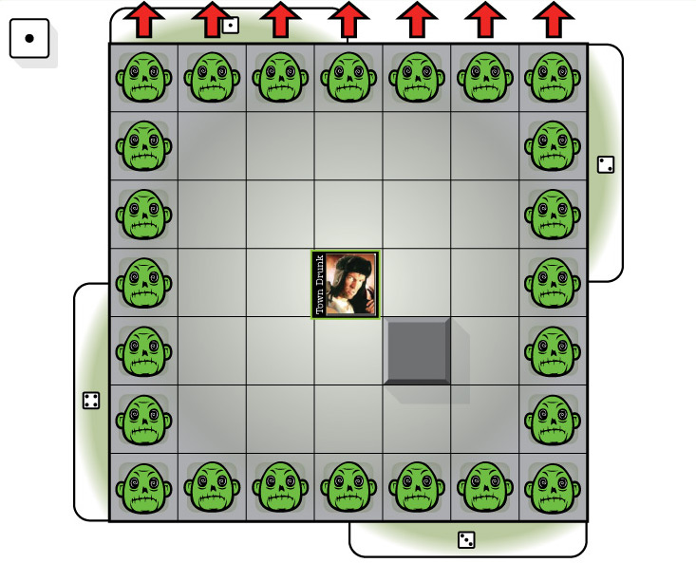

Slide 29
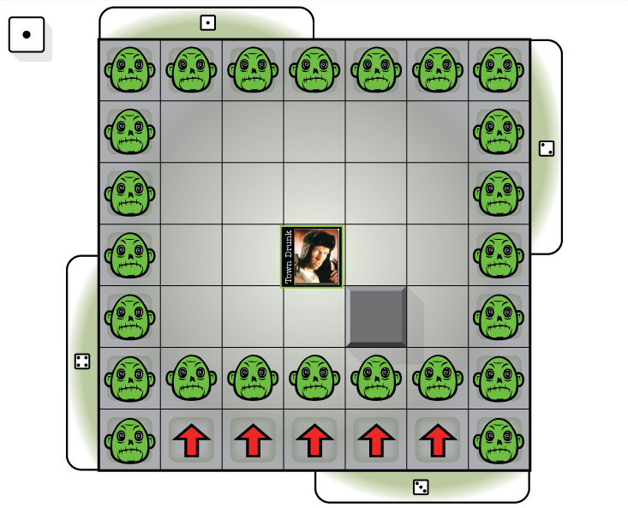

Slide 30
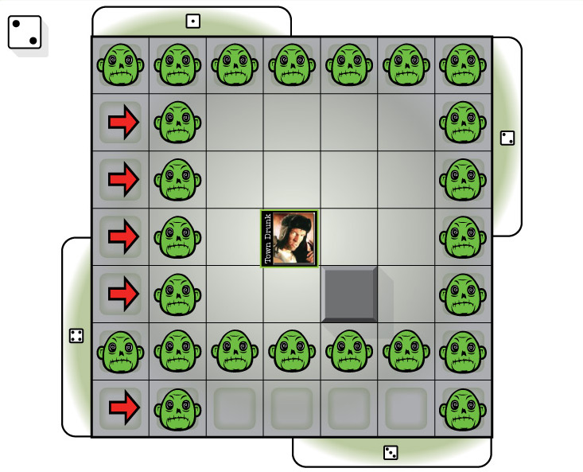

Slide 31
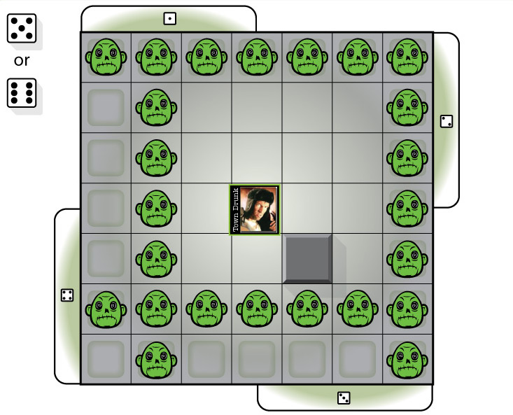

Slide 32
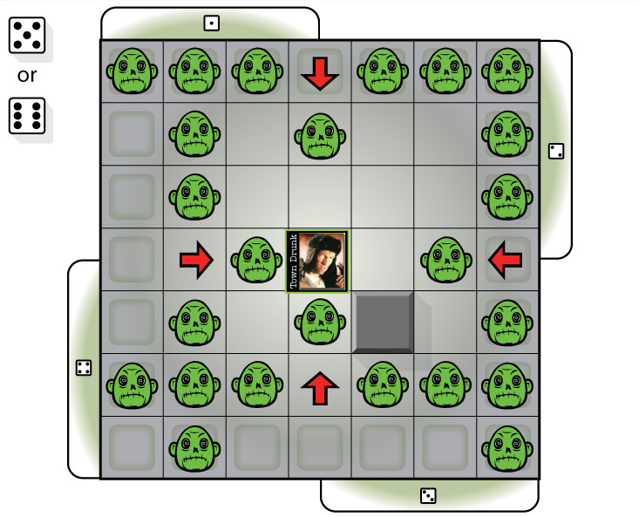

Slide 33
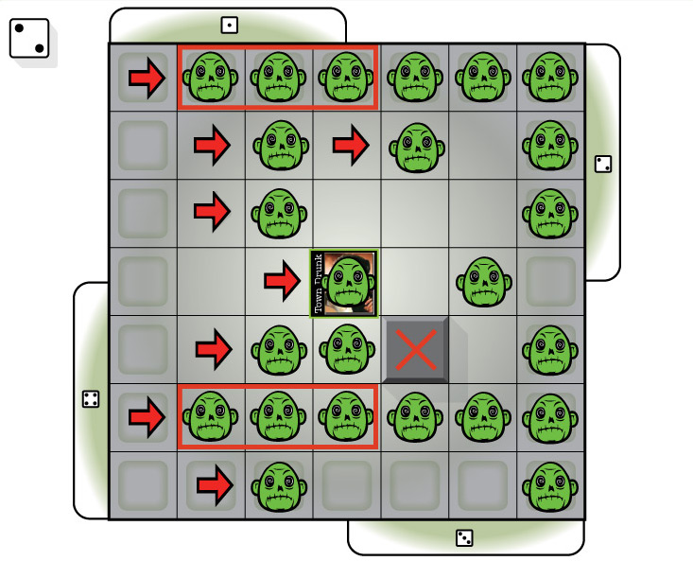

Slide 34
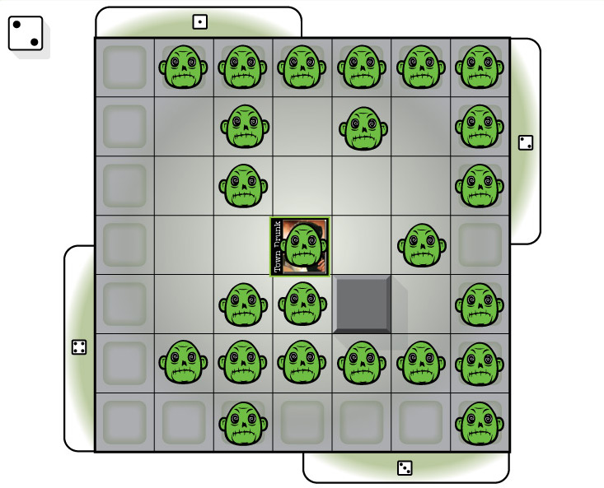

Slide 35
Creating a Character with Personality
All characters should have a MOVE and an ATTACK option.
It is up to you to determine how and when to MOVE and ATTACK.
Your character’s rules needs to match the personality.
Ex.: Priest doesn’t have a shotgun, he has holy water.
Tune your character based on the personality.
School principal shouldn’t be able to kill 10 zombies in one turn.
Make sure your character will sometimes win and sometimes lose.

Slide 36
Creating a Character with Personality
Ultimate test:
Can another group guess which character you chose just by reading the rules?

Slide 37
Decisions
How many choices does the player need?
Simulation vs. game play
Encourage immersion with flavor text
Asymmetric decisions for each player
Notes:
Decisions Summary

Slide 38
Balance
Design Considerations:
Player vs. Player (fair opposition)
Player vs. Game (challenge and depth)
Component vs. Component (nouns)
Action vs. Action (verbs)
Notes:
Balance

Slide 39
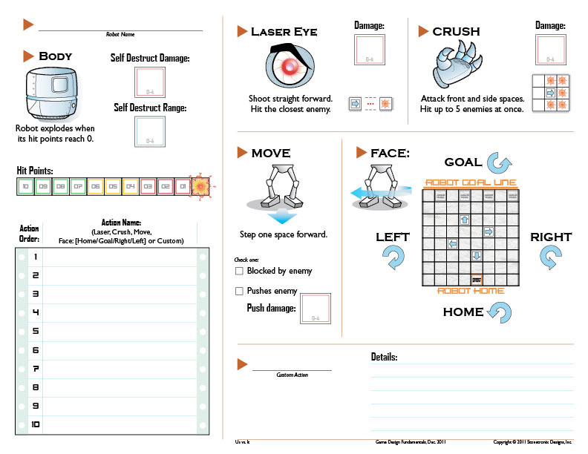
Exercise #5: Us vs. It
Notes:
Us vs. It Exercise

Slide 40
Thank you!
This presentation is available for download at:
www.stonetronix.com
Notes:
Thank You

