Slide 1


One Page Designs
@StoneLibrande

Slide 2
Overview
Standard design documentation
What are one-page designs?
Creating your own one-page designs
Benefits
Notes:
Overview
First, we’ll take a brief look at other types of design documentation.
I’ll show you examples of one-page designs that I have worked on.
I’ll share some tips and techniques about making your own one-page designs.
We’ll look at some of the pros and cons of one-page designs.
Then we’ll wrap it up!

Slide 3
Design Bibles
Notes:
Designer API
In the mid-90’s most design documents were printed and physically distributed to the team members.

Slide 4
1. Game Mechanics
1.1. Core Gameplay
1.2. Game Flow
1.3. Characters/Units
1.4. Gameplay Elements
1.5. Game Physics
1.6. Statistics
1.7. AI
1.8. Multiplayer
2. User Interface
2.1. Flow chart
2.2. Functional Requirements
2.3. Mock-up
2.4. Buttons, icons, pointers
3. Art and Video
3.1. Goals, style, mood
3.2. 2D art and animation
3.2.1. GUI
3.2.2. Special Effects
3.3. 3D art and animation
3.4. Cinematics
4. Sound and Music
4.1. Goals, style, format
4.2. Sound effects
4.2.1 GUI
4.2.2.Special effects
4.2.3.Environment
4.3. Music
4.3.1. Events
4.3.2. System screens
4.3.3. Level theme
4.3.4. Situations
4.3.5. Cinematic soundtrack
5. Story
5.1 Backstory and world
5.2. Character descriptions
5.3. Game text, dialog requirements
5.4. Sample scripts
6. Level Requirements
6.1. Level Diagrams
6.1.1. Flow diagrams
6.2. Asset revelation schedule
Notes:
The idea was that you could start with a standardized outline and fill in the blanks. The design is finished when the document is complete. There were many talks at GDC about the best outlines and formats to use.

Slide 5
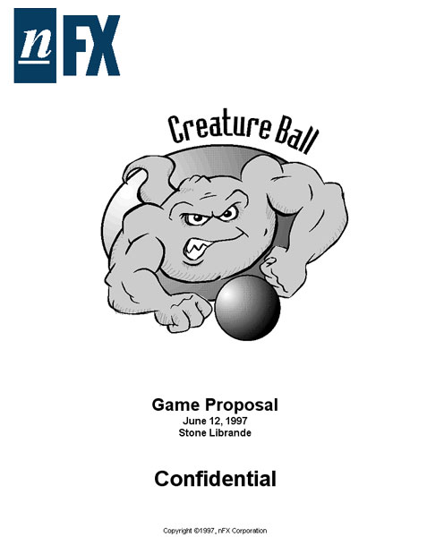
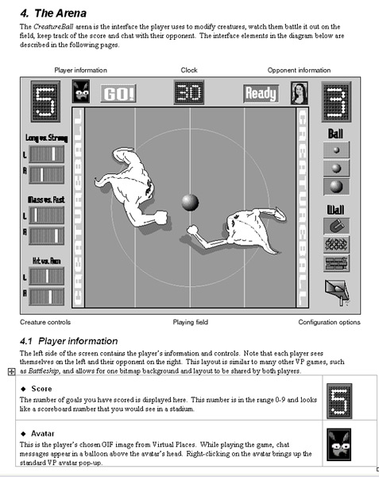
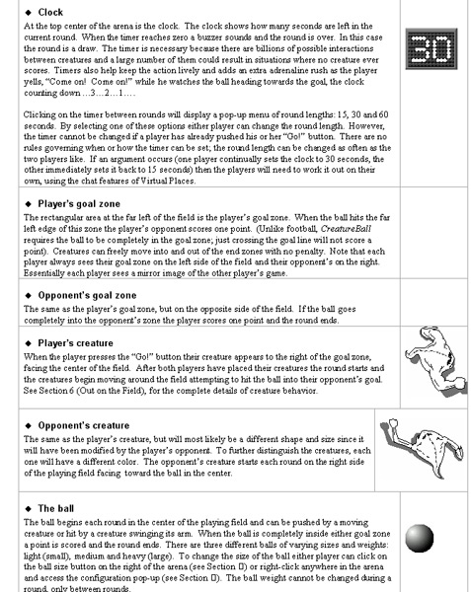
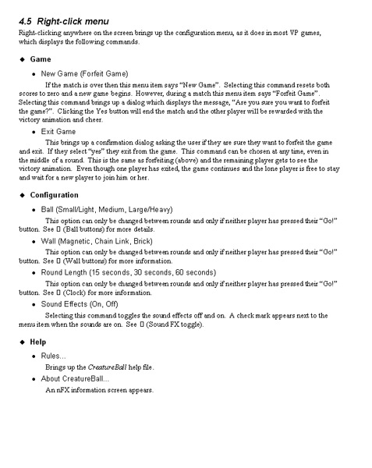
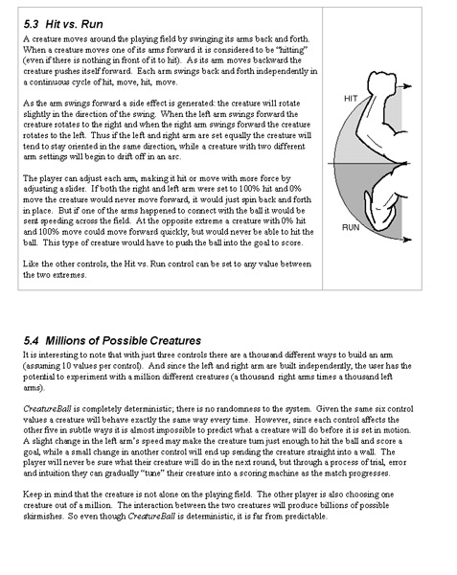
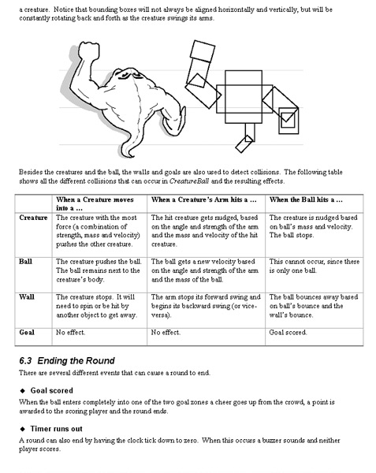
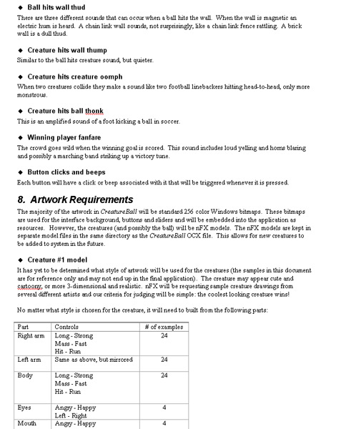
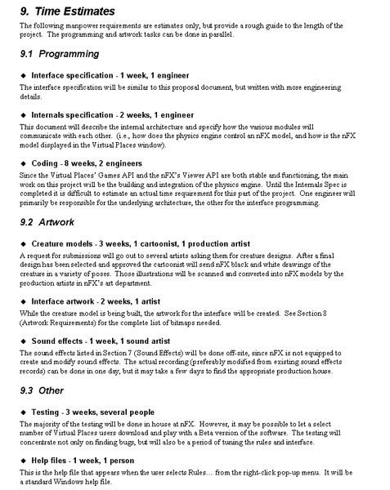
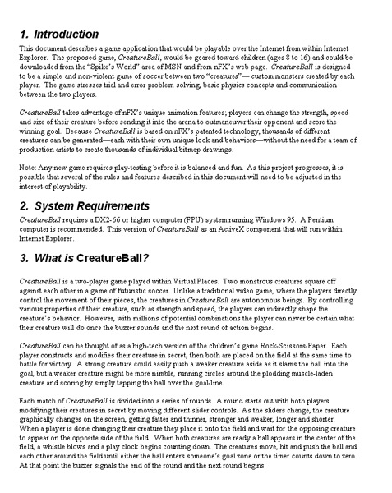
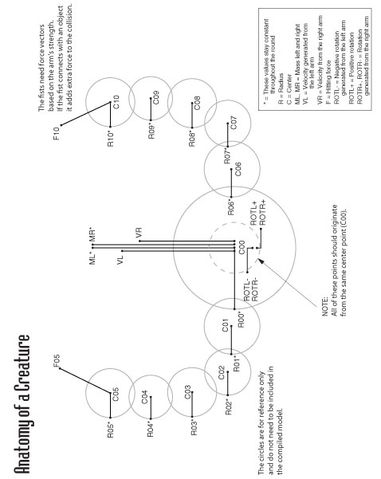
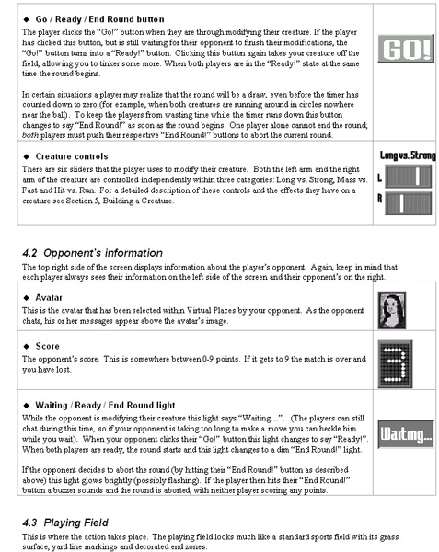
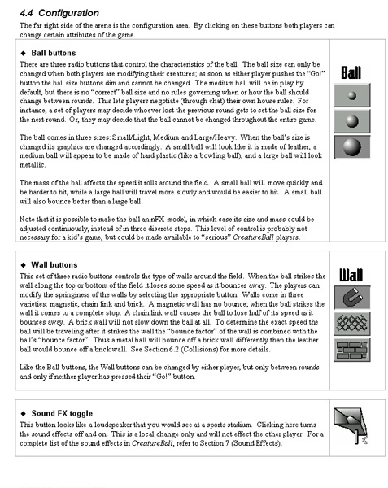
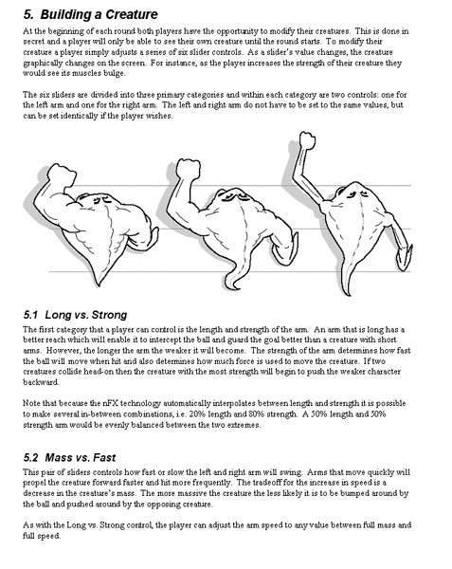
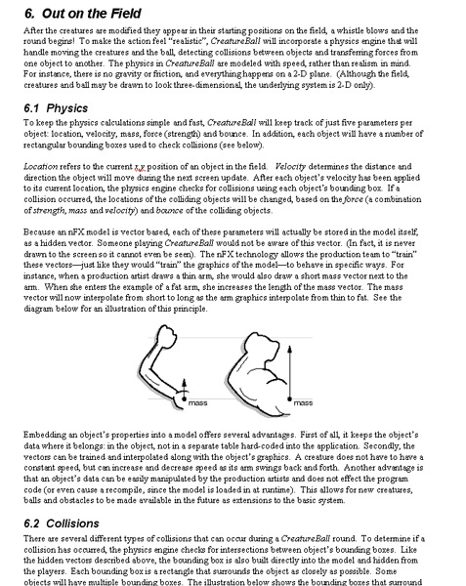
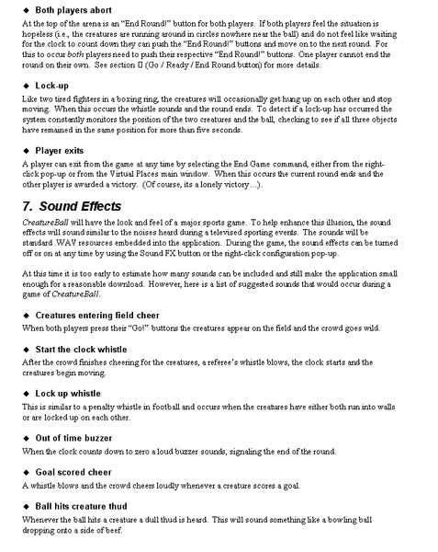
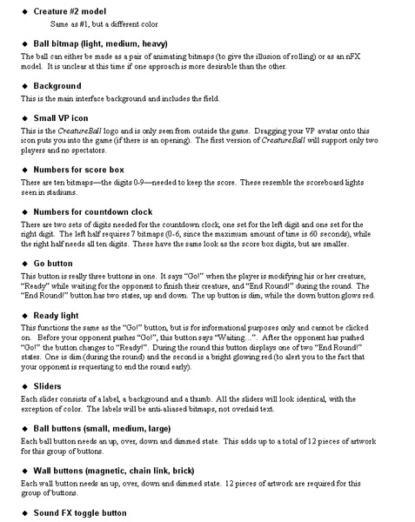
Notes:
5
Creature Ball
I wanted to use the company’s technology to make video games, so my first design documents followed a similar format.
Needless to say, it didn’t take me long to realize that this type of document was not inspiring people.

Slide 6
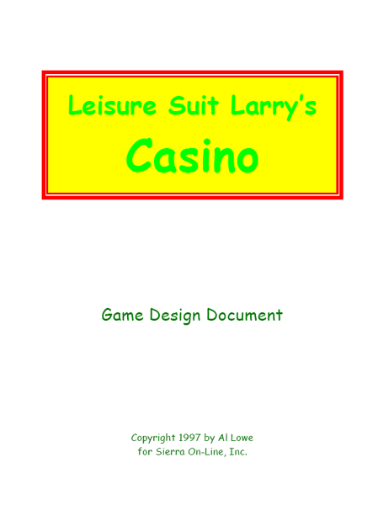
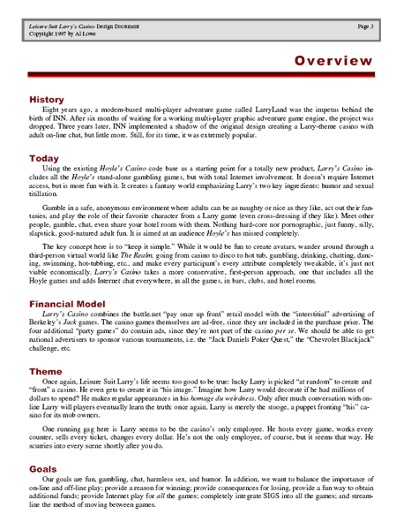
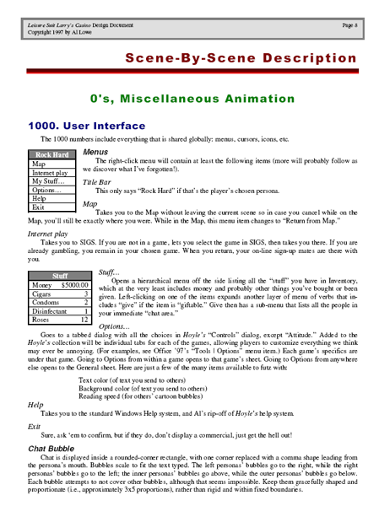
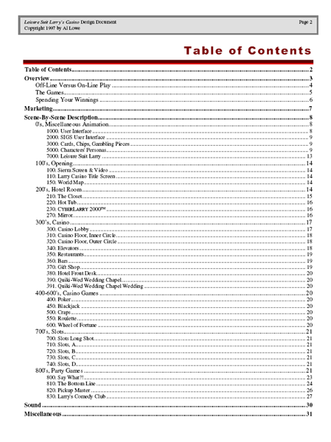
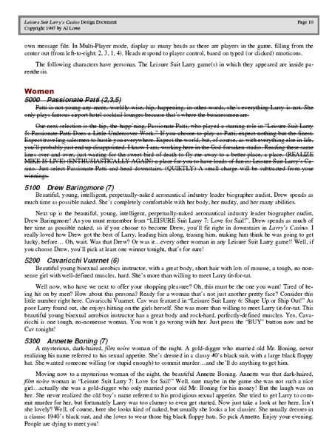
Notes:
Leisure Suit Larry Design Doc
A few of the 30 pages in from the design doc.

Slide 7
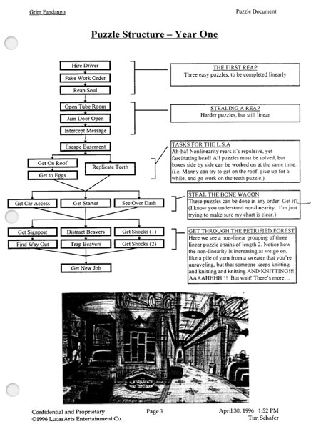
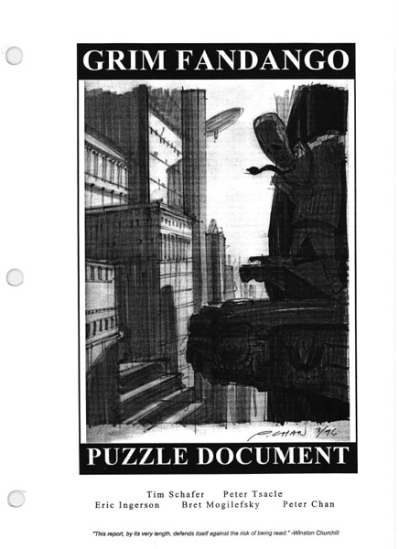
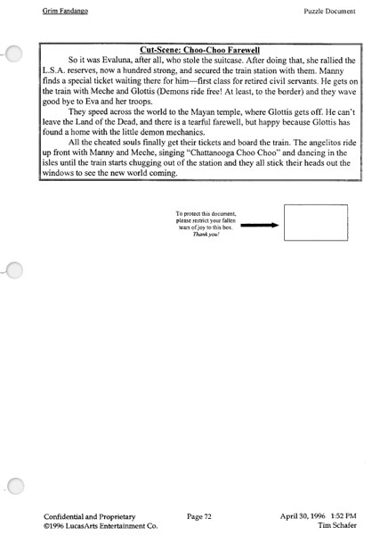
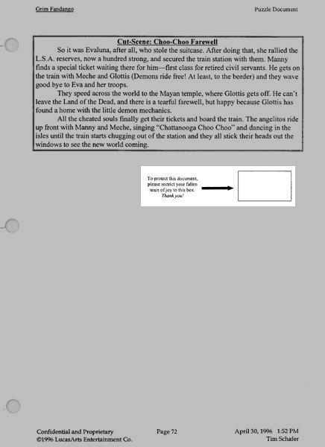
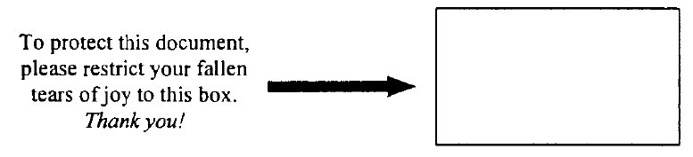
Notes:
Industry Standard
Design bible for puzzle in Grim Fandango.

Slide 8
Pros
Definitive source of information
Entire design is in one place
The act of creating the document is the act of designing the game
Cons
Doesn’t scale up
Hard to manage updates
Difficult to search
Notes:
Pros
Forces thoroughness
The designer must think about every aspect of the game.
The act of writing a sentence forces the designer to think through the implications.
Cons
Most of the team won’t read it
Some of the team will skim the document, but most people would rather just ask me to tell them what it says when they need to know.
Hard to manage updates
Game design is about iteration. Since revisions happen so frequently it can hard to make sure all the changes are written down.
Even if you do write it down it is hard, if not impossible, for another team member to find out what’s changed.
Kills trees
Some of these documents can be over 100 pages long.

Slide 9
Design Wiki
Notes:
Design Wiki

Slide 10
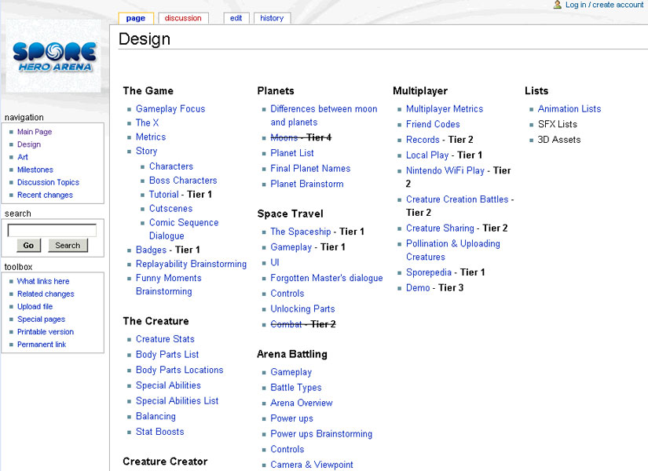
Notes:
This is the design section of the Spore Hero wiki site. It is basically a design bible. Each high level topic links to a page of design details.

Slide 11
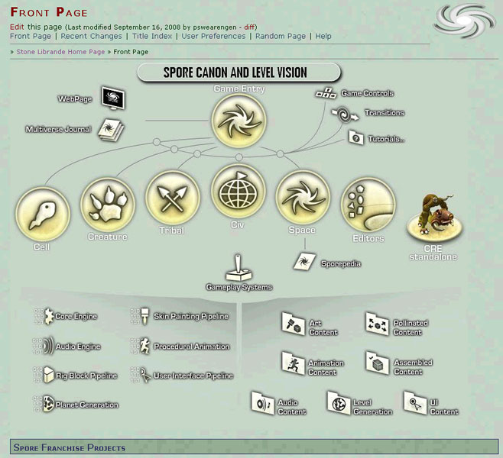
Notes:
The Spore wiki home page.

Slide 12
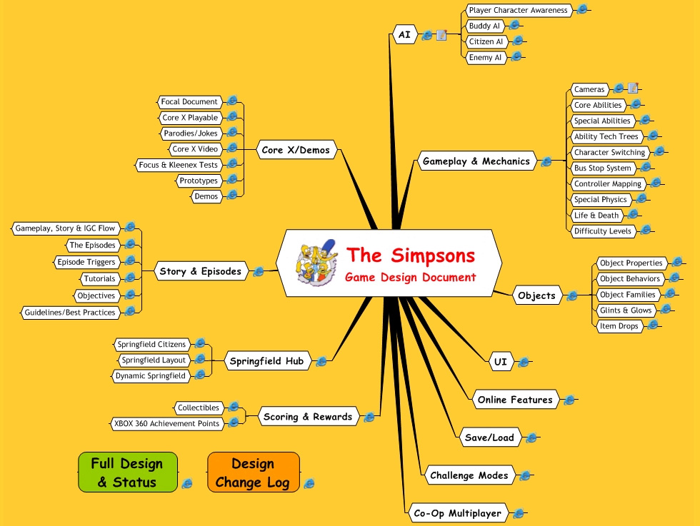
Notes:
12
The Simpsons game with a team that used the wiki for all their design documents.
I was on a team of 4 designers and each of us had our own section.
We had a full-time design producer who was in charge of keeping the wiki up to date.
We had frequent meetings and each page went through a process of concept, design approval and engineering approval.

Slide 13
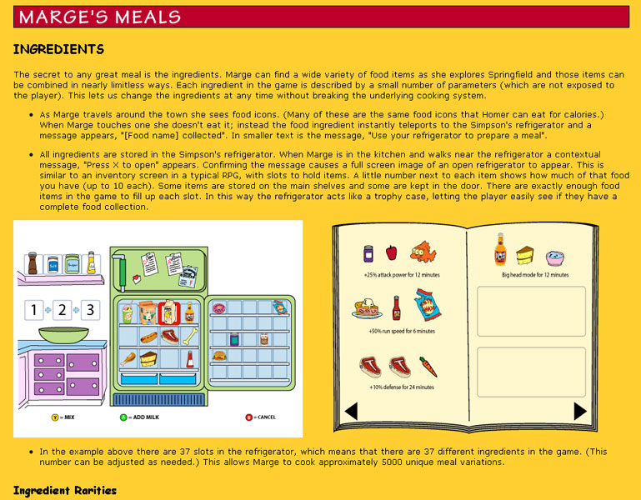
Notes:
Design details of Marge’s cooking mini-game.

Slide 14
Pros
Easy access
Easy to update
Bite-sized chunks
Team contributions
History tracking and accountability
Cons
Requires constant maintenance
Hides design relationships
Low resolution
Frustrating viewport limitations
Notes:
Pros
Can access from anywhere
As long as you are near a networked computer you can view the documentation.
Easy to update
Double-click to go to edit mode and make the changes while you are discussing them with someone else.
Bite-sized chunks
No one needs to read the whole document (although you hope the lead designer has).
Click on the link (or search) to get to section you want.
Team can contribute
Anyone with an account (which in our case was the entire team) could edit the wiki.
All the changes are stamped with both the person’s name and the time of the change.
Can view history
You can look back at the history and see why a design is changed.
Cons
Needs constant maintenance
In the early phases of pre-production everything tends to stay organized and up-to-date.
But when production starts then it is easy to forget to document important decisions.
You need a dedicated wiki manager to keep everything organized and relevant.
Need to be near computer
If you are in a room without a computer then the design is inaccessible.
Low resolution
The pages don’t print out nicely and the resolution of the graphics is low.
Large, detailed illustrations don’t fit on the screen.
Can’t write on it
While it is easy to make text changes it is impossible to make quick diagrams. You have to open up a separate illustration program, save your work, upload it to the wiki and link to it.

Slide 15
Observation
Problem: Most people don’t read past the first page or screen.
Solution: Only use one page.
Notes:
Both printed Word documents and electronic wiki sites have a common problem. Most of the team won’t read them. They are too busy. It’s easier to ask. It’s not their department, etc. So if you are really trying to communicate design information to the entire team then you have to realize that any information that is not right in front of someone is going to get ignored.

Slide 16
One Page Design Inspirations
Notes:
Inspirations

Slide 17
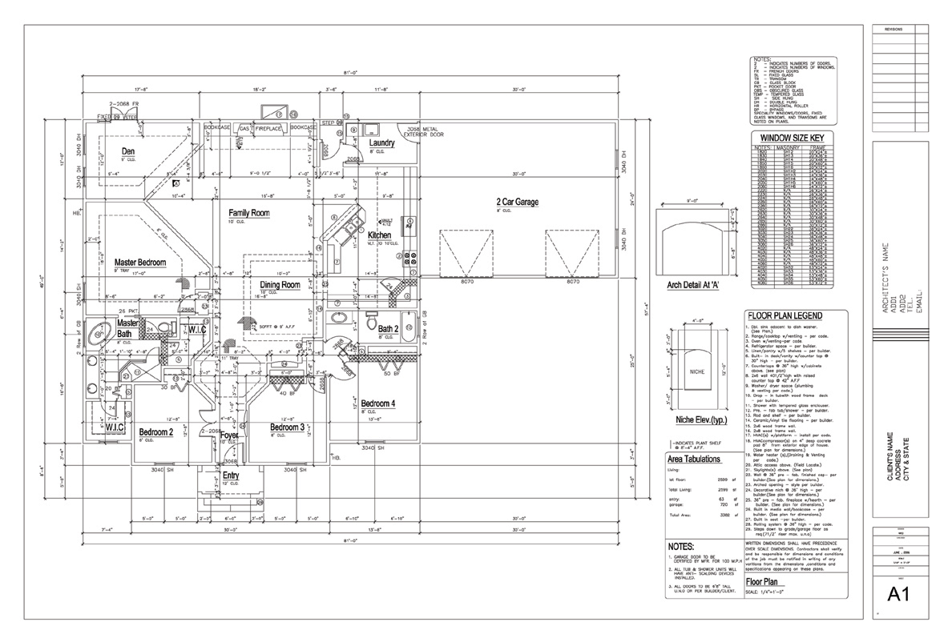
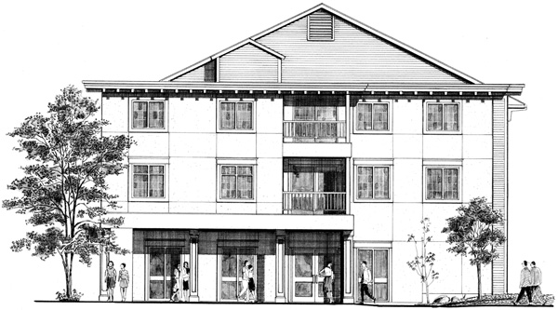
Notes:
Who is the Audience?
Contractor? Or resident?

Slide 18
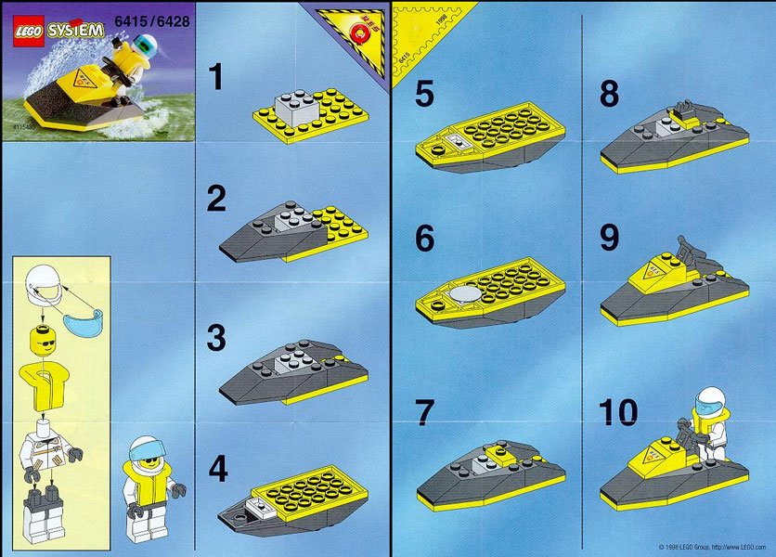
Notes:
Inspirations
Lego manuals have no words yet convey a huge amount of information.

Slide 19
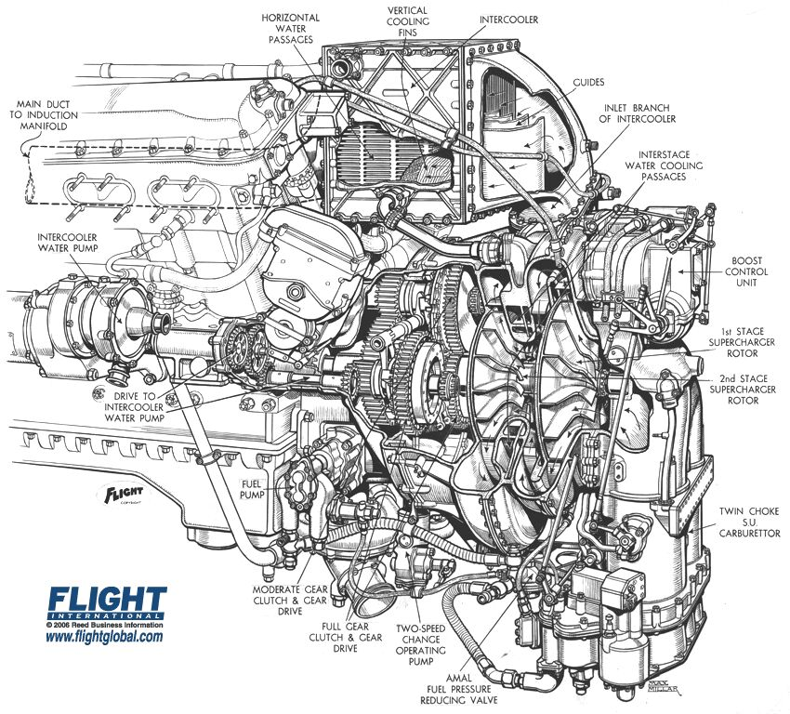
Notes:
Inspirations
Cut away diagrams that show the internal workings of common objects. How many pages of text would it take to describe this engine?

Slide 20
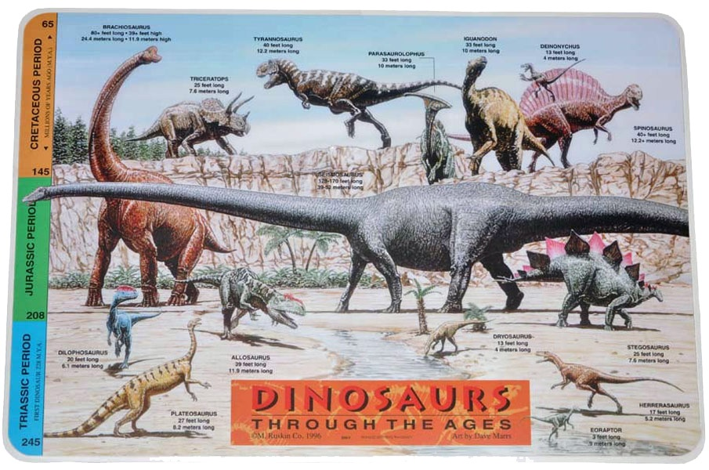
Notes:
Inspirations
Placemats for kids are one page and contain playfully disguised information.

Slide 21
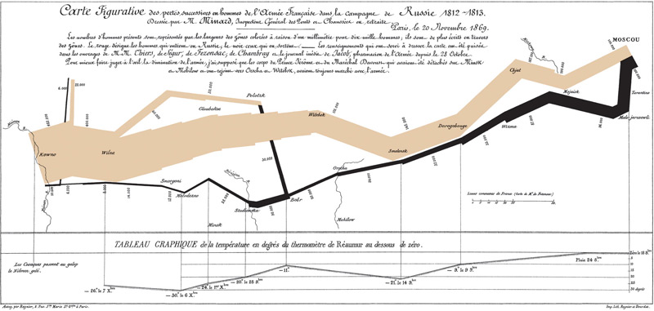
Notes:
Inspirations
When I first saw this illustration I was impressed by how much information was contained on one page. This shows Napolean’s march from the Polish border into Moscow in 1812.
It contains troop strength, location, date and temperature.

Slide 22

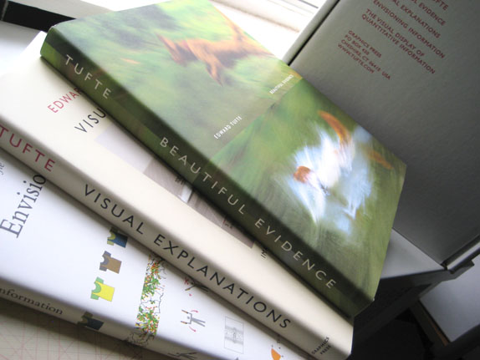
Notes:
Edward Tufte has written several excellent books about graphic design.

Slide 23
One Page Design Examples
Notes:
Examples

Slide 24
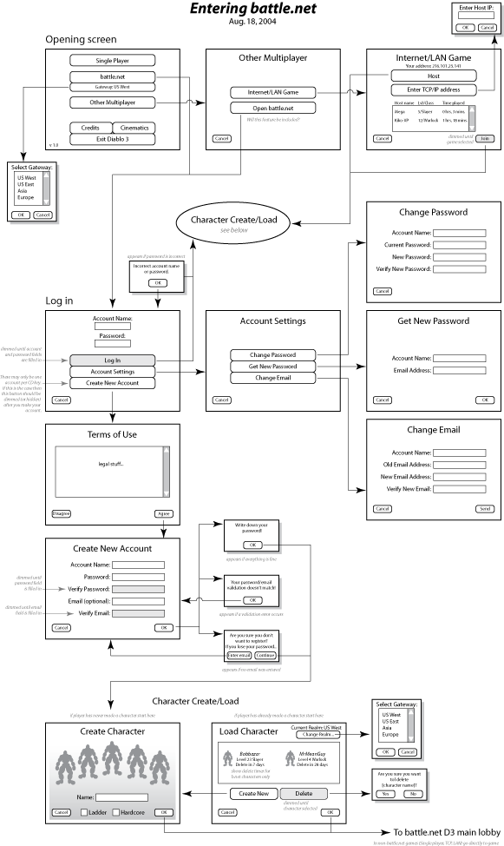
Notes:
When I was working at Blizzard I was making UI flow diagrams and I noticed that a few engineers were hanging the documents on their walls for reference.

Slide 25
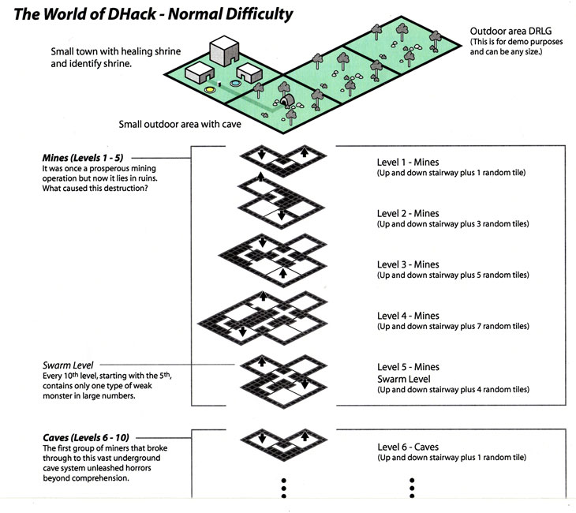
Notes:
This is a portion of the one-page design for Diablo III’s prototype “D-Hack” mode.

Slide 26
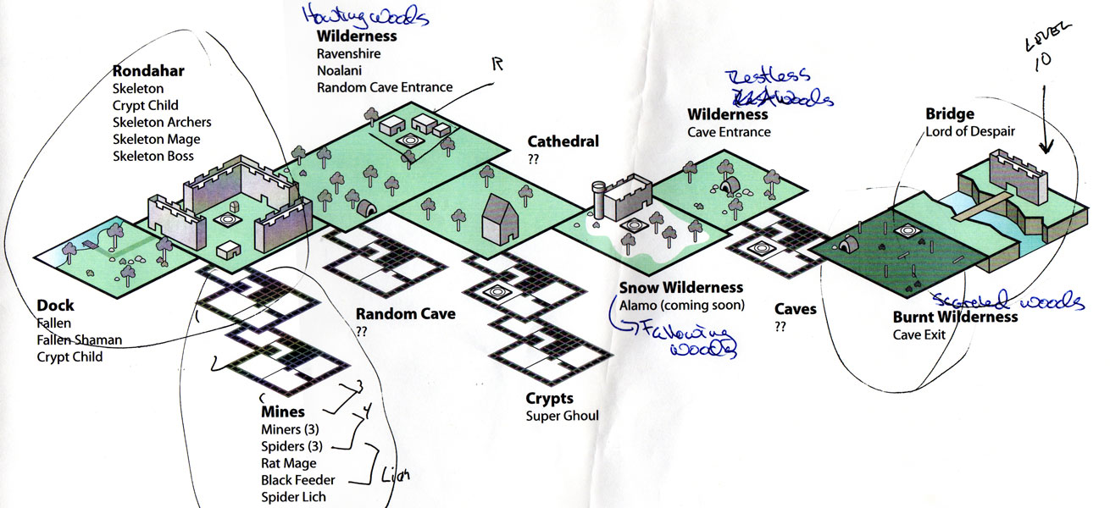
Notes:
Over time that diagram evolved as we began fleshing out the full game.

Slide 27
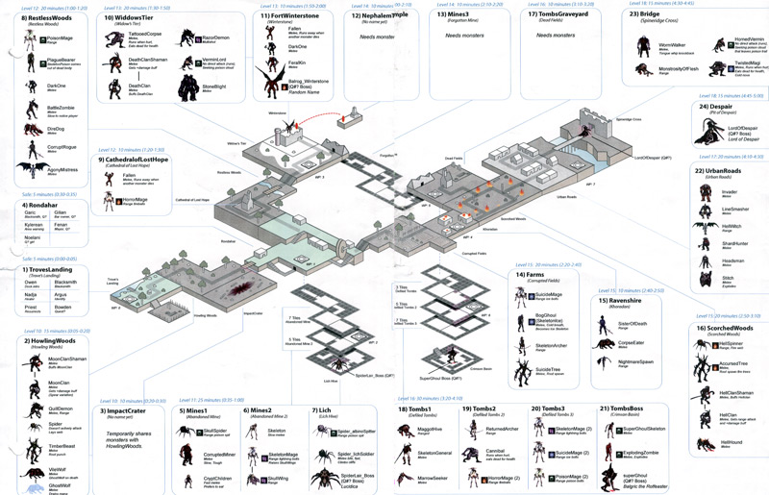
Notes:
27
I started taking this to the extreme, wondering how far I could push the concept before it would break.
This diagram shows the relative location of areas, the approximate timing, the player’s expected level, monster names, monster model thumbnails, special abilities and damage types.
Here I realized the most important trick behind one-page designs: print on large paper.

Slide 28
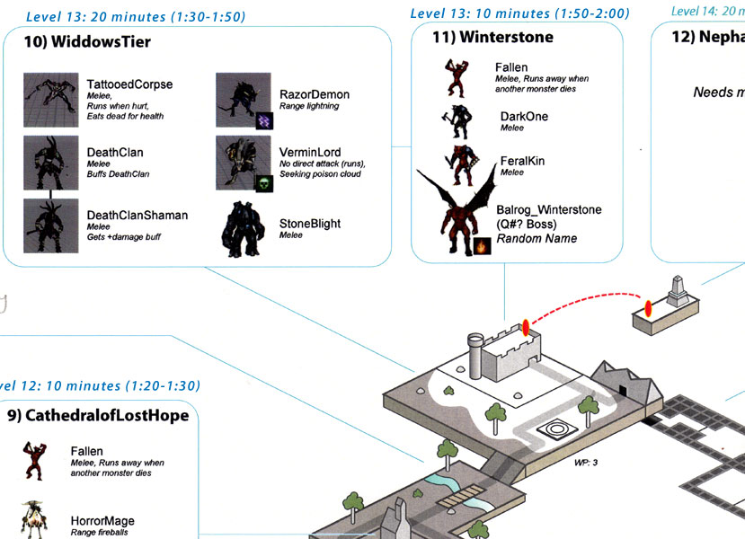
Notes:
28
Here’s a close up showing some of the detail. For each section of the map you can see the dominant terrain feature, the player’s assumed level, the approximate amount of time the player should be in the area, the total elapsed time from the start of Act 1. Each monster: Model name, AI combat style, elemental damage.

Slide 29
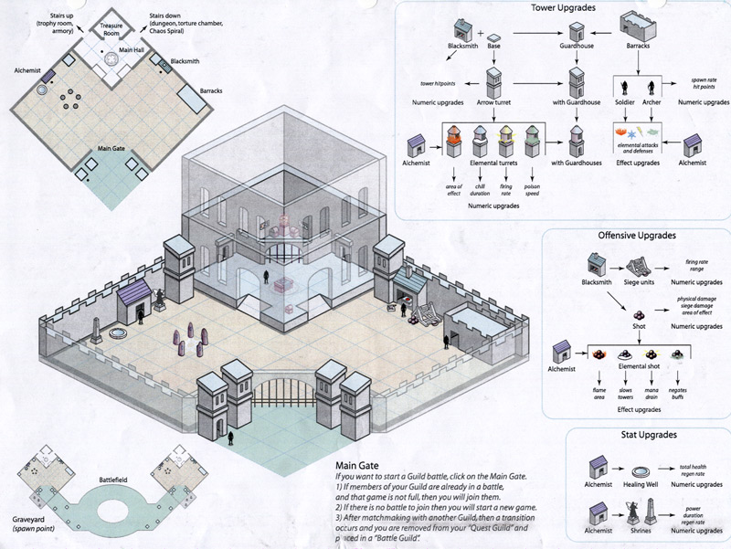
Notes:
29
Here is one of my first attempts at putting a game design onto one page. There are three tech-trees, an isometric illustration and an overhead view.

Slide 30
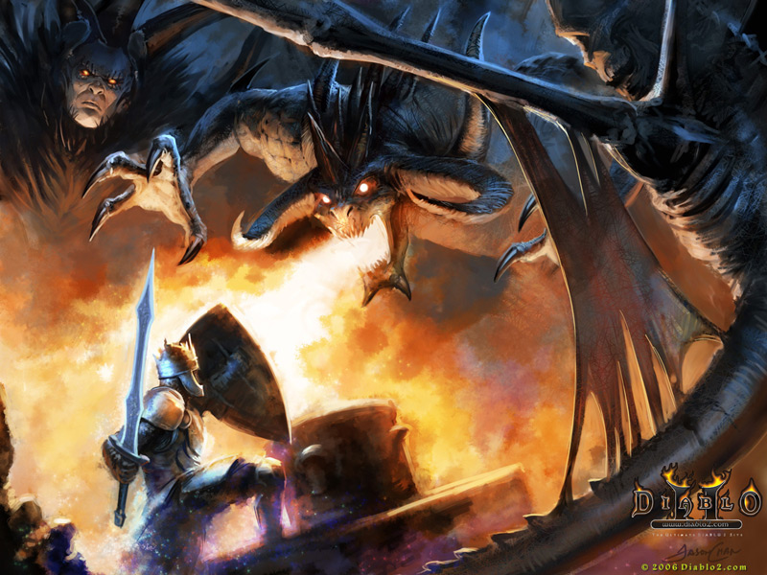
Notes:
30
Concept Art
When we think of illustration we typically think of concept art. While concept art is a powerful way of emotionally expressing the theme, it typically informs the art design, not the game design.
It tells you the end state, but doesn’t tell you how to get there.

Slide 31
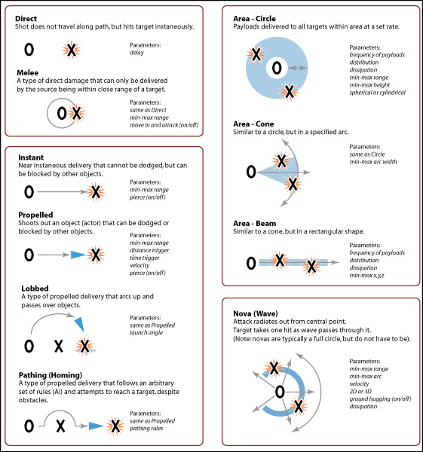
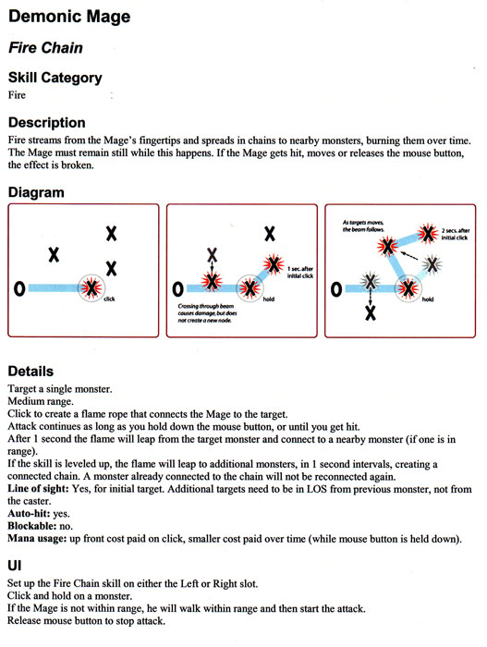
Notes:
31
Combat Diagram
As a game designer, this is how I would make a diagram showing combat in Diablo. The illustration needs to focus on the iconic rather than be an actual screenshot. If you are too literal then people will focus on the surface, not the information.

Slide 32
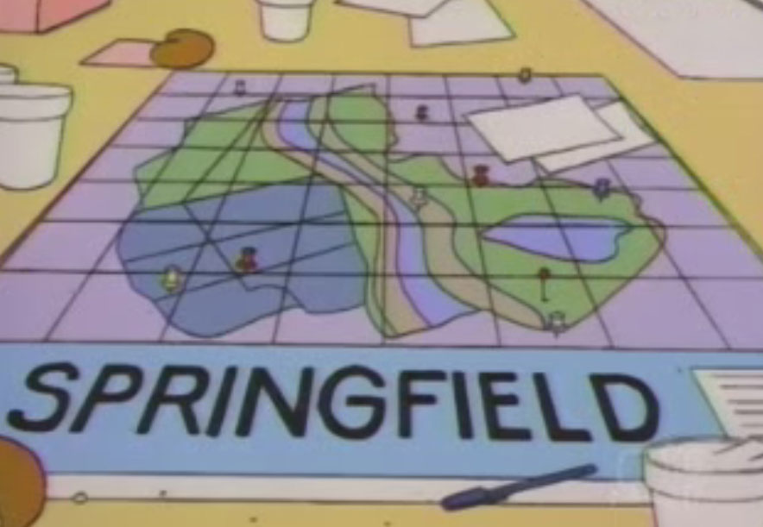
Notes:
32
I was in charge of designing Springfield for the Simpsons game. I thought it would be easy because I could just find a map in the TV show. This was the best we could find.

Slide 33
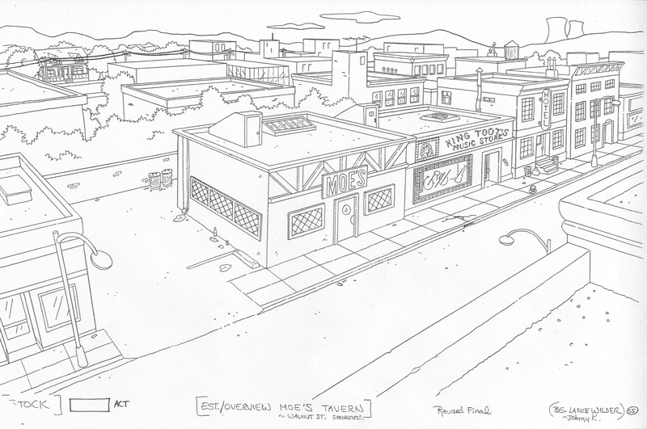
Notes:
33
Art from Gracie Studios.

Slide 34
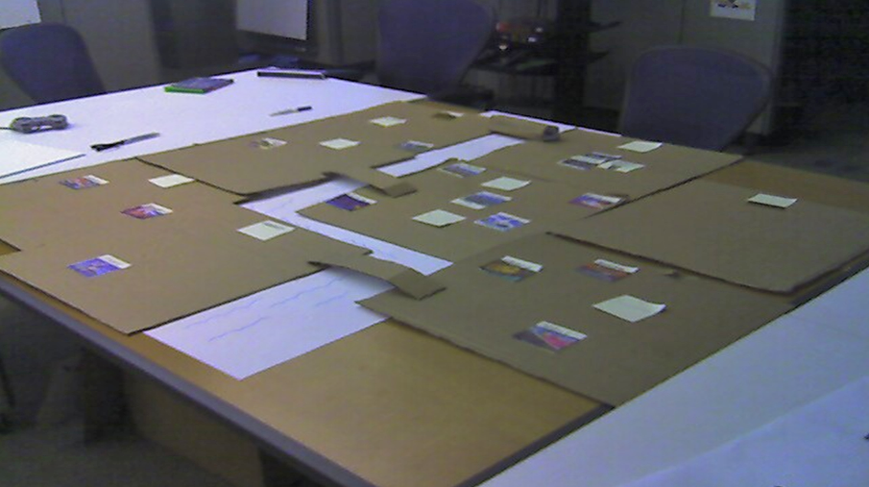
Notes:
34
So we made a cardboard model that took up the whole table in the design area.

Slide 35
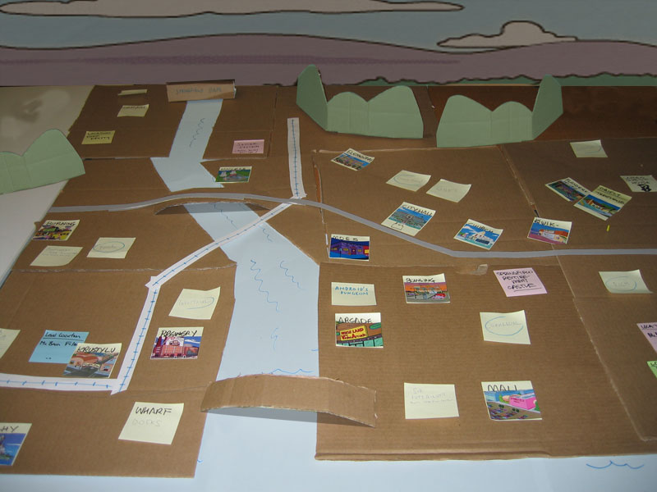
Notes:
35
I consider this a one-page design, even though it is technically on a table, not a page. But it meets all the requirements. No pages to turn, not a lot of text to read, hard to ignore.

Slide 36

Notes:
The final “skeleton” for Springfield. Once we had all agreed on the high-level structure we could begin working on the details.

Slide 37

Notes:
37
Over time the diagram evolves and gets refined.

Slide 38

Notes:
The detailed plans are used for many different purposes. This one shows the choreography of a boss battle with “Lard Lad”.

Slide 39

Notes:
This one shows how beers are hidden around Springfield by difficulty and time.

Slide 40

Notes:
40
Eventually I transfer everything into Illustrator and print out posters to hang around the office.

Slide 41
Notes:
Even though it may not look much like this diagram, if you compare the two you can see that the underlying structure never changed.

Slide 42
Notes:
42

Slide 43


Notes:
We also needed plans for all of the interior locations in Springfield.

Slide 44


Slide 45


Slide 46

Notes:
Those all went on a giant poster as callouts on the main map.

Slide 47

Notes:
(Detail)

Slide 48
Creating a One Page Design
Notes:
Creating a One Page Design

Slide 49

Notes:
This was the first pitch diagram for the “Galactic Adventures” expansion for Spore.

Slide 50

Notes:
Here is a paper prototype we used to help understand how the UI might work.

Slide 51

Notes:
This is the final flow chart showing how all the systems work together.

Slide 52

Notes:
52
Each level had its own detail page…

Slide 53

Notes:
53
…which were hung on the wall as 24 one-page adventures.

Slide 54

Notes:
54
Basic format
Slide: Iconic construction in steps
Central information, in the form of an illustration
Text call-outs around the illustration
Think of the callouts as mini-illustrations if possible
Pay attention to the size of things. Make important things bigger.
Start out at letter size, then work up to legal, 11 x 17, and posters.

Slide 55

Notes:
55
Tools and Software
You will want to use a vector illustration program like Adobe Illustrator.
File size is small
Forces you to be concise
Need to be able to put text wherever you want
Mathematical description gives perfect resolution for your printer.
Can export as JPG, Flash or PDF for the wiki.

Slide 56

Notes:
56
Slide: Creature Keeper types
This diagram shows how traits would combine to give a pet different skills.

Slide 57

Flow Charts
Notes:
57
Flow Charts
Slide: Creature Keeper training
Flow charts are particularly good at showing relationships between systems. But be careful…

Slide 58

Flow Charts
Carries information
Notes:
Flow Charts
In SimCity every sim (or “agent”) is carrying information through the city as they go from one place to another.
What you are looking at is a one-page design that was printed out and hung up for everyone to see. Notice how simple it is. It has one purpose: to educate the team on three vocabulary words—source, agent and sink—and the relationship between them. It was critical that everyone on the team understood this relationship because our entire game is based on this concept.
Remember that your designs don’t need to be complex to be effective. They only need to be as complex as the idea you are trying to communicate.

Slide 59

Flow Charts
Notes:
Flow Charts
Once the basic vocabulary is established we can use the primitives to illustrate higher level concepts.

Slide 60

Storyboards
Notes:
60
Timing Diagrams
Slide: Creature Keeper storyboard
A simpler form of a flow chart is a one-dimensional storyboard, which takes you from one scene to the next.

Slide 61

Notes:
Region Timeline
This is one of my favorite diagrams from SimCity. It describes play patterns in more detail and how they change through time. I strongly believe that every game designer should make a timeline like this early in the development process. At this phase in the project we didn’t have exact timings figured out, but we can still approximate it by breaking up the gameplay into early, mid, late and end game phases.
Most games have a very linear structure, which means that it will be simpler to create a traditonal timeline. Unfortunately, there is no “right way” to play SimCity which made the process much more difficult. One timeline can’t represent the thousands of ways that a player can construct a city.
To get around that problem, I decided to show off two extreme cases as book ends. If we can understand the extremes then we can assume that most cities will be shades of these extremes in varying proportions.

Slide 62

Notes:
Garbage Flow
This one shows how agents might travel back and forth from work to the garbage dump. They put out their garbage in the morning and go to work. They pick up the garbage, take it back to the dump and burn it. Then they get paid and go back home. (Presumably to buy more garbage and repeat the cycle.)

Slide 63

Time + Space
Notes:
63
Timing Diagrams
Slide: Creature game map
I think of this type of a diagram like a musical score. It is not the game itself, but shows the structure of the game and sets expectations about the minute-to-minute, hour-to-hour and day-to-day play patterns.

Slide 64

Notes:
Overview Timeline
Earlier, I mentioned the importance of gameplay timelines. An “early”, “mid” and “late” game timeline is a good starting point, but it isn’t sufficient later in development when you need more precision.
Most games follow a very linear structure (level 1 content, level 2 content, etc.) and making a timeline is relatively easy. But SimCity doesn’t have a fixed goal which means it can be played in thousands of different (often unpredictable) ways. Instead of notating the play experience as a line, this document treats it more like a branching structure. Imagine the trunk at the bottom and the leaves at the top. The exact order of actions isn’t as important as the types of actions the player will be taking minute-to-minute, hour-to-hour, and session-to-session.
I like to think of charts like these as an orchestral score. The conductor needs to refer to a score in order to get all the different orchestra sections to harmonize together. Similarly, a good gameplay timeline will help you coordinate your development efforts across different departments.

Slide 65

Notes:
Overview Timeline
When I created this document the numbers on the side were complete guesses, and my plan was to update them as we accumulated more playtest data. But it turns out that based on telemetry from the final game, the actual times match this first chart on average.
In retrospect, this isn’t too surprising, since we frequently referred to this chart to help us tune different aspects of the game.

Slide 66

Relationships
Notes:
Relationships
High-level document showing all of the systems in a game. Take this with you to every meeting and put it on the table in front of everyone to remind them of scope.

Slide 67

Notes:
SimCity Overview
This overview diagram was one of the first ones created for SimCity, about three and a half years ago (Sept. 2009). It’s purpose was to lock down the high level features of the game. Think of it as an outline for the entire game, where each bold heading describes a feature set. There’s not a lot of detail about each feature, because back then I didn’t know the details. But this gave the team a sense of what work we were going to be doing and kept us from wandering off-course.
The diagram turned out to be a good way to organize this talk, since the majority of the design documents that I’ll be showing will fit into one of the categories listed here.
It’s interesting to note that we consistently touted SimCity as a “bottom up” simulation (meaning that the high level simulation was not predetermined, but happened organically based on the aggregate actions of each individual citizens). However the entire design process was heavily “top down”. We started with this overview document and over the course of the project continuously drilled down into the details of each section.
In order to explain how this worked, let’s start out here with “Selecting a Region”.

Slide 68

Notes:
Transporting Cargo
Here’s another attempt at illustrating the same idea. This is essentially the same diagram as the one on the previous slide, but I replaced the 2D boxes with isometric buildings and added trucks along the arrows. Now it is much more compelling to look at. If you hang this up on wall then people will stop to look at it.
You have to be careful when doing this sort of decorating. Make sure that everything you place on the chart reinforces the ideas you are trying to communicate. For instance, I could have drawn in actual roads instead of colored arrows, or placed little trees and houses along the truck routes. This would have made the city look more realistic and appealing but it would have only been a distraction (not to mention more work for me). Edward Tufte calls this “chartjunk” and it should be avoided.

Slide 69

Relationships
Notes:
69
Slide: Robot archetypes
This is a rock-scissors-paper style diagram showing the strength and weaknesses of different robot factions.

Slide 70

Relationships
Notes:
70
Slide: Robot archetypes
Similar diagram, focusing on the idea that each faction is actually a range of choices along a side, instead of one choice jammed into a corner.

Slide 71

Matrices
Notes:
71
Matrices and tables
Slide: Empty grid
Thinking about a design as a matrix is a great way to breakdown a complex problem into an easy to manage whole.

Slide 72
Matrices
Character Class
Fighter
Archer
Mage
Scout
Thief
Warlock
Fire
Metal
Faction
Nature
Water
Notes:
72
Matrices and tables
Slide: Empty grid
Thinking about a design as a matrix is a great way to breakdown a complex problem into an easy to manage whole.

Slide 73
Matrices
Character Class
Fighter
Archer
Mage
Scout
Thief
Warlock
Fire
Rage
Cleave
x
x
x
Piercing
Hunting
x
Fireball
x
x
Ice Bolt
x
x
Tracking
Swimming
x
Backstab
x
Potion
Demon
x
Golem
x
Metal
Faction
Nature
Water
Notes:
73
Matrices and tables
Slide: Empty grid
Thinking about a design as a matrix is a great way to breakdown a complex problem into an easy to manage whole.

Slide 74

Notes:
Matrices and tables
Slide: Cell types
In Spore this cell chart shows all the NPC cells and is arranged by environment (time) and size.

Slide 75

Notes:
75
Matrices and tables
Slide: Cell part interactions
This diagram shows the different interactions between all the parts.

Slide 76

Notes:
76
Non-grid charts
Slide: Excel spreadsheet of space archetypes

Slide 77

Notes:
Expressing the spreadsheet as a graphic.

Slide 78

Notes:
The previous graphic, but compressed to highlight the differences between the extremes. (Warrior is aggressive, Trader is neutral, Shaman is peaceful.)

Slide 79

Notes:
Expressing the previous diagram as an algorithm for the programmers.

Slide 80

Notes:
All the possible vectors spread out.

Slide 81

Notes:
The vectors from the previous slide aligned at the origin.

Slide 82

Notes:
82
Slide: Space archetypes pyramid
Sometimes the information doesn’t easily fit into a grid. If you find yourself forcing it, or the grid becomes too unwieldy, then think about other shapes. This chart is another way of looking at exactly the same information that was contained in the excel chart (in the earlier slide).

Slide 83

Problems
Hard to keep up
Notes:
Final Thoughts
When I started SimCity I didn’t think that I would be able to push the concept of one-page designs as far as I did. Was the effort worth it?
First of all, it was hard to keep up. The quality of the diagrams deteriorated a lot when we hit alpha. Most of the core design work was done at that point, but when a new design was needed, or an existing design was modified, I resorted to scribbling on the printout and had a difficult time getting the Illustrator versions updated.

Slide 84

Notes:
Coal System
Done during preproduction when I had more time. Detail is good at selling an idea and making the implementation clear. But it takes time!

Slide 85

Notes:
Electronics Specialization
While in production the diagrams can be simpler. No sense in spending time on “selling”.

Slide 86

Notes:
Trading Specialization
Near the end of the project some of the documents started looking like this. I hoped that I would have spare time to clean up these sketches, but I never got around to it. Fortunately, no one seemed to mind (or notice, since everyone on the team was scrambling and distracted by that time).
It’s an obvious statement, but I recommend doing as much as possible in preproduction. Build up a library of icons and clipart that you can quickly reuse so you aren’t always starting from scratch. And don’t get hung up with the surface. As long as the core idea is sound then the design will still be of use.

Slide 87
Problems
Hard to keep up
Hard to organize
Notes:
Final Thoughts
I made so many of these one-page designs that it was hard to keep them organized.

Slide 88







Notes:
Miscellaneous
There were over 100 documents like these created for SimCity. There are many systems I don’t have time to talk about: fire spread, drawing curving roads, crime flow, education influence, airports, casinos, and great works like the space center.

Slide 89

Notes:
My Desk
They were all piled up on my desk and I would have to dig through the stack to find the one I wanted. Often it was faster for me to load it up into Illustrator and print a new copy then it was for me to find the most recent version.

Slide 90

Notes:
One-Wall Design Docs
It makes a lot of sense to hang them up on the wall where you can find a particular design easily. Essentially, at this point I was no longer making one-page designs, but what I started calling “one-wall” designs. (This is Chris Schmidt’s wall. He was in charge of tuning and needed to refer to these designs often.)

Slide 91

Notes:
One-Wall Design Docs
Eventually the designs started spreading throughout the entire design area until we ran out of wall space. (This is Ross Treyz’s wall. He was also responsible for tuning.)

Slide 92

Notes:
One-Hall Design Docs
Eventually I ended up taking over a main hallway. I call these “one-hall” designs.
I don’t have a picture of it, but for a while I filled up the walls of an entire conference room. I called it the “Design Gallery”. I would walk members of the press and new employees around the room talking about the game.

Slide 93
Problems
Hard to keep up
Hard to organize
One size doesn’t fit all
Notes:
Final Thoughts
Every document doesn’t need to be suited to everyone on the team. Think carefully about the intended audience. An exec is going to prefer high-level concepts while a programmer will need the details.
And taking this idea more literally, don’t think that every design you make has to be printed out on as a giant poster and hung up in a main hallway.

Slide 94



Notes:
Timing Chart
Here’s an example of a timing chart that is the size of a playing card. I referred to it frequently when I needed to convert game time into real time. It was so handy that I made several and handed them out to the tuners, animators, and effects artists. Technically, this isn’t a design document, but it is a way of communicating helpful information to the team, which is part of a designer’s job.

Slide 95
Problems
Hard to keep up
Hard to organize
One size doesn’t fit all
Doesn’t replace writing
Notes:
Final Thoughts
I don’t want you going away from this talk thinking that one-page documents can replace writing. I still used the wiki daily. In many cases, writing can be much faster and precise than an illustration. The problem isn’t the writing—which I find incredibly important part of the design process—but the reading. It is difficult to get people to read a long page filled with text.

Slide 96

Notes:
Wiki Page
I usually start off with a wiki page and write down all the important parts in an outline form. Once I have a good understanding of the concepts then I’ll convert it into a one-page design that is more suitable for public consumption.
The process is not one-way. The illustration informs the text just as often as the text informs the illustration.

Slide 97
Problems
Hard to keep up
Hard to organize
One size doesn’t fit all
Doesn’t replace writing
But…
Notes:
Final Thoughts
So is all the effort worth it? Yes! The act of creating a one-page design forces you to thoroughly understand the design. And once a design is easy to understand then the dev team members (and ultimately, your players) benefit greatly.
Consider that this presentation was about an hour long and you now know, at least at a surface level, all the main features of SimCity. Most of our new hires received a similar lecture from me.
Compare that to an alternative process: the Lead Designer tells a new employee, “Sit down and read this wiki. When you are finished let me know if you have any questions.”

Slide 98
Team Benefits
Easy to share designs across team
Make sure the designs are seen
Syncs up imaginations
Hand out pencils and encourage participation!
Notes:
You might have a specific person or group that needs the information, but if you do it right then everyone on the team will benefit. (Level designers, programmers, artists, marketing, testing.)
Encourage them to draw on it and give it back to you. (“Battle map” meetings.)
Make sure it gets seen. Hang it up on the wall. Print it out and put one on key team members’ desks. (Take old ones back.) Put thumbnail versions on wiki pages and link to a printable PDF.

Slide 99
Notes:
99
The design as it came off the printer…

Slide 100

Notes:
100
…and after the level designer had it for a day.

Slide 101
Personal Benefits
Forces a complete understanding
Forces concise design
Highlights relationships in the system
Aids problem solving
Notes:
To make a diagram like the ones I’ve been showing involves a lot of thought about the game.
What is important enough to put on this diagram?
Forces concise design: How can I simplify the core design? What is the essence?
Highlights relationships between modules: How do all the systems fit together?
Aids problem solving: Complex problems are broken down into simpler chunks.

Slide 102
The goal of design is to efficiently communicate ideas.
It can take a lot of time and effort, but isn’t that what you are getting paid for?
People will read your designs!
Notes:
From experience I can guarantee you that your team members will read a one-page design.
Like your game itself, the document will go through several revisions.
It can take a lot of time and energy, but when you pull it off it is worth it.

Slide 103

Notes:
What is a One-Page Design?
Here’s an example of a large one-page document (with Maxis designer, Brian Bartram, pretending to look intrigued). This is one of the first documents produced for the project and it’s hung up where many people will see it. I like to use our plotter because it’s a lot easier to make a one-page document if you have a big piece of paper!

Slide 104
Thank you!
www.stonetronix.com
@StoneLibrande
Notes:
Thank You

