Slide 1

Paper Prototyping
Digital Games

Slide 2
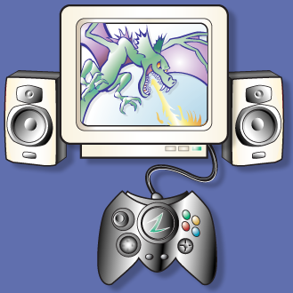
Take a digital game…

Slide 3
…remove the controller…

Slide 4
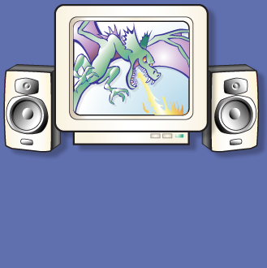
…remove the controller…

Slide 5
…the sound and music…

Slide 6
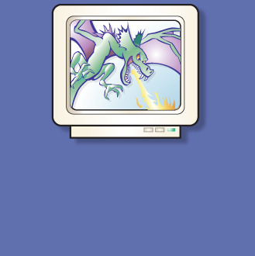
…the sound and music…

Slide 7
…and the graphics

Slide 8
…and the graphics

Slide 9
What’s left?

Slide 11
“Prototype” a video game using only pencils, index cards and dice.
Select an existing game, but imagine your team is still in pre-production.
What features can you prototype?

Slide 12
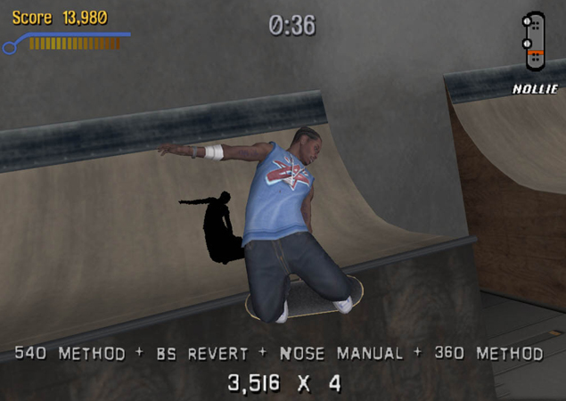
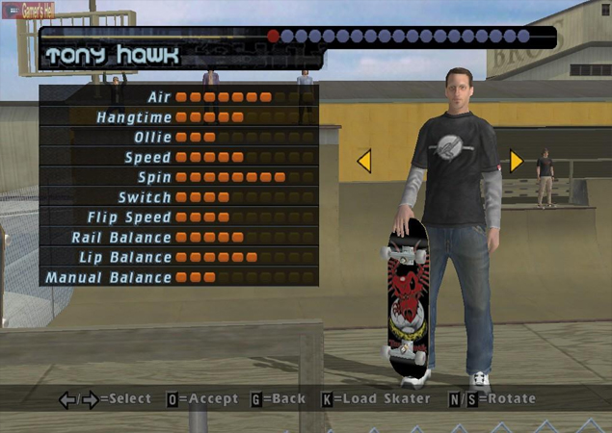
Example Game
Tony Hawk’s Pro Skater

Slide 13
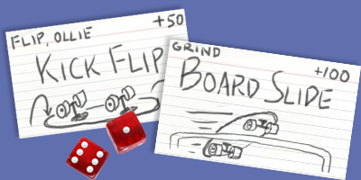
Example Game
Tony Hawk’s Pro Skater

Slide 14
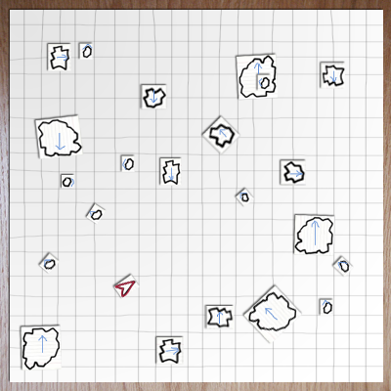
Asteroids

Slide 15
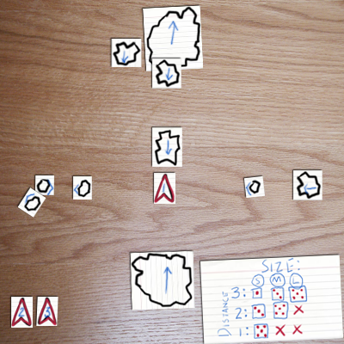
Asteroids

Slide 16
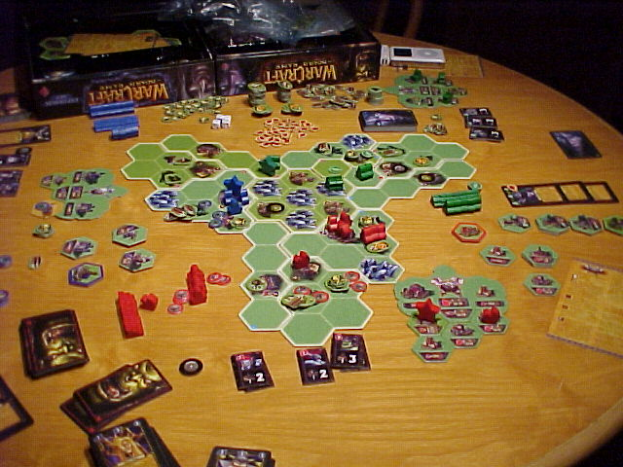
Warcraft
The Board Game

Slide 17
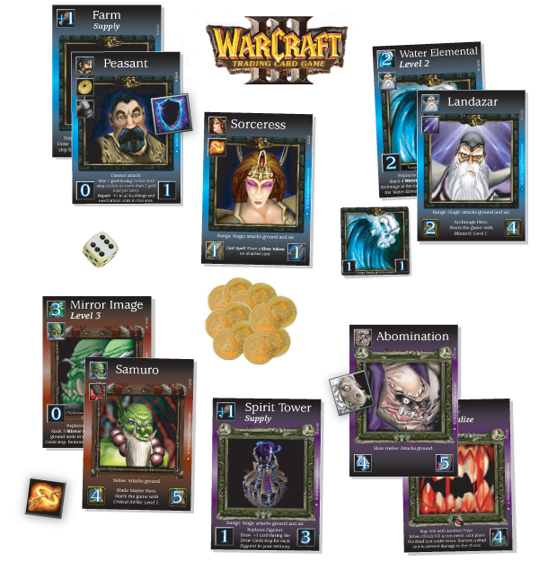
Warcraft
The Card Game

Slide 18
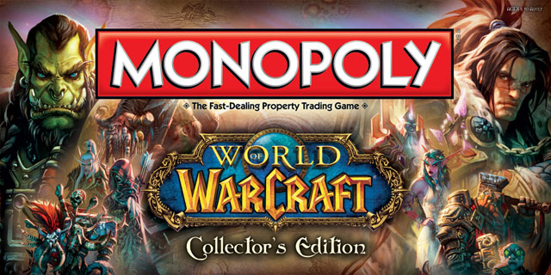

Slide 19
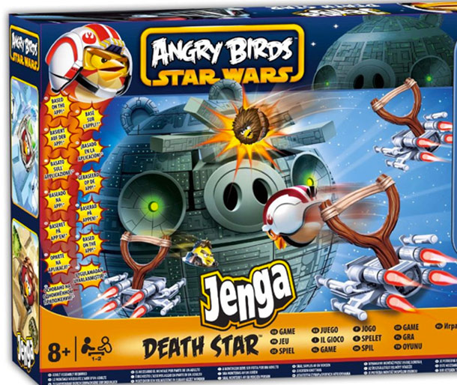

Slide 20
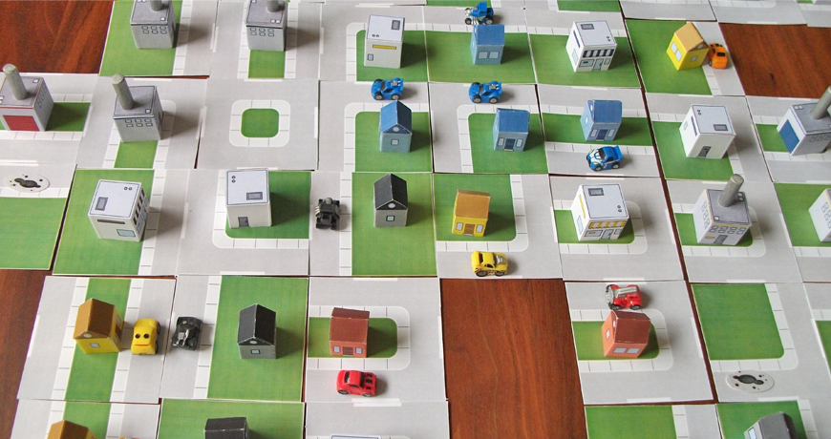

Slide 21
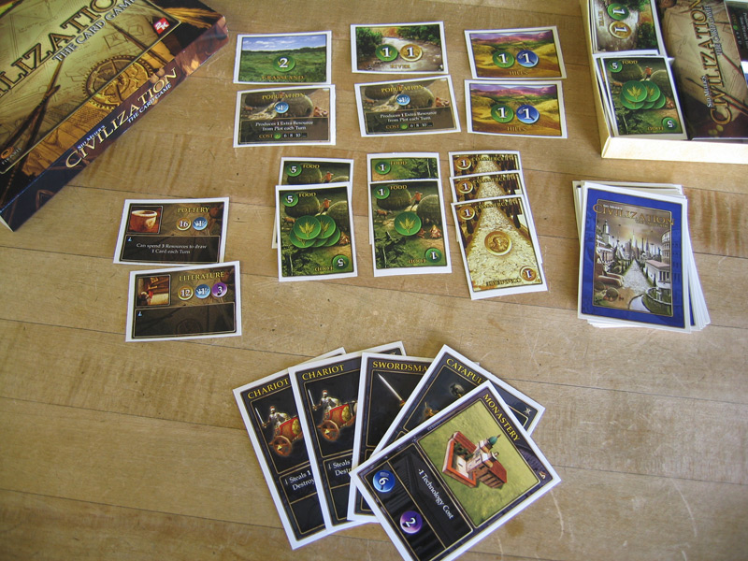
Civilization
The Card Game

Slide 22
Exercise
Divide up into groups of 3-5
Analyze a shared video game:
  What parts of it would make good paper prototypes?
Pick one and start prototyping

Slide 23
Divide into Groups
Name a video game
If you played that game go to the same table

Slide 24
Analyze the Game
Write down the marketing features
Break it up into discrete sections
Talk about the player experience as well as the mechanics

Slide 25
Build a Paper Version
What To Do
  Identify your game’s play aesthetics
  Choose one aesthetic element to capture
  Write it down and put it in the middle of your table
  Identify the game actions that create that feeling

Slide 26
Build a Paper Version
What Not to Do
  Don’t sweat the details
  Don’t try to duplicate the whole game
  Don’t focus on simulating computer functions
  Don’t make a board!

Slide 27
Alpha Deadline
  Try to have something playable quickly!
  Iterate!

Slide 28
Beta Deadline
  Send teammates to other tables
  Test until lunch

Slide 29
Discussion
What did you learn about the game that you didn’t already know?
What did you leave out?
Where would you go from here?

Slide 30
Using Paper Prototypes
Good for understanding existing games.
Use these techniques for games in progress.
Process is quick and cheap.
You don’t need programmers or artists.

Slide 31
Using Paper Prototypes
Can’t replace actual gameplay testing.
Can give you a head start and keep you focused.
Creates a vocabulary to use when discussing your game.
Can be used as a tool to educate other team members. Have them play, too!

