Slide 1

One Page Designs
Stone Librande
CMU/ETC Spring 2022
Notes:
Ultimately, design is about communicating ideas, so that those ideas can be made real.
How do you communicate information to your team to make sure everyone is aligned and understands the work they will be doing?
I’m going to describe the process that I’ve been using for many years, called “One Page Designs”.

Slide 2
Overview
Standard design documentation
What are one-page designs?
Creating your own one-page designs
Pros and Cons
Notes:
The talk will be divided into four main sections. I’ll start by describing standard game design documentation and how it has changed over the years.
Then I’ll explain what I mean by a one-page design and how they are used.
I’ll show you how to apply these principles to your own one-page designs.
And at the end of the talk I’ll summarize some of the pros and cons of using this approach for design documentation.

Slide 3
Design Bibles
Notes:
When I first started working in the industry, the standard approach to design documentation was to create what was called a “Design Bible”. The idea is to write the complete book that describes the entire product. You give that book out to the team and then they build the game, based on the details specified in the bible.

Slide 4
1. Game Mechanics
  1.1. Core Gameplay
  1.2. Game Flow
  1.3. Characters/Units
  1.4. Gameplay Elements
  1.5. Game Physics
  1.6. Statistics
  1.7. AI
  1.8. Multiplayer
2. User Interface
  2.1. Flow chart
  2.2. Functional Requirements
  2.3. Mock-up
  2.4. Buttons, icons, pointers
3. Art and Video
  3.1. Goals, style, mood
  3.2. 2D art and animation
    3.2.1. GUI
    3.2.2. Special Effects
  3.3. 3D art and animation
  3.4. Cinematics
4. Sound and Music
  4.1. Goals, style, format
  4.2. Sound effects
    4.2.1 GUI
    4.2.2.Special effects
    4.2.3.Environment
  4.3. Music
    4.3.1. Events
    4.3.2. System screens
    4.3.3. Level theme
    4.3.4. Situations
    4.3.5. Cinematic soundtrack
5. Story
  5.1 Backstory and world
  5.2. Character descriptions
  5.3. Game text, dialog requirements
  5.4. Sample scripts
6. Level Requirements
  6.1. Level Diagrams
    6.1.1. Flow diagrams
  6.2. Asset revelation schedule
Notes:
To start out, the designer would get a template or an outline that lists all the topics that need to be covered. Here’s a simple example of what that might look like. The designer’s job was to go down this list and fill in all the details so that each section contained a complete description of what needed to be built. Eventually, when you worked your way through the entire template, the design was considered complete. You would print out multiple copies, hand them out to the team leads, and—in theory—you could go home, because your design job was finished.

Slide 5
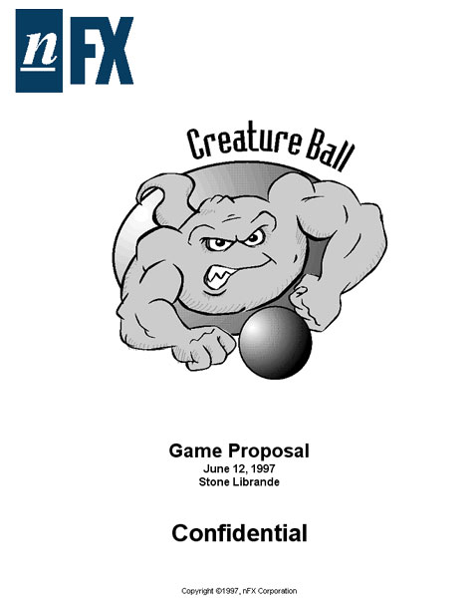
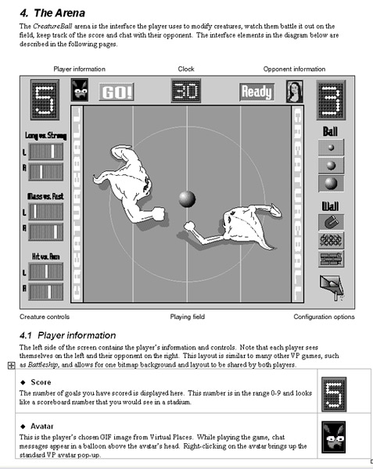
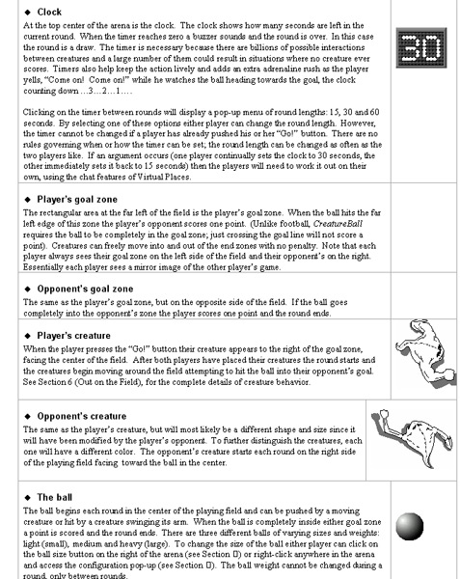
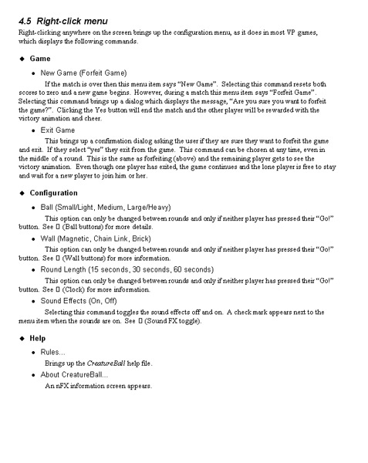
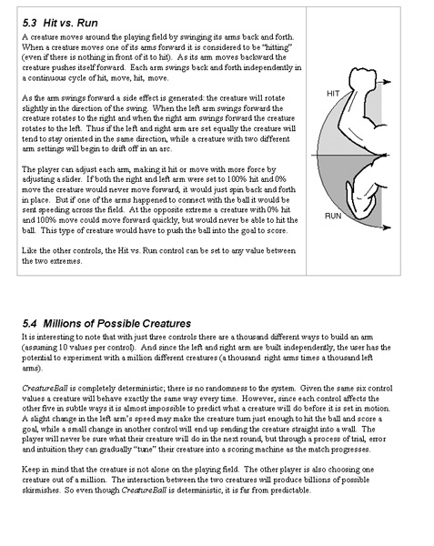
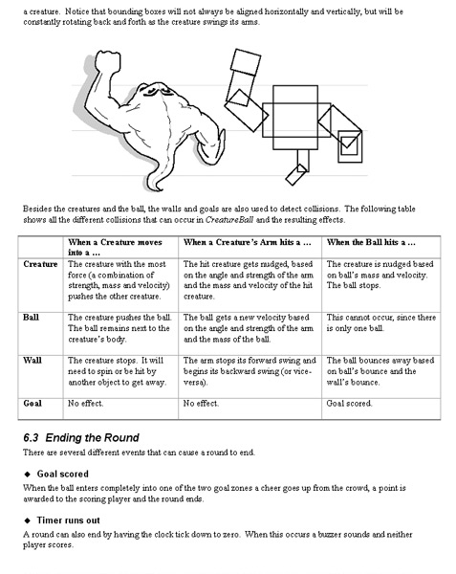
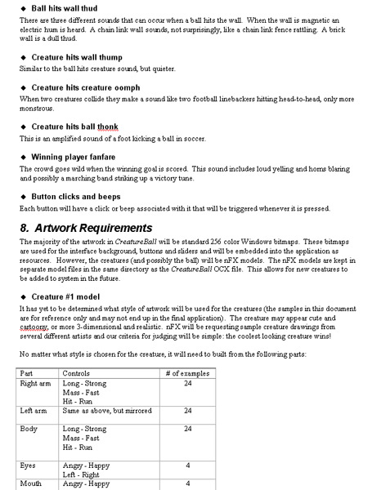
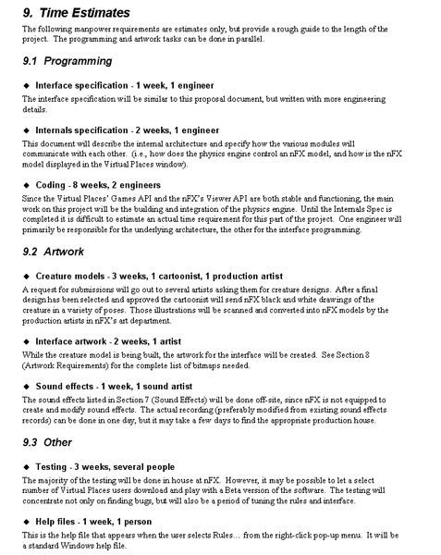
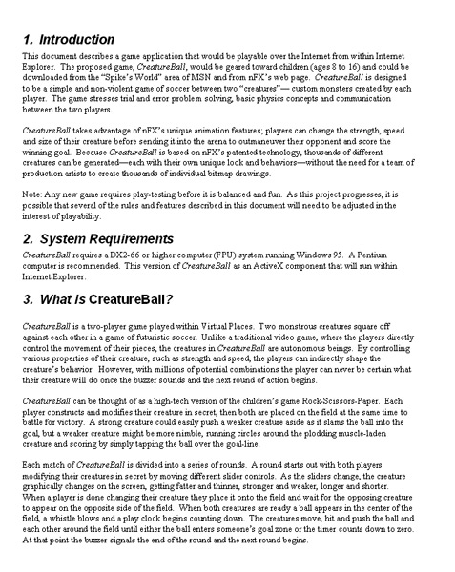
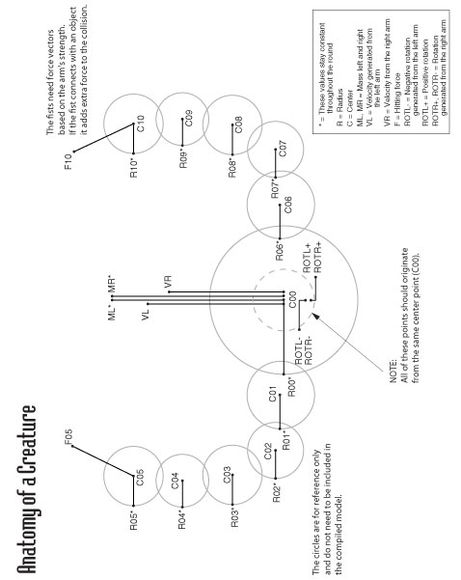
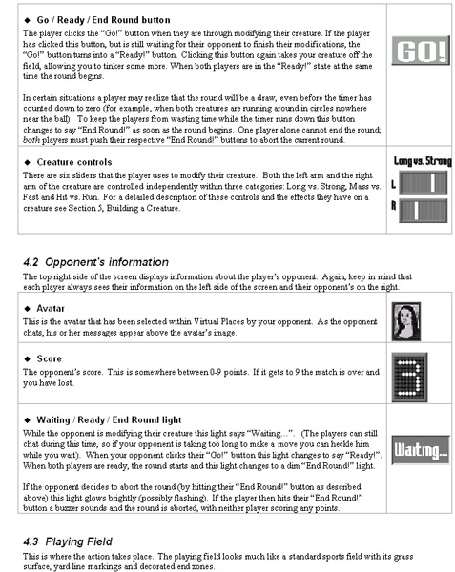
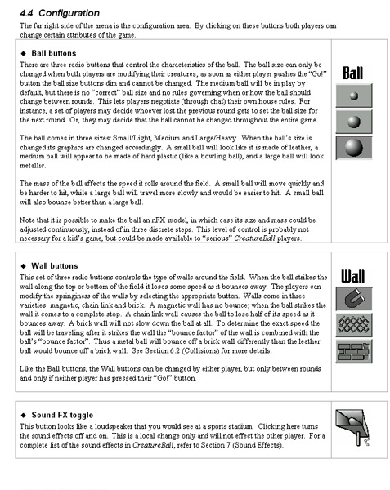
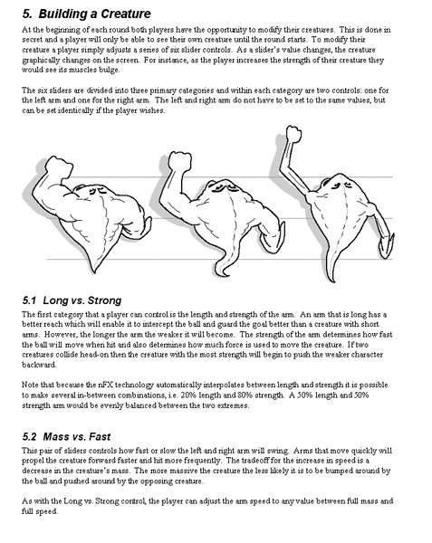
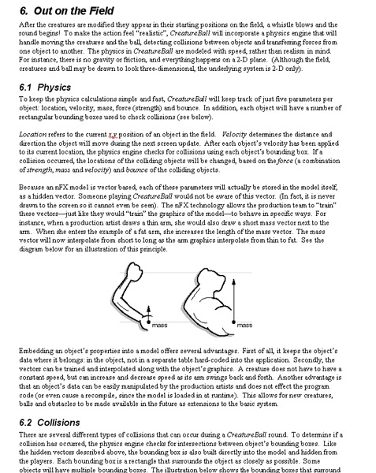
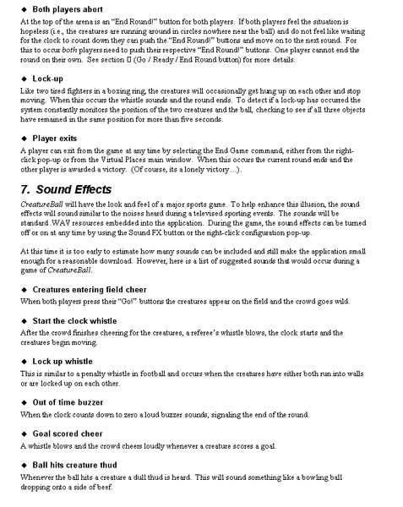
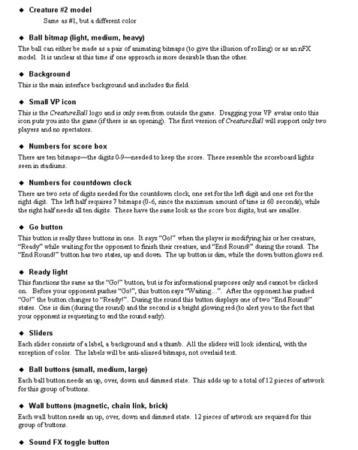
Notes:
5
Here’s a simple example of a design bible that I created in the late 90’s for a small, unpublished game. It starts out with a nice picture on the cover, but as soon as you open it up you see a wall of text. There are descriptions for UI elements, building your creature, physics, sound FX, and artwork requirements. Most of it written out in text, with only a few supporting illustrations.

Slide 6
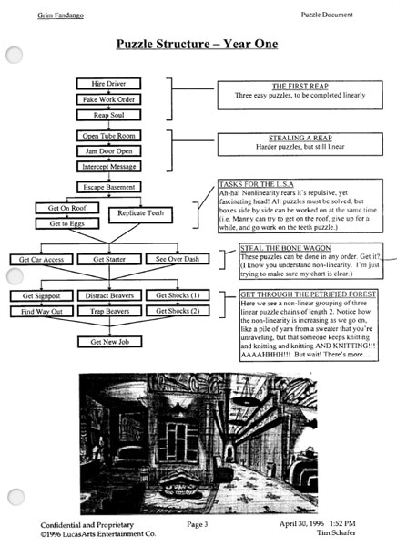
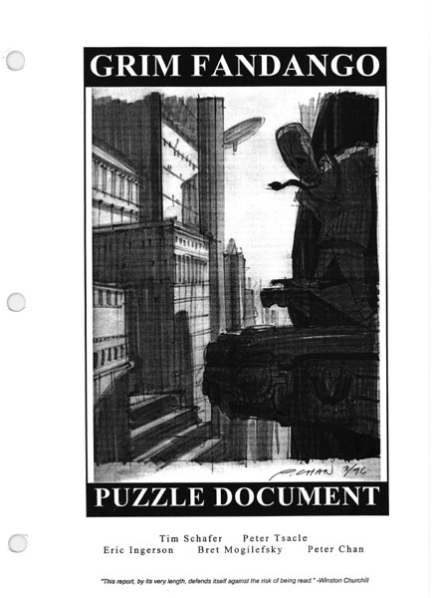
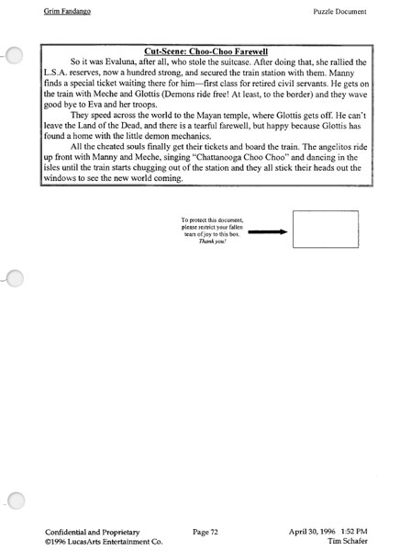
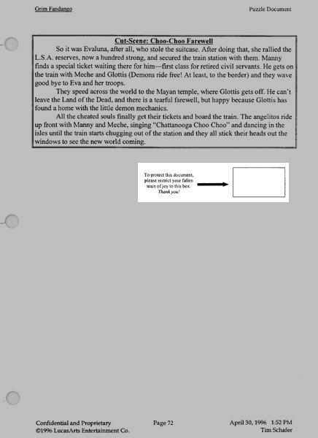
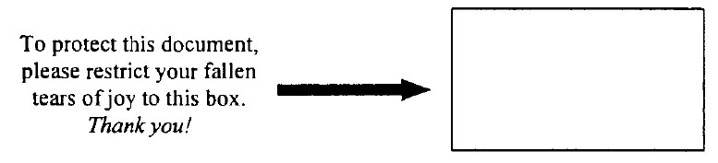

Slide 7
Pros
Definitive source of information
Entire design is in one place
The act of creating the document is the act of designing the game
Cons
Doesn’t scale up
Difficult to update
Difficult to search
Notes:
[Pros] Even though design bibles aren’t used in the industry now, they have several properties that I really like.
First, it’s nice to know that there is one master source of truth for the project. If it’s in the bible then the team is doing the work. If it is not there then you don’t need to worry about it.
Everything is in one place. You don’t need to look through multiple documents. If you have a question, you know where to go to find the answer.
This last point is subtle, but I’ve found that when I am writing a design bible, I am forcing myself to step through every aspect of the design. It’s not like you do all the design in your head, and then write it all down at the end. Rather, as you are writing you are forcing yourself to make hundreds of design decisions. This requires a lot of deep thinking. You have to consider every piece of the game and how it relates to every other piece before you can write that one perfect sentence that explains the design to the reader.
[Cons] Despite these benefits, there are some obvious reasons why this technique is no longer used.
It doesn’t scale up. As teams got bigger, and projects became more complicated, it might take hundreds of printed pages to fully describe a project.
Games are created over long periods of time with constant iteration. Changes could happen at any point in development. If I need to make a change to one sentence in a hundred page printed document, how should I do that?
And even if it was easy to make the change, how would the reader know? Even if the document isn’t changing at all, it can still be difficult to find specific information quickly.

Slide 8
Design Wiki
Notes:
To address these issues, game companies started switching over to design wikis in the early 2000’s. Instead of printing out all the pages of the design, all the information is available through your web browser. I’m sure many of you use some sort of design wiki in your studios today.

Slide 9
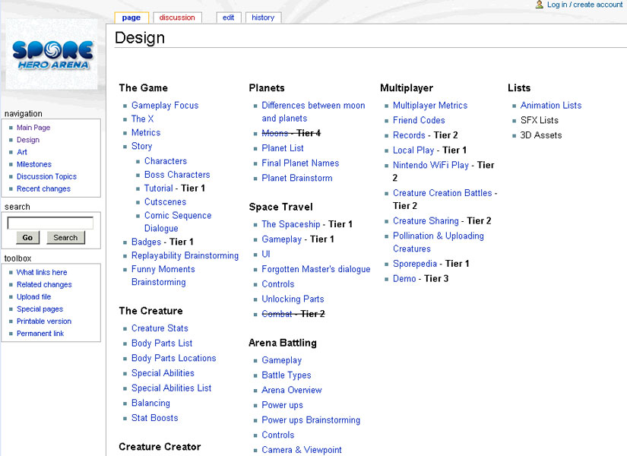
Notes:
But despite the obvious differences, the process is often handled in the same way as the design bible. You start with an outline describing all the sections of your game, then you fill in the details over time. Eventually all the links on the main page point to sub-pages with the required information.

Slide 10
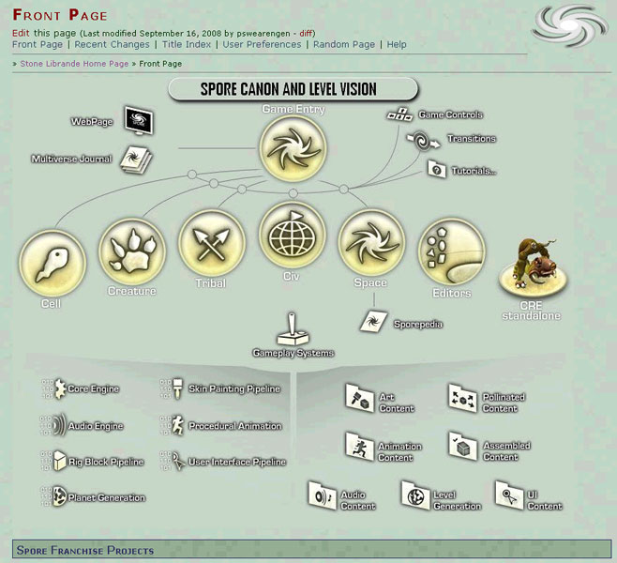
Notes:
This is main page for the Spore wiki. It looks nice and organized, with one big button that takes you to the design pages for each of the sections of Spore: the cell game, the creature game, the tribe game, and so on.
However, looks can be deceiving. Underneath this nice-looking main page there was a chaotic mess. Each team had their own way of using the wiki. Some kept their designs up to date, others didn’t. Most of the sub-sections weren’t organized clearly. And there was no way to see how all these separate parts integrated into the game as a whole.

Slide 11
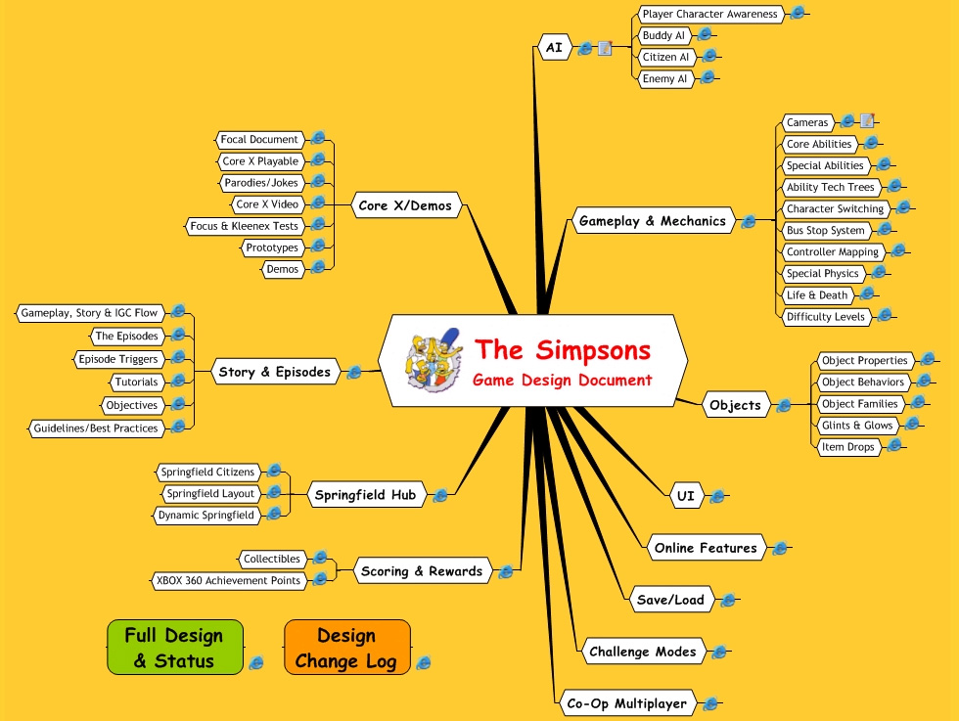
Notes:
11
For contrast, here is the front page of The Simpsons Game wiki. It also has sections for all of the different systems—I was responsible for a small portion that covered the city of Springfield—but other designers owned these different sections.
What worked really well on this project was that we had a producer on the team, named Hans, who oversaw the entire wiki. His job was to make sure all the designers were updating their designs regularly and following all the formatting conventions. He also made sure that there were approval meetings every time a new page was created or information changed.
This oversight makes a huge difference in the effectiveness of the wiki and how valuable it is as a tool for the team.

Slide 12
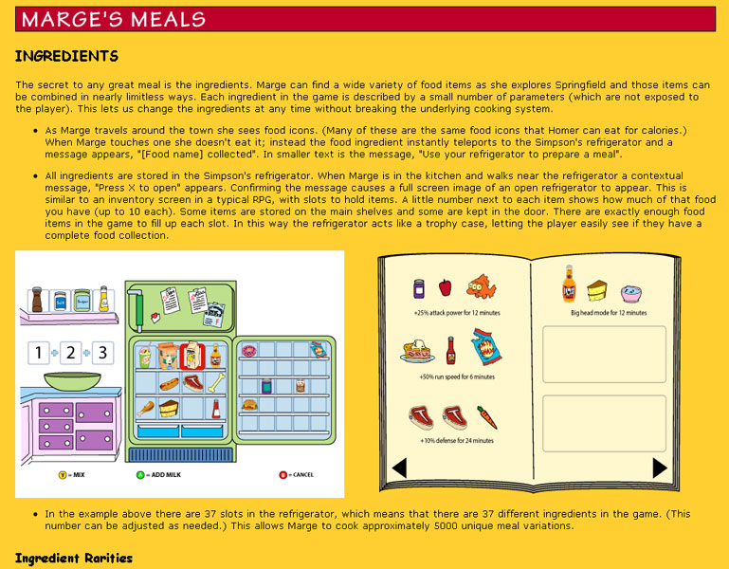
Notes:
This is an example of what each design page would look like. This is one of my designs describing how you could cook different recipes in the Simpson’s kitchen to earn temporary power-ups.

Slide 13
Pros
Easy access
Easy to update
Bite-sized chunks
Team contributions
History tracking and accountability
Cons
Requires constant maintenance
Hides design relationships
Low resolution
Frustrating viewport limitations
Notes:
[Pros] So what are the positive aspects for design wikis?
First is that it is easy to access to the information. If you are on any computer in the studio you just open a web browser and visit the wiki.
It’s easy to update. If you need to make a change you can click the edit button and start typing in new text or modifying existing text.
You only need to see the information that is relevant to you. You don’t need to understand the entire document to get your portion of the work done.
Everybody on the team can contribute to the design. If an engineer or an artist wants to make changes they can click the edit button to add clarifications or leave comments.
Of course, that can cause problems, but if you ever need to know why a certain change was made you can find out who made the edit, when they made it, and go talk to them if you have any questions.
[Cons] Wikis require constant maintenance. If you don’t have someone like Hans on your team, then it’s very likely that the wiki will fall apart the further you get into development. This causes a bad feedback loop. If the design wiki has the wrong information on it, then teammates quickly learn not to trust it, and they stop using it. And if your team isn’t using the wiki, the designer doesn’t have a motivation to update it…which makes it even more out of date.
Another problem is that a wiki tends to hide design relationships. You can only see one section at a time and it can be difficult to see how any one design relates to another. Sure, you can put links on any page to all the related information, but it isn’t easy for your readers to keep a mental picture of how all the designs are organized when they can only see one screen at a time.
The screen itself if low resolution. Even if you have a high-resolution monitor, text will still be unreadable when it is small. That means you have to zoom in on the document to see everything clearly.
Which brings up this last issue: the viewport limitations. Most monitors have a 16:9 aspect ratio. But what if your design doesn’t easily fit into that rectangle? Then the reader needs to scroll around and zoom in and out. They can’t see the design as one whole, they can only see a section at a time. I’ll show you a few examples of the problems this creates in a moment.

Slide 14
Observation
Problem: Many people don’t read past the first page or screen.
Solution: Only use one page.
Notes:
I’ve worked on many designs, in many different formats, and one problem I’ve observed over and over again is that most people don’t read past the first page of a printed document, or what’s hidden off the first screen of an electronic document.
This isn’t really a problem if someone is just browsing a random webpage. But it can be big problem if the information is related to the game you are designing, and describes work that needs to be done. You don’t want your development team to quickly skim through your designs, or, worse, ignore them altogether.
One solution is to force everyone to read your designs. On one team I was on, the designers would have meetings where we would read our designs out loud to the team. This works, but is very inefficient.
But a better solution I discovered was to only use one page. Then, there is no scrolling. There is no zooming in and out. There is no page 2 to flip to. The entire design is visible at all times.

Slide 15
One Page Design Inspirations
Notes:
Before I get into the details of the one-page design process, I wanted to share a few inspirations with you.

Slide 16
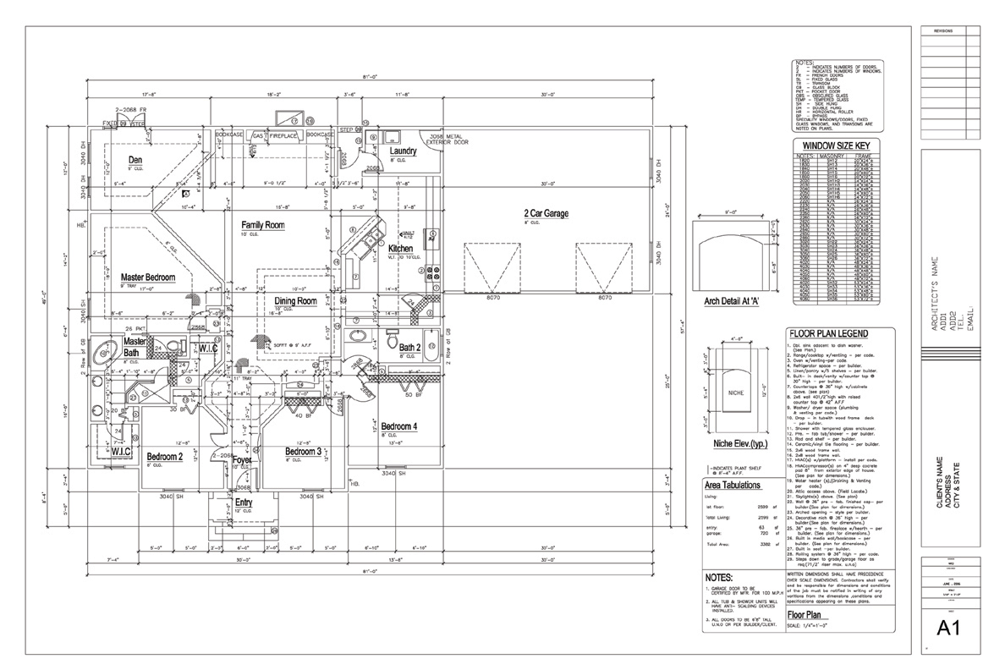
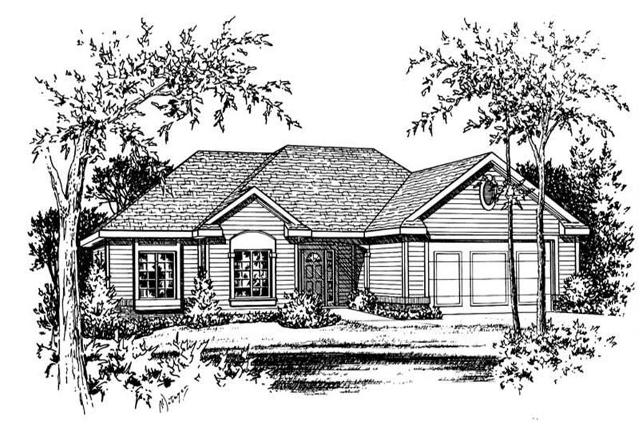
Notes:
When I was younger, I wanted to be an architect and I studied drafting and construction. Here is a one-page floor plan for a house. If I were to give this to a contractor and ask them to build this house they would have the information that they needed to start work. But if I gave this to the future residents and asked them, “Would you like to live here?” they might be confused. It’s not immediately clear if this would be a nice place to live.
On the other hand, if I show them this illustration and say, “Do you want to live here?” they might have an immediate positive reaction.
But, the contractor can’t build the house from this one image. The information they need to do their job doesn’t exist.
The main point here is that when I talk about one-page designs, I’m not saying that there is only ONE one-page design. There can be many of them. The goal isn’t to make one perfect design that describes the entire project. Different members of your team need specific information at different points during development. You aren’t trying to please everyone with each design. Instead, make sure you know the needs of your intended audience and create the appropriate design for them.

Slide 17
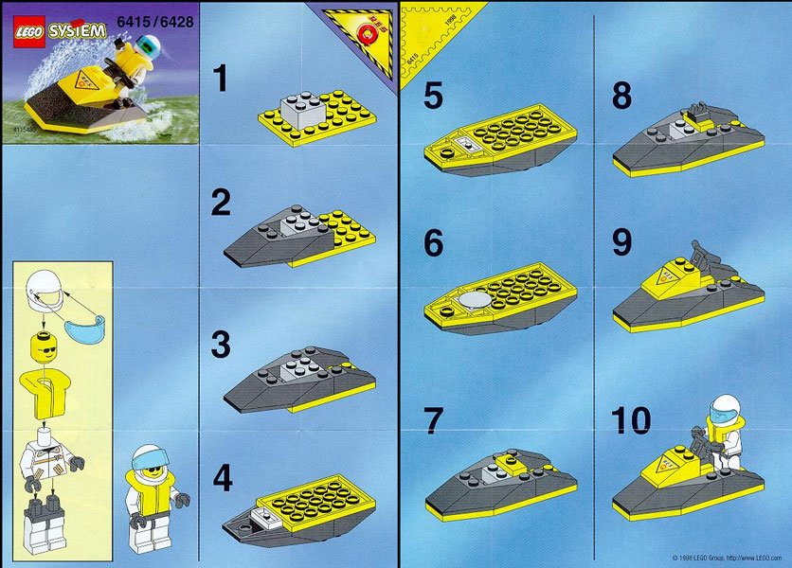
Notes:
If you ever built a Lego toy before then you have seen these designs. This one page clearly shows how to build a jet ski, even if you are too young to read.

Slide 18
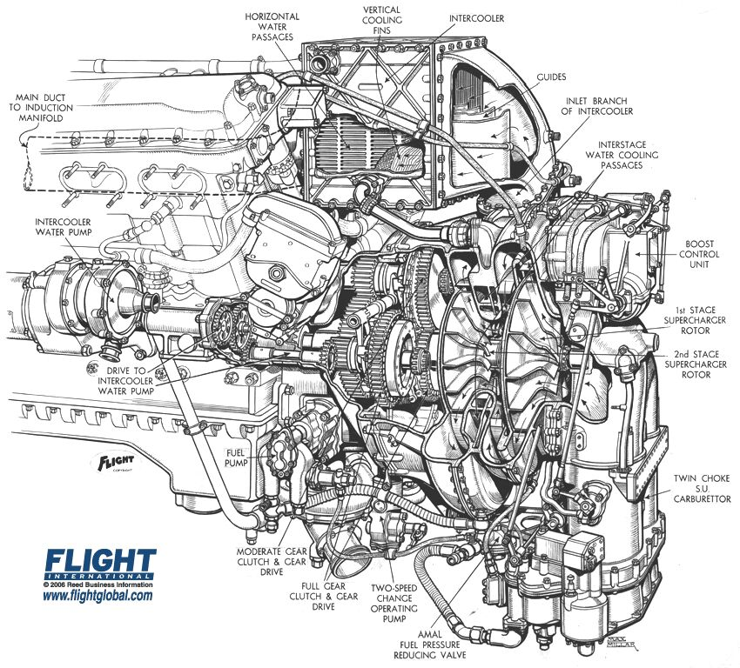
Notes:
This is a beautiful rendering of an engine from a small plane. Notice how it clearly shows all the relationships between the various parts of the engine on one page. Imagine trying to describe these relationships using several pages of text.

Slide 19
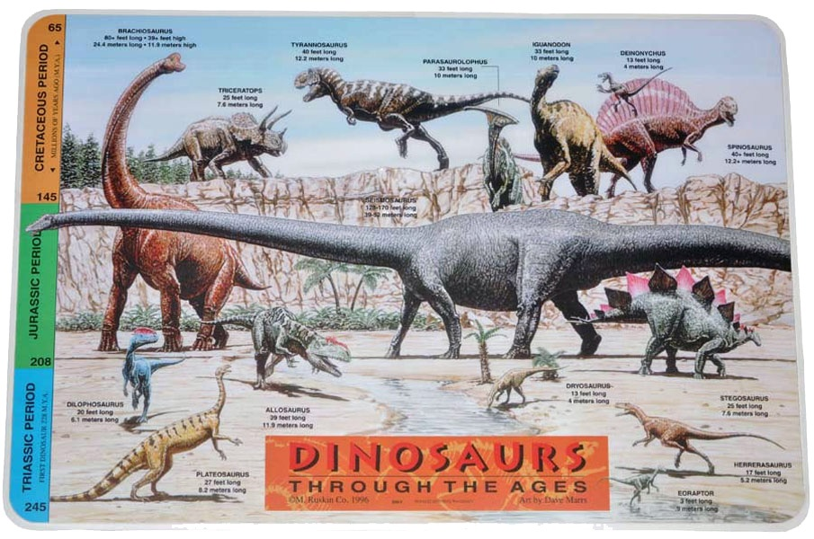
Notes:
This is a plastic mat that parents put under their child’s plate to keep them from spilling food on the table during meals. Look at all the information that is presented here: types of dinosaurs, their relative sizes and how long ago they roamed the earth.

Slide 20
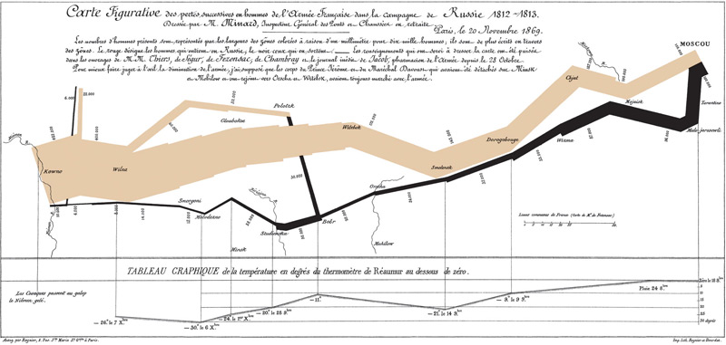
Notes:
This is a famous chart from 1869 by Charles Minard. It might look a little confusing and abstract right now. But after I explain it to you, you may have an emotional reaction to it.
This is a map of Europe showing Napolean’s march of 1812 into Russia and back. The brown line represents the strength of the troops as they advanced. And the black line represents the strength of the troops as they retreated. Here you can see the difference between the size of army before and after the campaign.
Notice all the different types of information presented on this one page. In addition to troop strength you also have geographical information, such as cities and rivers. You have time and distance. And you have temperature. It was winter and you can see how the temperature is decreasing as the soldiers return home.
Here they lose over half their men as they attempt to cross an icy river.
It’s a lot of information, all presented concisely, with few words, and only two colors of ink.

Slide 21

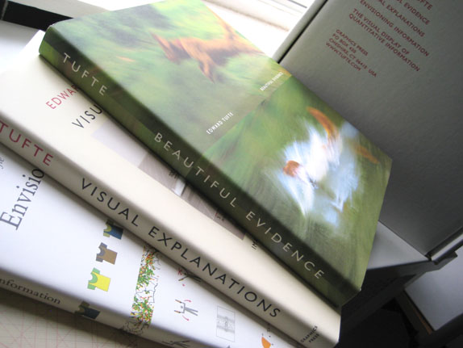

Slide 22
One Page Design Examples
Notes:
Now that you’ve seen some of my inspirations, let me show you some of my first one-page designs and explain how I began experimenting with this process while working at Blizzard on Diablo 3.

Slide 23
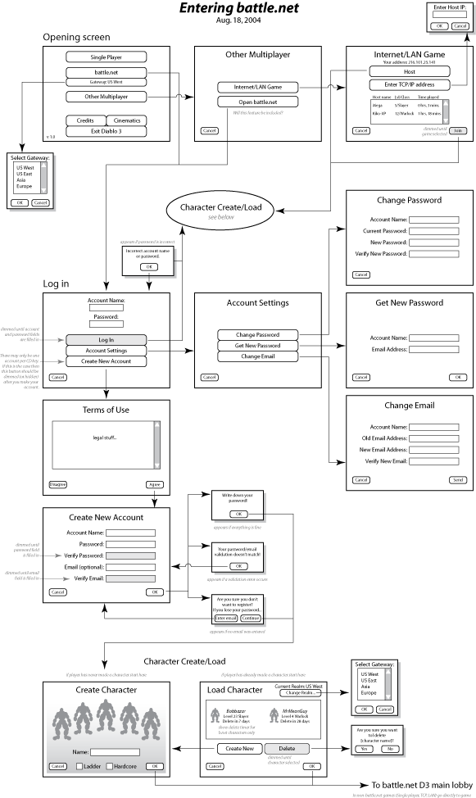
Notes:
This is one the first one-page designs I made while working on the UI for logging in to the game using battle.net. At the time, I wasn’t thinking of it as anything special, since this is a standard method of showing a UI flow using wireframe diagrams. I want to point out since this chart was originally printed in a portrait format, you can’t see the whole thing on the screen at once.

Slide 24
Notes:
Of course, I could shrink it to make it fit, but then you can’t read any of the text. I’m sitting right next to the monitor and I can’t even read it. This is an example of what I meant by the viewport limitations. Even though this diagram looks great when printed out on a piece of paper, it wasn’t meant to be viewed at a 16:9 aspect ratio.
OK, so I had printed this out and given it our lead engineer who was working on the user interface. We finished up the work and I didn’t think about the diagram until a few weeks later. I went into his office to talk about another design document that I had written. He looked around for it on his desk, and finally found it under some other papers. I asked him if he had any questions and he said he hadn’t had a chance to read it yet.
Then I noticed that he had hung up this UI diagram on his wall. I asked him why he had that design hanging up in clear view, even though we had already finished that project. He replied, “Because I thought it looked cool.”
That was the moment that the idea for one-page designs popped into my head. I realized that if I could make all of my design documents look cool, then people wouldn’t lose them on their desks and forget to read them. Instead, they would hang them on their wall and look at them all the time!

Slide 25
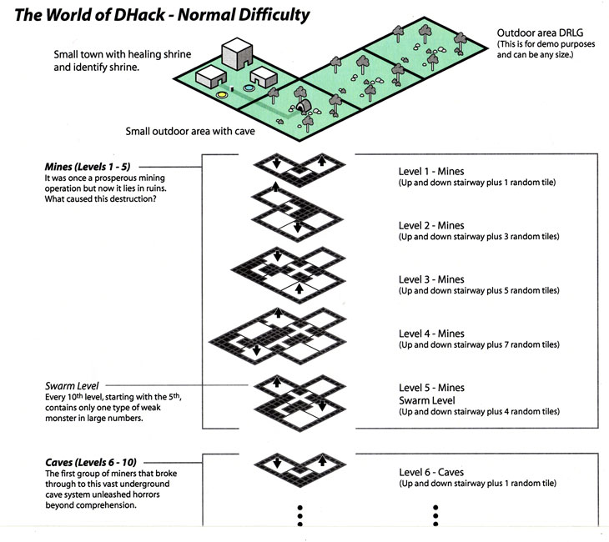

Slide 26
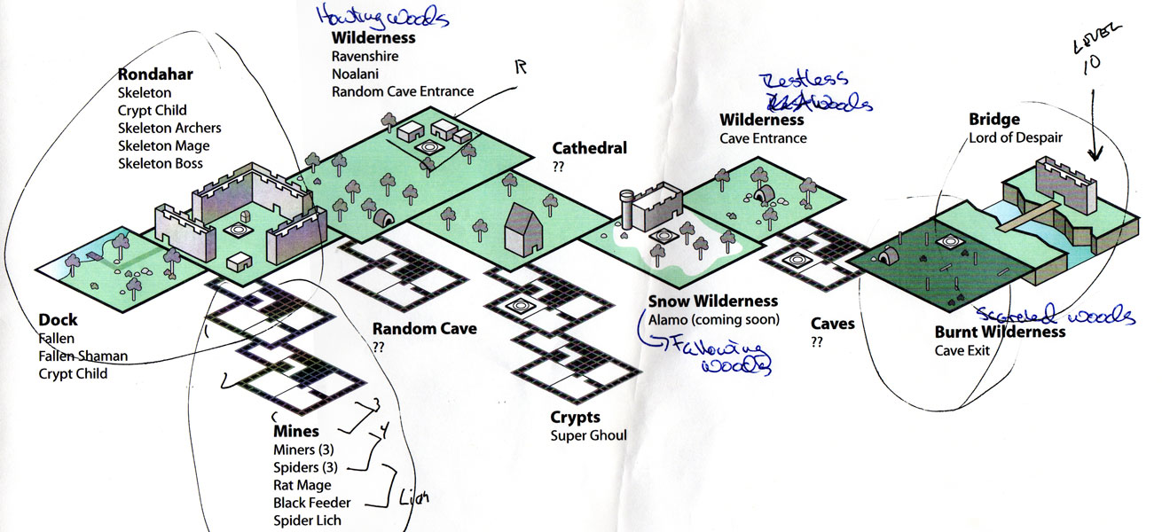
Notes:
I decided to try it out as an experiment. At the time we had just started making a prototype of the first act in Diablo 3. Instead of writing out a formal design document, I just drew this image you see here. You can see the player’s journey from the docks, through this town, out into the forest and into the crypts, and eventually crossing a bridge to fight the boss. I printed it out, took it into meetings, and we would discuss the level and the team would suggest changes.
I would take those changes back to my office, rework the diagram, and take it into the next meeting a few days later. This process continued for several weeks as the level became more and more refined. After many iterations it ended up looking like this…

Slide 27
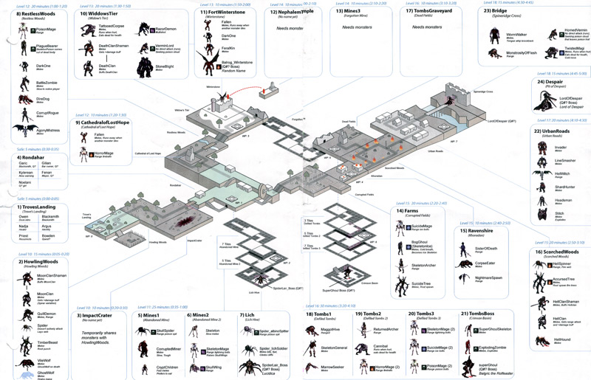
Notes:
27
Here you see the same journey, from the docks, through the forest, and ending at the boss at the end of the bridge. But now there is a lot more detail. Let me zoom in so you can see it better…

Slide 28
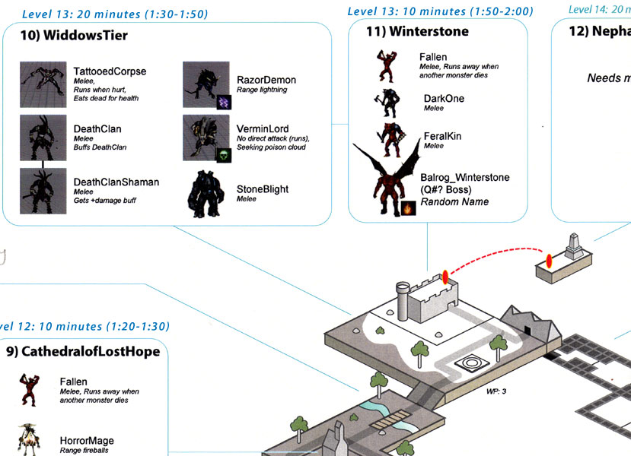
Notes:
28
Each section of the map shows the approximate player level, how long we expect the player to be in that area, and the total time since the player began playing. It also describes the monsters that they will fight, and their AIs. In this case, the player is level 13, has been playing for one hour and thirty minutes. They will be here for about 20 minutes while they fight some monsters with electric attacks and others with poison attacks.
This experiment was very successful. Almost every member of the team had this image hanging up on a wall near them, and we referred to it constantly. Ever since then, I have continued to create one-page designs on all the projects I have worked on and found them to be a valuable way of communicating designs to the team.

Slide 29
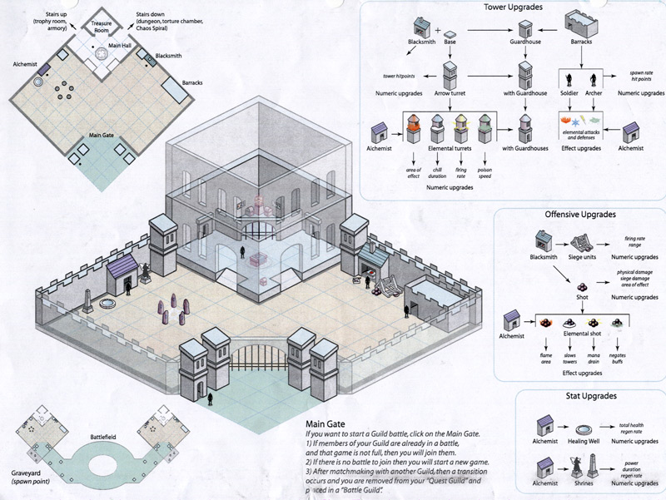
Notes:
29
Here is one of my first attempts at putting a game design onto one page. There are three tech-trees, an isometric illustration and an overhead view.

Slide 30
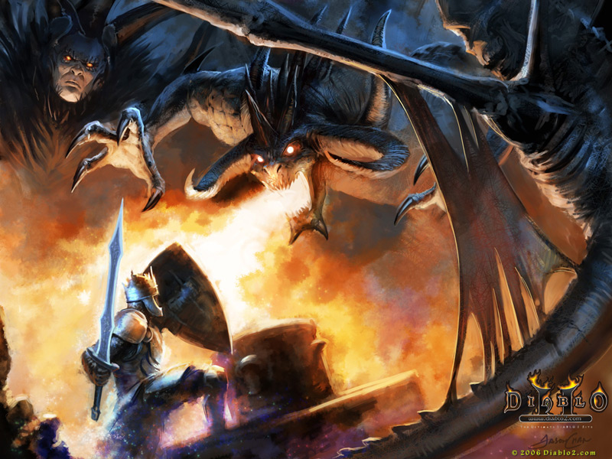
Notes:
30
Concept Art
When we think of illustration we typically think of concept art. While concept art is a powerful way of emotionally expressing the theme, it typically informs the art design, not the game design.
It tells you the end state, but doesn’t tell you how to get there.

Slide 31
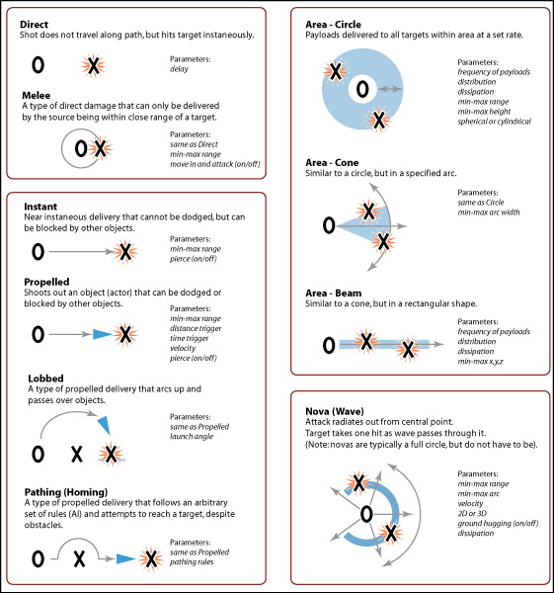
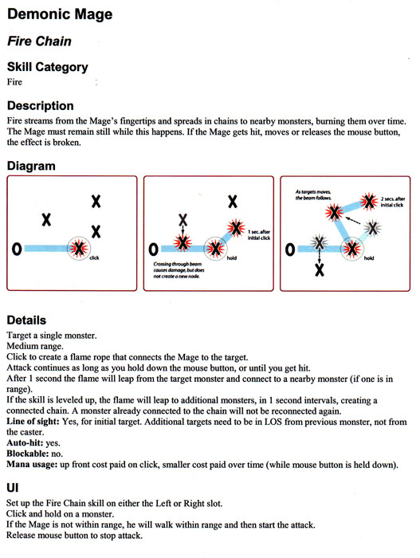
Notes:
31
Combat Diagram
As a game designer, this is how I would make a diagram showing combat in Diablo. The illustration needs to focus on the iconic rather than be an actual screenshot. If you are too literal then people will focus on the surface, not the information.

Slide 32
One Page Design Process
Notes:
Now let me show you a quick overview of how this process works.

Slide 33
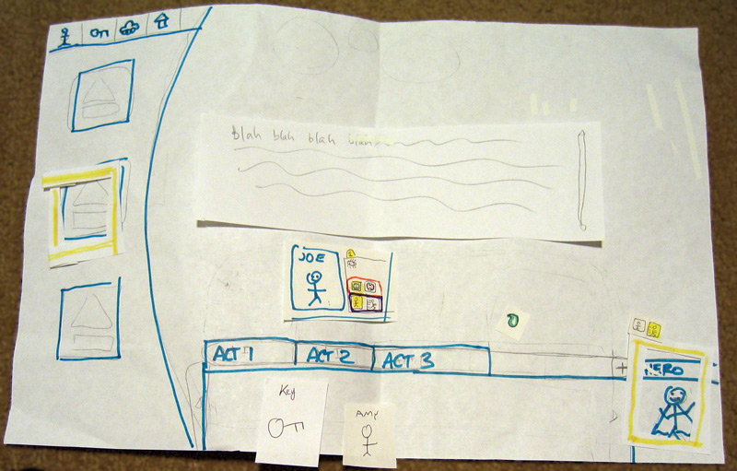
Notes:
Every project is going to be different but here’s the process that I used for Spore’s Galactic Adventures expansion pack. As I mentioned in the previous talk, we often start out with a quick paper prototype, just to collect feedback and make sure we understand the general concepts.

Slide 34
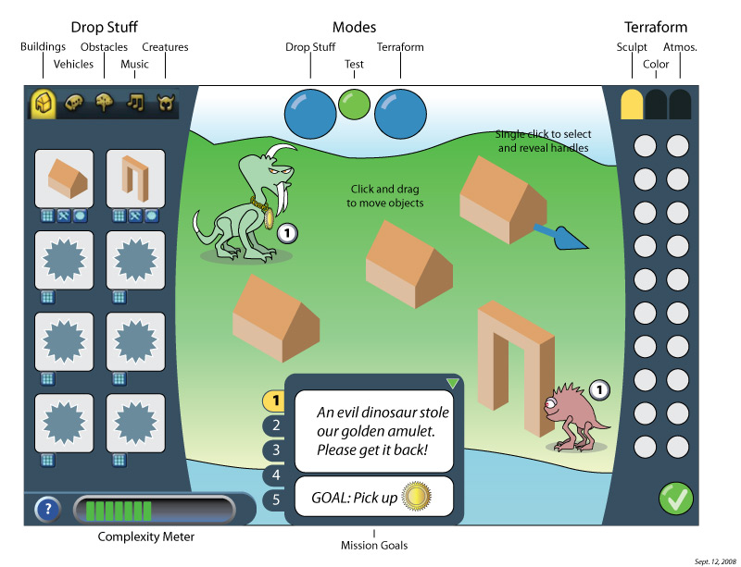
Notes:
Then I’ll take the information that we gathered and try to mockup a view showing how the screen will look and what players will see. In this case, it shows the tabs, buttons, and dialog boxes. The goal here isn’t to determine the final UI, but to give the team a sense of the different pieces that we will need and how they might interact with each other.

Slide 35
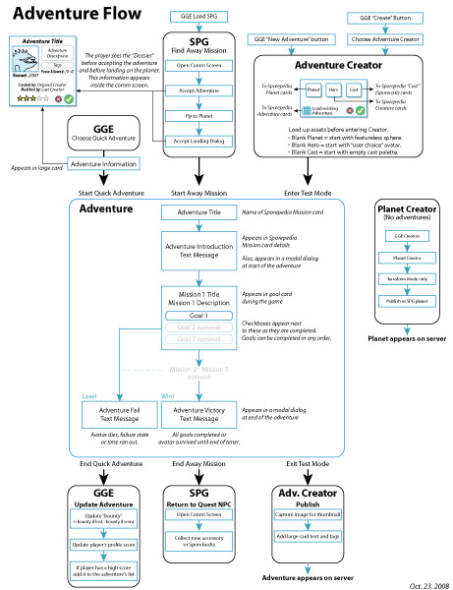
Notes:
After that is agreed on, I typically start working on higher-level system diagrams. These aren’t player-facing, but are meant to show the modules that we will need and the flow of information through the system. This helps us understand the scope of the work and to determine if we have enough time, money and people to get the job done.

Slide 36
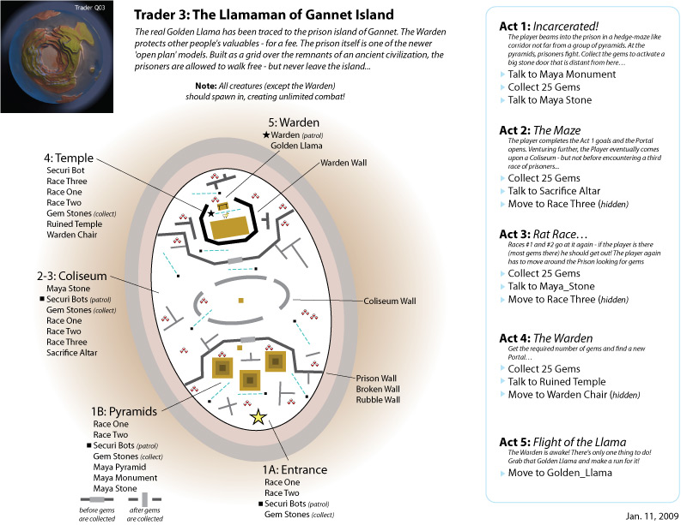
Notes:
36
Once the project is in development, it is time to start making detailed designs for specific systems, as needed. In this example, we wanted to ship 24 levels with the game, so I needed to make a separate design for each level. These were then given to the level design team who would build and playtest them in the engine.

Slide 37
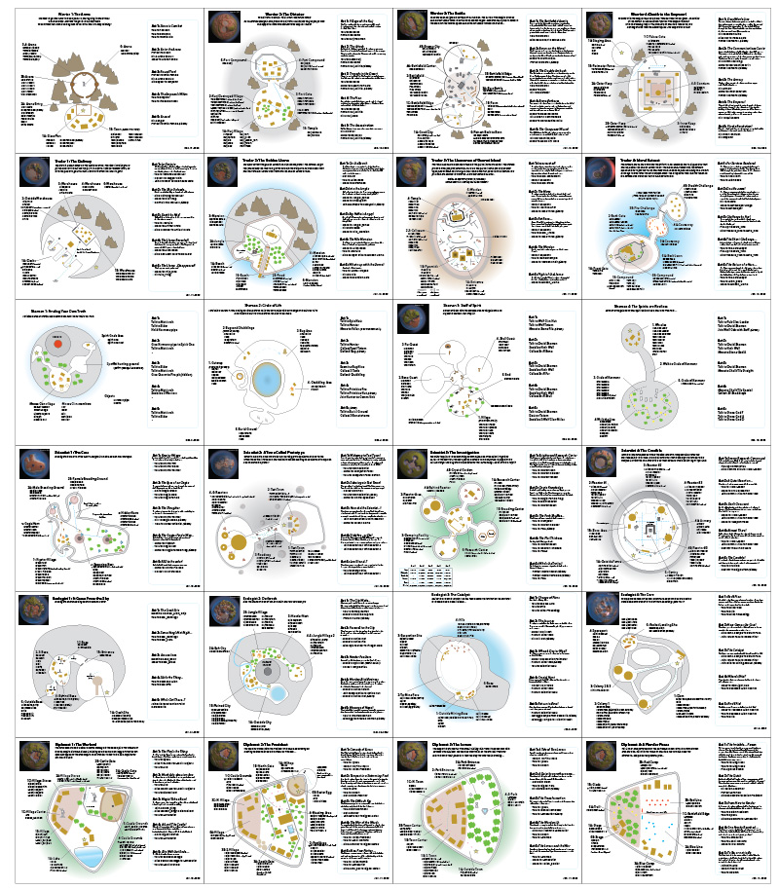
Notes:
37
Here you can see the diagrams for all the levels. Rather than printing these all out on one big piece of paper, each one was printed individually and then tiled on the wall. That way if I needed to make a change to one level, I only needed to print the page with the changes.
These were displayed in a central hallway so that everyone on the team could see them and comment on them. This reveals my secret trick of one-page designs. As I said earlier, the important part is that they are printed out and there is no second page to flip to. But I never said that you have to use a small sheet of paper. If you need to, your page can be the size of an entire wall.

Slide 38
Creating a One Page Design
Notes:
For this next section, I want to talk about how you can create your own one-page designs. Hopefully when you return back to your studios you will be able to use some of these techniques to help communicate your designs to the team.

Slide 39
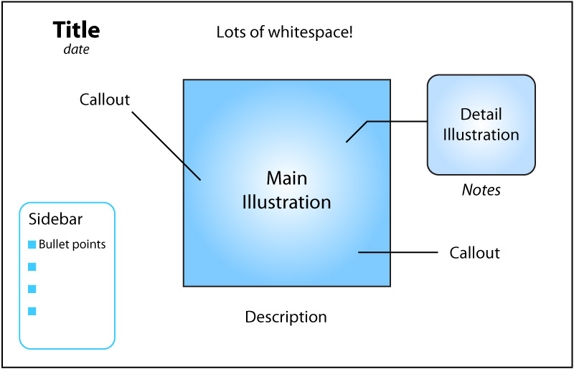
Notes:
39
Here’s a simple template showing the important elements of a one-page design. I always use Adobe Illustrator, but you could use any vector drawing program. I don’t recommend using bitmap paint programs like Photoshop. Vector programs allow you to print at high-resolution with no artifacts and the file sizes tend to be much smaller.
The most important part, and the thing I always start with, is the title. You don’t want to start working on the design until you know what you are trying to accomplish. By writing down the title, you are forcing yourself to stay focused. Only elements that support the title should be on the page.
Underneath that you want to put the date. You will probably end up printing out multiple variations of the same document, so it is helpful to be able to quickly tell which one is the most recent. My habit is that as soon as I open up a file to work on it, the first thing I do is update the date, save the document, and then I start editing it.
The other important thing to keep in mind is the whitespace. Don’t cram all the information together. That will just make the document difficult to read. If you find that you have too much information and can’t figure out how to make it all fit then print on a larger sheet of paper. Or consider changing your title to make the document more focused and delete the extraneous information.
I usually put a large illustration in the middle of the document. This can act like a beacon and helps draw your reader in. Any clarifications or support material can be noted with callouts or more detailed illustrations around the edges.
If you need to include a lot of text, try to write it out as a simple list, with each major idea having its own bullet point. Avoid large paragraphs of text. As the number of words on a page increases, it becomes more likely that people will not read it all.

Slide 40
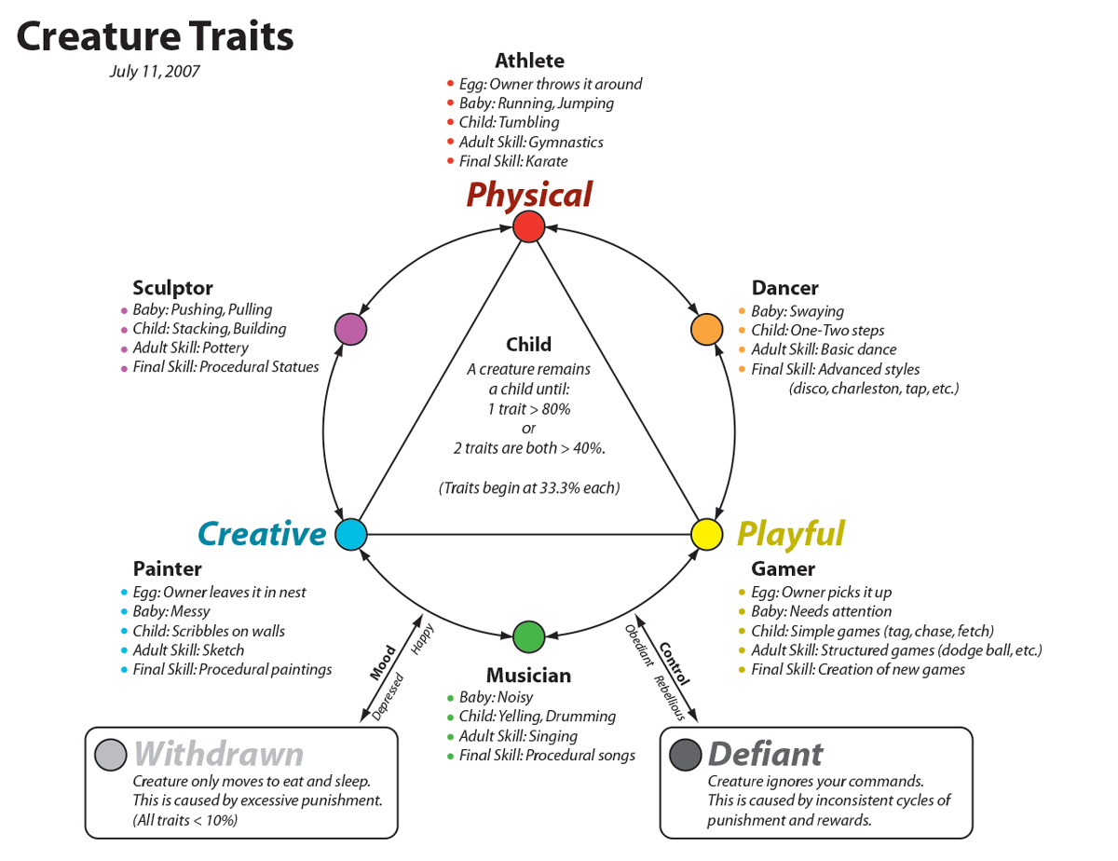
Notes:
40
Here’s how this template works in a real example. This diagram is from a game that never shipped called Terrarium, where the player raises a Spore creature as a pet. The details of the game aren’t important, I just want to show the structure of the diagram.
At the top you have the title, “Creature Traits”, and the date. Then the main illustration, which is this circle that shows the relationship between the 3 primary traits and the 3 secondary traits. Notice how this illustration isn’t fancy; it’s just a simple circle with some brightly colored highlights. The callouts break down each trait using a color-coded bullet point list.
There is plenty of whitespace and no large blocks of text.

Slide 41
Types of One Page Designs
Notes:
So now that you have seen the basics, let me show you how to apply these techniques to different types of designs. Every design is unique, so there isn’t a fixed number of types. But in my experience, these are the 5 most common patterns that I use.

Slide 42
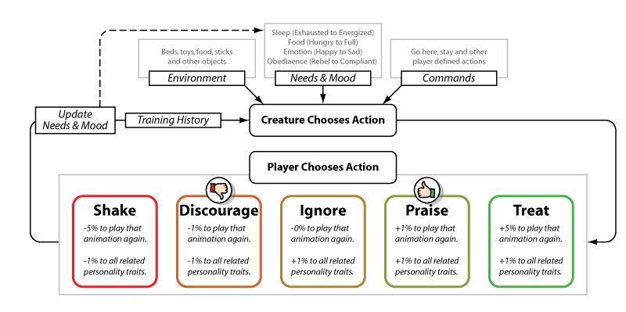
Flow Charts
Notes:
42
The first type of diagram is a flow chart. These are easy to understand and to create. So if you are just starting out, I recommend trying to illustrate one of these first.
This is another example from Terrarium. It shows the core loop of the game. Your creature needs to choose an action, so it looks at its environment, its needs and mood, and the commands that the player is giving it. For example, your dinner is on the table, your creature is hungry, and you command it to sit still. Let’s say the creature ignores your command and decides to jump up on the table and eat your dinner.
Now the player gets to react. Do they reward the creature? Do they punish it? Or do something in-between? Depending on the result, the creature updates its needs and mood, modifies its training history, and the loop repeats.
I’ve found that identifying your core loop and clearly communicating it can really help align the team. Early in development, I strongly recommend trying to illustrate your core loop as a simple one-page design. Then hang it on the wall for everyone to see.

Slide 43
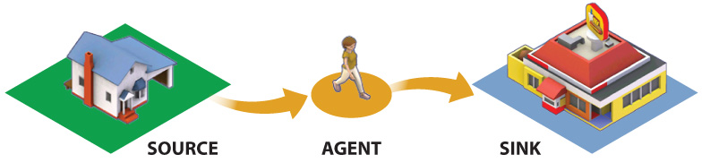
Flow Charts
Carries information
Notes:
Basic Agent Behavior
But this version of SimCity doesn’t operate in the same way. Every sim (or “agent”) is actually carrying information through the city as they go from one place to another.
What you are looking at is a one-page design that was printed out and hung up for everyone to see. Notice how simple it is. It has one purpose: to educate the team on three vocabulary words—source, agent and sink—and the relationship between them. It was critical that everyone on the team understood this relationship because our entire game is based on this concept.
Remember that your designs don’t need to be complex to be effective. They only need to be as complex as the idea you are trying to communicate.

Slide 44

Flow Charts

Slide 45

Storyboards
Notes:
45
The second type of diagram is a storyboard. Normally, storyboards are used for in-game cinematics. But I like to use them to show the major beats of the game, from beginning to end. Usually, I put time estimates next to each section to get a sense of how to allocate our resources as we begin to develop the different parts of the game.
This storyboard from Terrarium shows how a player first chooses a creature as a pet, then hatches it from an egg. In 10 minutes it grows from a small baby to a kid as the player meets its basic needs. The main part of the game is based on the core loop I just showed you. For the next 2-5 hours the player trains the creature using rewards and punishments. In the final phase of the game the player can specialize their creature and start a family.

Slide 46

Notes:
Region Timeline
This is one of my favorite diagrams from the project. It describes play patterns in more detail and how they change through time. I strongly believe that every game designer should make a timeline like this early in the development process. At this phase in the project we didn’t have exact timings figured out, but we can still approximate it by breaking up the gameplay into early, mid, late and end game phases.
Most games have a very linear structure, which means that it will be simpler to create a traditonal timeline. Unfortunately, there is no “right way” to play SimCity which made the process much more difficult. One timeline can’t represent the thousands of ways that a player can construct a city.
To get around that problem, I decided to show off two extreme cases as book ends. If we can understand the extremes then we can assume that most cities will be shades of these extremes in varying proportions.
I know that it is difficult to see the detail (another reason why you should print out the documents instead of keeping them online) so let’s zoom in…

Slide 47

Notes:
Garbage Flow
This one shows how agents might travel back and forth from work to the garbage dump. They put out their garbage in the morning and go to work. They pick up the garbage, take it back to the dump and burn it. Then they get paid and go back home. (Presumably to buy more garbage and repeat the cycle.)
This is still one of my favorite documents, because out of context it seems like a subversive anti-consumerism propaganda poster. In fact, I thought it would make for some interesting graffiti. So I printed up some stickers…

Slide 48

Time + Space
Notes:
48
The third design pattern, a Time and Space chart, is based on the Napolean’s March diagram I showed earlier. Here you are trying to illustrate the player’s journey through the world, and describe the events that will take place along the way.
This diagram is from Spore and shows how a cell climbs out of the ocean and begins to evolve on land. There are many paths it can take, but all of them involve moving from west to east across the continent. As the creature travels it meets friends and enemies along the way. At the bottom of the chart is the estimate of how long the player has been playing, divided into sections that show the brain level of the creature, which determines how fast it is evolving.
After about an hour the creature will reach the east coast, with a brain level of 4, where it will begin to group with other creatures and form a primitive tribe.
These diagrams can take some time to create, but are great at showing the team how the game works at a high-level.

Slide 49

Notes:
Overview Timeline
Earlier, I mentioned the importance of gameplay timelines. An “early”, “mid” and “late” game timeline is a good starting point, but it isn’t sufficient later in development when you need more precision.
Most games follow a very linear structure (level 1 content, level 2 content, etc.) and making a timeline is relatively easy. But SimCity doesn’t have a fixed goal which means it can be played in thousands of different (often unpredictable) ways. Instead of notating the play experience as a line, this document treats it more like a branching structure. Imagine the trunk at the bottom and the leaves at the top. The exact order of actions isn’t as important as the types of actions the player will be taking minute-to-minute, hour-to-hour, and session-to-session.
I like to think of charts like these as an orchestral score. The conductor needs to refer to a score in order to get all the different orchestra sections to harmonize together. Similarly, a good gameplay timeline will help you coordinate your development efforts across different departments.

Slide 50

Notes:
Overview Timeline
When I created this document the numbers on the side were complete guesses, and my plan was to update them as we accumulated more playtest data. But it turns out that based on telemetry from the final game, the actual times match this first chart on average.
In retrospect, this isn’t too surprising, since we frequently referred to this chart to help us tune different aspects of the game.

Slide 51

Relationships

Slide 52

Relationships
Notes:
The fourth type is a relationship diagram. This shows a set of systems in the game and describes the inputs and outputs between them.
This example is from SimCity. Each of the major systems in the game is represented by a bold header. You can quickly get a sense of how the simulation will work as the player builds up their city’s infrastructure. The player can harvest resources and either trade them or use them to manufacture goods. Then they can open up a port and buy and sell goods from the global market.
This type of diagram is crucial for scoping. And I strongly recommend making a high-level relationship diagram before you begin pre-production. It allows everyone on your team to see which systems will be in the game and which one didn’t make the cut.

Slide 53

Relationships
Notes:
53
Slide: Robot archetypes
This is a rock-scissors-paper style diagram showing the strength and weaknesses of different robot factions.

Slide 54

Relationships
Notes:
54
Slide: Robot archetypes
This is a rock-scissors-paper style diagram showing the strength and weaknesses of different robot factions.

Slide 55

Matrices
Notes:
55
The final type is a matrix. I’m constantly making matrices to help me understand the components in the game. They’re simple to construct. First, draw a grid…then label the axes…and then fill in the data.

Slide 56
Matrices
Character Class
Fighter
Archer
Mage
Scout
Thief
Warlock
Fire
Metal
Faction
Nature
Water
Notes:
56

Slide 57
Matrices
Character Class
Fighter
Archer
Mage
Scout
Thief
Warlock
Fire
Rage
Cleave
x
x
x
Piercing
Hunting
x
Fireball
x
x
Ice Bolt
x
x
Tracking
Swimming
x
Backstab
x
Potion
Demon
x
Golem
x
Metal
Faction
Nature
Water
Notes:
57

Slide 58

Matrices
Prey
Peer
Competitor
Predator
Notes:
This example from Spore’s cell game shows the size of the cells along the horizontal axis, and the environment they live in along the vertical axis. Once those were established it was relatively easy to create a unique creature for each space in the grid.
Matrices are an excellent way to break down large problems into smaller, manageable tasks. I usually start the process in a spreadsheet, and then when the basics are sorted out, I use Adobe Illustrator to decorate it with images and print it out for the team to see.

Slide 59

Notes:
59
Matrices and tables
Slide: Cell part interactions
This diagram shows the different interactions between all the parts.

Slide 60

Notes:
60
Non-grid charts
Slide: Excel spreadsheet of space archetypes

Slide 61


Slide 62


Slide 63


Slide 64


Slide 65


Slide 66


Slide 67

Notes:
67
Slide: Space archetypes pyramid
Sometimes the information doesn’t easily fit into a grid. If you find yourself forcing it, or the grid becomes too unwieldy, then think about other shapes. This chart is another way of looking at exactly the same information that was contained in the excel chart (in the previous slide).

Slide 68
Pros and Cons of
One Page Designs
Notes:
I’d like to end this talk with an overview of the pros and cons of one-page designs. There are a lot of benefits, but there are also a few problems you should be aware of if you are going to be making your own.

Slide 69

Problems
Hard to keep up
Notes:
The first problem is that they require time to produce, so it can be difficult to keep up, especially as your project moves into production.

Slide 70

Notes:
Here is an early flow chart from SimCity that I made while we were still in the early prototype stage. I had plenty of time, and wanted to make the design appealing to the whole team to get them excited by the project.

Slide 71

Notes:
Once we moved into pre-production it was no longer necessary to communicate to everyone. I could focus on communicating in a more focused way with a smaller group of people. They didn’t need to see the fancy illustrations; they just needed the information that would allow them to complete their tasks.

Slide 72

Notes:
And during the final stages of production when we were racing to get the project done, I didn’t even have time to convert my pencil sketches into Adobe Illustrator. By this point in development, speed was the most important factor.

Slide 73
Problems
Hard to keep up
Hard to organize
Notes:
As you create and print more designs it gets harder to keep track of them all.

Slide 74







Notes:
For SimCity, there were designs fire, roads, crime, education, airports, casinos and launching rockets into space, to name just a few.

Slide 75

Notes:
This is what my desk looked like.

Slide 76

Notes:
One-Wall Design Docs
It makes a lot of sense to hang them up on the wall where you can find a particular design easily. Essentially, at this point I was no longer making one-page designs, but what I started calling “one-wall” designs. (This is Chris Schmidt’s wall. He was in charge of tuning and needed to refer to these designs often.)

Slide 77

Notes:
One-Wall Design Docs
Eventually the designs started spreading throughout the entire design area until we ran out of wall space. (This is Ross Treyz’s wall. He was also responsible for tuning.)

Slide 78

Notes:
Eventually I converted an entire hallway into a design gallery so that everyone could see the entire scope of the project.

Slide 79
Problems
Hard to keep up
Hard to organize
One size doesn’t fit all
Notes:
One size doesn’t fit all.

Slide 80



Notes:
Even though I’ve been showing you a lot of large designs during this presentation, I found it is often valuable to make smaller designs, too. This one-page design is about the size of a playing card and was used to help the animators understand the differences between game-time and real-time.

Slide 81
Problems
Hard to keep up
Hard to organize
One size doesn’t fit all
Doesn’t replace writing
Notes:
Finally, and maybe most importantly, I want to stress that one-page designs can’t replace written documentation. In many cases, a written document is going to be much faster to produce and can contain a lot details. So you should continue to write.

Slide 82

Notes:
I usually start with a written document to make sure that I have a complete understanding of all the details. Then, depending on the topic, I decide how important it is to communicate those ideas to the team. As I mentioned at the start of this talk, I assume that nobody will read my written document. That means I must convert the most important aspects into a one-page design.

Slide 83
Problems
Hard to keep up
Hard to organize
One size doesn’t fit all
Doesn’t replace writing
But…
Notes:
So, with all of these problems, you might wonder if it is worth the time and effort to make one-page designs. The answer is definitely, “Yes!”

Slide 84
Team Benefits
  Easy to share designs across team
  Make sure the designs are seen
  Syncs up imaginations
  Hand out pencils and encourage participation!
Notes:
There are many team benefits that I have observed after using this approach for almost 20 years now. I’ve talked about most of them already, but here is a quick summary…
The designs are easy to share. Even people that aren’t your target audience can gain a better understanding of the project.
You are guaranteed that your teammates will see your designs. They aren’t hidden away in a folder on the server.
You can make sure that the team shares the same images in their heads. You are showing them how to think about the design, so you don’t have to guess what they are imagining.
Make sure that your teammates know that it is OK to write on the printed designs. They are not delicate works of art. They are a way of communicating visually, and everyone should be able to add to a shared vision.

Slide 85
Notes:
85
Here is one of the level designs that I showed earlier…

Slide 86

Notes:
86
And here is how it came back to me after the level designer started working on it. This is great! It means he was engaged with the design and actively contributed to the design process.

Slide 87
Personal Benefits
  Forces a complete understanding
  Forces concise design
  Highlights relationships in the system
  Aids problem solving
Notes:
And finally, there are the personal benefits.
It forces you to have a complete understanding about your design. It’s very difficult to create a one-page design if you don’t thoroughly understand your topic.
It also forces you to make concise designs. In general, simple and focused designs are going to be better than bloated and complex designs. Often I’ve discovered that if I can’t elegantly fit a design on one page then it is probably too complicated.
As I’ve mentioned, it also makes it easy to see relationships between all the pieces. How does data flow from one system to the next? How do all the parts come together to create the whole?
And it greatly aids in problem solving. Sometimes I might think I have an answer to a problem, but when I try to draw it out on paper I quickly discover all the holes in the design.

Slide 88
The goal of design is to efficiently communicate ideas.
It will take extra time and effort, but the process works.
People will read your designs!
Notes:
The ultimate goal of design it to efficiently communicate ideas.
Yes, it does take time and effort to create effective one-page designs, but I can tell you from experience that it works.
People will read your designs!

Slide 89

Notes:
And that is what matters the most!

Slide 90
Thank you!
www.stonetronix.com
@StoneLibrande
Notes:
Thank you for listening to my talk, and I hope this inspires you to make your own one-page designs in the near future.

