Slide 1
15 Games in 15 Years
Please turn on “Notes View” to see an outline of the spoken portion of this talk.
Stone Librande
Creative Director, EA/Maxis
Notes:
Intro
My name is Stone Librande, I’m a Creative Director at EA/Maxis.
This talk is probably going to be a lot different than other talks you will hear at the Conference. It’ s not about video games, working with large teams, schedule management, or marketing budgets. It’s not about compromises, deadlines, sales charts or Metacritic scores. It’s about making a personal piece of entertainment for the people closest to you.
I’ve been working as a programmer and a designer in the video game industry for over 10 years, but I’ve been making card and board games since I was a kid. Not surprisingly, when I had children of my own I made games to play with them. I want to share 15 of those games with you today.

Slide 2
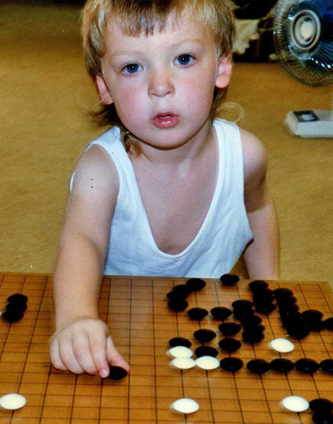
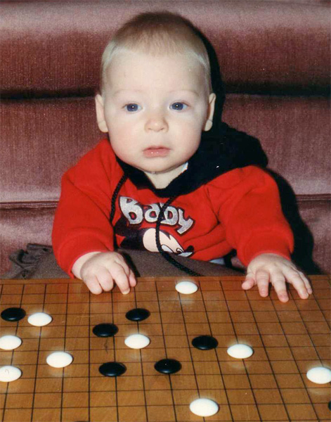
The 15 Games: Overview
They are not commercial games.
Notes:
The Games
These games were not intended to be sold. They had a very specific audience—my 2 sons.
This is a major point. By deciding up front that you have no intention of marketing or selling your game then you instantly gain complete freedom as a designer. Suddenly you no longer have to worry about time, money, and team constraints.
You don’t have to make compromises with business guys (it’s your bank account, so spend as much as want), production people (who cares if has too many pieces), or the marketing team (the game is its own advertisement).

Slide 3
The 15 Games: Overview
They are not commercial games
It’s not about the game mechanics and rules
Focus on high level design goals, the challenges, and the lessons learned
Notes:
The Games
I only have about 3 minutes to talk about each individual game, so I don’t have time to get into specific rules, details and mechanics.
Rather, the focus is on the flow of the games over time and how my design knowledge grew as my children grew.
Along the way I’ll talk about the various design goals, constraints, and challenges and how those changed as my kids (and I) matured.
But one goal was constant: Make a game that my children will want to play.
This is trickier than it seems. Kids love to play games, but the games I made were competing with an house full of toys, video games, DVDs.

Slide 4
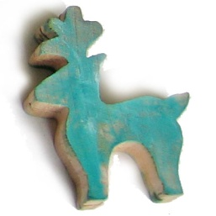
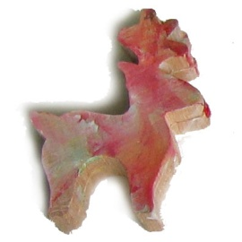
Hidden Reindeer
Year: 1995
Ages: 3 and 0
Design Goals:
Keep a 3-year old busy
Test memory and color recognition
Notes:
1: Hidden Reindeer - Goals
My wife, Toby, was setting up Christmas decorations and I was in charge of keeping Jordan entertained.
I decided to make a simple memory and color matching game.

Slide 5
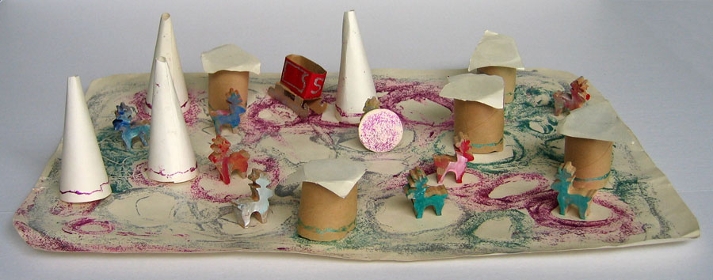
Notes:
1: Hidden Reindeer - Images
Jordan helped put this together. It started out simple enough. Three paper cones and a little wooden reindeer were used to play a version of 3-card monte. When he mastered that I started adding new pieces, rules and changing the goal. Find two reindeer. Find the red reindeer. Find the blue reindeer in the green house.
It was meant to be a disposable distraction; a way to kill some time. I didn’t think much about it until it surfaced a year later when we dragged the Christmas decorations out of the attic. Magically, this wrinkled, glitter glue covered piece of poster board had transformed into a “tradition”.

Slide 6
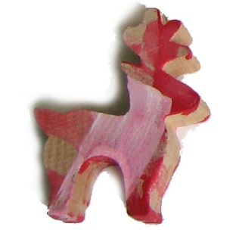
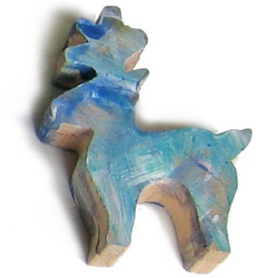
Hidden Reindeer
Year: 1995
Ages: 3 and 0
Design Lessons:
The goal of the game is unimportant
Pay attention to your audience
Change the rules and goals as needed to keep kids engaged
Notes:
1: Hidden Reindeer - Take away
For a game designer, goals have a lot of weight. Older players understand the importance of the goal and the entire play session revolves around reaching it.
But younger kids don’t care about the goal. They are focused on the play experience.
Kids are brutal critics, and if they are not enjoying something you will know it instantly. This makes them excellent testers! Pay close attention to their faces and their actions.
Since you are not shipping the game you can (and should!) change the rules and goals as needed to keep interest.
As kids mature this becomes harder to do because it goes against conventional game wisdom. Take advantage of it while you can.

Slide 7


Fishin’
Year: 1996
Ages: 4 and 1
Design Goals:
Make an “heirloom” game
Rewards dexterity, not mind-power
Notes:
2: Fishin’ – Goals
The next year I decided to make a game, wrap it up, and give it to the kids for Christmas. I wanted to make a worthy heirloom. Something that would be just as entertaining to my future grandchildren as it would be to them—an old fashioned, sturdy wooden toy.
Since the Reindeer game was a thinking game, I wanted to do the opposite and make something that required physical play.

Slide 8
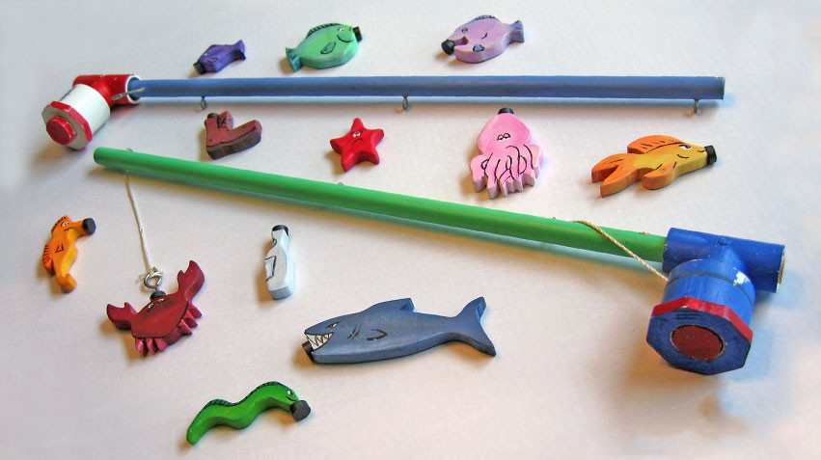
Notes:
2: Fishin’- Images
My mother loves to do woodworking, so I convinced her to cut out the shapes on her jigsaw and I painted them, glued a magnet to each one and made the fishing poles out of dowels and pieces of PVC pipe.
I think most of you understand this game without any explanation. The thing was, it wasn’t really a game in the formal sense, as there wasn’t any defined rules or goals. I think of it more as a collection of game pieces than an actual game.
But the key point here was that we could use these pieces to make lots of games. There was never an “official” way to play.

Slide 9
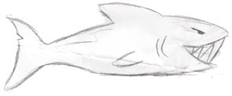
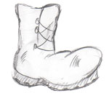
Fishin’
Year: 1996
Ages: 4 and 1
Design Lessons:
Pieces are more important than rules
Why use a game board when you can use the real world?
Engage imagination with story
Notes:
2: Fishin’ - Take away
Cool pieces make a huge difference. Even without knowing the rules you can get people interested in your game. Unfortunately, the opposite is not true. It’s hard to get people to play a game with cheap or ugly pieces without some extra “incentives” (cookies or cash, depending on their age). Sturdy pieces are the constants; the rules are the variables.
Game sessions don’t need to take place around a table. We went fishing off the bed, the couch, the bathtub (with no water).
When we played we were never catching wooden fish with a magnet. In our minds we were out on a stormy sea, or in a tropical lagoon. The settings and stories we told while we played shaped the gaming experience. Sometimes the shark piece was evil and would attack us if we accidentally hooked it. Other times we were shark hunters and our sole purpose was to capture him.

Slide 10


Alpha Zoo-tauri
Year: 1997
Ages: 5 and 2
Design Goals:
Reduce production stress
Teach alphabet and spelling
Talk about space travel
Notes:
3: Alpha Zootauri - Goals
Fishin’ was stressful and a lot of late night work, so I wanted to do another cooperative “build”, like the Hidden Reindeer game.
The kids had some flash cards, but they never used them (drills are not fun!) so I decided to make a game around them.
I also thought that this would be a good chance to talk about spaceflight and travel to other planets (for my older son).

Slide 11
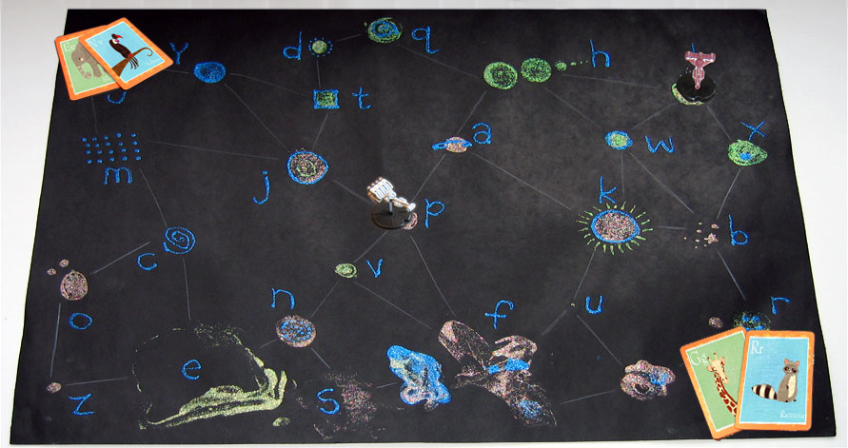
Notes:
3: Alpha Zootauri - Images
Here’s the glitter glue and poster board galaxy. The idea was to travel to each planet along the hyperlines. When you arrived at a planet you would take the flash card from the deck with the matching animal. (A for Alligator, B for Bear, etc.)
You couldn’t move your spaceship onto a planet with another spaceship, and you had to move each turn, so there was an interesting puzzle about trying to force the other player to move the wrong direction. The winner was the player with the biggest zoo when all the animals had been collected.

Slide 12
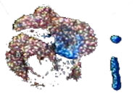

Alpha Zoo-tauri
Year: 1997
Ages: 5 and 2
Design Lessons:
Cannibalize other toys
Building the game is an educational process
Notes:
3: Alpha Zootauri - Take away
You can get high quality components by using toys and other objects found around the house. There is no need to build everything from scratch.
This game was meant to teach the alphabet and spelling, but during the construction of the game my son was involved in many of the design decisions. We were able to discuss different rules and options and why some rules were better than others. It quite possible he was learning more about game design than he was about the alphabet, animals or space travel.

Slide 13
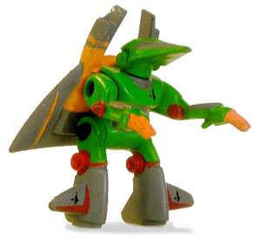
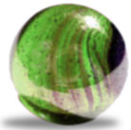
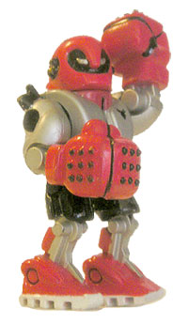
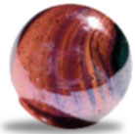
Roboball
Year: 1998
Ages: 6 and 3
Design Goals:
Use Z-Bots as pieces
A modern take on marbles
Chaos and destruction
Notes:
4: Roboball – Goals
I had a desk drawer filled with Z-Bot toys (miniature robots) that the kids liked to play with, so I decided to make a game where each player would have a robot army.
At the time I was thinking about other classic kid’s games and realized that most kids don’t get to play marbles any more. I wanted to do a modern version of marbles. Of course, knocking over robots immediately came to mind.
Dylan (my younger son) was still too young to get into strategy games, so this game would be about knocking stuff down. Any kid can relate to that!

Slide 14
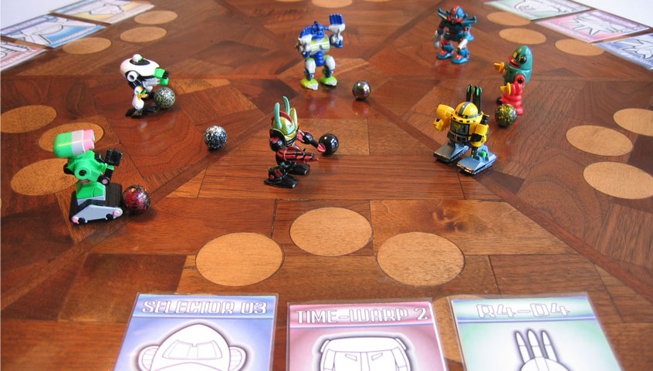
Notes:
4: Roboball - Images
The game started out as a simple “bowl over as many robots as possible”, but that got old quick. Over a series of play sessions the chaotic elements were slowly phased out (I was tired of chasing marbles across the floor) in favor of game less like bowling and more like pool.

Slide 15
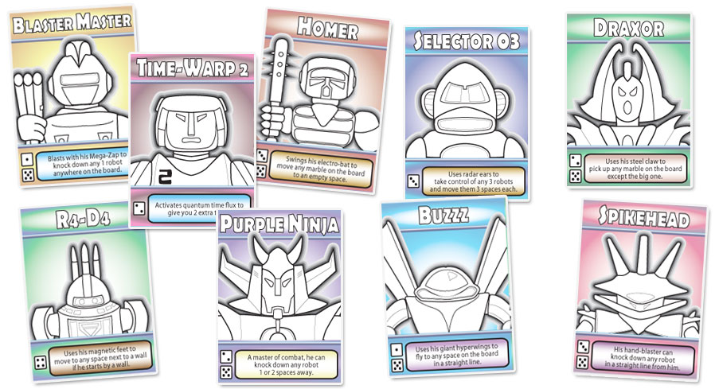
Notes:
4: Roboball - Images
No one wanted the robots with small feet on their team because they fell over too easily, so I made a set of trading cards and gave each robot a name and a special power. The smaller the feet, the stronger the power. (I was “balancing the balance”.)

Slide 16
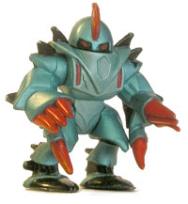

Roboball
Year: 1998
Ages: 6 and 3
Design Lessons:
Setting stuff up over and over gets boring fast
Make the rules fit your pieces, not the other way around
Give your pieces personality
Notes:
4: Roboball - Take away
Knocking stuff down is great, but setting stuff up is chore. Make sure you are spending more time playing than setting up. One trick is to make the set up part of the game play. For instance, in Roboball one robot can stand up a downed teammate if it touches it.
Get the pieces first. It is much easier to make your design match the pieces than it is to find pieces to match your design. Try to make rules that are supported by the look of the pieces. For instance, a robot with wings “flies” (moves to any space on the board), a robot with claws can “carry” marbles.
Robots that act like bowling pins don’t feel like robots. Make sure that the actions that the player takes evoke the feelings that you want them to have. Give your pieces names and a personality. Players will care about them much more and the pieces accumulate a history over the course of several games.

Slide 17
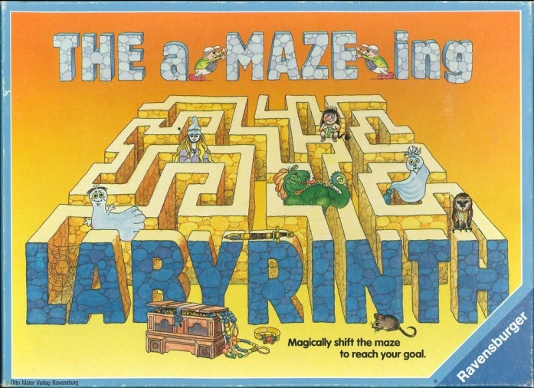
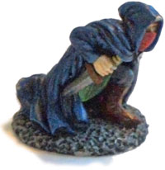
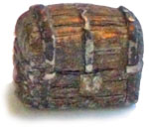
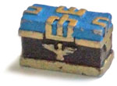
Maze
Year: 1999
Ages: 7 and 4
Design Goals:
My take on The aMAZEing Labyrinth
Play with memorable characters
Make a “non-violent” game
Notes:
5: Maze - Goals
It’s based on the board game Labyrinth , which has an amazing sliding board. But I didn’t like Labyrinth’s rules and wanted to make my own custom version.
The Roboball characters were fun to design and I wanted to advance several of the design ideas. Maze would have memorable characters with special powers that would shape the way the game played out.
My wife, Toby, was wondering why so many of my games were about fighting and destroying things. I tried to explain to her that conflict and competition are necessary parts of any game. She challenged me with the statement, “Well, if you really were a good game designer you could make a fun non-violent game.” Of course, after that I didn’t really have a choice.

Slide 18
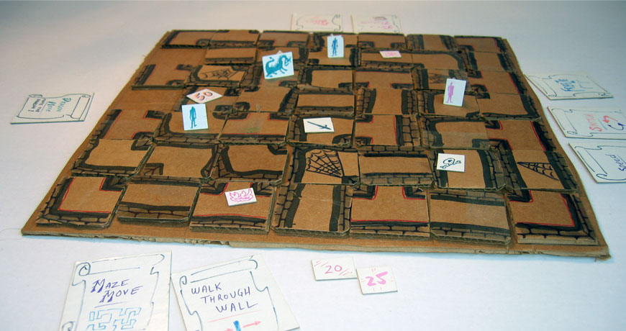
Notes:
5: Maze - Images
Early cardboard prototype
This is the first version that made out of an old cardboard box and some magic markers. The tiles didn’t slide well and the game was basically unplayable.

Slide 19
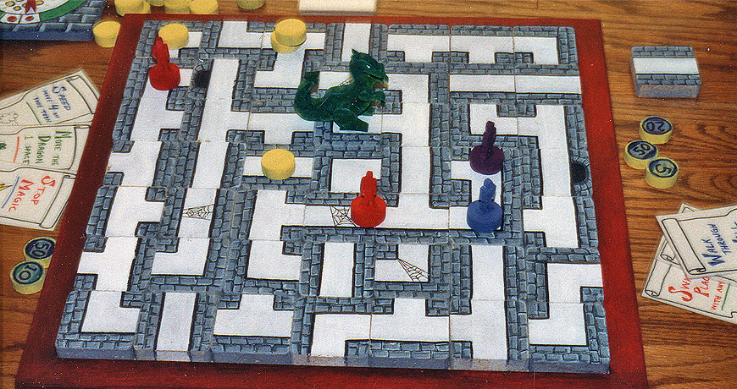
Notes:
5: Maze - Images
Wood version
I borrowed my parents’ workshop when I was visiting for Christmas and cranked out a wooden version working late at night, right up until Christmas morning. There were no rules at this point; only a bunch of pieces. But after Christmas we played around with it and eventually came up with a solid game.

Slide 20
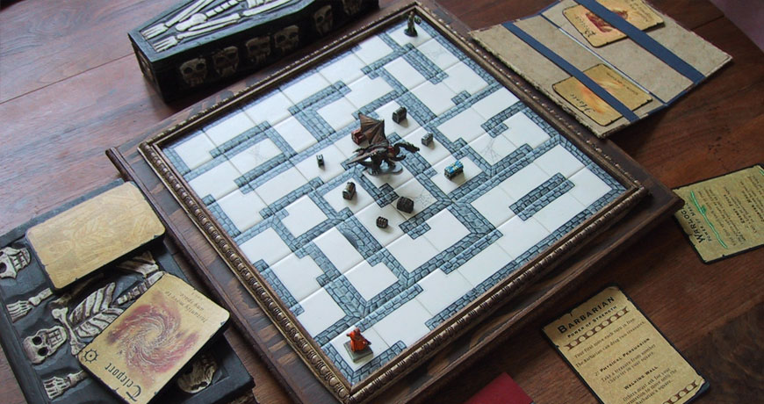
Notes:
5: Maze - Images
Final version
Here are the current board and pieces. It is made out of wood and tile and hand-painted miniatures. This is about 5 years worth of work and iteration. I still have some ideas about how to make it better so who knows what it will look like 5 years from now.

Slide 21
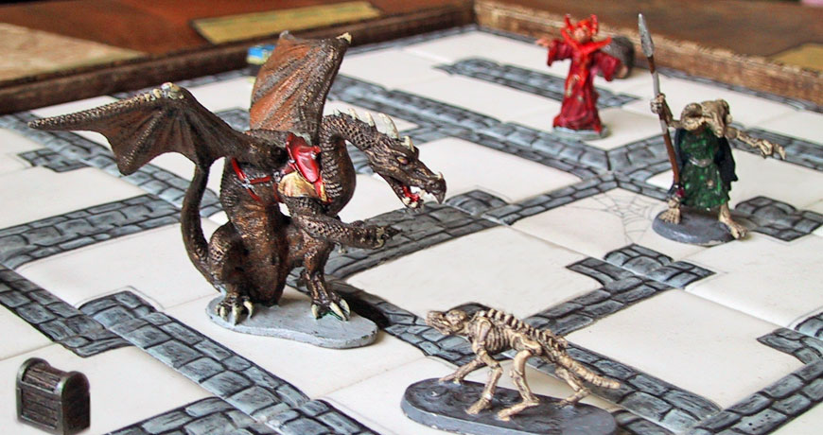
Notes:
5: Maze - Images
Final version (detail)
The goal of the game is to move your character around the sliding maze while trying to collect treasures and avoid the dragon. Each character has a unique ability. For I
instance, the Necromancer can summon demon dogs and the Sorceress can cast powerful spells.
There are no battles in Maze. Characters don’t have hit points and there no attack and defense stats. It is purely a race for treasure.

Slide 22
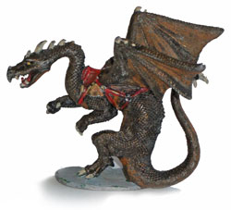
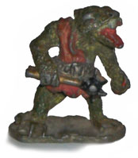
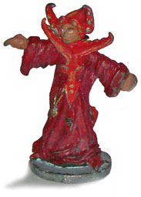
Maze
Year: 1999
Ages: 7 and 4
Design Lessons:
Iterate for years…maybe forever
Characters are excellent expansion opportunities
Let the players decide which rules they want to use
Notes:
5: Maze - Take away
Your game doesn’t need to be finished…ever. If you are not under any pressure to ship then there is no reason to say you are done. It takes time and iteration to hone a game. Each time people play your games you will find at least one more thing that you would like to change. Does it take too long? Can a confusing rule be simplified? Are the icons on the cards legible? Don’t be rushed. Fix them at your convenience and play again.
The basic rules of the game are very simple, and no updates have been made to them in a long time. But the characters are constantly being reworked and new ones added. It’s wonderful to work with other designers and brainstorm new characters and powers. For instance, I recently found a cool Reptile Man figure in my closet and immediately started making his Maze powers.
One of the reasons for the longevity of this game is that each character is a modular rule component. The characters (and their rules) can be inserted into the game in any combination and the game will play out differently depending on the combination. As the designer, you often have to pick the one “right” rule out of many worthy options. But with a modular design you can add rules in chunks then let the players pick the ones they like best. For instance, I was frustrated that some players took too long to make their moves, so I made a new character called the Witch. Her special power was that she had a 30-second sand timer. When it ran out of sand it signaled the end of an opponent’s turn. I always pick the Witch when I play against a slow thinking player.

Slide 23

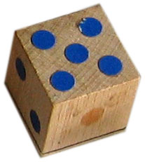
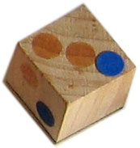
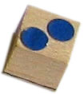
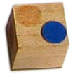
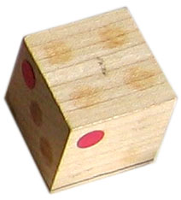
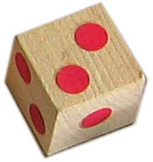
Junkyard Bots
Year: 2000
Ages: 8 and 5
Design Goals:
Only use dice
Modular character design
Fast turns with no downtime
Add a “non-violent” option
Notes:
6: Junkyard Bots - Goals
After Maze, I did not want to build another elaborate board with realistic pieces. I thought a dice game would be simple. I gave myself the constraint that I could only use dice. There would be no board or cards.
I wanted to explore the idea of modular character design and break it down even more. What if instead of modular characters, like the pieces in Maze, there would be modular pieces that the player assembled together. Essentially, the players are building their own personal characters out of small parts. Robots were a natural fit for this idea.
The kids were now old enough that we could gather around a table and play games together. But 4-player games can drag on for a long time if the players are taking too long to take their turns. I knew that this game needed to have turns that lasted under 1 minute each and that when it wasn’t your turn you still had something to do.
I was happy with Maze’s combat-free approach, but I a game featuring customized robots has to have missiles and explosions, too. I decided to put the decision about whether to fight or not into the players’ hands. You could build a death machine or a fast collector, depending on your play style.

Slide 24
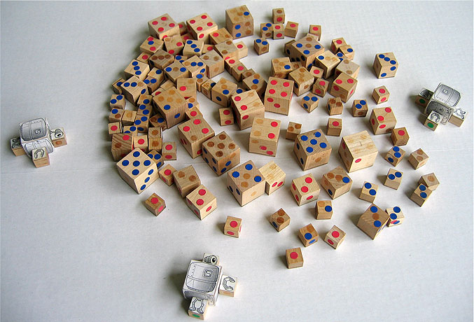
Notes:
6: Junkyard Bots - Images
The dice are placed in a “junkyard” in the middle of the table so that the players can’t see what the parts. Each turn they can either look at part (using the robot’s eyes), pick up and equip a part that they have previously looked at (using the robot’s claws) or attack (if they have a bomb). If a robot has a mouth then it can eat energy cubes. A “battle” victory goes to the last robot standing. A “peaceful” victory goes to the robot who eats enough energy to teleport off the planet to an orbiting space cruiser.

Slide 25
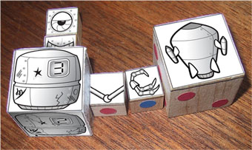
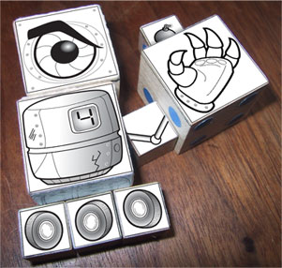
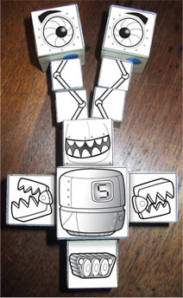
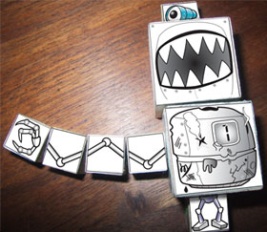
Notes:
6: Junkyard Bots - Images
There is no right or wrong way to build a robot. Players have complete freedom to change the look as desired. As far as the actual game is concerned, there is no real reason to even make a robot out of your dice. But it’s hard to resist.

Slide 26
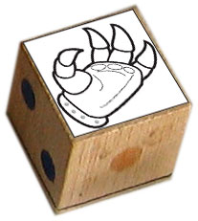
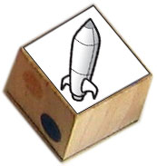
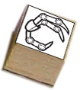
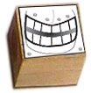
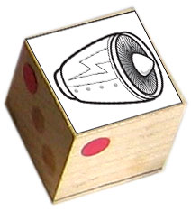
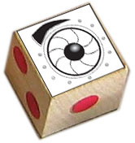
Junkyard Bots
Year: 2000
Ages: 8 and 5
Design Lessons:
Give the player something to fiddle with when it is not his or her turn
You can have two victory conditions
Notes:
6: Junkyard Bots - Take away
When you work on a game a lot of design effort is spent on determining the optimal turn sequence for the active player. But what about the non-active players? Think about them, too. Texture and weight are key! We are spend so much of our lives touching cold hard surfaces like plastic and glass. Use warm, inviting materials like wood and thick textured papers. Video games will always have better sound and graphics than your board game, but they can’t simulate the sensation of touch. Compel the player to touch your game.
Why have just one victory condition? For Junkyard Bots I had two goals; there was a violent and a non-violent way to win. As you are working on your board game think about the types of players that are in your play group and their personalities. Would your game be more interesting to them if it had multiple routes to victory?

Slide 27


Year: 2001
Ages: 9 and 6
Design Goals:
Make a game with the mighty Kongzilla!
Lasers!
Asymmetric rules and goals!
Notes:
7: Kongzilla - Goals
I saw the Kongzilla statue in the comic book store and I knew I had to make a game with him as the star. He cost around $100 so I promised myself I couldn’t buy it unless I had the game design all worked out first.
It takes an army to bring down Kongzilla. Each side has a unique goal and completely different set of rules. In many ways the players are not even playing the same game.
I had been looking for an excuse to make a game with lasers, and this project was a natural fit.

Slide 28
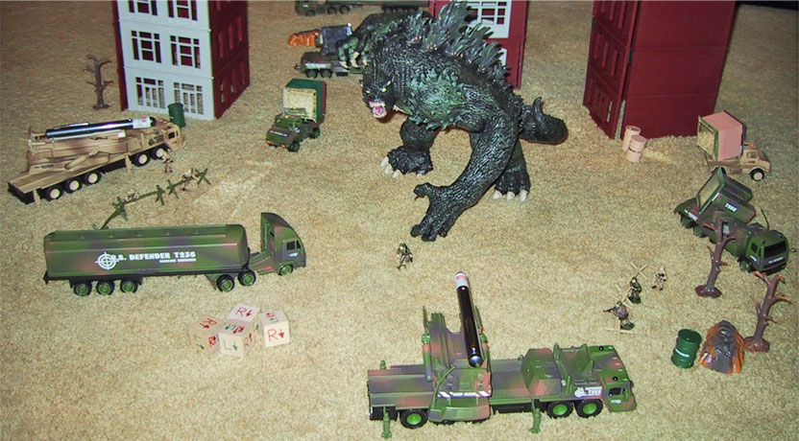
Notes:
7: Kongzilla - Images
One player controls Kongzilla and attempts to knock down three buildings. The other player controls the army and tries to bounce lasers off of mirrors and into Kongzilla’s head. Three hits and he is out! (Shoot the laser into his mouth for an instant victory!) It’s kind of like playing pool.
There is no board. You can play the game anywhere.

Slide 29
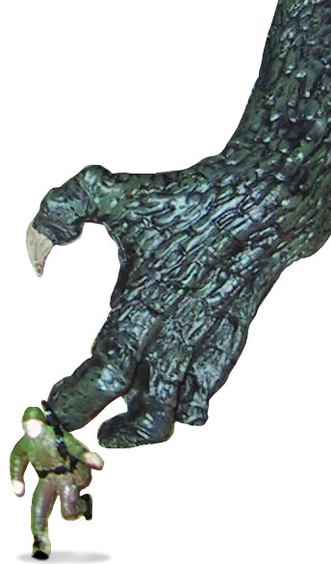
Year: 2001
Ages: 9 and 6
Design Lessons:
Bigger is better…up to a point
Who needs numbers?
Notes:
7: Kongzilla - Take away
Kongzilla is an impressive game to look at, but it is too wieldy to play regularly. You have to clear off a large space on the floor, set up the buildings, find batteries for the lasers, etc. It is a bad choice for a party game because it dominates a large area and is somewhat fragile.
I have played far too many number-heavy battle games. (If you are an avid board gamer you probably have a closet full of them.) In Kongzilla, I managed to remove all the charts, odds tables, and movement/attack/defense stats that are typically associated with this type of game. Every time you make your players refer to a chart or do calculations then they are taken out of the game. Keep your players in the game at all times!

Slide 30


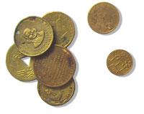

Year: 2002
Ages: 10 and 7
Design Goals:
Convert Diablo into a card game
Try to capture the social and story aspects of a role-playing game without a game master
Notes:
8: Monster Hunter - Goals
Toby didn’t think it was a good idea to have the kids play (or even watch me play) Diablo II. This game was my attempt at converting Diablo II into a card game so that the kids could play it with me. (It wasn’t based on the video game Monster Hunter, which didn’t come out until 2004.)
I used to play a lot of RPGs when I was younger and wanted to relive some of those moments. I wanted the players to act in character. But I didn’t want a game master running everything. The deck of cards would act like the GM, doling out monsters, treasures and encounters.

Slide 31

Notes:
8: Monster Hunter - Images
The first step was to make the cards. I spent about an hour sketching as fast as I could to get a collection of 100 monsters, weapons and characters. The basic concepts were all fleshed out at this stage.

Slide 32

Notes:
8: Monster Hunter - Images
When I was comfortable with the game I made the final templates and decorated them with illustrations from the D&D Monster Manual. (Another advantage of not trying to commercial your game is that you don’t need to fear copyright lawyers.)

Slide 33

Notes:
8: Monster Hunter - Images
The final game feels a lot like Diablo (or any other fantasy RPG) but plays out in 3 hours instead of several weeks. Players start out by fighting rats and the winner is the first to kill the dragon. Like Maze, there is no player vs. player combat. Players are free to cooperate or go solo, depending on their personality.

Slide 34



Monster Hunter
Year: 2002
Ages: 10 and 7
Design Lessons:
Use Excel
You can get a job in the video game industry by making a card game!
Notes:
8: Monster Hunter - Take away
There are hundreds of cards in Monster Hunter, and the game lasts three or more hours. There are five hero types each with their own set of 6 unique powers. This game would have been impossible to balance without Excel and a lot of time spent calculating probabilities and studying graphs.
Up until this point in my career I was working as a graphics programmer at a software company. When I took the game in to show it to some folks at Blizzard they played it with me and suggested I work there.
If you are currently a student or someone who is not already in the industry then making your own games is one way to prove that you have what it takes to be a game designer. I’m not sure how it is at other studios, but when a designer interviews at Maxis we are thrilled if he shows a card or board game in his portfolio.

Slide 35






Hyperline
Year: 2003
Ages: 11 and 8
Design Goals:
Convert Masters of Orion into a board game
No numbers!
The pieces had to fit in a small box
Notes:
9: Hyperline - Goals
My son desperately wanted the video game Masters of Orion 3 for Christmas, but unfortunately it was delayed. I decided to make him a board game version as a substitute. I figured that if I could do it for Diablo then I could do it for MoO, too.
Masters of Orion is filled with numbers. In fact, many gamers say that playing the game feels like playing a spreadsheet. I didn’t want any of that. My goal was to capture the 4x feel (explore, expand, exploit and exterminate) without using any numbers.
A friend from Blizzard gave me a small, futuristic-looking plastic box and said, “Maybe you can use this for one of your games.” Most of my games don’t transport well, so this was going to be a game that could easily be carried to a party. I put a constraint on myself that I couldn’t make more pieces than would fit in that box.

Slide 36







Notes:
9: Hyperline - Images
Players start out in the corners and attempt to reach the center to research Nexxus. Like a lot of my games for the family it is possible to achieve this goal without fighting. Each turn you explore the galaxy looking for technology on planets. As you gather technology your ship grows. The game plays out differently depending on your ship configuration. You can choose to focus on weapons, shields, engines or scanners.

Slide 37


Notes:
9: Hyperline - Images
Close up of good ship and damaged ship
Building ships is similar to building robots in Junkyard Bots.
In order to get rid of the numbers normally associated with games of this type I made all the components have two sides. When you take damage you flip the piece over. When you repair it you flip it back again.

Slide 38




Hyperline
Year: 2003
Ages: 11 and 8
Design Lessons:
Cannibalize other games
Keep the game going forward: Reward, don’t punish
Notes:
9: Hyperline - Take away
I tried cutting my own perfectly square tiles and failed repeatedly. I needed a way to manufacture perfect squares that were all exactly the same size. Eventually I realized that the people that make the board game Carcassonne had already done the work for me. I printed out my tiles on sticker paper and stuck them onto the Carcassonne tiles.
Early versions of the game had much harsher combat rules and you could permanently destroy a ship’s parts. Losing parts early in the game was equivalent to losing the entire game. After a few frustrating play tests the rules were softened so that you could only temporarily damage parts. A lot of designers insist on punishing the player, but I recommend focusing on the rewards. What rules are in place in your games that make players lose ground? Try to find ways to keep everything moving forward.

Slide 39




Spellbind
Year: 2004
Ages: 12 and 9
Design Goals:
Keep the kids occupied on their daily trip to school
Make a self-contained car-friendly game
Notes:
10: Spellbind - Goals
As my boys grew they do what brothers always do: fight. It seemed like every morning on the way to school they would find a way to annoy each other. My goal was to give them something to do during that 10 minute car ride.
I remembered those old Bingo car games from when I was a kid and wanted to make something similar. The game had to be completely self-contained with no parts to lose. It had to have a “save system” so that it could be stopped at any point in time—I didn’t want to hear, “We can’t get out of the car because we haven’t finished our game yet”—and restarted at the same point in future, no matter how much time had elapsed.

Slide 40

Notes:
10: Spellbind – Bingo Cards

Slide 41


Notes:
10: Spellbind - Images
Each player gets one card and starts with 5 life and 0 power. The goal of the game is to either reduce your opponent’s life to 0 (the “battle” victory) or increase your own power to 5 (the “peaceful” victory).
Simultaneously, both players pick a spell in secret by spinning the spell wheel. Cards are revealed at the same time (like rock-paper-scissors) and the spells are executed. You can blast your enemy to reduce their life, summon a monster that will attack every turn (unless blocked by the enemy’s monster), power yourself up, or “bind” the other player by sliding down a red plastic window over the spell of your choice.

Slide 42


Notes:
10: Spellbind - Images
Monsters slide out of the top and will attack the opponent unless it is blocked by another monster.

Slide 43



Spellbind
Year: 2004
Ages: 12 and 9
Design Lessons:
Go beyond Rock–Paper-Scissors
Break symmetry and give the players unique powers
Notes:
10: Spellbind - Take away
The first version of Spellbind was just like rock-paper-scissors, but with 8 choices instead of 3. It felt incredibly random and there was no sense of satisfaction when you won. Avoid Rock-Scissors-Paper style balancing in your games. A perfectly balanced game makes all decisions random and ultimately meaningless. Make different options have different weights that vary over the course of the game. This keeps the players engaged as they re-evaluate the situation each turn.
After a few days Spellbind was getting too repetitive and I was sad that I had spent more time making the cards then the kids actually spent playing the game. The solution was to break the symmetry and give each player a unique power. There were 4 to choose from: a blast master, a power master, a summoning master and a bind master. Just by creating 4 special powers there were suddenly 16 different combinations to try out. Pay close attention when your players discuss the age old question, “Which power is the best”. Tune accordingly.

Slide 44


Fridge
Year: 2005
Ages: 13 and 10
Design Goals:
Create a game that is always active and can be played at any time
Use a refrigerator as a game board
Make an abstract strategy game
Notes:
11: Fridge - Goals
It was getting harder to get us all together at the same time to play a game. Someone always had something to do: meetings, soccer, piano lessons, homework, etc. I thought it would be interesting to see if I could make a game that could be played over a long time by whoever happened to be near it, even if no one else was around to watch the move.
This is the opposite approach of many of my other games with fast turns. This game could have turns that last days.
The refrigerator turned out to be an ideal surface. It was always available in a central room, but wouldn’t be in the way. I knew that I would need a lot of magnets to make this work.
I was tired of high production games and this one was going to be abstract and simple. Nothing complicated or tricky, but it needed to have a lot of depth.

Slide 45






























Notes:
11: Fridge- Images
The goal of the game is to connect your main base to as many other bases as possible. You can go over other trails by stacking magnets up and taking your sticks to “the next level”. But you only have a limited number of magnets, so you have to use them wisely.
One thing I love about this game is that it makes a piece of abstract art on the refrigerator. We experimented with several different base configurations in attempt to make better art pieces.

Slide 46

Fridge
Year: 2005
Ages: 13 and 10
Design Lessons:
Long turns are fine, if the players aren’t bored while they wait
Challenge conventional game design wisdom and see where it leads
Notes:
11: Fridge - Take away
Its OK to have long turns if no one is waiting for you. In fact, it means your game can have deep strategy. In Fridge the players have to manage magnets and stick sizes, while also trying to predict where the other players are heading. Since the game has no grids or movement guides it is hard to visualize distances and angles. Fortunately, since the game was designed for long turns you have all the time you need for planning. You can play around with the pieces and explore several moves in advance. This could never happen with a traditional board game.
Most games are meant to be played together for a relatively short amount of time. So how does the design change when you try to make a game where it is to your advantage to make a move when no one is around and the game lasts weeks? Push yourself as a designer by messing with conventional approaches and see where it leads.

Slide 47





Nanobots
Year: 2006
Ages: 14 and 11
Design Goals:
Convert Spore’s cell stage into a board game
Make a 3-player game
Fast combat with no randomness
Notes:
12: Nanobots - Goals
I was working on Spore at this time and was doing the design work for the Cell Stage. I had made some paper prototypes of the game (see my 2009 talk for details) and wanted to convert some of my ideas from the computer game into a full-fledged board game.
Most of my games are designed for 4 players so that the whole family can join in. Around this time I was having a talk with another designer about how most games don’t work well with three players and I decided to add in the constraint that this game could only be played with 3 players. The idea was to build a game that could only be played with 3 players.
Since the Cell Stage of Spore is an arcade experience, I wanted this game to have fast action. I also wanted no randomness. Dylan was playing a lot of chess at this time and I was trying to capture the feel of speed chess. But I felt it would be cheating to use a timer, so I was going to try solve the problem by making the decision space small.

Slide 48

Notes:
12: Nanobots - Images
So, by now you are probably recognizing this design pattern. The players make their own nanobots by combining parts together in different configurations. The direction and facing of the part matters. Nanobots have to eat food pellets in order to grow parts. The winner is the first player to grow their nanobot to have 4 segments. The trick is to stay small for as long as possible because of the speed and maneuverability bonuses, and then grow large as quickly as possible.

Slide 49



Notes:
12: Nanobots - Images
[Detail of pieces]
The pieces are wood and metal and were all milled at a friend’s garage. It took many attempts to come up with a way to lock the pieces together, but I’m really happy with the solidity of the final pieces.

Slide 50




Nanobots
Year: 2006
Ages: 14 and 11
Design Lessons:
No randomness = slow game
Use your board game as a pitch for a video game
Notes:
12: Nanobots - Take away
I failed on the goal of fast action. The game could easily take two or more hours to play out. I kept simplifying the rules but I couldn’t get rid of analysis paralysis. Is it possible to make a fast action game with no randomness and no timer? At least for now I have given up on the idea.
Nanobots started out as a conversion of the Cell Stage of Spore. 4 years later, I had the opportunity to make a pitch for an Xbox Live Arcade game. I used Nanobots as an example of the game I would like to make. It was selected and eventually became the arcade game MicroBot. Finally, I was able to make the fast action I had been trying to make all along!

Slide 51


Notes:
12: Nanobots - MicroBot
This is the Xbox Live and PSN game, MicroBot. You can build your own robots and control their movement, attack and defense powers.

Slide 52



W.Z.D.
Year: 2007
Ages: 15 and 12
Design Goals:
How do I compete with video games?
A box filled to the top with zombies…
…that get destroyed by giant robots!
It had to play fast
Notes:
13: W.Z.D. - Goals
Both of my kids were now playing video games all the time. Given the choice between a video game and a board game they would almost always choose to sit around the TV than the kitchen table. I wondered, when they open their game this Christmas will they be excited to play it? What could I possibly create that could be better than Tony Hawk, Master Chief or Mario?
After a few days of thought I knew I had my answer: zombies vs. robots! My kids had a collection of about 10 zombies from the board game Heroscape. I thought it would be great to fill a box with 100 zombies. When they opened it up on Christmas morning there would be no way that they could resist playing this board game.
After the unintended slow pace of Nanobots, I knew I had to focus on speed right from the beginning. I didn’t want anyone to wait around for their turn. This wasn’t a strategy game, it was going to be an explosive game of carnage.

Slide 53

Notes:
13: W.Z.D. – Images
W.Z.D. stands for Weapons of Zombie Destruction. The fiction is that zombies have invaded the earth and a small group of research scientists are holed up underground trying to build a high tech robot that can go back to the surface and make the planet safe for humanity. From time to time the scientists open the doors and let zombies into the lab to see whose robot is the best.
Each turn the players simultaneously add a programming card to their robot and then watch what happens. Cards either cause the robot to move, turn or attack. The game is similar to the game Robo Rally, but plays out much faster (and your killing zombies instead of racing around a factory!). During the “slow” part of the game—where you have to make a decision about which card to play—all the players are thinking at the same time. During the resolution phase there are no decisions to make. The robot blindly follows its program…for better or worse.
When the 100th zombie has been killed then the game is over. The winner is the player that killed the most zombies.

Slide 54



Notes:
13: W.Z.D. – Images
Detail of pieces

Slide 55

Notes:
13: W.Z.D. – Images
Later on, I found a place that could custom cut and etch acrylic, so I had a new board made and replaced the printed paper board.

Slide 56




W.Z.D.
Year: 2007
Ages: 15 and 12
Design Lessons:
Reduce downtime by making all the
players plan at the same time
What is the player’s role in the game world?
Notes:
13: W.Z.D. - Take away
If there is a point in your game where lengthy decisions need to be made then have all the players do it simultaneously. We also added another rule that when all but one of the players are finished then they start counting down from 5. (“5…4…3…2…1…0”). If they get to 0 then the slow player doesn’t get to place a card and the game immediately advances to the execution phase.
In W.Z.D. the player isn’t a robot, but a “robot scientist” sitting in a booth above the board programming the robot remotely. If the player was the supposed to be a robot on the board then he would demand more direct control. As an example, suppose the robot walks into a wall instead of attacking a nearby zombie. If the player is a scientist then the action can be explained as a “programming error”. If the player is supposed to be “inside” the robot then he would say things like, “Why did I do that? I can see the zombie so I should be able to attack it.”
As a designer, one of your primary goals is to immerse the players in your game world. When you are trying to decide on which rules are best for your game, favor the rules that keep them in that world. Ask yourself, “Who is the player in this world? How should they feel? How can the rules make the player feel the way that you want?”

Slide 57




Soccer Bots
Year: 2008
Ages: 16 and 13
Design Goals:
Fix Nanobots’s speed problem
Laser-cut pieces
Sports game, not a battle game
Notes:
14: Soccer Bots - Goals
Nanobots never got a lot of play, primarily because it took too long to play. Now, armed with the knowledge that I gained from W.Z.D. I vowed to solve that problem and rebuild the game so that it could be played in under 30 minutes.
I will never hand mill individual parts for a game again (once was enough) so I started experimenting with laser cutting. The plan was to cut a collection of robot parts out of plastic that would snap together.
I was a bit burned out on weapons and combat after W.Z.D. and wanted to switch gears and make a goal scoring sports game. Both Toby and Dylan play soccer, so it was a natural theme for the game and one that I thought the family would appreciate.

Slide 58





Notes:
14: Soccer Bots – Images
This is the what the file looks like that I send off to Ponoko for laser cutting.

Slide 59

Notes:
14: Soccer Bots – Images
Each player makes a team of 4 bots out of a collection of plastic parts. There are three primary systems: movement, claws (for carrying the ball), and shooters (for launching the ball across the arena). You get to decide your team’s composition and strategy. One player might favor speed, while the other favors shooting.
Each turn you only have 30 seconds to move as many of your bots as you can. Once you are done moving a bot you can no longer move it again that turn.

Slide 60

Notes:
14: Soccer Bots – Images
[Detail of pieces]
Players can easily tune the length of the game by changing the number of goals needed to win. The game has a frantic pace and I did manage to capture the feel of speed chess.

Slide 61

Soccer Bots
Year: 2008
Ages: 16 and 13
Design Lessons:
It is now possible to make pieces to match your rules instead of making rules to match the pieces
If you really want to control the length of a turn then use a timer
Notes:
14: Soccer Bots - Take away
I finally broke down and put a chess timer into the game to control the tempo. At first I felt bad about it, because I always consider timers to be a design cop out. But the more I played the more liked it. The reason it worked was because it helped make the player feel like they were participating in a sports game, which was the feeling that I wanted the player to feel. Sports and timers go together quite nicely.
I’ve always been a firm believer of “get your pieces first, make your rules second”, but I can see that restriction going away as it becomes easier to custom create the exact pieces that I need. I still can’t get a high level of detail, but that day might not be far off.

Slide 62




Swords
Year: 2009
Ages: 17 and 14
Design Goals:
Create a speed version of Monster Hunter
Use Ben Boos’ awesome art
Notes:
15: Swords - Goals
Looking back on all my games, I think Monster Hunter is one that the whole family enjoys playing the most. We frequently talk about starting up a game but can never quite find the time to make it happen. After successfully speeding up Nanobots I thought it would be interesting to make a 20 minute version of Monster Hunter.
A friend of mine from Blizzard, Ben Boos, had just finished a book called Swords and it was filled with awesome artwork. I asked him if I could make a game using his art and he agreed.

Slide 63

Notes:
15: Swords - Goals
Ben’s book.

Slide 64

Notes:
15: Swords – Images
The overall concept of Swords is similar to Monster Hunter. Place some random monsters down on the table and try to be the first player to kill them and get take the gold.

Slide 65

Notes:
15: Swords – Images
[Detail of pieces]
The main difference is that instead of controlling one hero, the player controls an army of meeples. When you kill a monster you get gold which lets you buy a sword. Each sword has a special power. For instance, the black sword is for the Thief, which has the power to steal gold even if the monster is still alive. The green sword is for the Scout, who can attack first. There is also a warrior, a necromancer, and a wizard.
The gimmick in this game is that there are no dice. Instead you roll your army whenever you attack. Heroes on their feet do double damage, while heroes on their heads die.

Slide 66





Swords
Year: 2009
Ages: 17 and 14
Design Lessons:
Look outside your game’s domain for fresh ideas and mechanics
Dynamic in-game balancing
Notes:
15: Swords - Take away
As I was trying to figure out how to keep game play fast I looked at gambling games. It’s not the obvious choice since Swords is about magic and monsters in medieval times. Specifically, I wanted the game to feel like Craps where everyone is active and socializing while the turn is happening.
There are about 100 monster cards in Swords and each one has a unique ability. It would have been a nightmare to try to balance them all. Instead, I borrowed a trick from the board game Puerto Rico. Each turn, every monster on the table gets one gold coin added to its bounty. When you kill a monster you get all of its gold. Monsters that are too strong tend to stay in play for several turns and get increasingly larger bounties. At some point, the potential reward outweighs the risk and the players gang up and start attacking it.

Slide 67



1001 Words
Year: 2010
Ages: 18 and 15
Design Goals:
Make a party game
No magic, weapons or robots!
Compete against Words with Friends
Notes:
16: 1001 Words – Goals
If you’ve been keeping track, then you’ll realize that this is the 16th game. The submission deadline for GDC 2011 talks is in Oct. 2010, so between then and now I made another game. (I didn’t want to deal with the process of changing of my talk.)
Toby asked me to make a light-hearted party game and I thought I’d give it a try since it was a lot different than other games I had worked on.
I was burned out on fantasy and sci-fi themes, so this would give me the opportunity to try a new theme.
Toby broke her ankle in Oct. and ended up playing a lot of iPad games. She got hooked on Words with Friends so I decided to try to make a word game.

Slide 68

Notes:
16: 1001– Images
[Detail of pieces]
A friend a work, Kate Compton, had access to a laser cutter and she helped me mass produce wooden word tiles. I didn’t know what the rules to the game would be, but I figured that if I couldn’t make a game out of 1001 word tiles then I wasn’t qualified to be a game designer.

Slide 69

Notes:
16: 1001– Images
[Board]
This is still a work in progress, but here is the current version. The goal is to get your partner to guess a word from your rack by using words on board as clues. As you connect up words you score points. As the game progresses the options become more and more constrained.

Slide 70



1001 Words
Year: 2010
Ages: 18 and 15
Design Lesson:
It’s good to have a friend with a laser cutter.
Notes:
16: 1001 Words - Take away
‘Nuff said.

Slide 71
What’s Next?
Year: 20xx
Ages: ? and ?
I’m losing my “captive” audience
Notes:
What’s Next?
Jordan has already moved out of the house and into a college dorm. Dylan is swamped with homework and soccer practice. Maybe I can take a break until I have grandchildren?

Slide 72


What’s Next?
Year: 20xx
Ages: ? and ?
Notes:
What’s Next?
[Kid photos]

Slide 73
What’s Next?
Year: 20xx
Ages: ? and ?
I’m losing my “captive” audience
Technology keeps advancing
Video games vs. board games
Notes:
What’s Next?
My early games used hand-cut wood and paint. My most recent games use laser-cut plastic and color printing. As technology continues to improve the possibility to create amazing game boards and pieces is staggering.
Looking back at the trends in my games it is clear that I have been trying to bring a lot of the immediacy of video games into the field of board games. Keep everyone engaged. No waiting. Go faster. Also, I’m continually pushing the production quality in order to compete with the virtual worlds that are created for video games. Maybe I should just give up on board games and make video games instead… (Oh wait, that’s my day job).

Slide 74
Conclusion
Make your own personal games
Think small
Think long term
Challenge yourself
Notes:
Conclusion
It is difficult to wrap this whole talk up with one nice summary. It was hard enough to compress 15 years of work down to a one hour talk, let alone a few bullet points. But I’ll try…
Most importantly, I hope this talk will inspire many of you to go home and start working on your own personal games. If you do, here are three pieces of advice to keep in mind:
Think small. Our industry is focused on making entertainment for the masses. We get big teams together and spend millions of dollars in an attempt to entertain millions of people. What about the 3 people closest to you? Can you make a game just for them? The answer is “Yes!” And you can do it for under $20.
Time is on your side. If you work in this industry then your life is already filled with deadlines. You don’t need another one. Take your time and work on your game when you are inspired. Iterate and improve your game in small steps over long periods of time. Like I mentioned earlier, there is no real reason to declare that your game is “done”.
You will only grow as a designer if you keep pushing your boundaries. Try to do things you’ve never done before. In your work environment it can be difficult to convince the team to spend money and time to try new things. After all, you may fail. But if you are working on your own personal projects then you might as well try something new and risky. What is the consequence of failing in that case? Not much. Each failure is a new opportunity for you to grow as a designer.

Slide 75
Thank you!
www.stonetronix.com
Notes:
Thank You

