Slide 1
Paper Simulations of Digital Games
Stone Librande
Creative Director, EA/Maxis
Notes:
The Games
These games were not intended to be sold. They had a very specific audience—my 2 sons.
This is a major point. By deciding up front that you have no intention of marketing or selling your game then you instantly gain complete freedom as a designer. Suddenly you no longer have to worry about time, money, and team constraints.
You don’t have to make compromises with business guys (it’s your bank account, so spend as much as want), production people (who cares if has too many pieces), or the marketing team (the game is its own advertisement).

Slide 2
Take a digital game…

Slide 3
…remove the controller…

Slide 4
…remove the controller…

Slide 5
…the sound and music…

Slide 6
…the sound and music…

Slide 7
…and the graphics

Slide 8
…and the graphics

Slide 9
What’s left?

Slide 11
Exercise #2
Simulate a video game using only pencils, index cards and dice.
Use it as a tool to help understand the game’s fundamental design principles.
Don’t sweat the details.

Slide 12
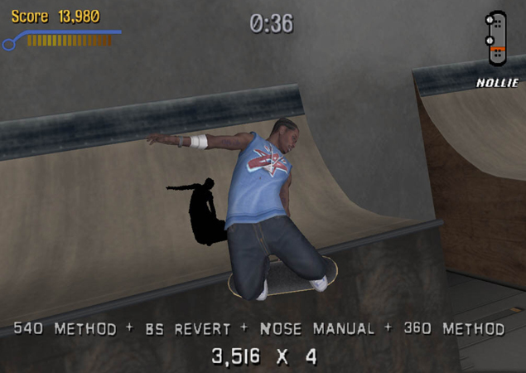
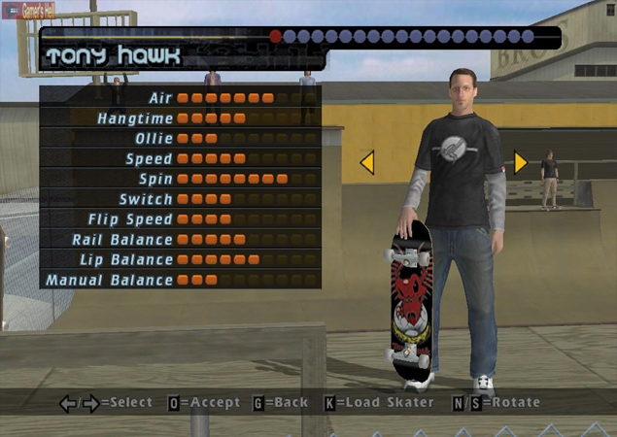
Example Game
Tony Hawk’s Pro Skater

Slide 13
Example Game
Tony Hawk’s Pro Skater

Slide 14
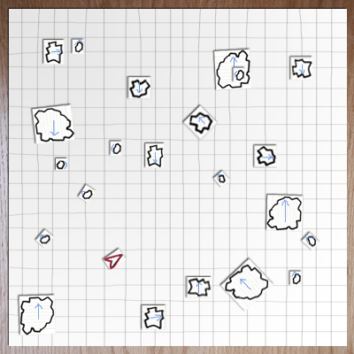
Asteroids

Slide 15
Asteroids

Slide 16
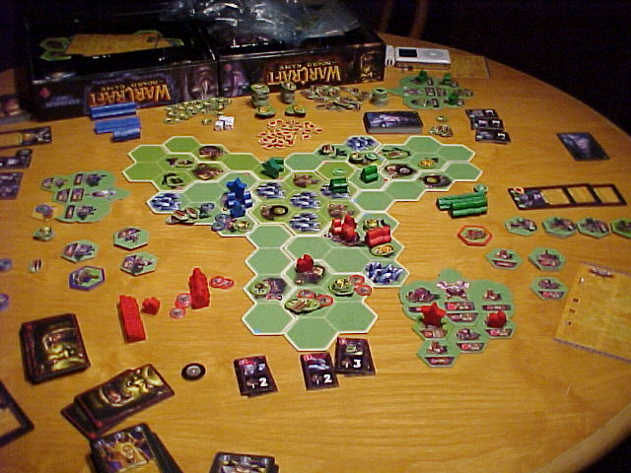
Warcraft
The Board Game

Slide 17
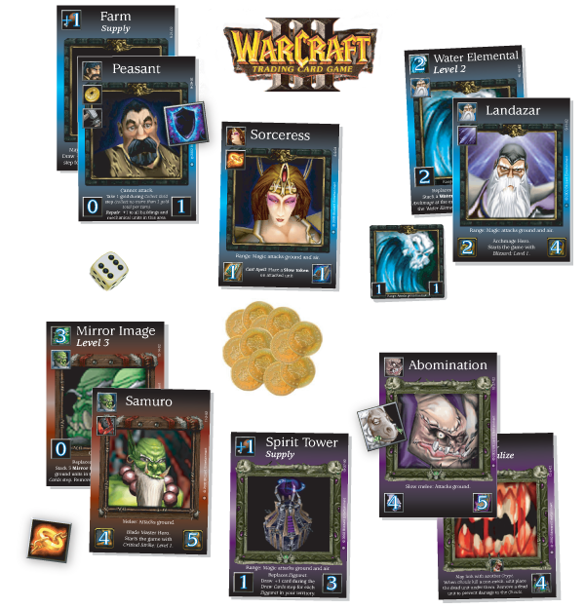
Warcraft
The Card Game
Notes:
Diablo card game
Kill monsters, get treasure, buy better stuff, kill bigger monsters, get bigger treasures…

Slide 18
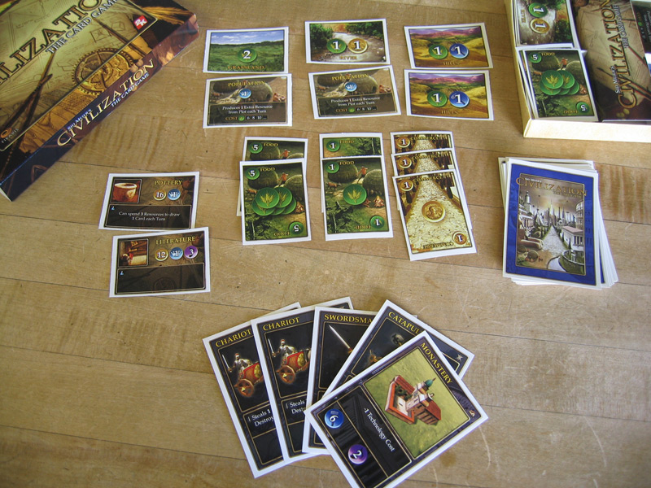
Civilization
The Card Game

Slide 19
Exercise
Select a digital game
Make a paper prototype
What aesthetics survive the change in medium?

Slide 20
Brainstorm
Name some games to “unplug.”
Break into groups

Slide 21
Build a Paper Version
What To Do
Identify your game’s play aesthetics
Choose one aesthetic element to capture
Write it down and put it in the middle of your table
Identify the game actions that create that feeling

Slide 22
Build a Paper Version
What Not to Do
Don’t sweat the details
Don’t try to duplicate the whole game
Don’t focus on simulating computer functions
Don’t make a board!

Slide 23
Beta Test at 3:15
Try to have something playable quickly!
Iterate!

Slide 24
Beta Test
Send two testers to other tables.
Test until 3:45

Slide 25
Discussion
Let’s share results.
What aesthetics did you capture?
What did you leave out?

Slide 26
The Message
Play transcends media.
Mechanics
Dynamics
Aesthetics
Sometimes.

Slide 27
Using Paper Prototypes
Good for understanding existing games.
Use these techniques for games in progress.
Process is quick and cheap.
You don’t need programmers or artists.

Slide 28
Using Paper Prototypes
Can’t replace actual gameplay testing.
Can give you a head start and keep you focused.
Creates a vocabulary to use when discussing your game.
Can be used as a tool to educate other team members. Have them play, too!

Slide 29
Elective C
236: Iron Game Designer
224: Facebook Hoedown
222: Feelin’ GRUVI

