Slide 1
Simulating a City, One Page at a Time
Stone Librande
Lead Designer, SimCity
@StoneLibrande
Notes:
Intro
Welcome!

Slide 2
Turn on “Notes View” to see talking points.
The majority of the designs in this presentation were created long before SimCity went into full production. As such, they do not accurately reflect the shipping product. The intention of this talk is to show the design process, not to document the final product.
All illustrations in this presentation are copyright Electronic Arts ©2009-2013. The illustrations cannot be reproduced or otherwise used except with the prior written permission of Electronics Arts.
Notes:
Legal Information
The majority of the designs in this presentation were created long before SimCity went into full production. As such, they do not accurately reflect the shipping product. The intention of this talk is to show the design process, not to document the final product.
All illustrations in this presentation are copyright Electronic Arts ©2009-2013. The material cannot be reproduced or otherwise used except with the prior written permission of Electronics Arts.

Slide 3
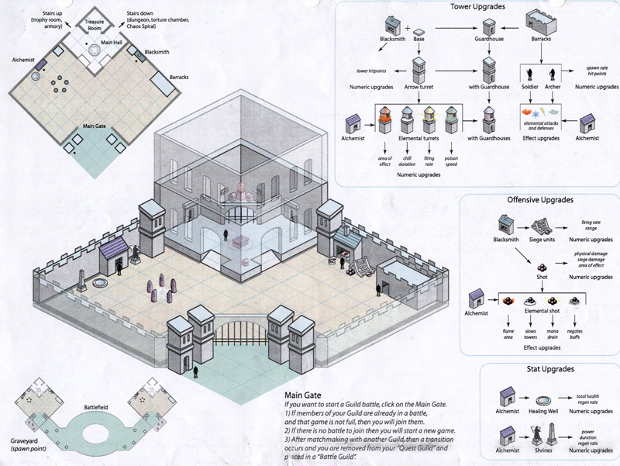
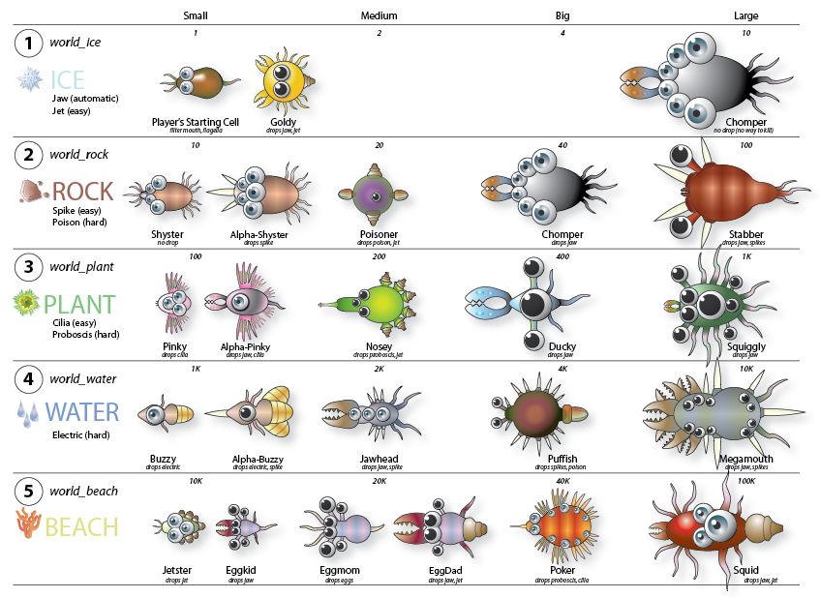
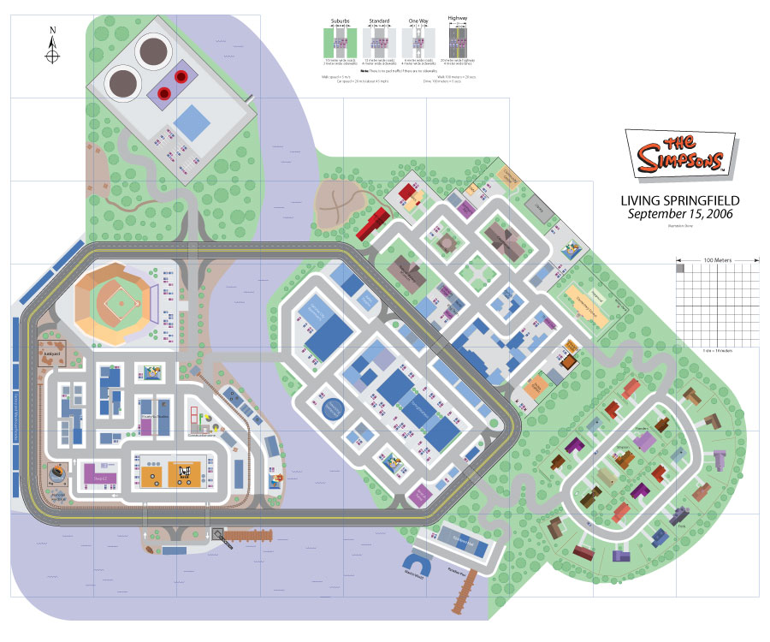
Notes:
Intro
Three years ago, at GDC 2010, I gave a talk about one-page designs. In that talk I showed several examples of one-page designs from other games I have worked on: Diablo 3, Simpsons and Spore. I don’t have time today to go over the topics that I discussed in that lecture, but if you are interested you can download the slides here: http://www.stonetronix.com/gdc-2010/ , or watch the talk on the GDC Vault: http://gdcvault.com/search.php#&category=free&firstfocus=&keyword=librande&conference_id=280 (requires Vault membership).

Slide 4
?
Notes:
Intro
I have had a lot of success with one-page design documents, so when I started working on SimCity, back when there were only five people on the team, I gave myself a challenge: Could I do ALL of the design work as one-page documents, from initial pre-production all the way up until when we shipped? Well, the short answer is, “No, I couldn’t”. But even though I knew it would be difficult, I wanted to push it as far as I could in an effort to both grow as designer and as a way to see where the one-page design approach would break.
I know that most of you will never work on a game where you have to simulate a city, so even though I’m only going to be showing SimCity documentation, I hope that the general ideas behind these documents will be valuable for any design project you are working on.

Slide 5
What is a One-Page Design?
Only one page
Printed out and displayed prominently
Communicates a core idea:
Clearly
Concisely
Thoroughly
Notes:
What is a One-Page Design?
For those of you who haven’t seen my previous talk, here is a quick review:
Obviously, it is only one page. Nothing is hidden from view. When you staple a page behind another page then you are taking a risk that your audience might not see that information. When you require people to scroll to see the entire design, or to click a hyperlink for more information, then there is a chance that they won’t. A page doesn’t need to by 8.5 x 11, it can be any size and in any orientation.
Print it out. Hang it up. Make copies and distribute it around the office. A cryptically named design document buried inside a folder on the server is worthless. You want the ideas out in open for everyone to see. You want to be able to take the page into a meeting and write on it.
Ultimately the reason you are creating designs is to communicate. Just because you are only using one page doesn’t mean that you are communicating effectively. Make sure to:
Present the core idea as clearly as possible. Make your design approachable, unambiguous and easy to interpret.
Be concise and focused. Don’t put too many ideas on one page.
Try to answer as many questions as possible. This sometimes puts you at odds with the “concise” and “clear” points. Put as much information as you can into the document, but not at the cost of making the document unwieldy to read. Finding the sweet spot may take some trial and error but it is worth the effort.

Slide 6
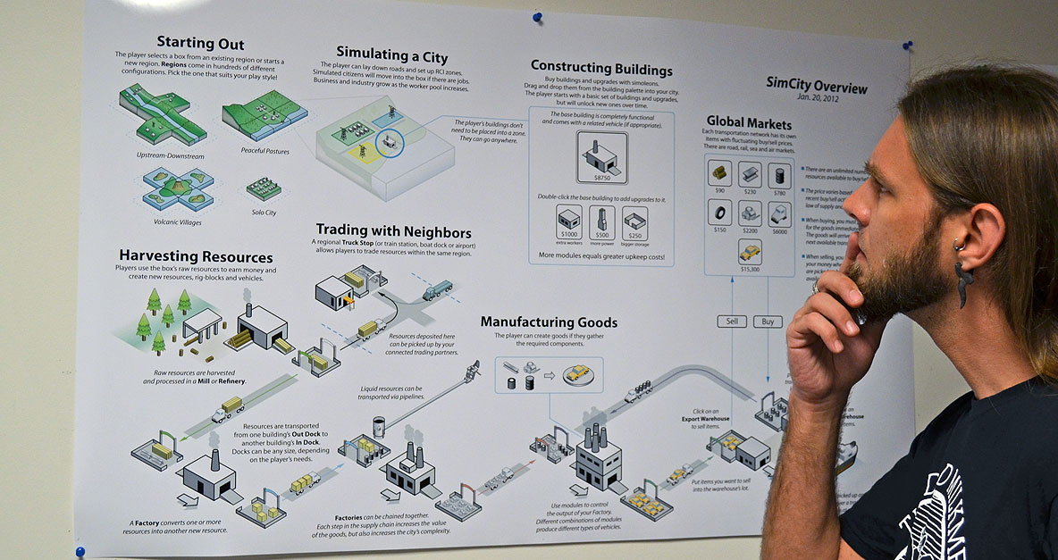
Notes:
What is a One-Page Design?
Here’s an example of a large one-page document (with Maxis designer, Brian Bartram, pretending to look intrigued). This is one of the first documents produced for the project and it’s hung up where many people will see it. I like to use our plotter because it’s a lot easier to make a one-page document if you have a big piece of paper!
I should note that it’s impossible to show you the actual paper documents in a PowerPoint presentation. The resolution is too low (96 ppi, compared to 1200 ppi from a laser printer), and the aspect ratio is forced to be 16:9. So throughout this presentation I’ll be showing you many diagrams that have had to be reworked for PowerPoint’s aspect ratio. After the talk feel free to come up front and check out the actual physical illustrations that I brought along with me today.

Slide 7
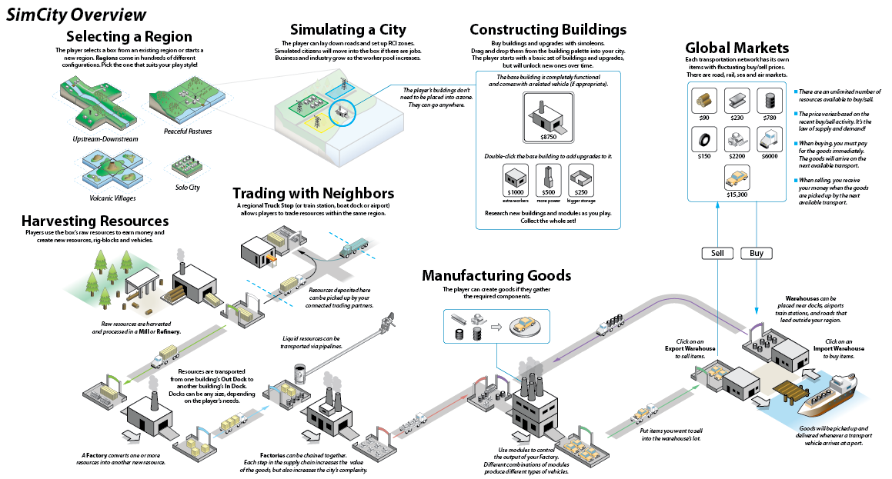
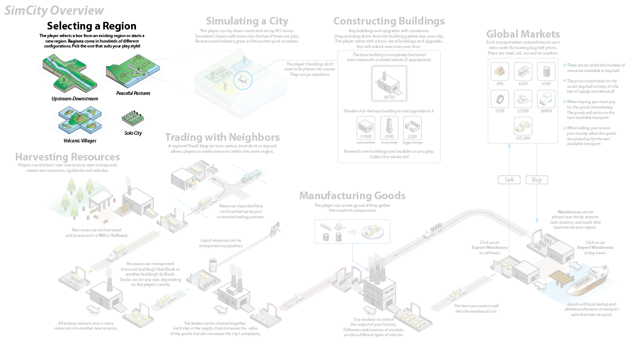
Notes:
SimCity Overview
This overview diagram was one of the first ones created for SimCity, about three and a half years ago (Sept. 2009). It’s purpose was to lock down the high level features of the game. Think of it as an outline for the entire game, where each bold heading describes a feature set. There’s not a lot of detail about each feature, because back then I didn’t know the details. But this gave the team a sense of what work we were going to be doing and kept us from wandering off-course.
The diagram turned out to be a good way to organize this talk, since the majority of the design documents that I’ll be showing will fit into one of the categories listed here.
It’s interesting to note that we consistently touted SimCity as a “bottom up” simulation (meaning that the high level simulation was not predetermined, but happened organically based on the aggregate actions of each individual citizens). However the entire design process was heavily “top down”. We started with this overview document and over the course of the project continuously drilled down into the details of each section.
In order to explain how this worked, let’s start out here with “Selecting a Region”.

Slide 8
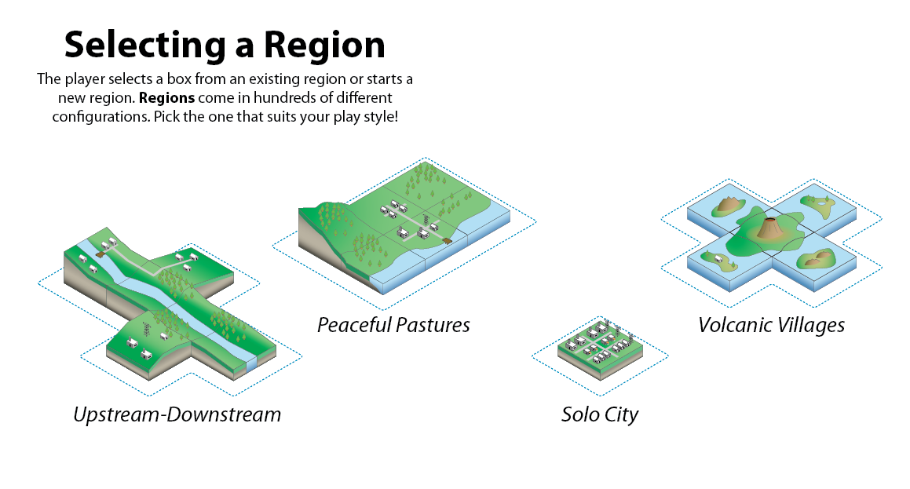
Notes:
Selecting a Region
We knew that we wanted to make large regions where multiple people could get together and play simultaneously. Here are a few early examples showing how different region configurations would promote different types of play.

Slide 9
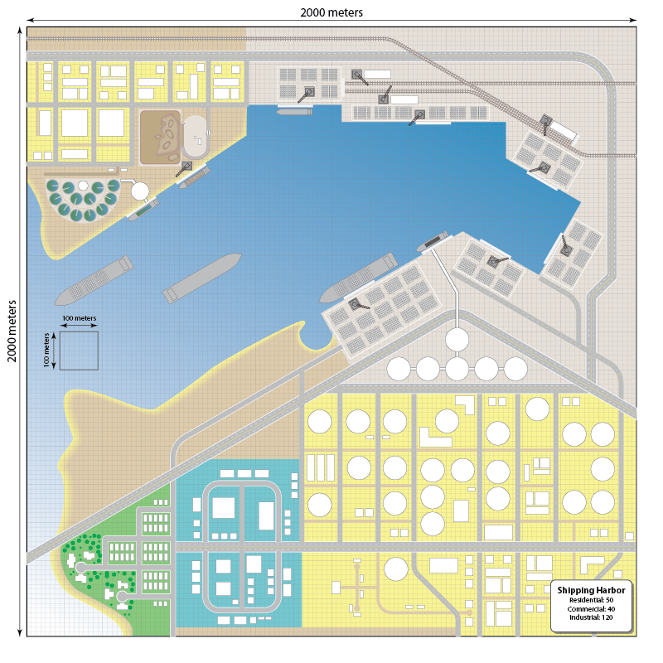
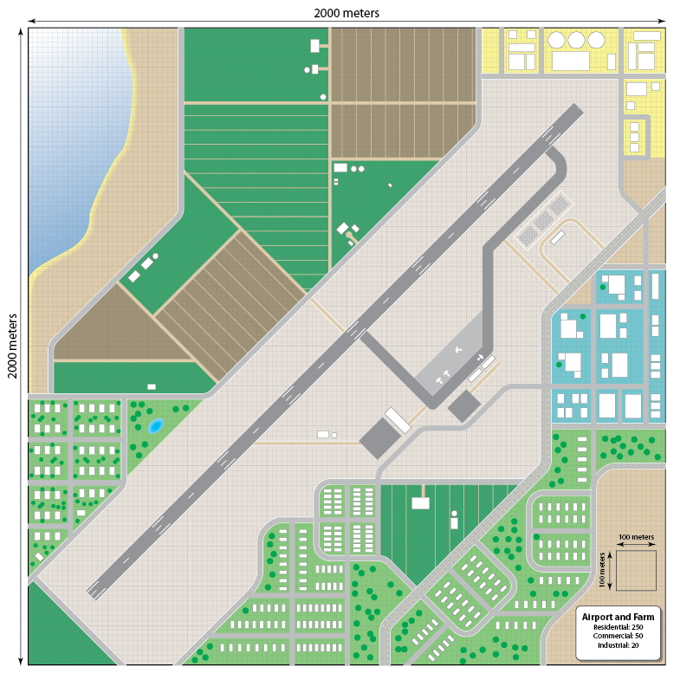
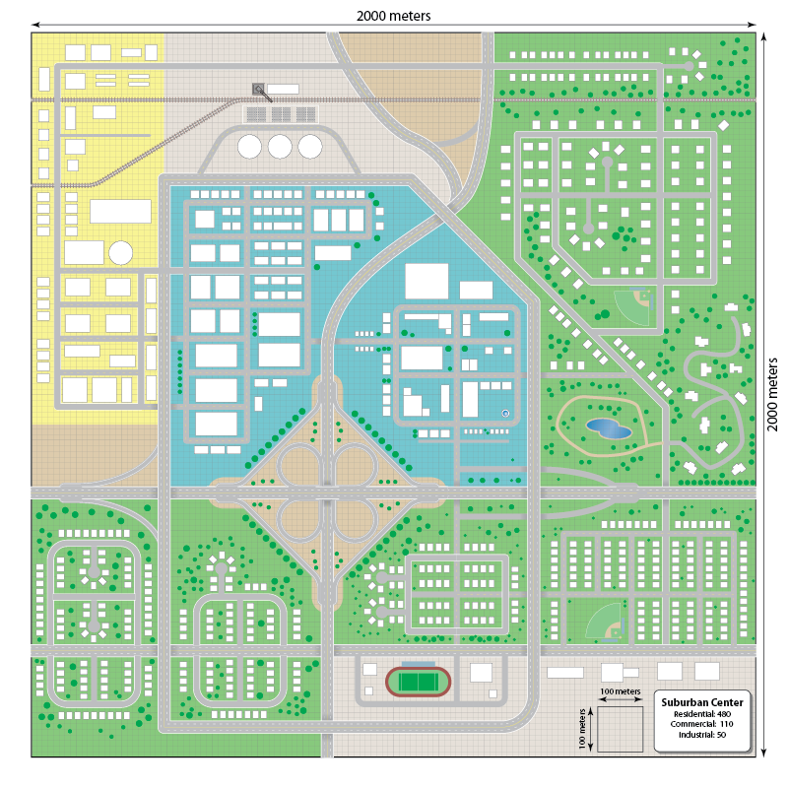
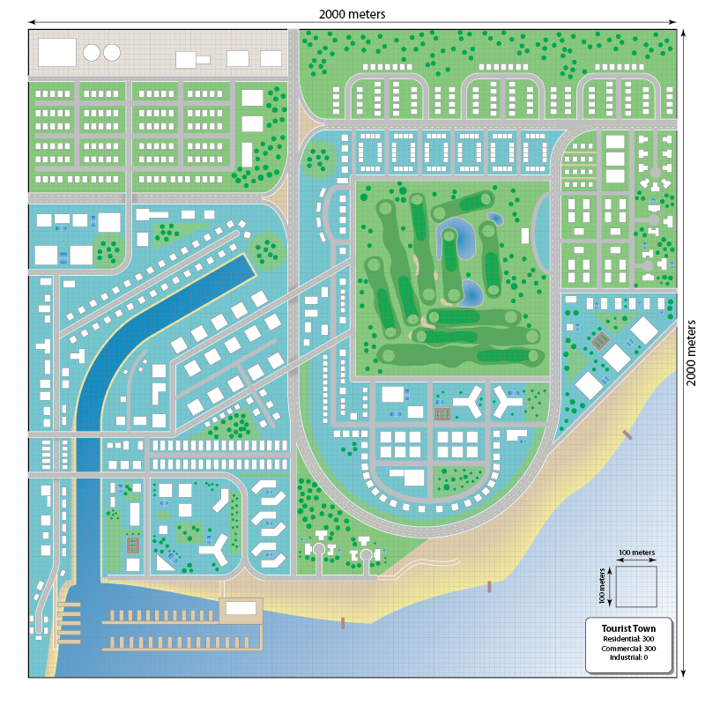
Notes:
Scale Maps
Some of the first diagrams I made were scale representations of actual cities. The engineering team had calculated that to run on our min-spec computer we should target 2K x 2K size areas, which is the size of a medium city in SimCity 4. In order to make it apparent to the team what that meant, I made some simple illustrations of different types of cities based on Google Earth view of real cities. In many ways I was already playing a non-simulating form of SimCity in Adobe Illustrator at this point in time, long before the engine was ready.
Here you see an industrial shipping yard
Here’s a suburban area with many houses, a school, parks and a small central commercial district
This one is a farming town with a municipal airport
And the last one is a hotel-filled beach resort.

Slide 10
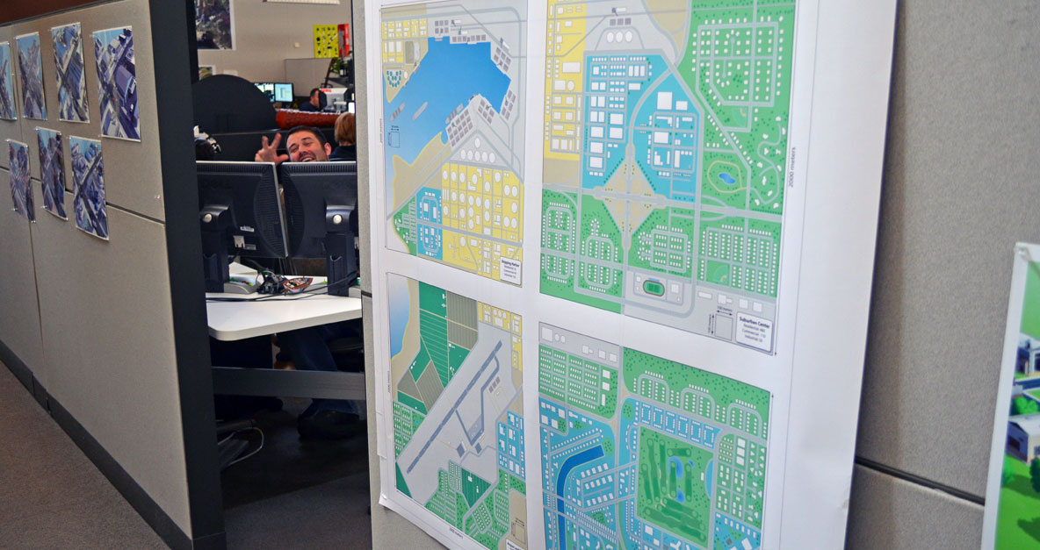
Notes:
Overview Scale Maps
Here is a picture of all four cities together, printed out and hung up in the hallway (and photobombed by scripter John Giordano). Even though this document has no words, it is really easy to understand at a glance one of the key features of our game: that cities could be specialized, and that individual cities would work together to make up a larger region.

Slide 11
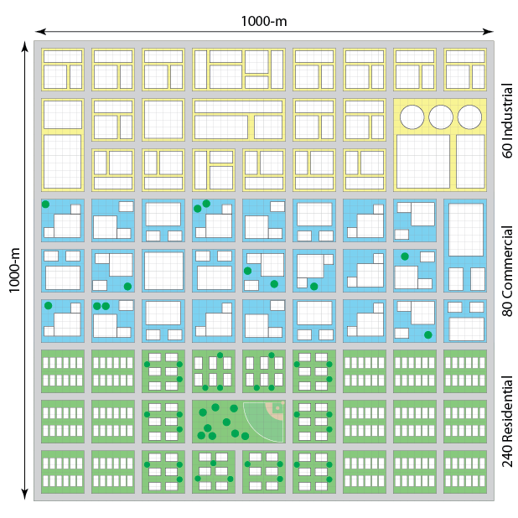
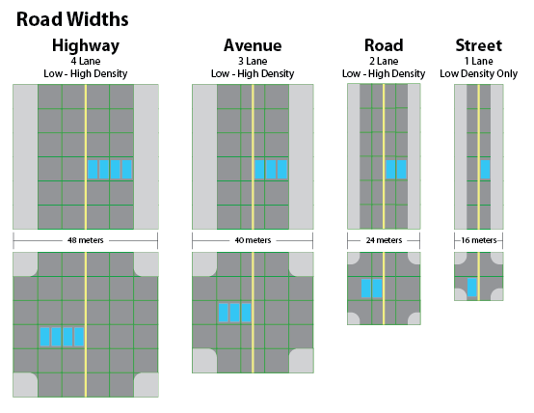
Notes:
Overview Scale Maps
Documents such as these go one level deeper and show individual widths for road types and RCI building approximations for 1K by 1K cities. These were needed by both engineering and art in order to establish the performance benchmarks. There were several of these illustrations that were used to estimate the maximum number of buildings in cities based on different wealth and density levels. (A city made of low-wealth skyscrapers has fewer buildings than a city of wealthy single-story mansions.)

Slide 12
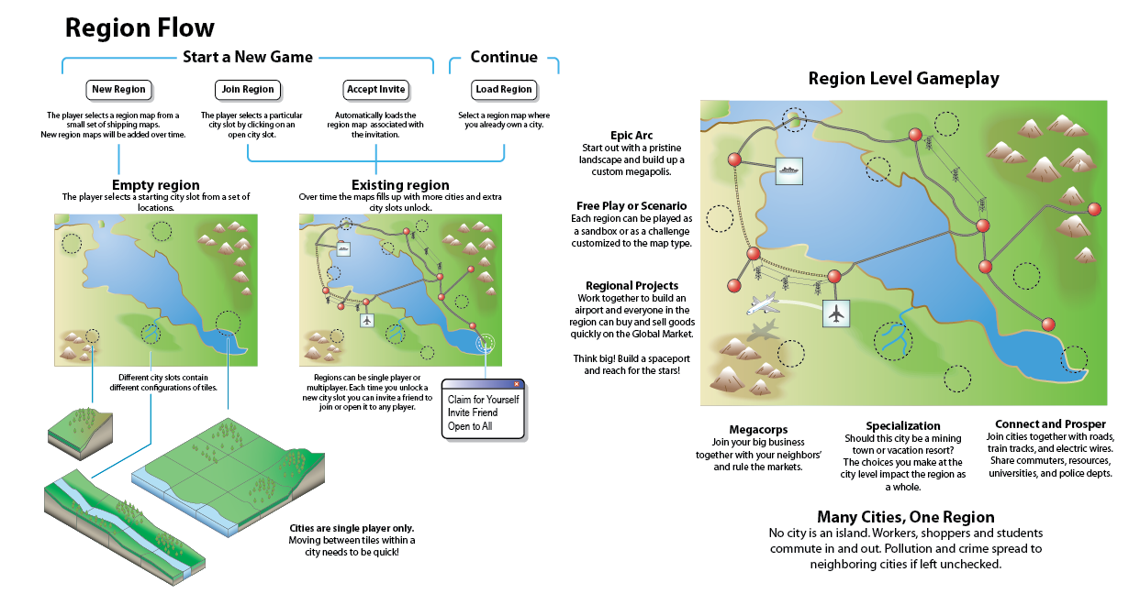
Notes:
Region Flow
The previous documents were useful for determining engineering and art metrics, but this design is about the player experience.
This diagram shows the UI options, as well as the reasons why the player will care. High level gameplay activities are listed around the diagram. (Like many of the examples I’m showing today, the printed document has a long vertical layout and is meant to be read from top to bottom, instead of from left to right as you see it here.)
By coming at the problem from both ends (developer’s view and player’s view) it helps the team understand the problem fully.

Slide 13
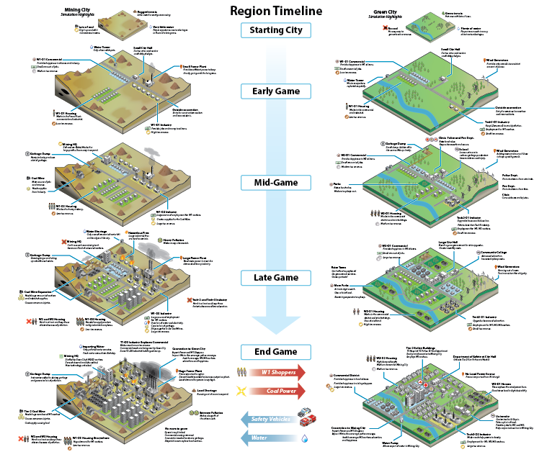
Notes:
Region Timeline
This is one of my favorite diagrams from the project. It describes play patterns in more detail and how they change through time. I strongly believe that every game designer should make a timeline like this early in the development process. At this phase in the project we didn’t have exact timings figured out, but we can still approximate it by breaking up the gameplay into early, mid, late and end game phases.
Most games have a very linear structure, which means that it will be simpler to create a traditonal timeline. Unfortunately, there is no “right way” to play SimCity which made the process much more difficult. One timeline can’t represent the thousands of ways that a player can construct a city.
To get around that problem, I decided to show off two extreme cases as book ends. If we can understand the extremes then we can assume that most cities will be shades of these extremes in varying proportions.
I know that it is difficult to see the detail (another reason why you should print out the documents instead of keeping them online) so let’s zoom in…

Slide 14
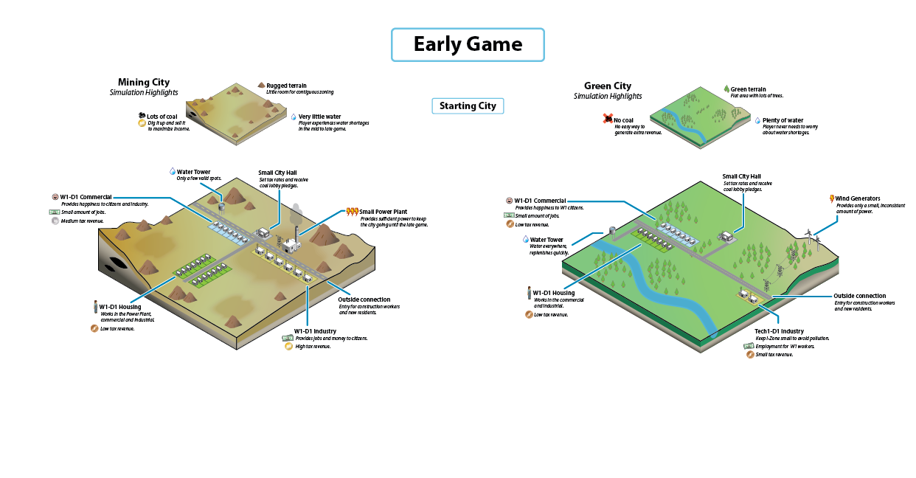
Notes:
Region Timeline
There are two cities. The one on the left has little water and a lot of minerals (we called it “Pittsburgh”). The one on the right has plenty of water, but no natural resources (we called it “Berkeley”). Despite the differences, both players begin the same way: they lay out roads and zones. Pittsburgh favors industry and coal power, while Berkeley favors commercial and wind power.

Slide 15
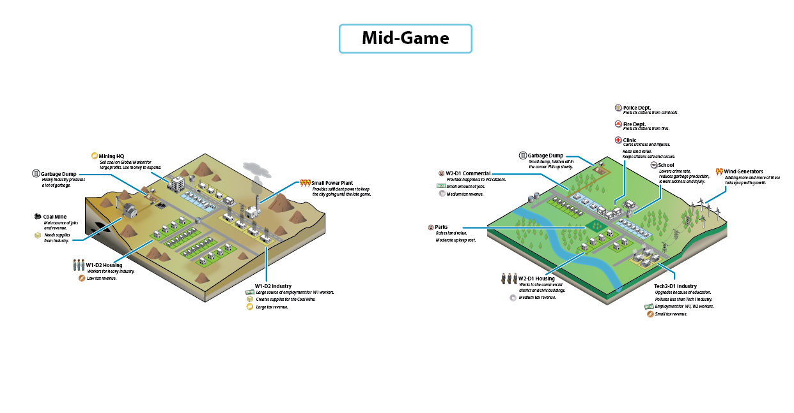
Notes:
Region Timeline
In the mid-game the players are starting to specialize. Pittsburgh starts mining coal and builds lots of houses for low wealth workers. Berkeley is encouraging higher wealth workers and education.

Slide 16
Notes:
Region Timeline
In the late game the cities are very specialized. Pittsburgh has expanded the coal production and now has low wealth high-rises. Pollution is a problem and the dumps are filling up.
Berkeley has to use a lot of space for wind power because the wealthy houses and shops are demanding more electricity. As the education level rises the factories “tech up”. Berkeley is usually low on money because it has to pay upkeep on the many government services.

Slide 17
Notes:
Region Timeline
In the end game both cities are facing crises. There is too much pollution and sickness in Pittsburgh and to make matters worse they are running out of water. There is too little money and electricity in Berkeley. However, if they work together they can solve each other’s problems by sharing commuters, utilities and services.
There are a lot of other details in these diagrams, but for the purposes of this talk it is not important. The main take away here is that you should always be looking at your game as arcs over time and attempt to document the important points that occur along the way. Figuring this out early on paper means that you won’t waste a lot of artist and programmer time later.

Slide 18
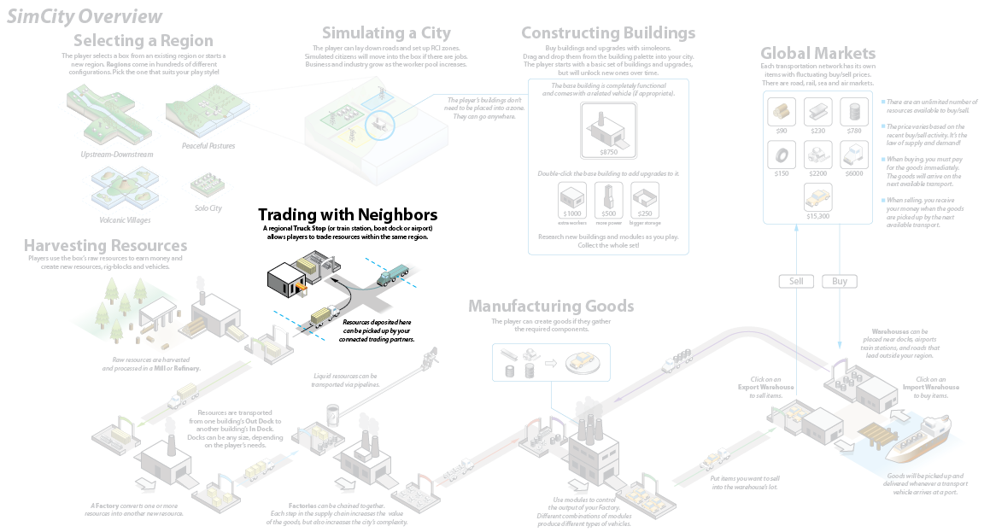
Notes:
Trading with Neighbors
We knew that cities would be trading with each other, but when I first put this overview together I didn’t think it would be a big feature.

Slide 19
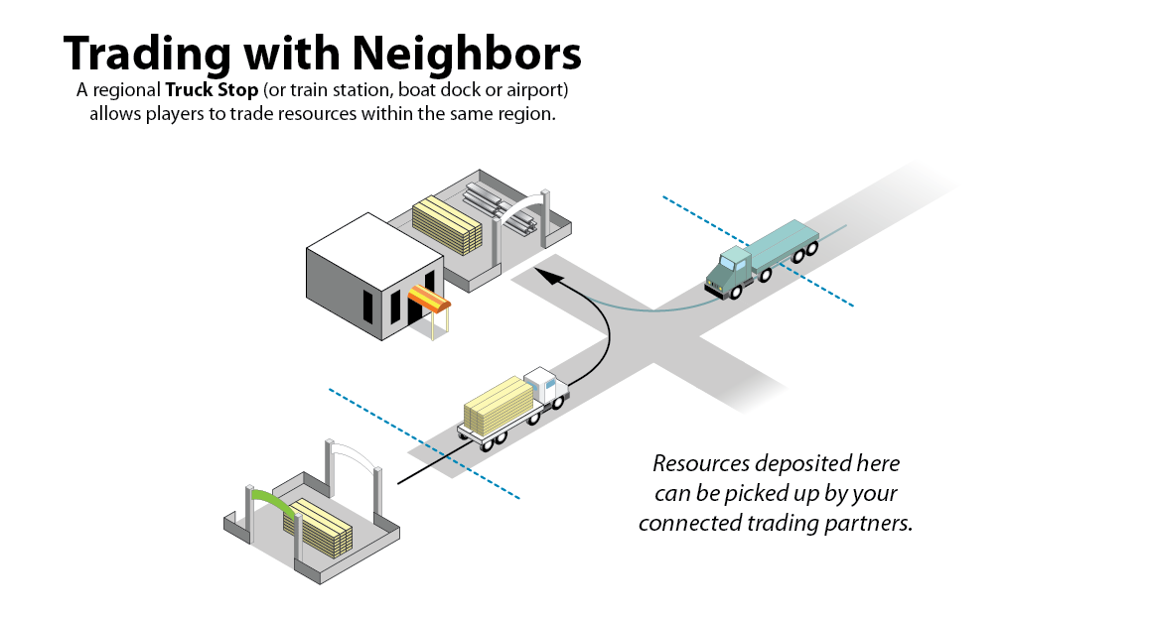
Notes:
Trading with Neighbors
I imagined it would just be a truck and a trade lot and that players would simply ship goods back forth. But as you just saw in the Pittsburgh/Berkeley example, trading got much more complex as we started discussing all of the possibilities.

Slide 20
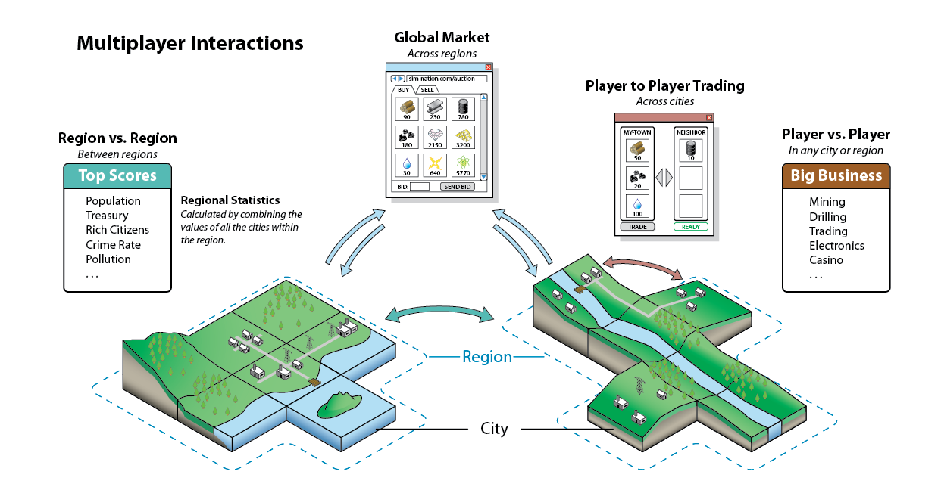
Notes:
Multiplayer Interactions
The first thing that needed to be documented was all the ways that players could interact with other players: city to city, region to region, globally and personally. This was an early diagram that showed high level interaction relationships. As we started digging into the details the model became increasingly complex…

Slide 21
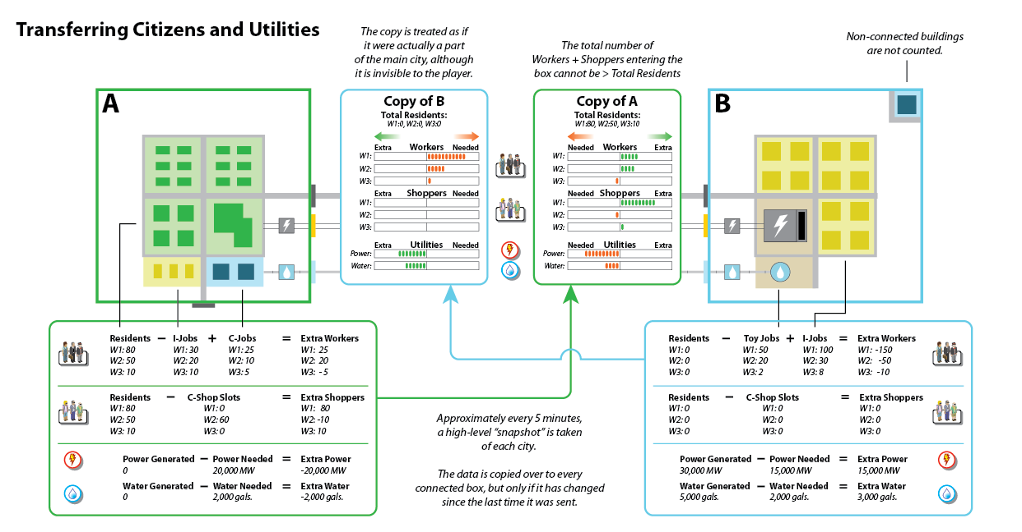
Notes:
Transferring Citizens and Utilities
This chart is an attempt at trying to capture the intricate flows of city-to-city trading. It is difficult to understand, but don’t worry about the details. In brief, this chart shows how City A is simulating next to a copy of City B and vice-versa. (In SimCity, players are only interacting with copies, not actual cities. This is necessary because the game can be played asynchronously, while one city is online and another one is offline. We don’t want to simulate a city when its owner is offline because we didn’t want a player to exit from a healthy city and come back later to find it in ruins.)
Given the engineering constraints of the Glassbox system, I was unable to come up with a more elegant design and we shipped the game with this system in it. Based on feedback that we have received, it is clear that players have a difficult time understanding how this system works.
What is important to note here is that if your design diagram is complex and can’t be easily understood, then there is a good chance your players (and your fellow developers) won’t understand it either. You may be better off changing the underlying design instead of iterating on the layout of the diagram.

Slide 22
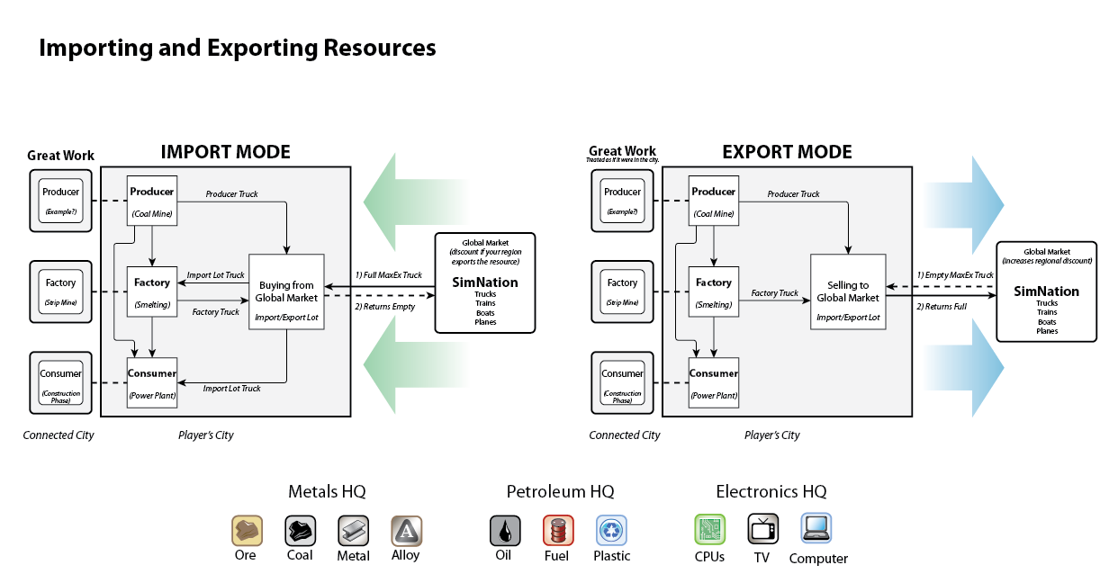
Notes:
Importing and Exporting Resources
Players can also trade with the Global Market. Unlike the previous slide, this chart doesn’t attempt to cover every aspect of trading, so it is much easier to understand. Still, it is rather dry and uninspiring. It was perfect for the one-on-one conversations I had with the scripter who was implementing the feature, but isn’t something that would attract much attention if it was hanging on a wall. (I tried “decorating” it by placing colorful resource icons along the bottom, but that didn’t make the core flow chart any more compelling.)

Slide 23
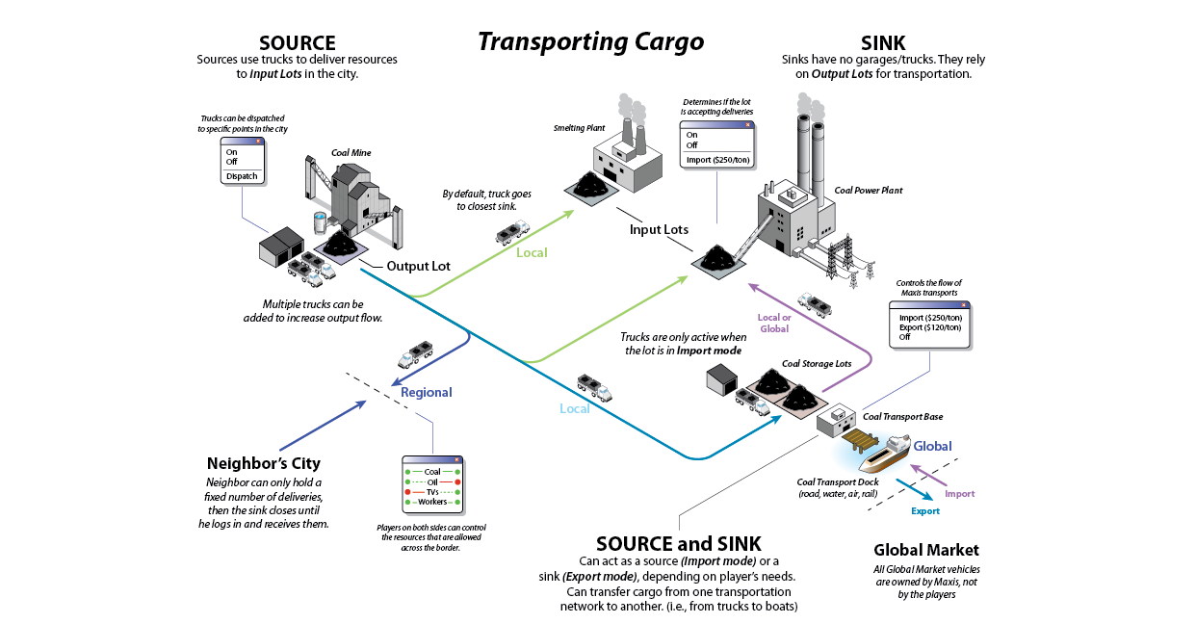
Notes:
Transporting Cargo
Here’s another attempt at illustrating the same idea. This is essentially the same diagram as the one on the previous slide, but I replaced the 2D boxes with isometric buildings and added trucks along the arrows. Now it is much more compelling to look at. If you hang this up on wall then people will stop to look at it.
You have to be careful when doing this sort of decorating. Make sure that everything you place on the chart reinforces the ideas you are trying to communicate. For instance, I could have drawn in actual roads instead of colored arrows, or placed little trees and houses along the truck routes. This would have made the city look more realistic and appealing but it would have only been a distraction (not to mention more work for me). Edward Tufte calls this “chartjunk” and it should be avoided.

Slide 24
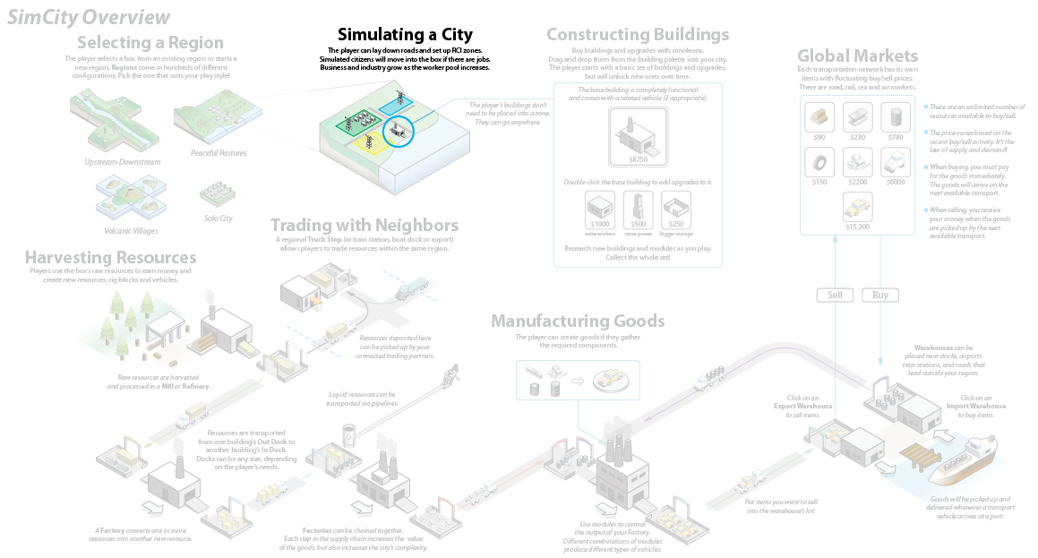
Notes:
Simulating a City
This next section of the overview chart is all about the core simulation. Notice how small it is on the chart. This is because at the time I didn’t think there would be much design needed here.

Slide 25
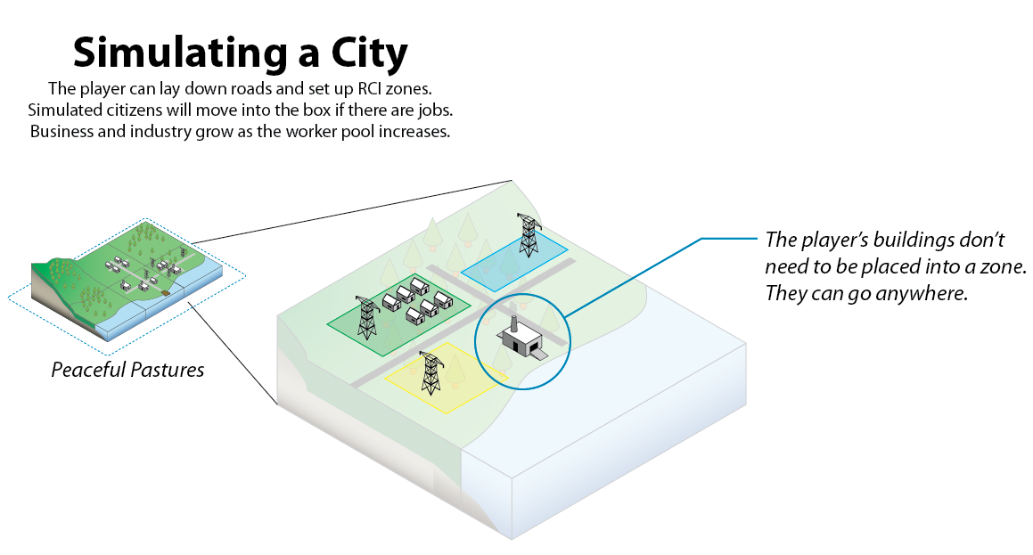
Notes:
Simulating a City
There have already been four other SimCity games, so I assumed that the simulation aspects were well understood and that we could just refer to the past games themselves for design knowledge. It turns out I was very wrong.

Slide 26
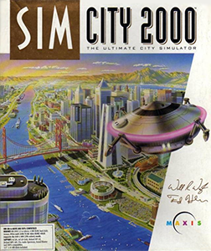
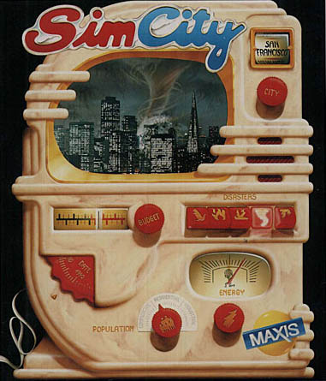
1989
1994
1999
2003
Notes:
Previous SimCity Games
To understand why, let me spend a moment talking about how the previous SimCity games simulated a city.
(As an aside, the first SimCity game was 2 MB. For comparison, this PowerPoint is over 20 MB.)

Slide 27
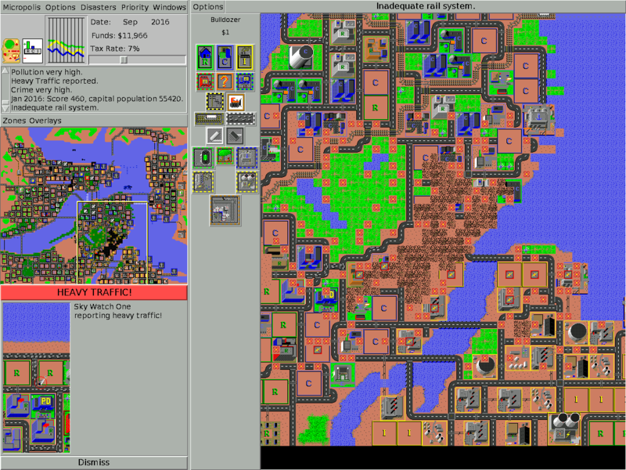
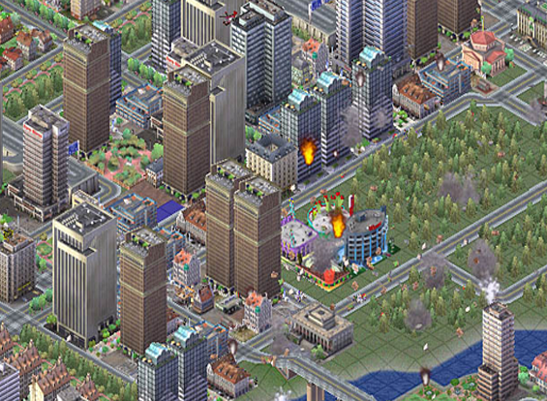
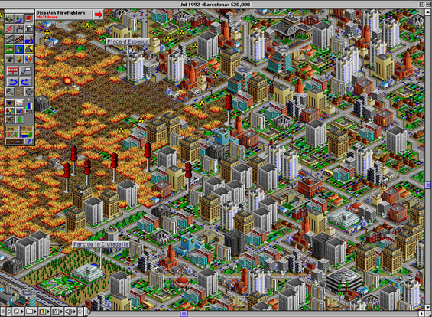
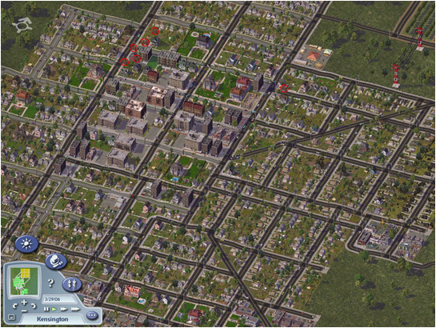
Notes:
Previous SimCity Games
Previous versions of SimCity were graphical spreadsheets where every cell’s state was determined statistically by looking at the influences of other nearby cells.
A building could spread influence through maps (usually in a radius). Even though the graphics improved over time the underlying grid-based simulation remained the same.

Slide 28
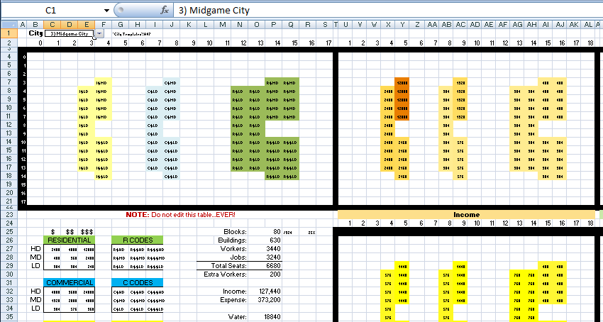
Notes:
Excel Simulation
Essentially, past SimCity games were just pretty spreadsheets. In fact, one of the first things I did when I started working on SimCity was to model it in a spreadsheet. While this was statistically interesting and valuable for tuning, it didn’t help as much as I hoped because the newest SimCity game isn’t based on an underlying cell grid; it uses agents. This changes everything.

Slide 29
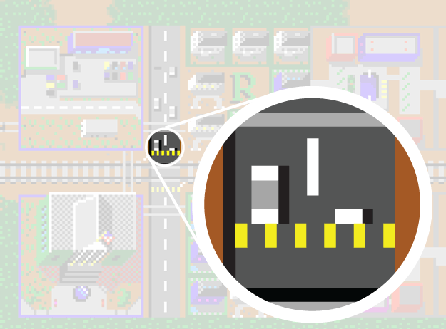
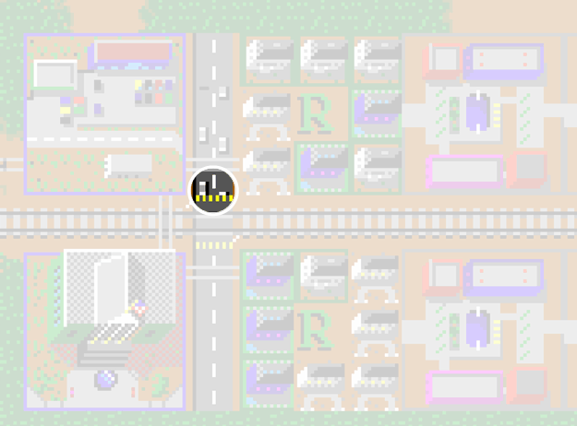
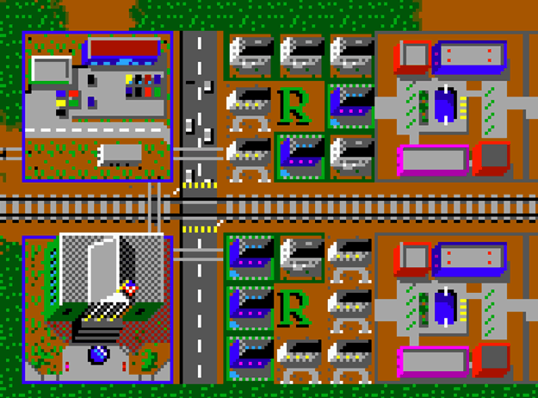
Notes:
Agents and Previous SimCity Games
Many people believe that the previous SimCity games were agent-based. That’s because if you look close you see little cars moving around. But if you try to follow one of them around the town you quickly realize they disappear shortly after leaving the block they started on.
In reality the streets are just showing the state of the adjacent buildings. The cars are simply graphical feedback and aren’t actually part of the simulation. If I zoom in you can see the hood of car on the right side of the road appearing out of a crosswalk. This is because the game thinks that cars should be on the street in front of the northern buildings, but not in front of the buildings directly to the south.

Slide 30
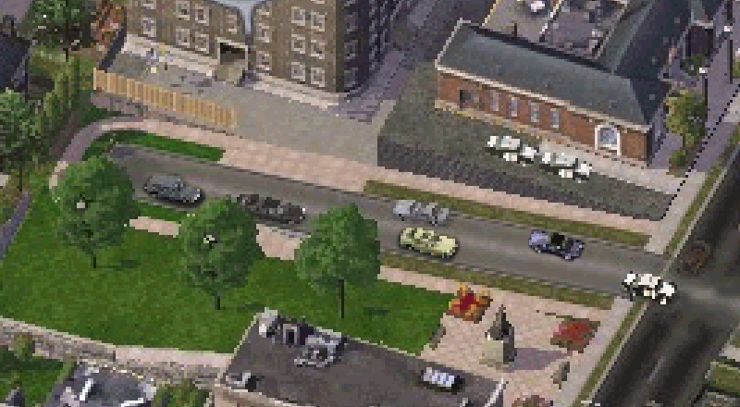
Notes:
Agents and Previous SimCity Games
Even in SimCity 4 you would often see cars disappear at the end of a road segment, and then reappear as a different car type a few moments later.

Slide 31
Carries information
Notes:
Basic Agent Behavior
But this version of SimCity doesn’t operate in the same way. Every sim (or “agent”) is actually carrying information through the city as they go from one place to another.
What you are looking at is a one-page design that was printed out and hung up for everyone to see. Notice how simple it is. It has one purpose: to educate the team on three vocabulary words—source, agent and sink—and the relationship between them. It was critical that everyone on the team understood this relationship because our entire game is based on this concept.
Remember that your designs don’t need to be complex to be effective. They only need to be as complex as the idea you are trying to communicate.

Slide 32
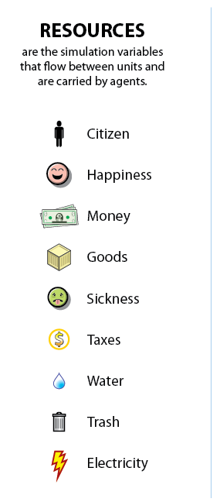
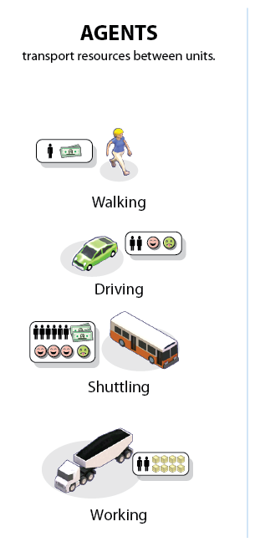
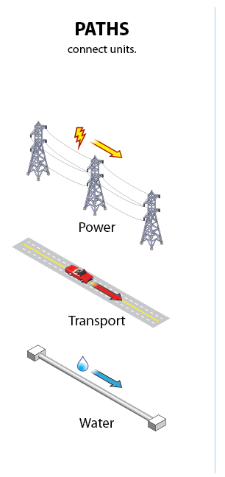
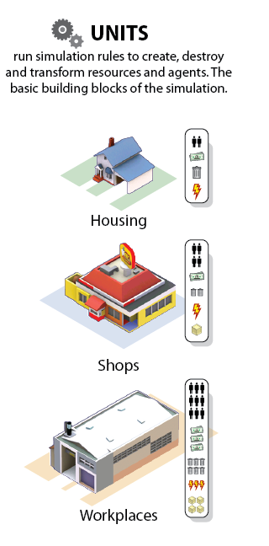
Notes:
Agent Definitions
Once that idea had been communicated then I could move on to more advanced concepts. This diagram shows how agents can carry many different types of resources down paths and into units.

Slide 33
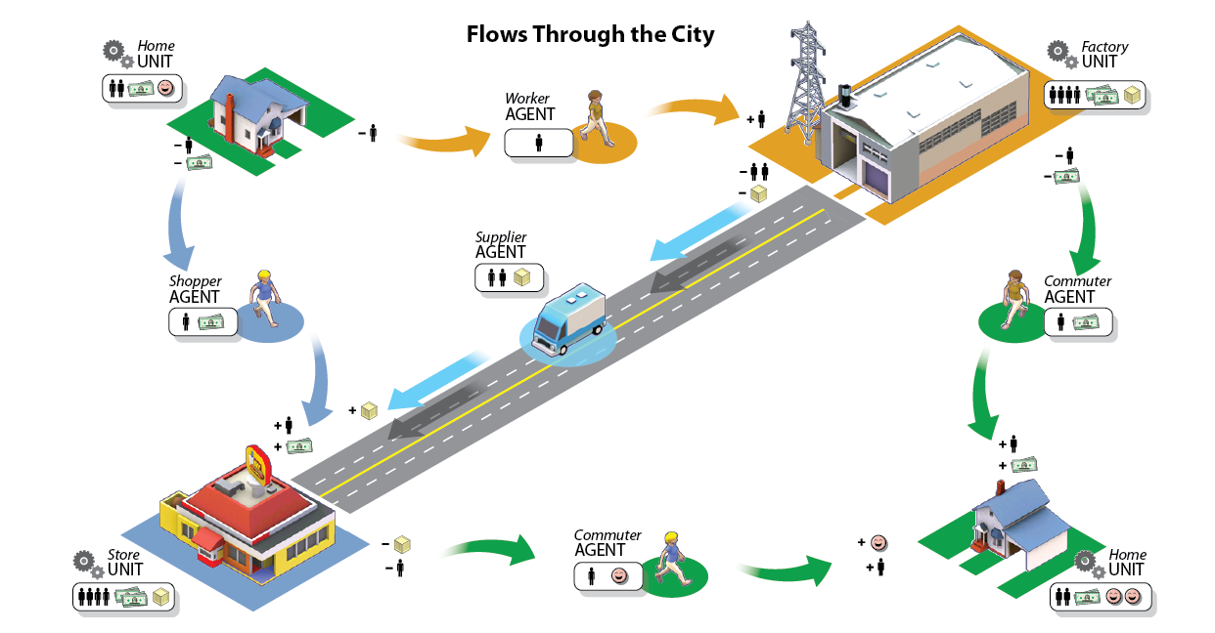
Notes:
Agent Flows Through the City
Now that I had established the basic vocabulary and iconography, it was easy to build up more complex examples. Here is a simple diagram showing how agents might flow around a small town. We can now start to drill down to the next layer of vocabulary. In this case, agents can be typed as shoppers, workers and commuters. Units can be typed as factories, stores and houses.

Slide 34
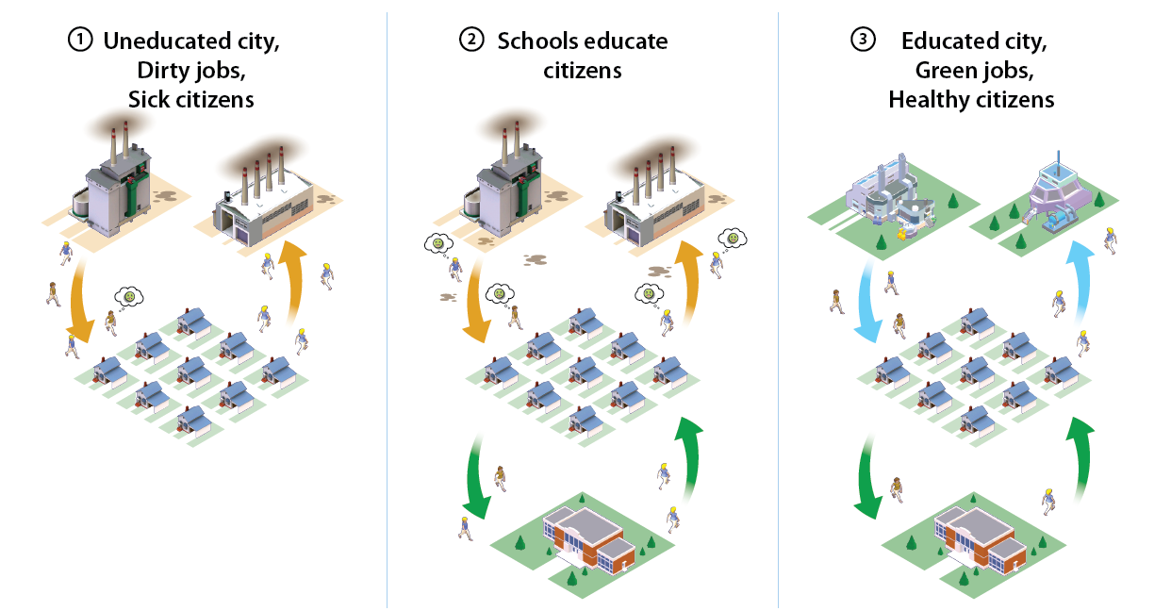
Notes:
Education Flow
Now I have enough pieces to build up higher level concepts. This diagram shows how agents might use education to reduce pollution by increasing the tech level of the factories.

Slide 35
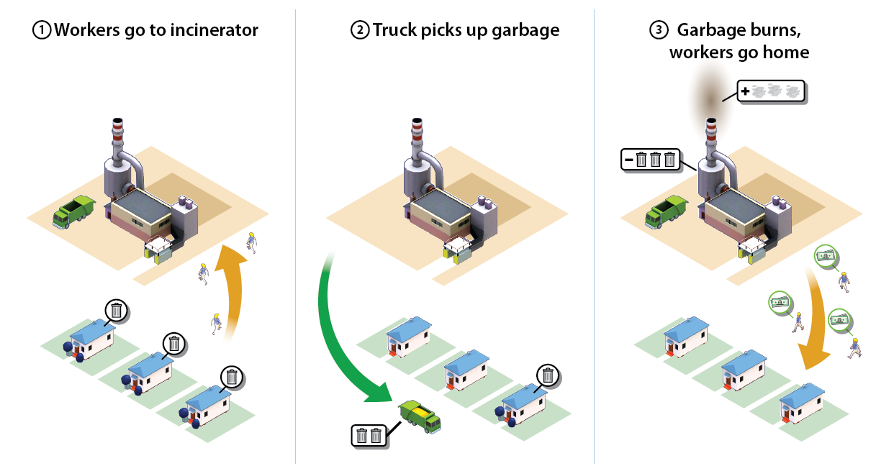
Notes:
Garbage Flow
This one shows how agents might travel back and forth from work to the garbage dump. They put out their garbage in the morning and go to work. They pick up the garbage, take it back to the dump and burn it. Then they get paid and go back home. (Presumably to buy more garbage and repeat the cycle.)
This is still one of my favorite documents, because out of context it seems like a subversive anti-consumerism propaganda poster. In fact, I thought it would make for some interesting graffiti. So I printed up some stickers…

Slide 36
Notes:
Bus Stickers
…and started sticking up one-page design propaganda around town. (I have some extra stickers here. Feel free to pick one up after the talk.)

Slide 37
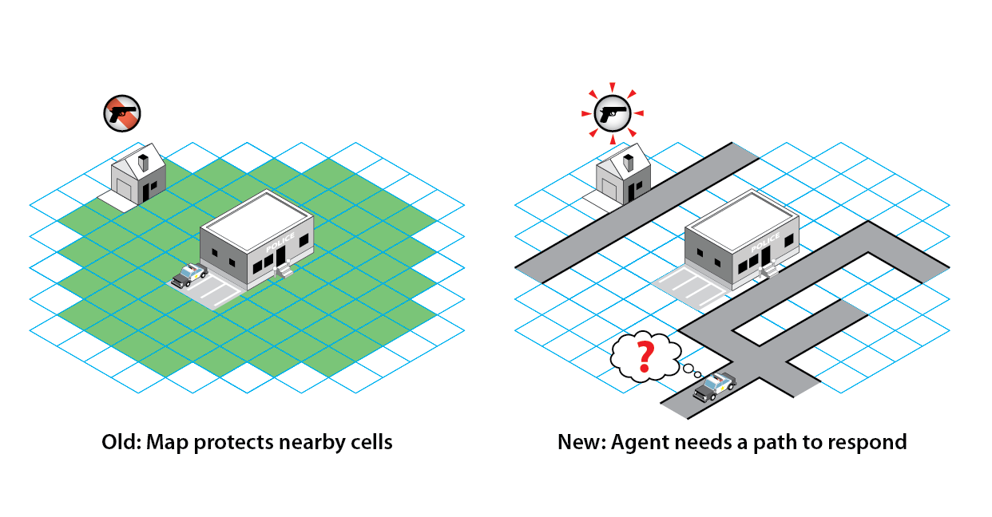
Notes:
Maps vs. Paths
Here is another simple design diagram meant to show the difference between how previous versions of SimCity handled crime vs. how our new version would handle it. On the left the house is protected from crime just because it happens to be close to the police station. On the left, the crime happens because the police car can’t find a way to get to the house.
These simple agent flow diagrams worked well as visual explanations, and they were effective at communicating the core simulation ideas to the team. But they aren’t adequate as plans to build the game. I still had to draw up “the master plan”. The goal was to get all the details of the simulation on one piece of paper so that I could easily see all the relationships.

Slide 38
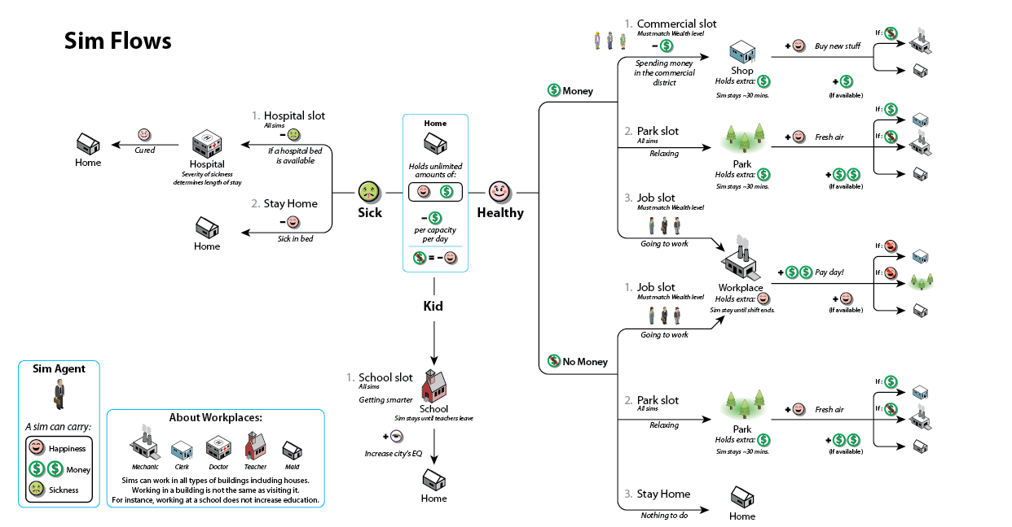
Notes:
Sim Flows
First I needed to understand how a single agent would work. This flow diagram shows the algorithm that one sim uses to move through the city. A sim wakes up in the morning and pays the rent if there is money. If not, they lose happiness.
An adult sim is either sick or healthy (based on how much pollution is in the area). Sick sims try to go to a hospital. If one isn’t available they stay home and roll the dice and either get better, stay sick, or die.
Healthy sims look at their wallets. If they have money they immediately try to spend it in a shop. If they can’t find a shop they hang out in a park. If they can’t find a park they go to work anyway.
If they have no money they try to find a job if they can. Otherwise they slack off in a park or stay home all day.
This diagram is relatively simple to follow, but it turned out to be too complex for the simulation and caused a lot of confusing behaviors. (For instance, some days your city might have too many shoppers and not enough workers, and the next day the opposite might happen.) When I realized we needed to simplify the algorithm it was trivial to do because I could just look at the image and see the problem area…

Slide 39
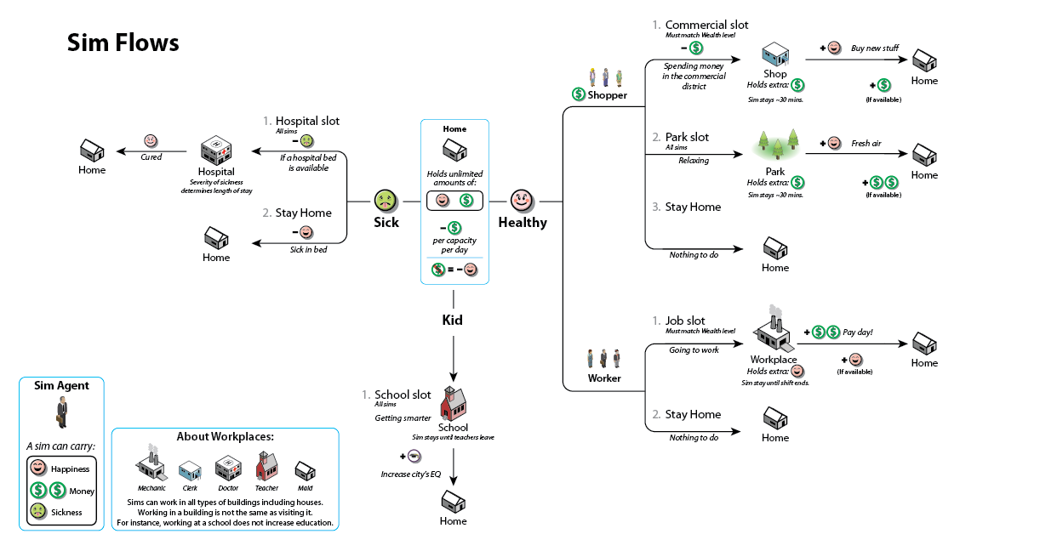
Notes:
Sim Flows
Instead of having sims decide whether they should work or shop dynamically, we ended up splitting the shoppers and workers into specialized agents with only one purpose. A shopper can never become a worker and vice-versa. [Compare this slide with previous slide to see how this simplifies the flow chart.]

Slide 40
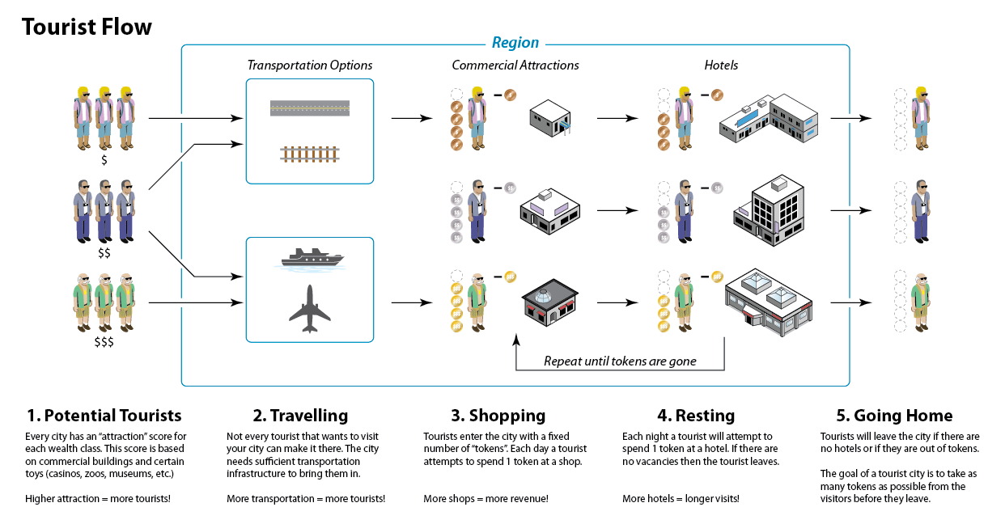
Notes:
Tourist Flow
I also had to do similar diagrams for the tourist agent flow. They don’t go to school, get sick or work so they needed a different diagram. Since all they do is shop and sleep in a hotel their diagram is much simpler.
They come into town, look for an attraction, spend some money, look for a hotel, spend some money, and repeat the loop until their wallets are empty, then they go home.
The diagram for homeless agents looks much like this one, except the shops are replaced with garbage cans and the hotels are replaced with parks and abandoned houses.

Slide 41
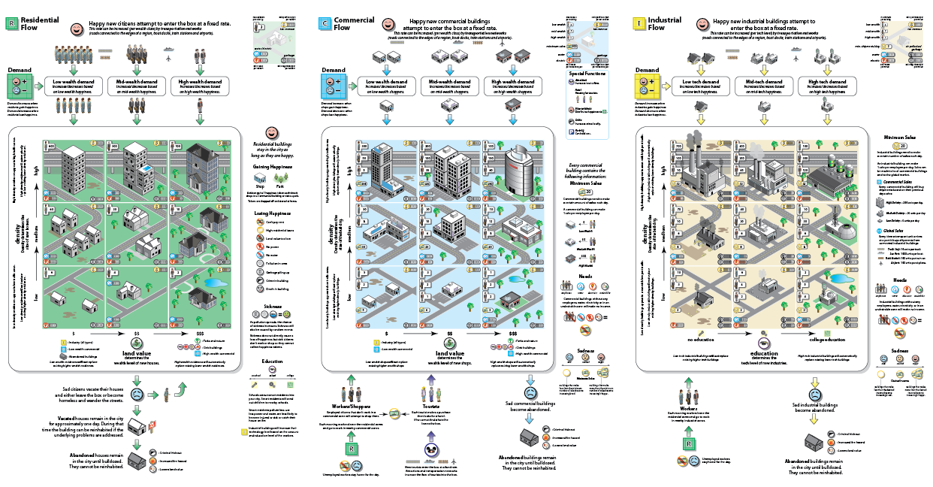
Notes:
Simulation Master Plan
I know this design is overwhelming at first glance. Don’t worry if this doesn’t make sense to you at the moment. I’m going to break it down piece by piece and it should make sense 5 minutes from now.
After we had a good understanding of an individual agent, I needed to come up with the master plan for dealing with thousands of them flowing around all at once. If the previous flow chart is a diagram for understanding a single pinball, then this diagram can be thought of as a pachinko machine. Thousands of agents drop in from the top, bounce around in the middle (possibly “scoring” you points), and drain out the bottom if they are unhappy.
Let’s zoom in to see the details…

Slide 42
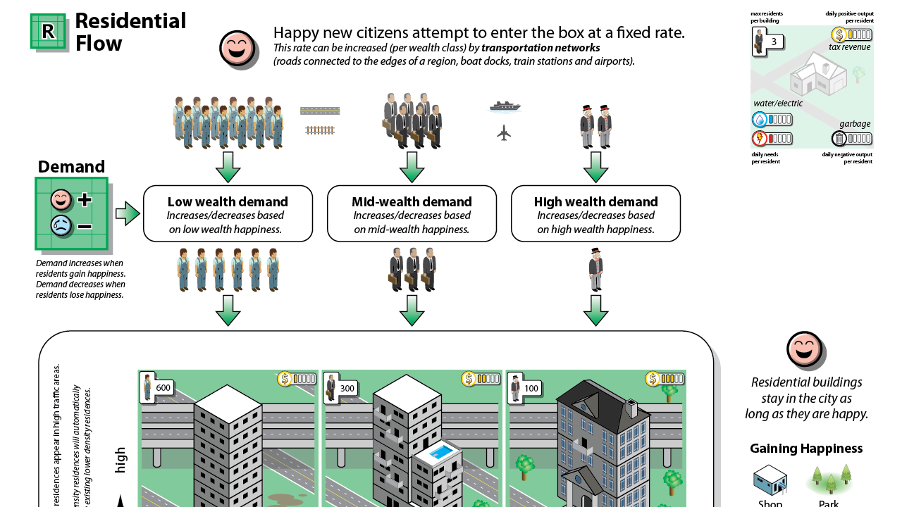
Notes:
Residential Flow
New sims come into the city in 3 wealth classes. The flow of each type can be adjusted by increasing the transportation networks.
Once they enter the city they create buildings of the appropriate wealth class.
Notice the legend in the top right corner. It shows the number of residents, tax revenue, water/electricity usage and garbage output. At this point in time during development it isn’t important to specify exact numbers, so I just use a bar graph to show relative tuning. Later in the process we’ll convert the general bars to specific numbers.

Slide 43
Notes:
Residential Flow
Houses start in the bottom corner (low wealth, low density) and can grow taller or richer, depending on how you place your roads, parks and services. Nothing ever goes backward.
Happiness determines if the sims will stay in the city. Happiness is mostly gained from shopping, but parks can help, too. There are many ways to lose happiness: crime, sickness, no jobs, etc.
Players tend to trick themselves into thinking that they will “win” the game by getting from the lower left corner to the upper right corner (high density/high wealth). But this chart shows that everything has a trade off. The rich need more “elbow room”, so you will lose population as you increase wealth. This results in fewer workers, which can put a strain on your shops and factories. Even worse, most buildings in the game require low wealth workers or they won’t function at all. (Someone has to sweep floors, run assembly lines, and operate cash registers. The rich won’t take those jobs.)
High wealth houses generate more revenue, but in exchange they use much more water and electricity per person, and produce more garbage. They also demand more services (police, schools, etc.). So even though you can make more tax revenue from them, you have to spend more money to keep them around.
The entire SimCity design is based heavily around the fact that there is no “right answer”. Every option has positive and negative consequences.

Slide 44
Notes:
Residential Flow
At the bottom of the chart is what happens when sims lose all their happiness and drain out of the city. A small percentage will become homeless and will lose their home but not leave.
Vacated houses will eventually go abandoned, which increases crime and fire risk and lowers land value.

Slide 45
Notes:
Commercial Flow
If you followed all of that for the Residential flow, then it’s easy to understand the Commercial flow because it is basically the same. Businesses come into the city and are dedicated to servicing only one wealth class of shopper. (However, they need all 3 wealth levels for workers, as shown by the numbers in the upper left corner of each cell.)

Slide 46
Notes:
Commercial Flow
Just like the residents, the stores have “happiness”, which is based on profitability. The more sales they make then the happier they will be.

Slide 47
Notes:
Commercial Flow
If they run out of money they will abandon the city.
The arrows at the bottom left show that stores need both workers and shoppers, but can also receive profit from tourists.

Slide 48
Notes:
Industrial Flow
The Industry flow is similar, but instead of wealth level it has a tech level that is determined by the schools you have. A Community College will create mid-tech demand and a University will create high-tech demand.

Slide 49
Notes:
Industrial Flow
Industry gets happiness from shipping freight. It can ship freight to your local commercial buildings in small amounts, or it can ship large quantities to the Global Market through Trade Ports.

Slide 50
Notes:
Industrial Flow
And, like Commercial buildings, Industrial buildings will go abandoned if they can’t make enough money shipping freight.

Slide 51
Notes:
Simulation Overview
Here’s the whole chart printed out from the plotter. (With software engineer, Conrad Tse looking perplexed.) This was a key diagram for understanding the simulation, so it wasn’t enough to hang up only one giant printout…

Slide 52
Notes:
Simulation Overview
I also printed out a “triptych” on 8.5 x 11 pages and made sure that all the designers and scripters (such as Michael Chrien here) had them close to their desks so they could easily refer to them.

Slide 53
Notes:
Constructing Buildings
Another new feature of SimCity was the ability to modify buildings over time to suit the needs of your city.

Slide 54
Notes:
Constructing Buildings
In previous versions of SimCity the buildings had an abstract “budget slider”. By moving the slider from left to right the player could increase or decrease the effectiveness of the building. In contrast, we wanted the new SimCity to feel more tactile. You could change a building’s functionality by adding or removing modules from it. For instance, if you need more power in your city you don’t build an entirely new power plant. Instead, you simply add a new turbine onto the existing power plant.

Slide 55
Notes:
Police Station Modules
The first pass at trying to capture this design was to make a sheet showing all of the modules of a building, the intended gameplay effects, and a couple examples of different buildings that could be created.
This was an adequate representation, but I wanted to add more detailed information for things like tuning, tool tips, and mission triggers. I also had this grand vision that I could represent every building and module in the entire game on one piece of paper.

Slide 56
Notes:
Magnetic Board
I tried this approach of printing out the buildings and modules on magnetic sheets, cutting them out, and sticking them to a whiteboard.

Slide 57
Notes:
Magnetic Board
This was a lot of fun to play with, but it turned out to be impractical to maintain. Each time the artists created a new white box model I would need to get a top-down image, scale it to a standard grid, print it, and cut it out. After doing several of these I realized that it was going to be too much work.
I also realized that I wasn’t creating a design document. I was only taking a “snapshot” of the current state of the game. This whiteboard wasn’t informing the team about what to do; it was only showing them what had already been done. I’m a big proponent of snapshots, since they are a valuable way of showing progress to the team. But maintaining a snapshot is a task best suited for a producer. Design is most effective when it is at the head of development process.

Slide 58
Notes:
City System board
We decided that a better approach would be to make simple black and white cards and tack them up onto a large corkboard. Here is the unlock tree for most of the buildings and modules in the game. (Perhaps we were watching too much of “The Wire” back then.)

Slide 59
Notes:
City System board
It was a great idea, but it turned out to be to impractical to maintain. One problem was the physicality: you had to untack the cards and the string and then reroute it. But I think we could have worked around that hassle. The bigger problem was that the board wasn’t in the design area. It was on the back wall in another area behind two artists. In order to change the board you would have to interrupt them and lean over their desks.
The third problem was that this board was hidden from the rest of team. When I was practicing this talk at work many of my coworkers in the audience commented that they had never even seen this wall and had no idea where it was.
You have to get your designs in front of your audience or they have no value.

Slide 60
Notes:
Police Modules
I also tried making index cards that held all the information about each building set. These cards were great in that they included all the relevant tuning information about each module. Early on, I imagined that I would have a box of these and would quickly flip through them to find the one I needed.
I only ended up making six of these cards before I realized that it would never be feasible.

Slide 61
Notes:
Excel List
I finally broke down and put everything into Excel. In retrospect, I should have done this first. Honestly, I knew I should have done it all along, but I was stubbornly trying to put everything into a one-page design. However, I think the experimentation that I did was worth it though. Throughout this project I was trying to find the limitations of one-page designs and I didn’t want to give up without pushing myself.
This Excel document has 650 rows, and needed to be updated almost daily. It was also shared by the content director and our writer. It can be sorted and filtered dynamically and has revision control. Needless to say, if you have this much data then it is best to store it digitally, not print it out on giant piece of paper (or magnetic whiteboard, or cork board, or card catalogue).

Slide 62
Notes:
“Decorated” Excel List
Despite all of that, I realized that all that Excel data was never going to be viewed by the majority of the team. I felt it was important that everyone understood the scope of the game without having to open a giant Excel document and scroll through it.
So I printed out the high level base buildings and divided them into the 12 base categories. (This is really just one long sheet, even though I had to cut it into two pieces to get it to fit on the slide.)

Slide 63
Notes:
“Decorated” Excel List
I printed out over 20 of these lists and hung them up near all the producers’, directors’ (like Steve Eng here), artists’ and designers’ desk. About once a month (or whenever there had a been a significant content change) I would walk around the office, pulling down the old lists and replacing them with the new version.
I also had a copy of this list that I would take into every meeting in order to make sure we had complete data for our discussions. With so many systems it was easy to get bogged down in one of them and forget about how it fit into the city as a whole. This list made it easy to understand the bigger picture.

Slide 64
Notes:
Overview Timeline
Earlier, I mentioned the importance of gameplay timelines. An “early”, “mid” and “late” game timeline is a good starting point, but it isn’t sufficient later in development when you need more precision.
Most games follow a very linear structure (level 1 content, level 2 content, etc.) and making a timeline is relatively easy. But SimCity doesn’t have a fixed goal which means it can be played in thousands of different (often unpredictable) ways. Instead of notating the play experience as a line, this document treats it more like a branching structure. Imagine the trunk at the bottom and the leaves at the top. The exact order of actions isn’t as important as the types of actions the player will be taking minute-to-minute, hour-to-hour, and session-to-session.
I like to think of charts like these as an orchestral score. The conductor needs to refer to a score in order to get all the different orchestra sections to harmonize together. Similarly, a good gameplay timeline will help you coordinate your development efforts across different departments.

Slide 65
Notes:
Overview Timeline
When I created this document the numbers on the side were complete guesses, and my plan was to update them as we accumulated more playtest data. But it turns out that based on telemetry from the final game, the actual times match this first chart on average.
In retrospect, this isn’t too surprising, since we frequently referred to this chart to help us tune different aspects of the game.

Slide 66
Notes:
Harvesting and Manufacturing
Another new feature of SimCity is the supply chain system that allows players to play as the owner of a corporation instead of as a mayor.

Slide 67
Notes:
Harvesting Resources
You could dig up resources, such as coal and oil, out of the ground and sell them for money. (This early document has lumber as a harvestable resource, but it was later scoped out.)

Slide 68
Notes:
Manufacturing Goods
Once resources are harvested then they can be converted into more expensive goods through manufacturing. For example, oil can be refined into fuel or plastics.

Slide 69
Notes:
White Board Supply Chain
Coming up with all the resources and the crafting recipes took several iterations. During this phase it was beneficial for me to work on a large whiteboard so that I can think about things quickly and at a high level without getting bogged down by details.
Here is the initial rough sketch that shows several different resources in the game and how they would flow through a supply chain.
Previous versions of SimCity don’t have systems like this, so we were making it up as we went along. We didn’t want to make Sim Coal Miner or Sim Fuel Refinery so we had to be careful not to go overboard. Ultimately, we were more concerned with how harvesting and manufacturing would affect the character of the surrounding city.

Slide 70
Notes:
Illustrator Supply Chain
After we were comfortable with the basic whiteboard concepts I cleaned it up using Adobe Illustrator. This shows the basics of the supply chain system: there are a few jobs for the wealthy, lots of jobs for the poor, and each step of the way you can sell or convert the resources into higher priced goods. The farther up the chain you go the more money you can make.

Slide 71
I’d like to meet again on Tuesday to go over our progress.
Here’s what folks should be working on:
· Ocean: Provide some inspirational landmarks, feel, and imagery for Coal City.
· Renaud: Mock-ups for the flow into the game.
· Stone: Matrix of Coal City, complete with the various levels of the manufacturing plants, the modules, the supporting toys needed to support the city, how it will influence the sim, the rewards, resource chains, in something that’s digestible.
Notes:
Producer Email
Around this time I realized that I had gotten myself into a bind. By now everyone on the team just took it for granted that I could turn any design into an easy to understand one-page document.
Here’s a real example from an email message that my Producer sent out. (Bold text is mine for emphasis.) “Something that’s digestable” means “one-page design”.
My first reaction was to reply with “No way can I do all of that in one-page!”, but then I reminded myself that if I really wanted to push it as far as possible then I should at least try before declaring defeat. After spending some time on it I was happy to discover…

Slide 72
Notes:
Coal System
…that it could be done. The moral of the story is to always do what your producer wants without question. (After all, he’s the one that eventually approves bonus checks!)

Slide 73
Notes:
Electronics Specialization
As we got closer to shipping the game, my diagrams got simpler because I didn’t have as much time to make them attractive. At first I felt guilty that I couldn’t turn every drawing into a miniature cityscape with isometric buildings, but realized that at this point in development it didn’t really matter.
The team already had a shared vision in their heads. And now the game was functional we could just refer to it instead of a piece of paper. Also, by now I was usually working closely with one or two people who only needed the details.
Drawings like these rarely got hung on the walls for everyone to see; they just ended up on the desk of the person implementing the feature.

Slide 74
Notes:
Global Markets
The last feature I want to talk about is the Global Markets.

Slide 75
Notes:
Global Markets
This was another new feature that allowed players to buy and sell resources. We knew we didn’t want a World of Warcraft style auction house, but we also wanted to make the prices fluctuate over time based on actual player activity.

Slide 76
Notes:
Resource Chains
Here is the original list of resources and recipes. We didn’t end up shipping with all of these, but early on it was helpful to see all the potential types on one page. This diagram also showed the mode of transport, which is important for SimCity because all resources sit in supply lots until they can be shipped to their destinations.
Overall, it is much easier for a single designer to make long lists than it is to get the programming, art, UI, and audio teams to coordinate to get those assets into the game. In preproduction I tend to purposefully overshoot so that when the inevitable cuts happen I can pick from the best.

Slide 77
Notes:
Scoped Resource Chains
After scoping we ended up with just 10 resources, but it was easy to make the cuts because we could just look at the previous diagram to determine which one were critical.
Looking at the design documents during a scoping process makes the decisions much more tangible. I strongly recommend printing out your documents and bringing them to meetings to help make sure everyone around the table is sharing the same image in their heads. Everyone can see exactly what‘s going on as you draw big X’s through your drawings. (I recommend using a red Sharpie.)
Compare that process to one where you are simply deleting lines from an Excel file. In the former case you are still able to perceive the design as a whole. In the latter case each cut happens in a relative vacuum.

Slide 78
Notes:
Demand Graph
This chart is kind of trivial but I wanted to show it because it ended up being very useful. The way the global market works is based on a simple formula (to the right). Basically, selling a resource causes the price to drop and purchasing a resource causes the price to rise. It’s a simple supply and demand idea, but I quickly learned that it was impossible for most of the team (especially artists and producers) to understand the formula. (Actually, most of them don’t even want to try.)
It only took me a few minutes to draw this simple line graph, but it turns out that I used this chart over and over to explain to people how the market worked. It did help make the concept much clearer to everyone on the team. Visuals, however simple, are always going to resonate more than formulas.

Slide 79
Notes:
Miscellaneous
There were over 100 documents like these created for SimCity. There are many systems I don’t have time to talk about: fire spread, drawing curving roads, crime flow, education influence, airports, casinos, and great works like the space center.
I printed out many of them and have brought them along with me today. Feel free to come up to the stage and check them out after the talk.

Slide 80
Final Thoughts
Hard to keep up
Notes:
Final Thoughts
When I started this project I didn’t think that I would be able to push the concept of one-page designs as far as I did. Was the effort worth it?
First of all, it was hard to keep up. The quality of the diagrams deteriorated a lot when we hit alpha. Most of the core design work was done at that point, but when a new design was needed, or an existing design was modified, I resorted to scribbling on the printout and had a difficult time getting the Illustrator versions updated.

Slide 81
Notes:
Electronics Specialization
I showed you this design earlier and mentioned it was crude in comparison to the diagrams with isometric buildings. But later on the drawings didn’t even look this good…

Slide 82
Notes:
Trading Specialization
Near the end of the project some of the documents started looking like this. I hoped that I would have spare time to clean up these sketches, but I never got around to it. Fortunately, no one seemed to mind (or notice, since everyone on the team was scrambling and distracted by that time).
It’s an obvious statement, but I recommend doing as much as possible in preproduction. Build up a library of icons and clipart that you can quickly reuse so you aren’t always starting from scratch. And don’t get hung up with the surface. As long as the core idea is sound then the design will still be of use.

Slide 83
Final Thoughts
Hard to keep up
Hard to organize
Notes:
Final Thoughts
I made so many of these one-page designs that it was hard to keep them organized.

Slide 84
Notes:
My Desk
They were all piled up on my desk and I would have to dig through the stack to find the one I wanted. Often it was faster for me to load it up into Illustrator and print a new copy then it was for me to find the most recent version.

Slide 85
Notes:
One-Wall Design Docs
It makes a lot of sense to hang them up on the wall where you can find a particular design easily. Essentially, at this point I was no longer making one-page designs, but what I started calling “one-wall” designs. (This is Chris Schmidt’s wall. He was in charge of tuning and needed to refer to these designs often.)

Slide 86
Notes:
One-Wall Design Docs
Eventually the designs started spreading throughout the entire design area until we ran out of wall space. (This is Ross Treyz’s wall. He was also responsible for tuning.)

Slide 87
Notes:
One-Hall Design Docs
Eventually I ended up taking over a main hallway. I call these “one-hall” designs.
I don’t have a picture of it, but for a while I filled up the walls of an entire conference room. I called it the “Design Gallery”. I would walk members of the press and new employees around the room talking about the game in a manner similar to the one I just used in this talk.

Slide 88
Final Thoughts
Hard to keep up
Hard to organize
One size doesn’t fit all
Notes:
Final Thoughts
Every document doesn’t need to be suited to everyone on the team. Think carefully about the intended audience. An exec is going to prefer high-level concepts while a programmer will need the details.
And taking this idea more literally, don’t think that every design you make has to be printed out on as a giant poster and hung up in a main hallway.

Slide 89
Notes:
Timing Chart
Here’s an example of a timing chart that is the size of a playing card. I referred to it frequently when I needed to convert game time into real time. It was so handy that I made several and handed them out to the tuners, animators, and effects artists. Technically, this isn’t a design document, but it is a way of communicating helpful information to the team, which is part of a designer’s job.

Slide 90
Final Thoughts
Hard to keep up
Hard to organize
One size doesn’t fit all
Doesn’t replace writing
Notes:
Final Thoughts
I don’t want you going away from this talk thinking that one-page documents can replace writing. I still used the wiki daily. In many cases, writing can be much faster and precise than an illustration. The problem isn’t the writing—which I find incredibly important part of the design process—but the reading. It is difficult to get people to read a long page filled with text.

Slide 91
Notes:
Wiki Page
I usually start off with a wiki page and write down all the important parts in an outline form. Once I have a good understanding of the concepts then I’ll convert it into a one-page design that is more suitable for public consumption.
The process is not one-way. The illustration informs the text just as often as the text informs the illustration.

Slide 92
Final Thoughts
Hard to keep up
Hard to organize
One size doesn’t fit all
Doesn’t replace writing
Huge win for the team!
Notes:
Final Thoughts
So is all the effort worth it? Yes! The act of creating a one-page design forces you to thoroughly understand the design. And once a design is easy to understand then the dev team members (and ultimately, your players) benefit greatly.
Consider that this presentation was about an hour long and you now know, at least at a surface level, all the main features of SimCity. Most of our new hires received a similar lecture from me.
Compare that to an alternative process: the Lead Designer tells a new employee, “Sit down and read this wiki. When you are finished let me know if you have any questions.”

Slide 93
Thank you, Maxis!
These slides are available for download at www.stonetronix.com
The video can be found at the GDC Vault (www.gdcvault.com).
Notes:
Thank You
Even though I’ve been showing you my design work, I want to make sure that none of you go away from the talk thinking that I made SimCity. This was a huge team effort by hundreds of people. As a designer, most of my work is done when I can test the systems in a whitebox version of the game (similar to the early prototype you see on the left). Taking it to its final look and feel takes many talented artists, engineers, animators, audio and sound technicians, and an army of testers.
[Q and A, if time remains]

