Slide 1
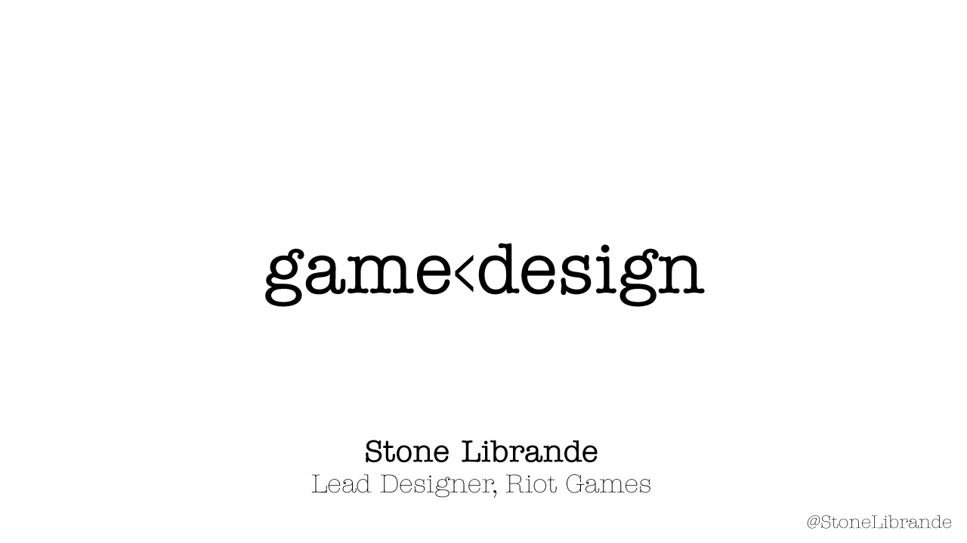
Please turn on “Notes View” to see the talking points for this presentation.
Notes:
Intro
Welcome!
I’m Stone Librande and my talk is “Less game, more design”.
I’ve been teaching game design classes and making video games for over 15 years. During that time I’ve been able to talk to a lot of designers, from students to veterans.

Slide 2
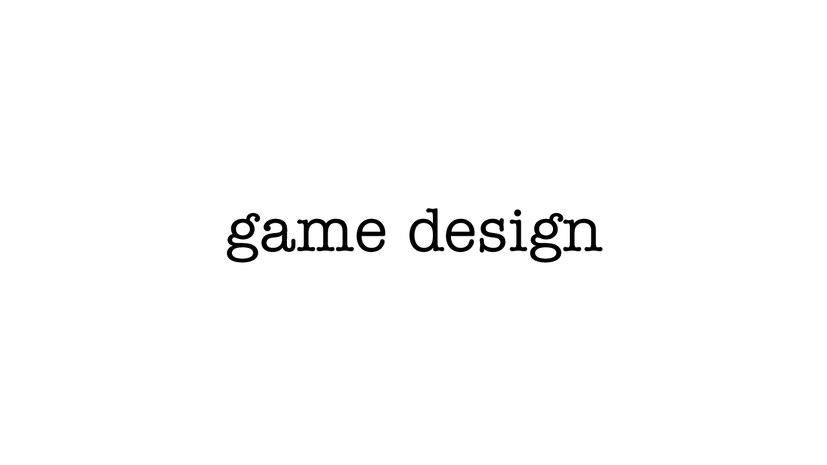
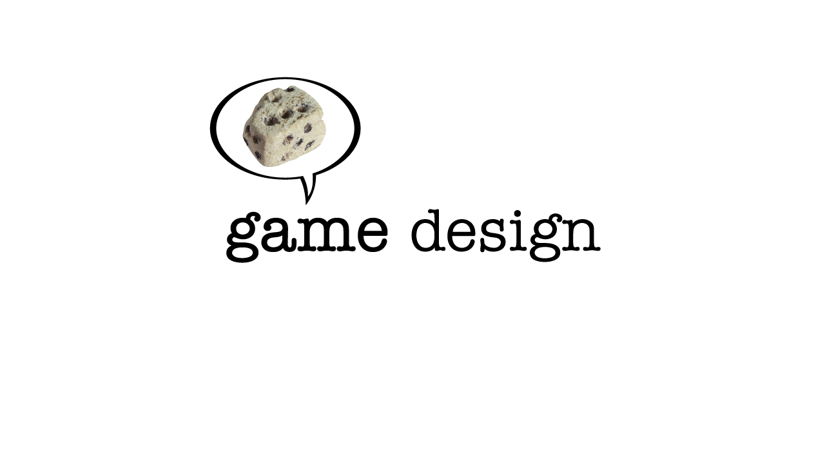
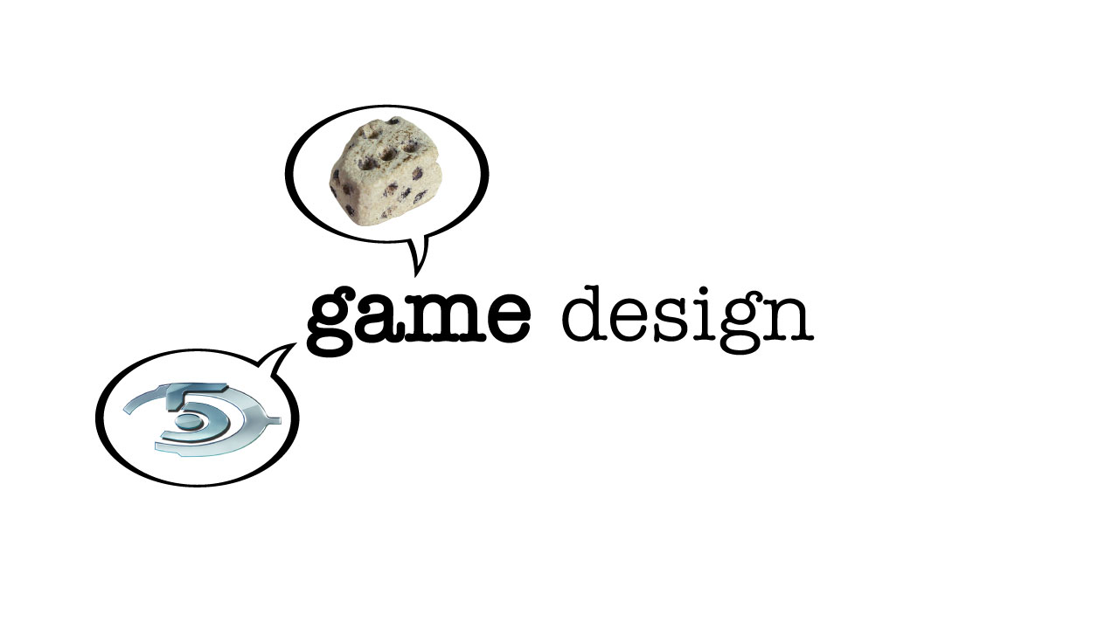
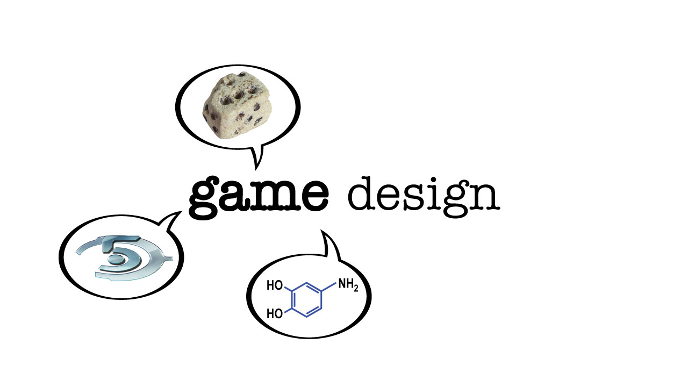
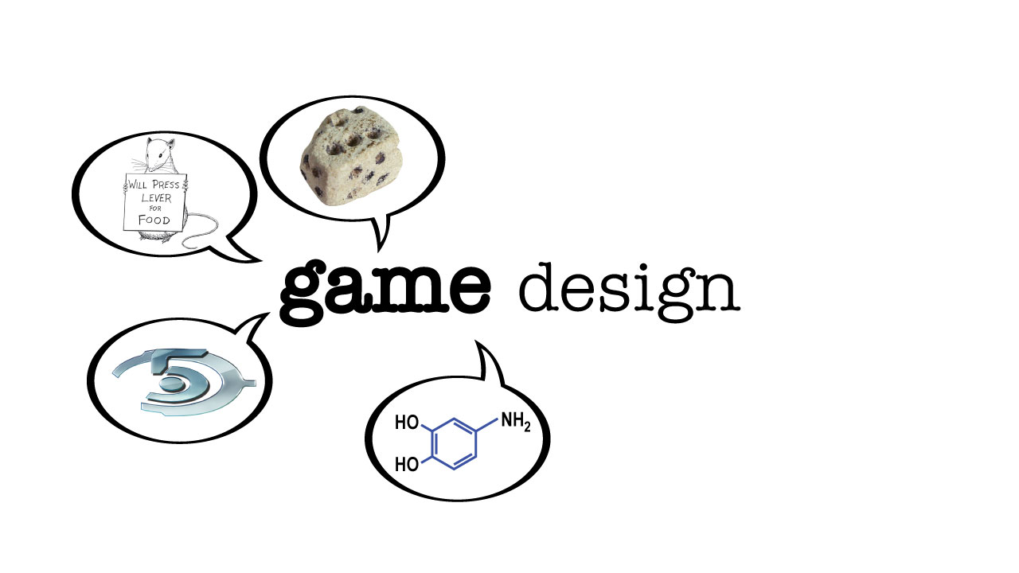
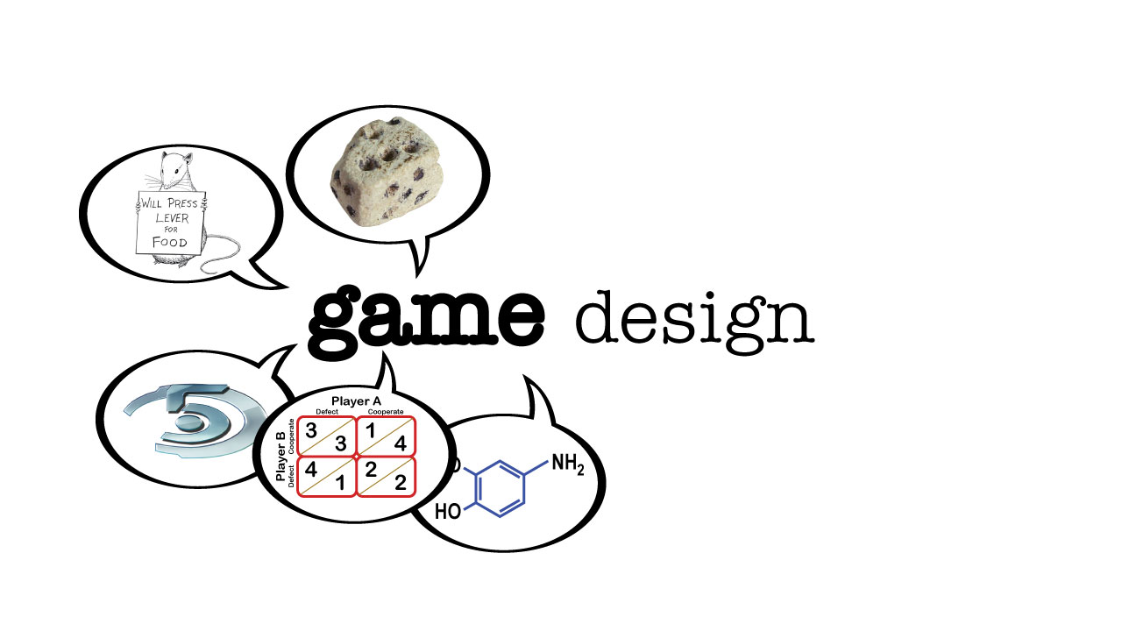
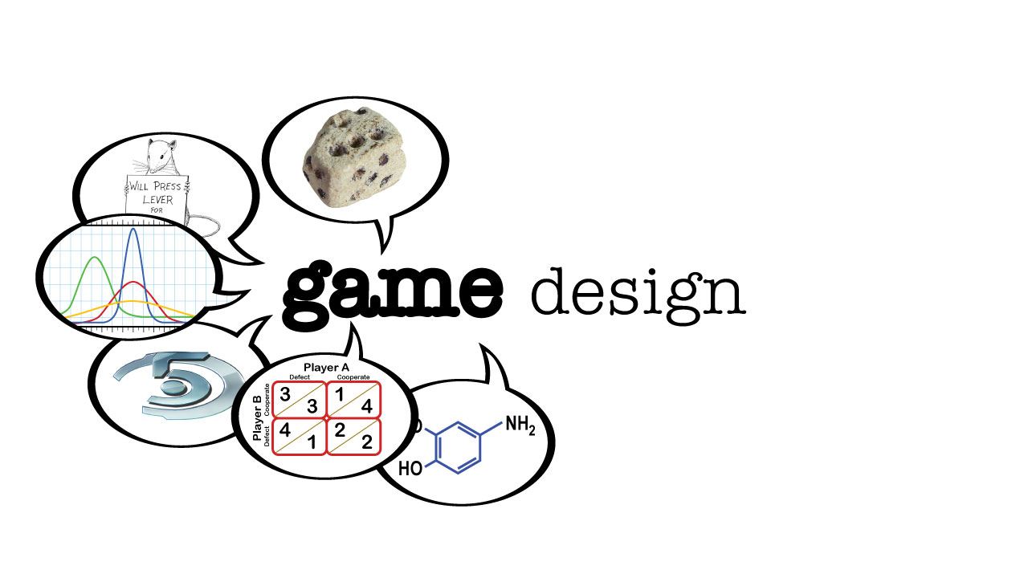
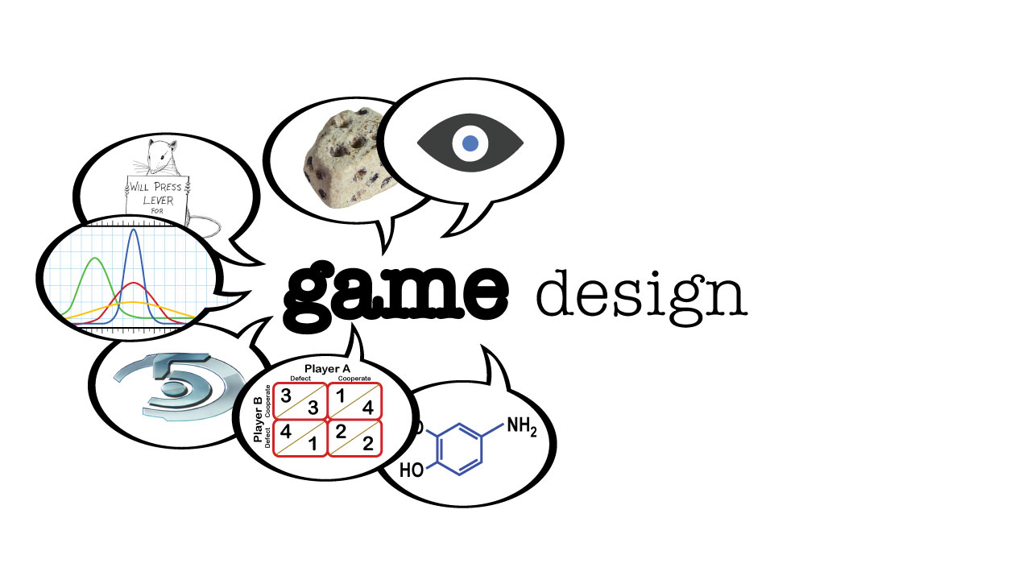
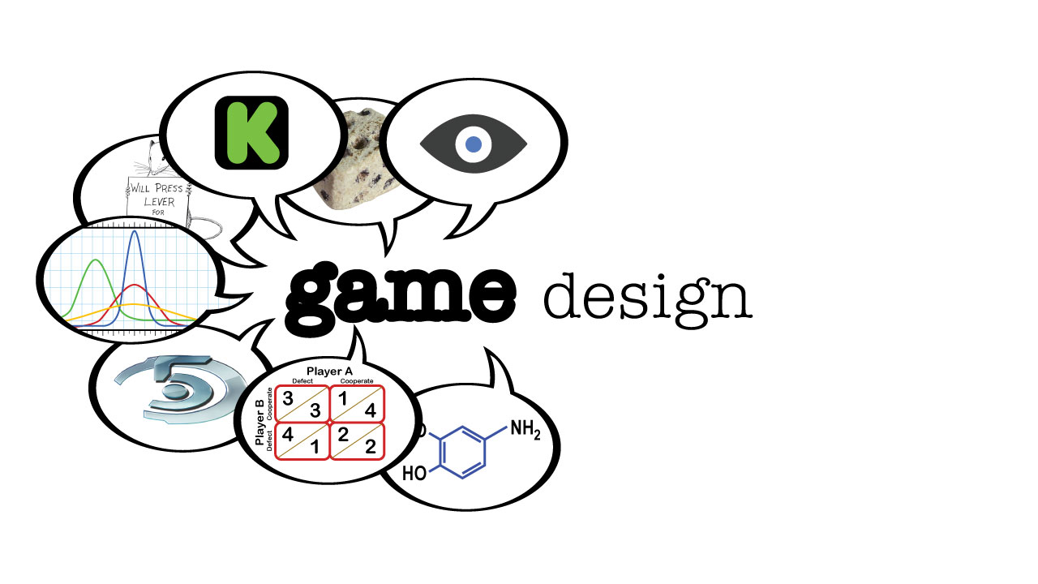
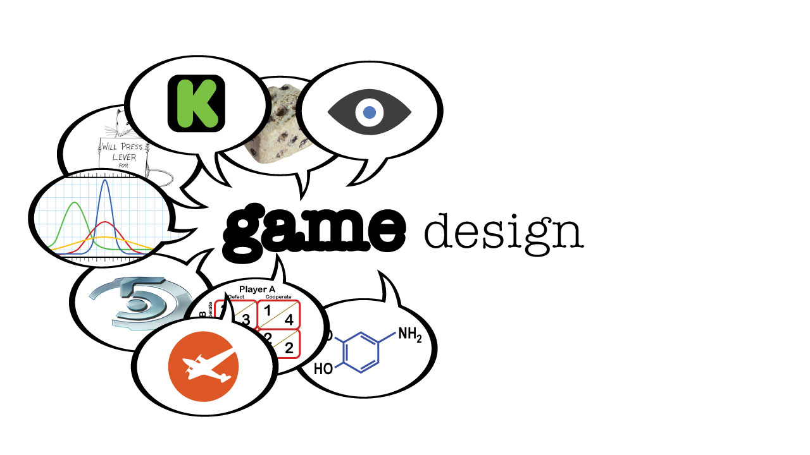
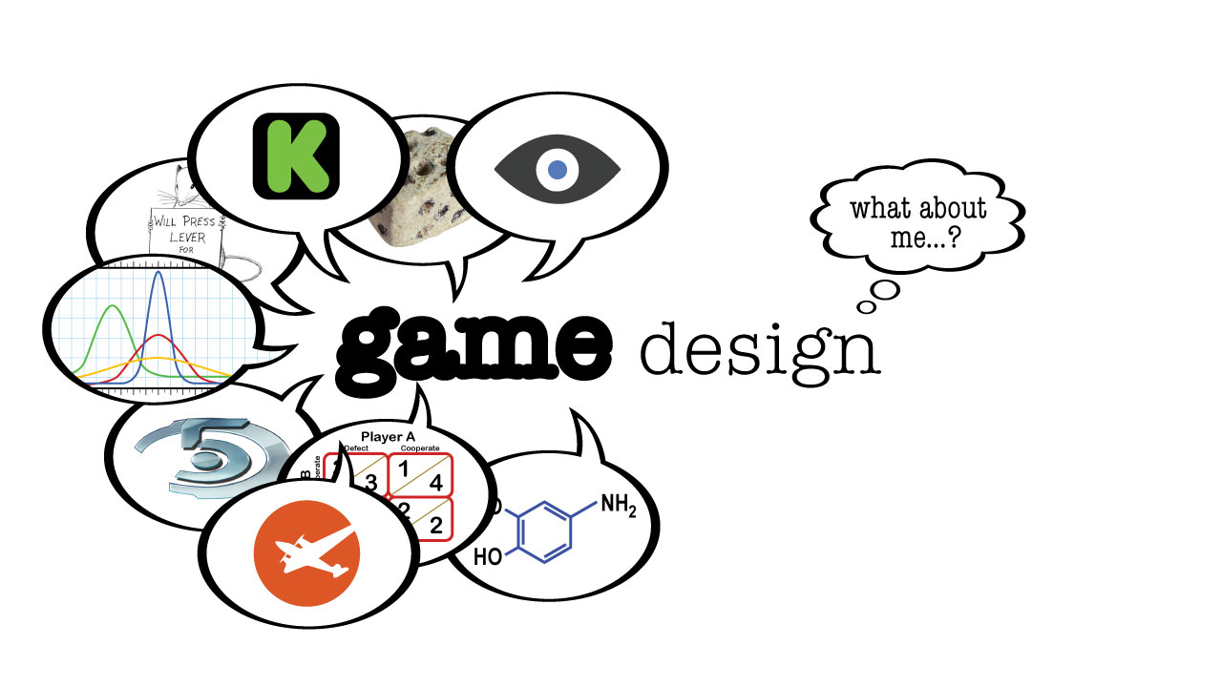
Notes:
Intro
When game designers get together, what do they like to talk about? Games, of course! We can talk about them:
Historically: Gaming history and the oldest gaming artifacts, like limestone dice from Egypt in 30 BC.
Cutting Edge: But also the latest AAA multimillion dollar console titles.
Chemically: We can talk about brain chemistry and how games affect dopamine production.
Psychologically: Or how to manipulate a players’ behaviors using reward schedules.
Mathematically: We can discuss game theory and the mathematics behind it to understand consequences of our tuning. (Prisoner’s Dilemma)
Statistically: And use statistics and probabilities to predict the frequency of outcomes we expect from our players.
We love talking about the newest hardware devices and what games we will develop for them.
And all the new business models and alternate publishing options.
We compare the game programs at different schools and wonder how the students of today will shape the industry’s future.
And that’s all great! I love talking about all of these things.
But recently I’ve been wondering: Why don’t we talk much about design? After all, game programmers frequently talk about programming. Game artists frequently talk about art. Shouldn’t game designers be talking about design?
So for the next 50 minutes I would like to talk about design. But first…let me talk about games.

Slide 3

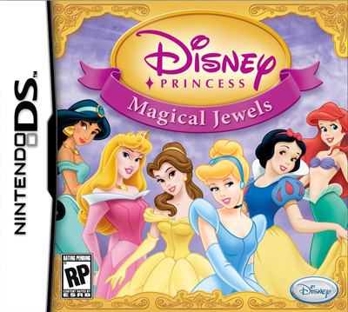
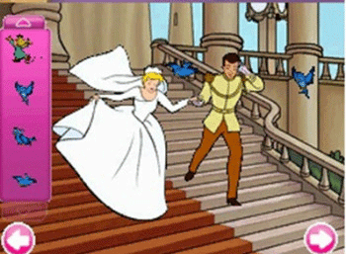
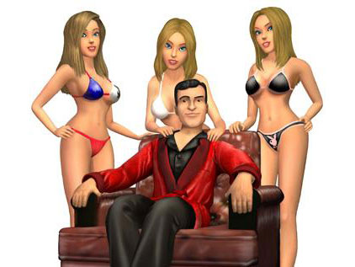
Notes:
Jeb Havens
Here are two games that appear to share nothing in common. Different budget, different audience, different platform. But they both have at least one thing in common: They were both designed by Jeb Havens.
I had the pleasure to work with Jeb at Maxis for several years. When he came into the studio for his first interview I noticed that both of these games were on his resume. I asked him, from a designer’s perspective how are these two games the same? He immediately started talking about their reward scheduling, the frequency of content unlocking, and overall game arcs from the beginning to the end. At that moment I knew that we should hire him.

Slide 4
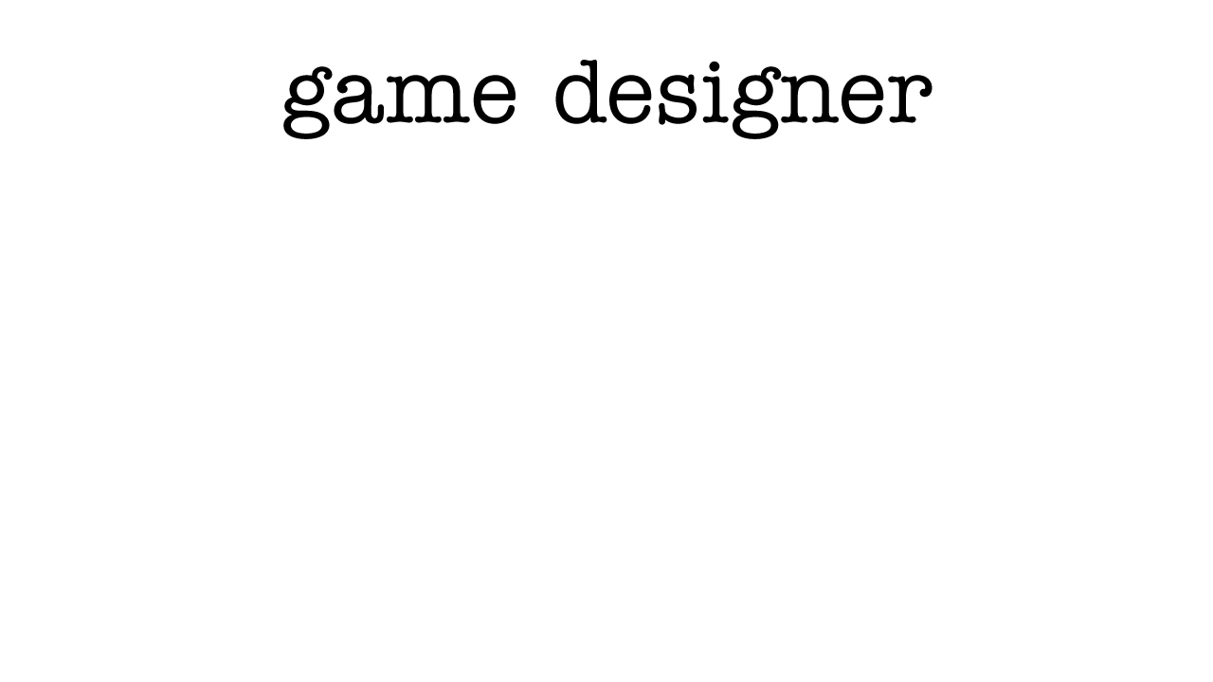
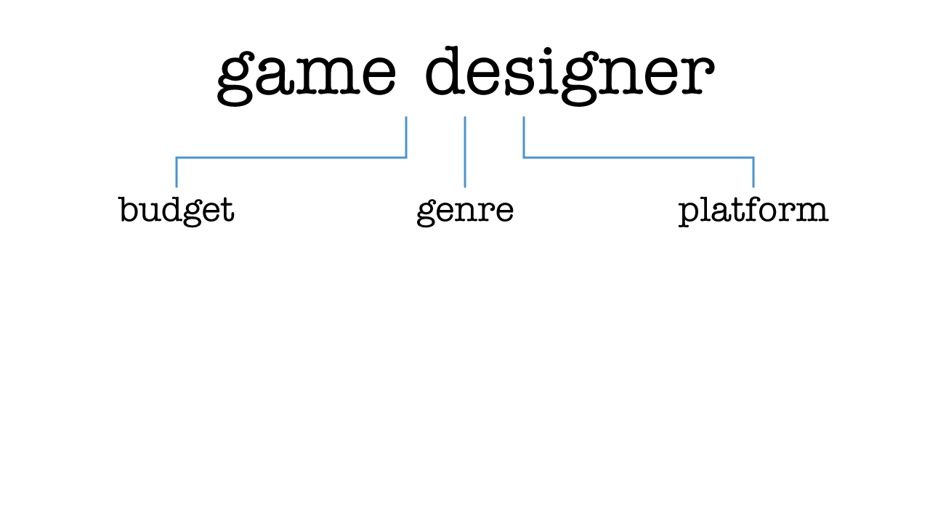
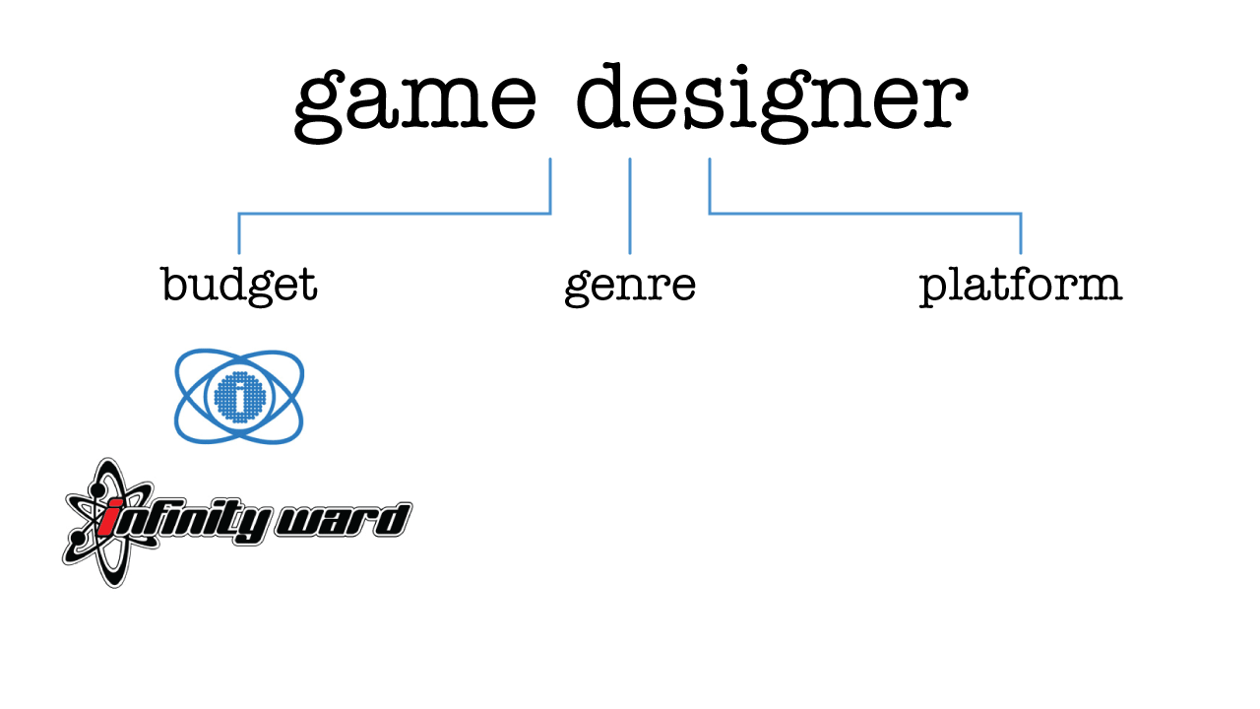
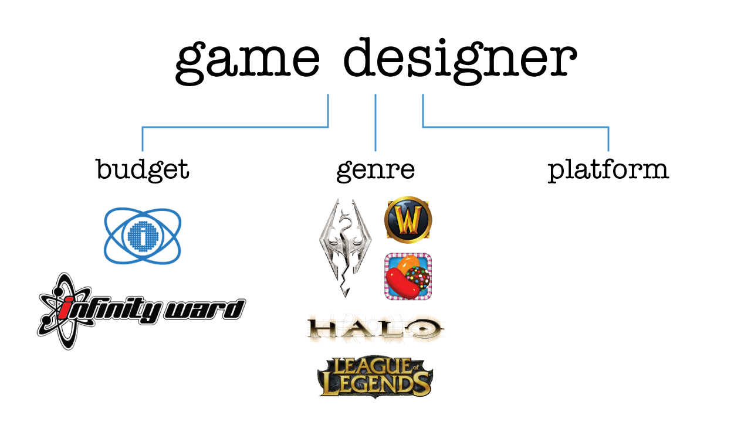
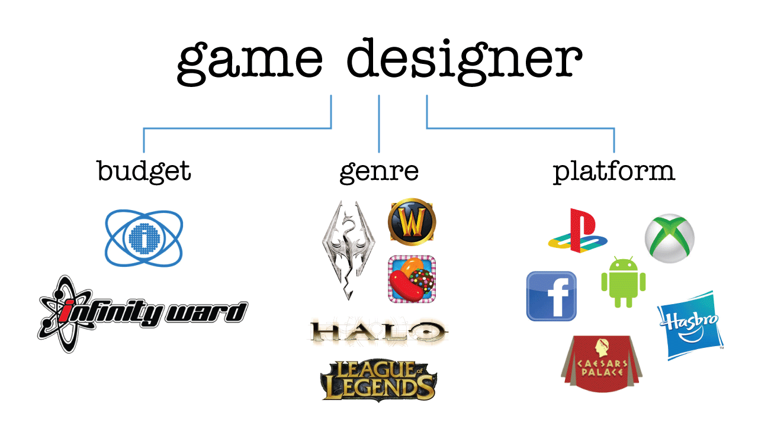
Notes:
Design Specialties
That interview got me thinking about how game designers tend to specialize over time. We all call ourselves game designers, but if you take a deep look at your own skills and experiences you can see that you are most likely focused on a small subset of the game design field.
Some designers may thrive at an indie studio, but wouldn’t have the qualifications (or the desire) to work at a giant corporate studio. And vice-versa. (IGF, Infinity Ward)
Others specialize in certain genres likes RPGs, MMOs, F2P, FPSs, or MOBAs.
Or maybe you are an expert at designing for consoles, or mobile devices, or web sites, or slot machines for casinos, or board games.
After talking with Jeb I wanted to know if it was possible to find the commonality of all of these games. Would it be possible to become a generalist game designer? The type of designer who would be comfortable working on any of these projects?

Slide 5
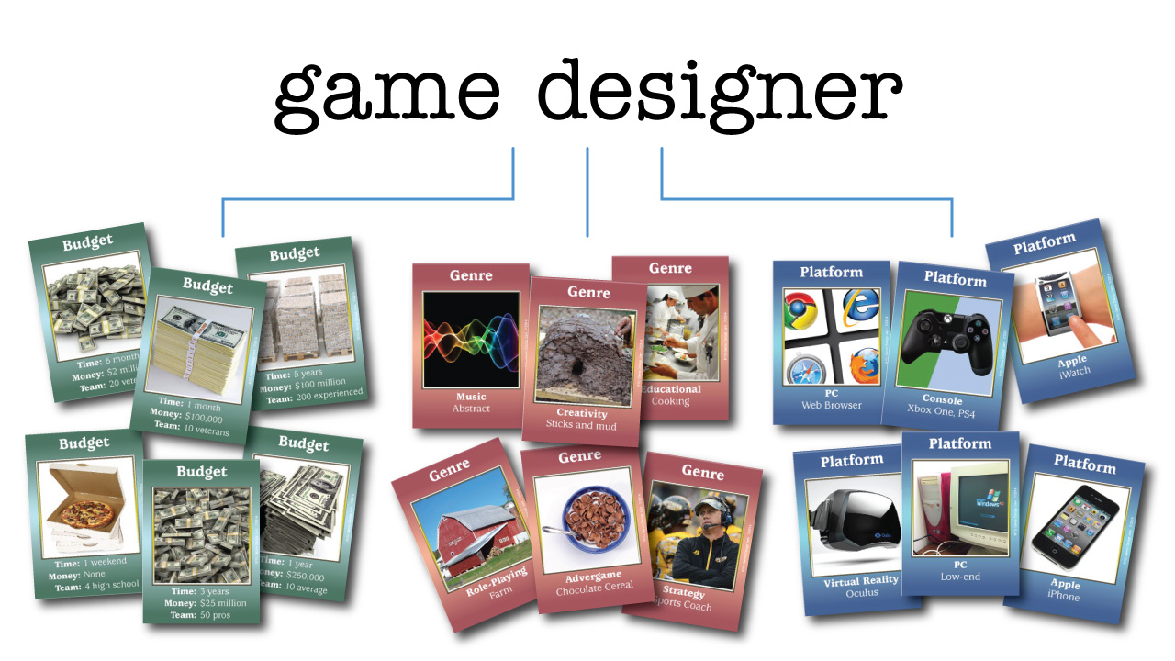
Notes:
Design Jam Game
To test your design skills, try this exercise that I give my students in my game design class. I call it a “Design Jam”. It’s has a Mad-Libs type set up where each designer (or design team) is dealt one random card from each deck. (These cards are available as PDFs on my website.)
The green card represents your Producer, the red card is your Creative Director, and the blue card is your Lead Engineer. (There are also purple cards that represent your target audience.) I give my students about 2 hours to come up with a pitch that will please all their “bosses”. Right when they are getting into it, after about 20 minutes, I walk around the room and replace one of their cards at random. (“Your Creative Director just quit and her replacement wants to do this instead.”)
This is a fun, eye-opening exercise. It is meant to show the students how game design is not about “imagining cool things”. Rather, it is about creating a set of plans under a system of numerous, and often changing, constraints.
In the real world, how flexible are you as a game designer? If the cards got changed would you be able to adapt, or are you so specialized that you would be forced to leave to go work at another studio?

Slide 6
Notes:
Design Specialties
Over the past several years I have been trying to learn as much as I can about game design at that higher level. I try to approach each project I work on from that overarching game design perspective. Of course, there isn’t enough time in one person’s life to work on every type of game. But that’s not the point; the objective is to grow your knowledge. This attitude has lead me to years of studying games, teaching about games and, of course, playing games. And not just video games, but all games, from football to darts to blackjack to Scrabble.
But recently I started wondering…

Slide 7
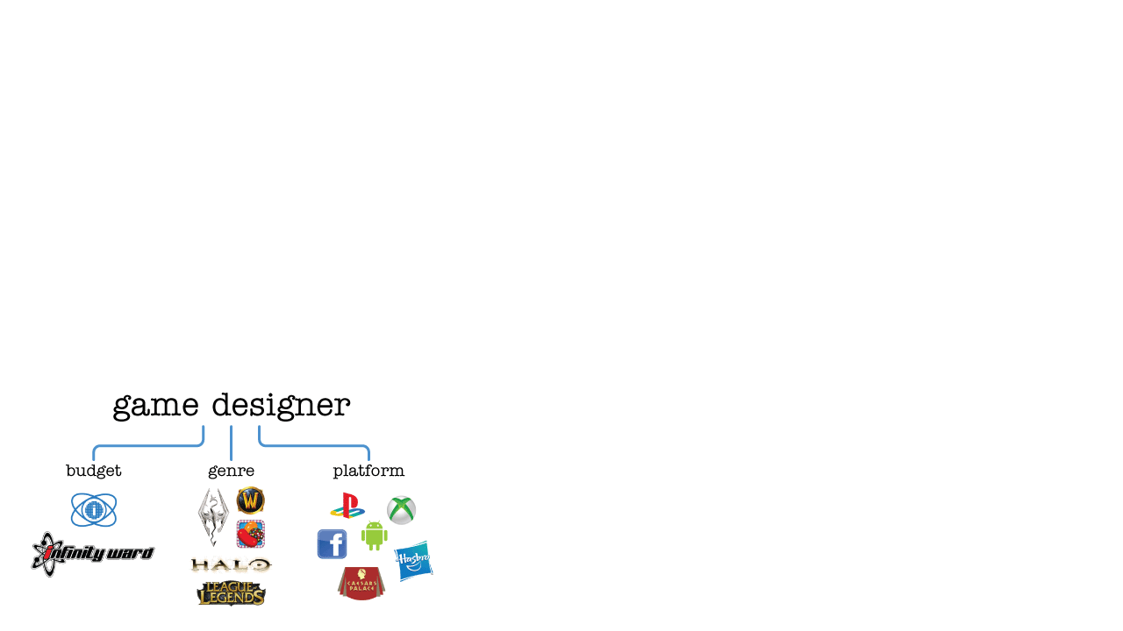
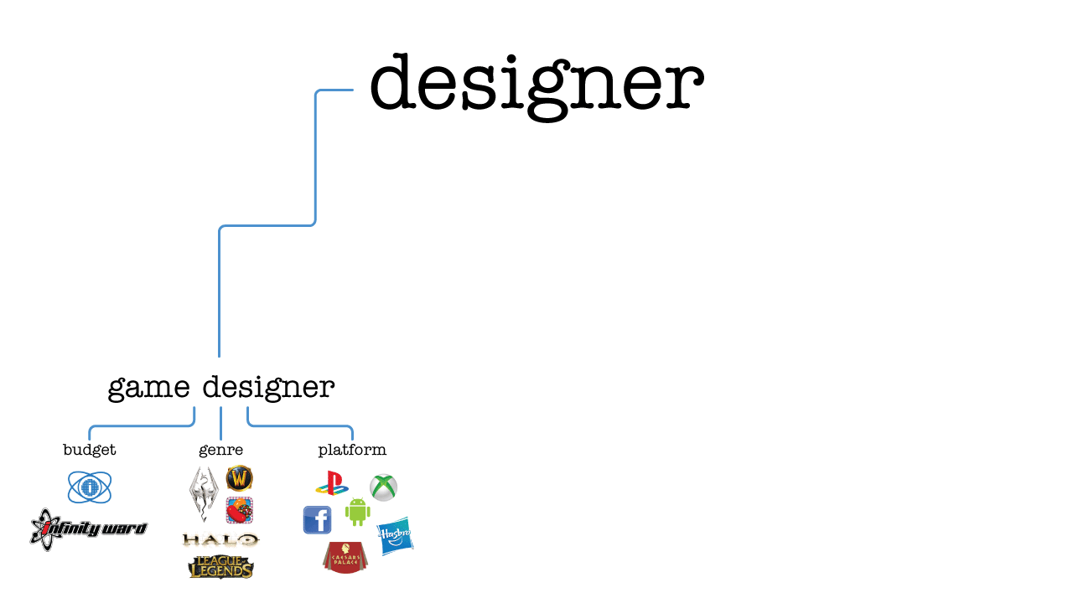
Notes:
Designer
…about what’s up above that? Would it be possible to the elevate my perspective further? Instead of focusing exclusively on the fundamentals of game design, what if I studied the fundamentals that are common to all fields of design?

Slide 8
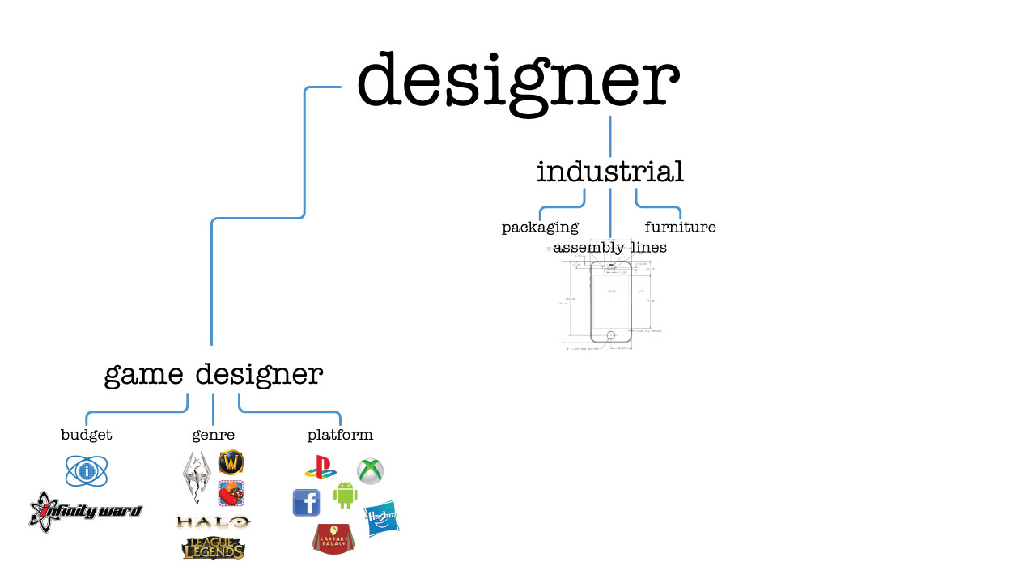
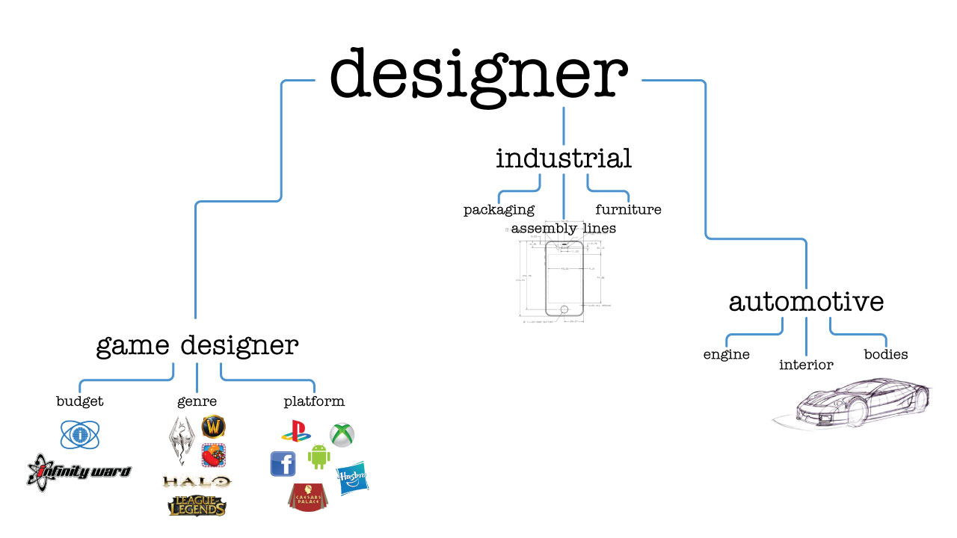
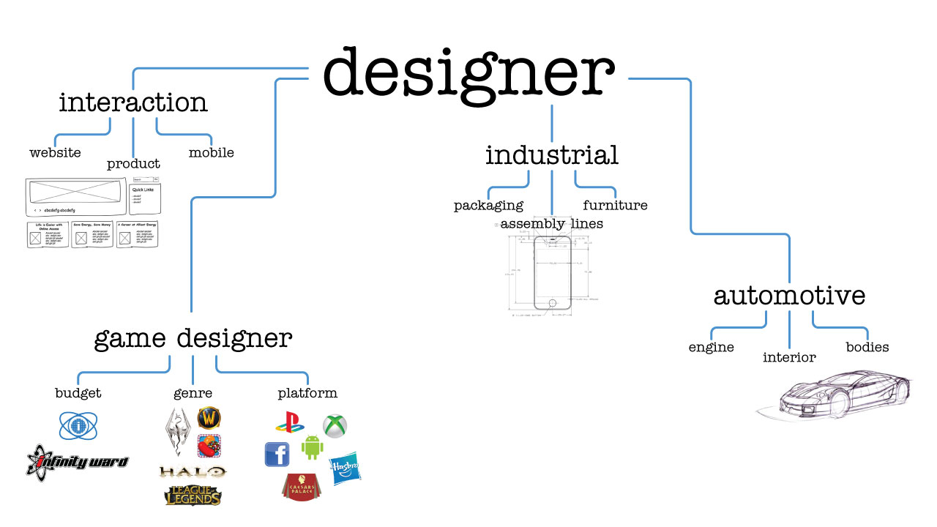
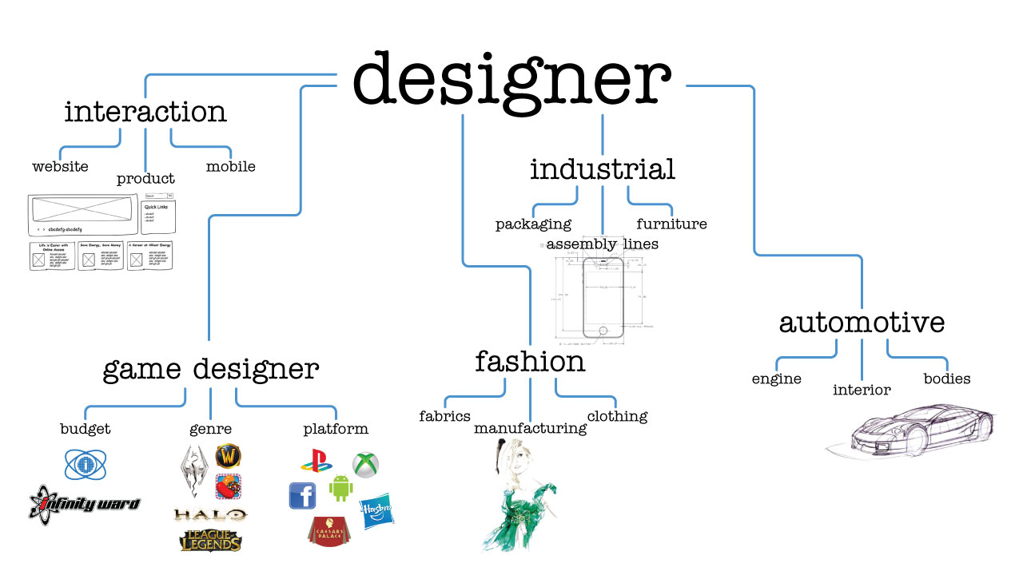
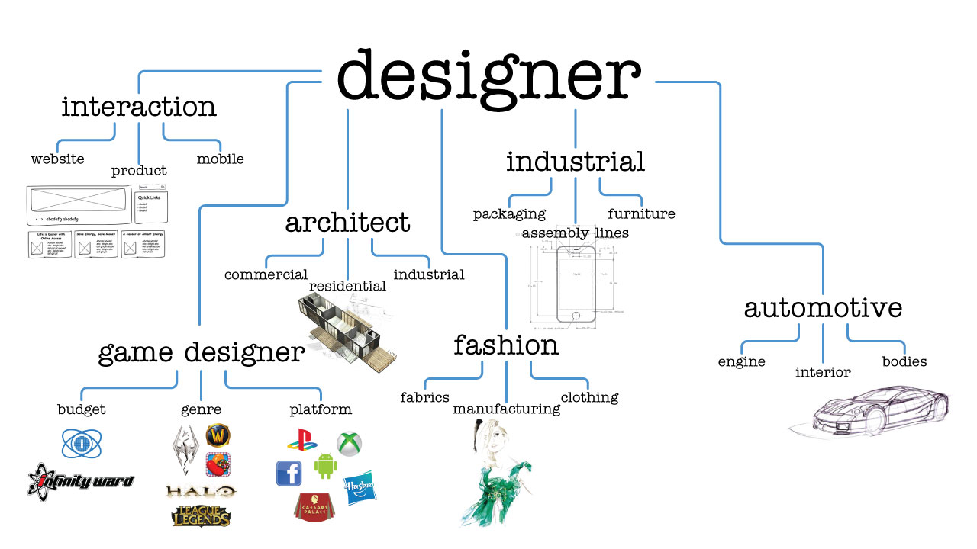
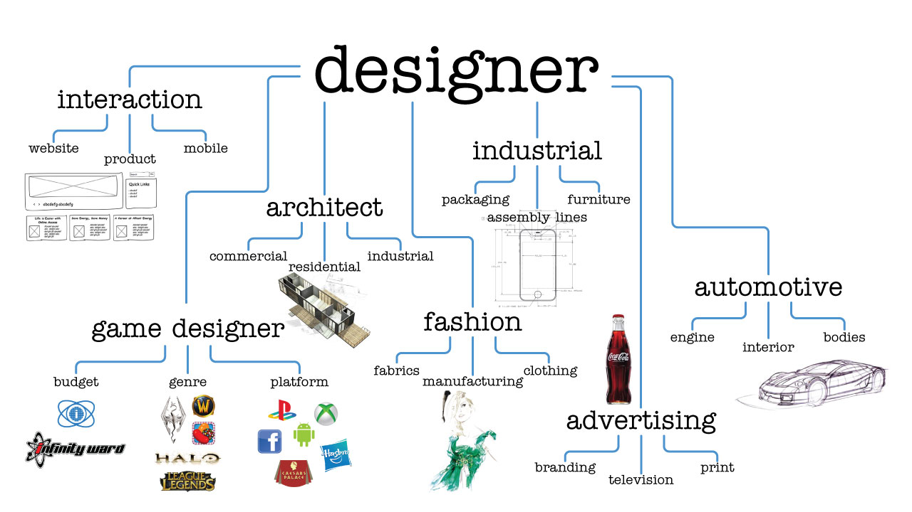
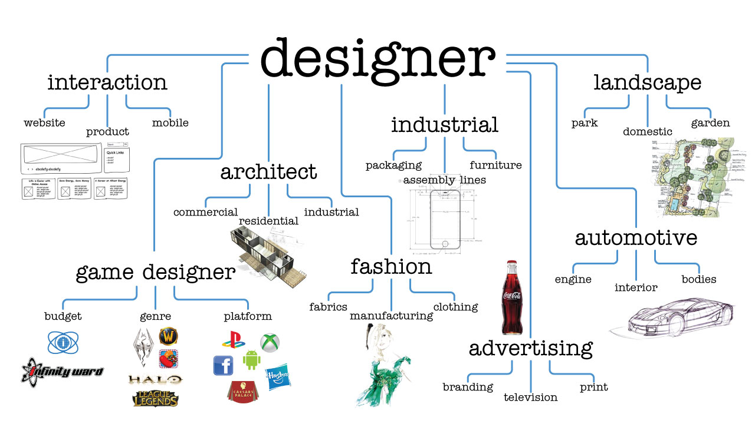
Notes:
Designer
The field of design is huge and covers nearly everything you touch and see.
Industrial designers, like Jonathan Ive from Apple, can become famous for the products they create. But there are thousands of unsung industrial designers working on the systems and the infrastructure to create, package and distribute every product you buy.
Automotive design, with specialist designers for every aspect of a car. For instance, audio designers determine the sound that your horn makes and tune the noise coming from the exhaust system.
Interaction design is familiar to most of you. Many game designers I know are also responsible for this, especially in smaller studios. Every electronic device and web page has an interaction designer (or team) behind it, but so does your microwave oven and your TV remote.
We typically associate fashion design with celebrity fashion designers like Calvin Klein and their seasonal high-fashion shows. But more common are the designers who create bolts of cloth in variety of patterns, colors and thread types. And designers who oversee the manufacturing process of mass-market consumer clothes and accessories.
Architecture is probably the oldest field of design, with hundreds of sub-specialties, including homes, stores, and factories.
Advertising designers who create logos for brands and orchestrate television, radio, web and print campaigns.
Landscape designers who determine where the playground goes in the neighborhood park, or what type of trees to plant for the best shade in the summer.
And this slide barely scratches the surface of the field of design. Look around you. The chair you are sitting on, the shoes on your feet, this microphone I’m using and the speakers that amplify my voice. It only takes a moment of observation to be overwhelmed by the diversity and complexity of the work of other designers.
Is there something that ties all designers together? And, if we find it, will it make us better game designers?

Slide 9
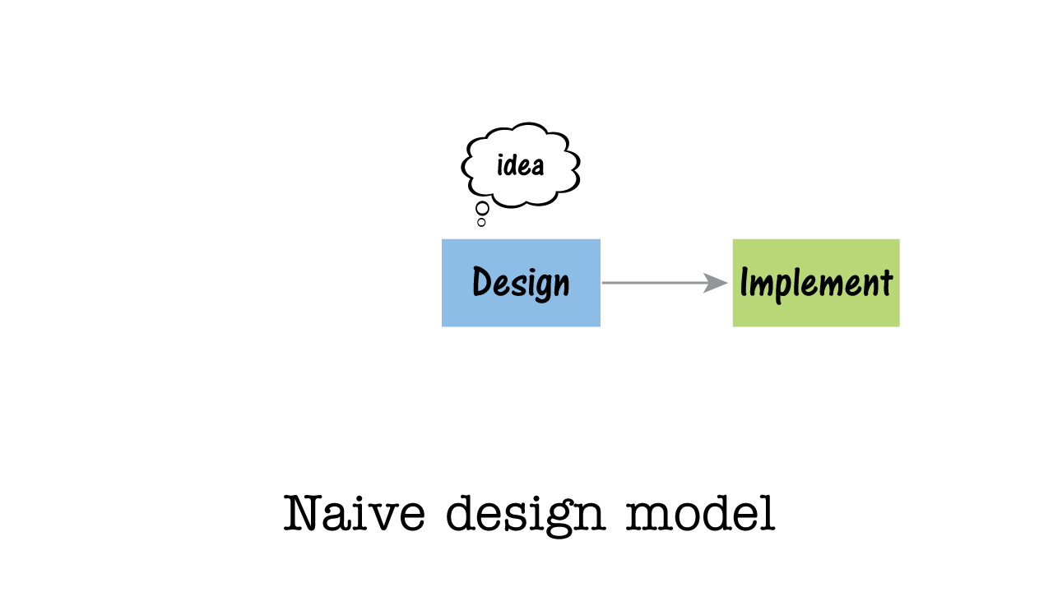
Notes:
Naive Design
So what is design? To people outside of the industry it seems like this:
A designer has a “cool idea” and tells other people to make it come true. This model could apply to a very small studio, perhaps one where the designer was also the multimillionaire owner. But typically, it looks more like this…

Slide 10
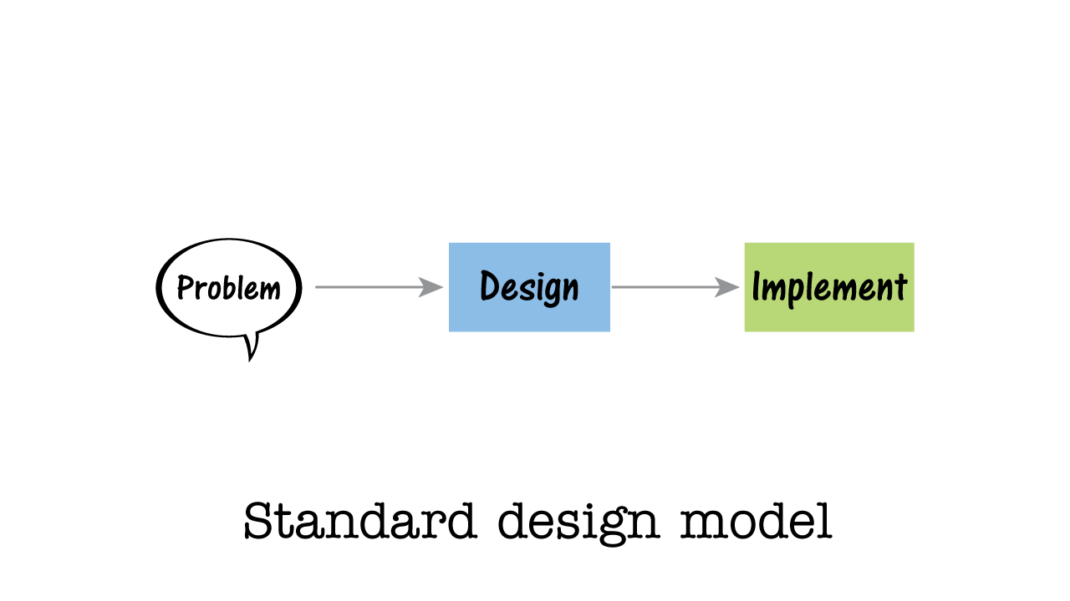
Notes:
Standard Design
The typical designer isn’t asked to think up “cool ideas”. Instead he or she is asked to solve problems, most often given to them from an outside client who is paying the bills. The designer’s job is to create a plan that can be used to produce a tangible object.
I’ll be showing many variations of this design model throughout this talk. I’d like to point out that these models are purposefully simplistic. Like all models, they are abstractions, meant to call attention to points that will be relevant for this talk. They are here to aid communication.

Slide 11
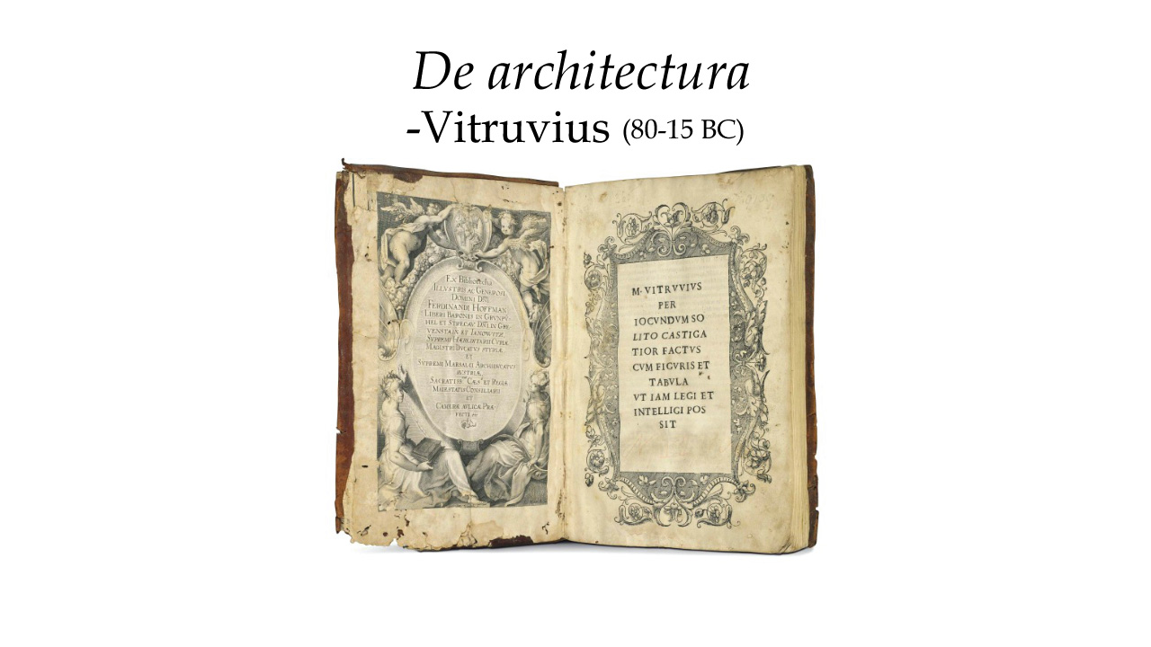
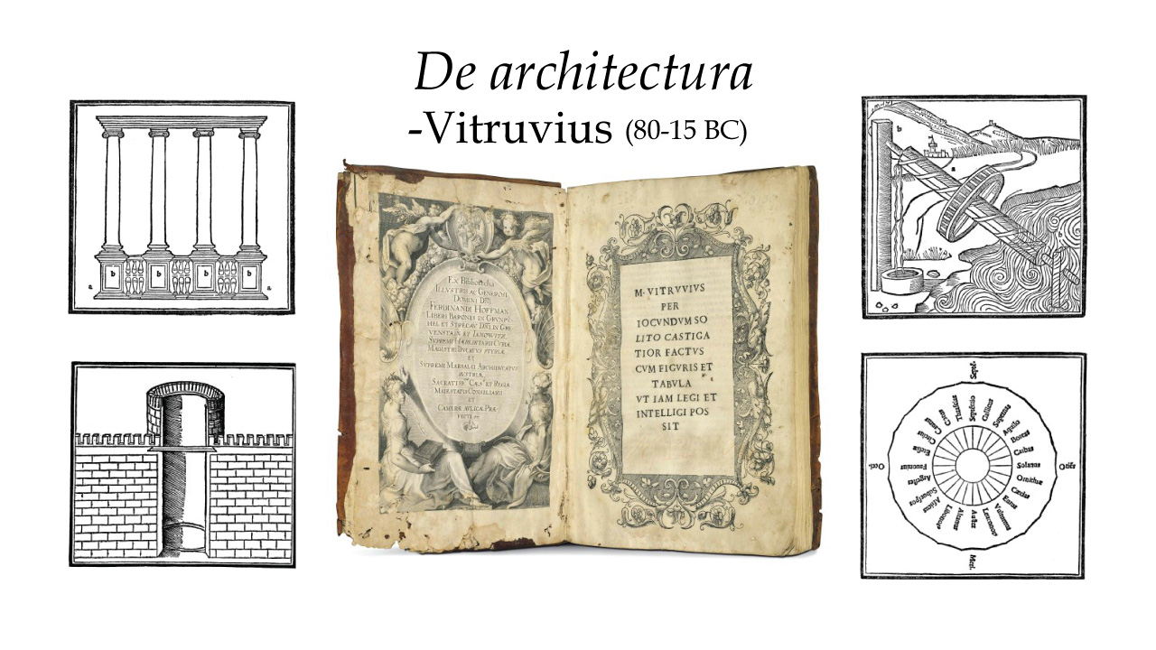


Notes:
De architectura - 15 BC
As I set off on my quest to undercover a deep understanding of design, my first thought was that someone has probably already figured this out. After all, designers have been around for a long time. So what is the oldest surviving design document? The earliest written record of design is de Architectura by Vitruvius of Rome. [Brief overview of the book, its history, and who Vitruvius was.]
Written around 15 BC, but rediscovered in the early 1400’s.
Latin edition in 1486.
Illustrations were lost, but redone in 1511.
Book became a major inspiration for Renaissance architecture.
Da Vinci’s “Vitruvian Man” in 1490.
Vitruvius asserts that an architect must strive to achieve three things: Strength, Utility, and Beauty. These “virtues” aren’t exclusive to architecture and can be applied to all fields of design.
Strength is easy to understand in fields like architecture and furniture making; you don’t want your buildings to fall over or your chairs to break when someone sits on them. In a video game you want your core systems to fit together as a solid whole. For instance, in an RPG your loot drop system, your skill trees, the mission structure, and combat mechanics must all support each other.
Utility means that the design produces something practical and useful. Your systems may be strong, but if the player determines that they don’t help him reach his goal then they are worthless.
Beauty means your designs help create aesthetically appropriate experiences and emotional engagement. The colors, forms, movement and sounds must all be in harmony.
Reference: http://www.stonetronix.com/gdc-2015/Vitruvius__the_Ten_Books_on_Architecture.pdf

Slide 12
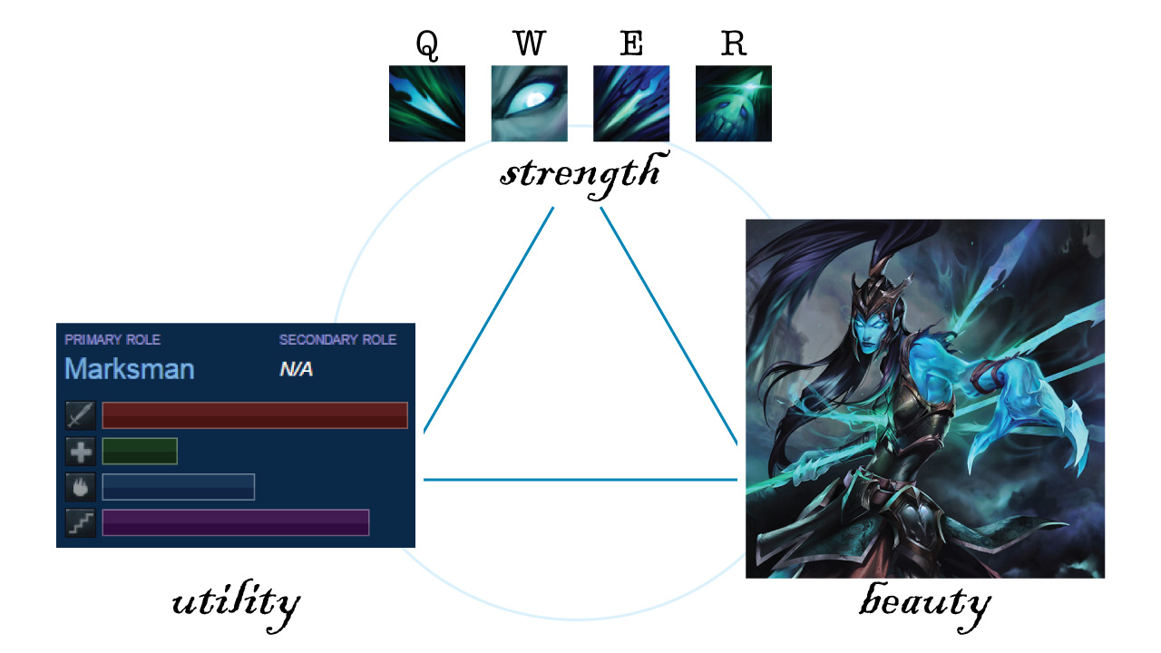
Notes:
Champion Design
Even though these virtues are over 2000 years old, they are still as important today as they were for Vitruvius.
At Riot you can see how these design virtues play out on the champion design team. A new champion needs to be mechanically sound (the controls need to feel responsive, the elements of the kit must synergize, etc.). It needs to have a function in the game context (it has a role to play, it helps the team achieve victory). And champion needs to resonate with the players (its backstory, model, animation, skins, and sound effects). It may even have a unique musical theme.
The process is not an assembly line that goes in linear steps from one team to the next. The champion team works as one group; each corner of the triangle supports and informs the other two.

Slide 13
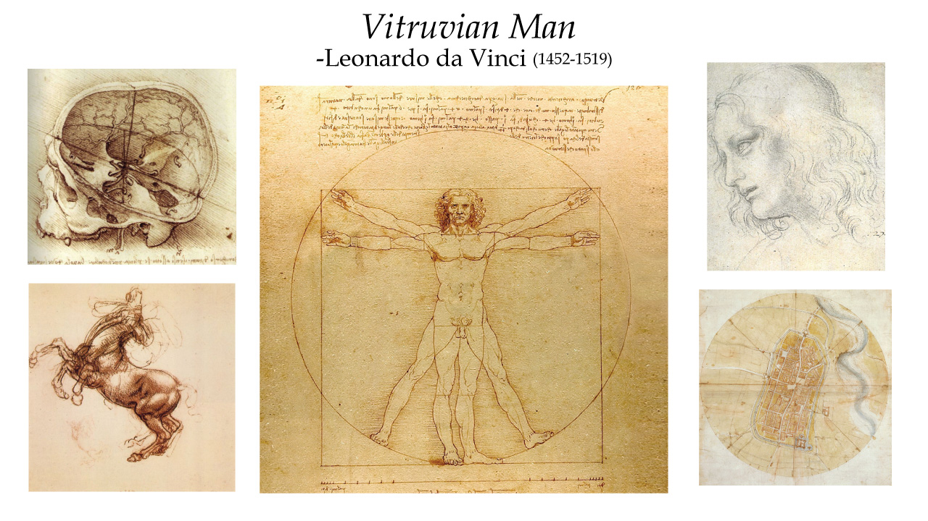
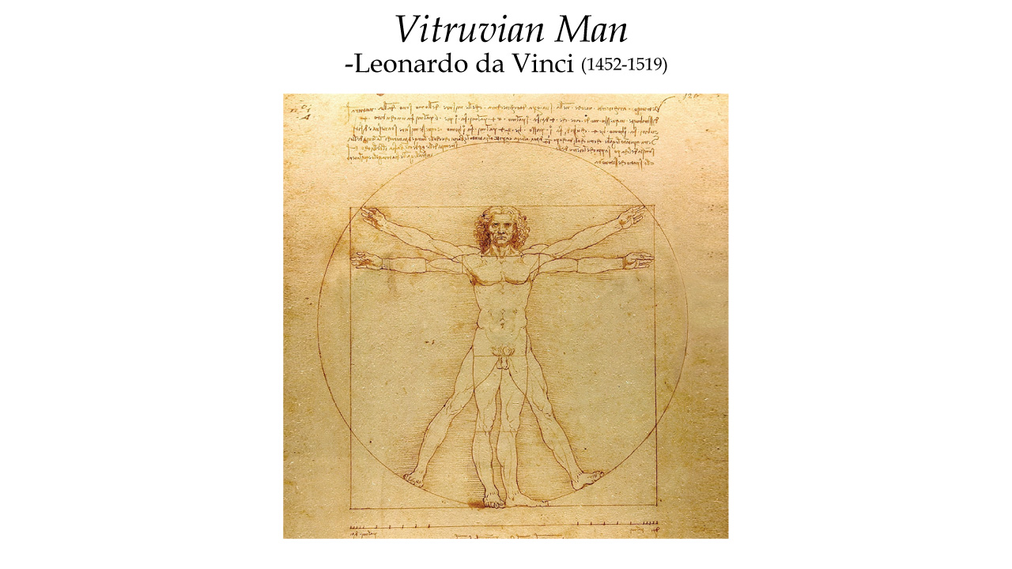
Notes:
Leonardo da Vinci 15 April 1452 – 2 May 1519
What can we learn by studying other great designers throughout history? Would their ancient ideas about design still apply to current day game designers?
One of the people inspired by de Architectura was Leonardo da Vinci. In fact, the famous Vitruvian Man (1490) illustration is based on the proportions that Vitruvius described. (The text at the top of the drawing is the passage from de Architectura describing the proportions of the human form.)
In my opinion, da Vinci is the best pure designer of all time. He a fantastic illustrator that could draw anatomy, wildlife, maps and portraits.
He was a painter, sculptor, architect, musician, mathematician, engineer, inventor, anatomist, geologist, cartographer, botanist, and writer.

Slide 14
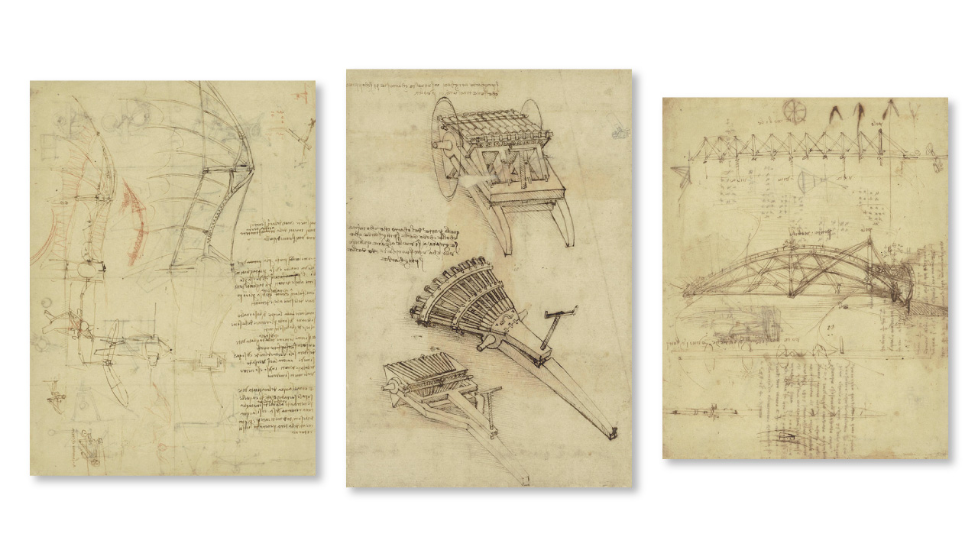
Notes:
Leonardo da Vinci 15 April 1452 – 2 May 1519
One of the many reasons I admire da Vinci is his “one-page” designs. He drew 1,000s of pages of sketches showing ideas for flying contraptions, water pumps, multi-barreled guns, and siege weapons. The majority of these sketches were never found until after da Vinci died. They were bound up haphazardly in several codices after his death. (Bill Gates bought the Codex Leicester for $30 million in 1994 and had the pages scanned for wallpapers in Windows 95.)
Imagine creating thousands of innovative designs, one sketch at a time, and then tossing them into a pile. Da Vinci’s goal here wasn’t to please a client or to publish a book, but simply to explore ideas and make his thoughts concrete.
[Flying machine wing, weapon cart, moveable bridge.]

Slide 15
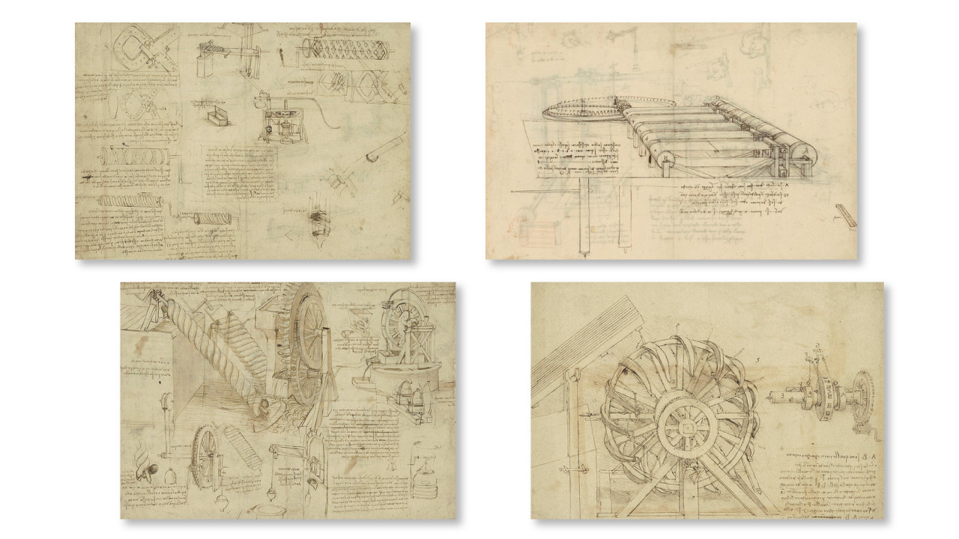
Notes:
Leonardo da Vinci 15 April 1452 – 2 May 1519
[olive oil press, fabric manufacturing, lifting water from wells, rotating crossbows]

Slide 16
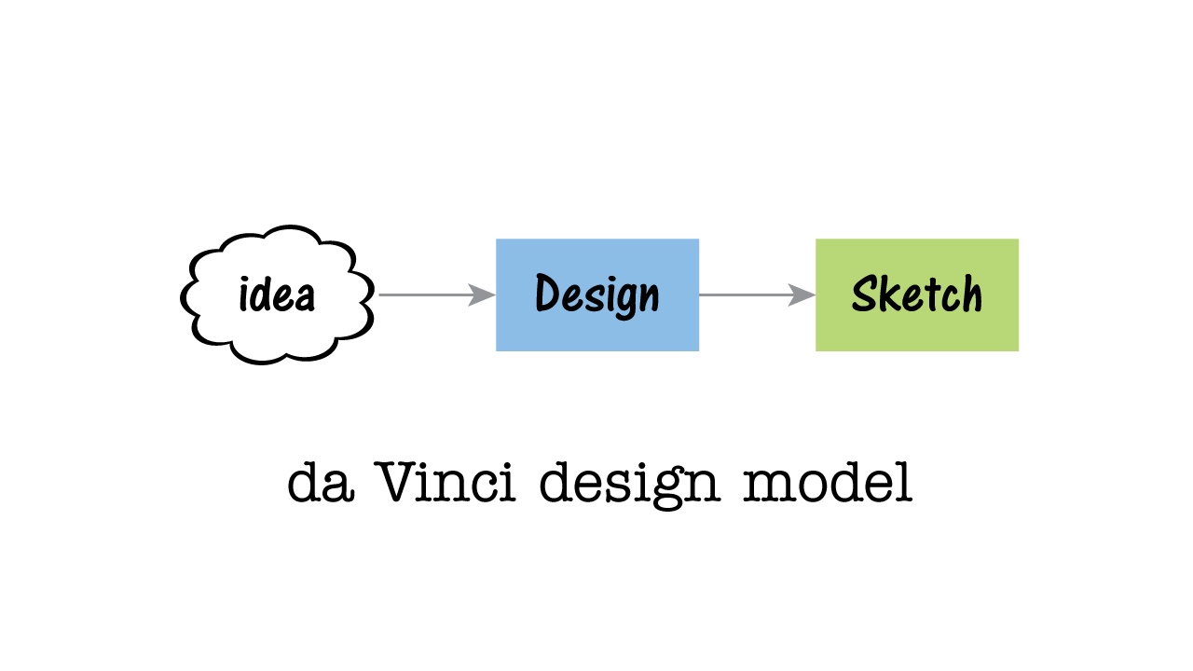
Notes:
da Vinci Model
What was his design process? A simple model looks like this. The input is an idea that he has. The output is a sketch.
Da Vinci didn’t need a client to give him the idea. He was in charge and could choose his own design topic.
And at the end of the process there was no customer to sell to. Building the object in the sketch wasn’t necessary. Once a sketch was completed it was time to move on to another.
But what is the blue “design” box? What happens in there?

Slide 17
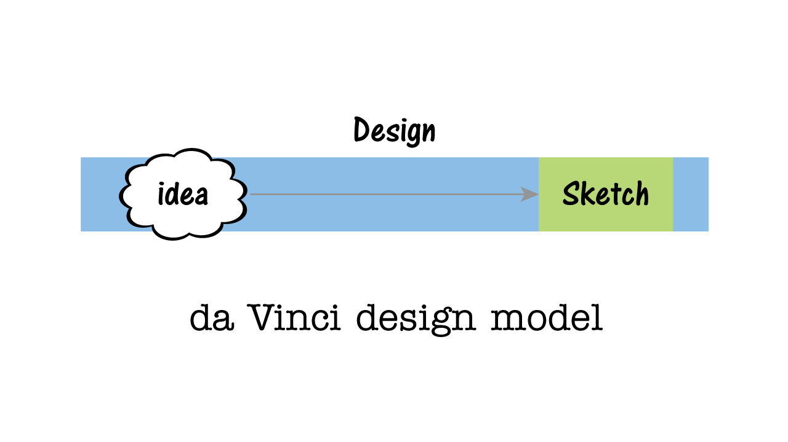
Notes:
da Vinci Model
In this case, the idea and the sketch are the design process. For me, this is design in its purest form. It’s the act of taking an intangible idea and converting it into a tangible plan.
Design requires both of these elements. Anyone can have an idea. But thinking and talking about something isn’t designing. Designing is the process of capturing those thoughts and expressing them as a plan. If executed correctly, the resulting plan can then be used to make that idea a reality.
Game design following this model might be done by a student or hobbyist. Imagine someone with a lot of ideas, but with no computer. This designer has no constraints and is free to sketch game concepts one after another. The goal is not to build the game, but to capture the idea so it won’t get lost before the next idea comes along.
This type of design can be satisfying. I’m sure many of you have sketchbooks filled with your own personal ideas. But these types of designs are “trapped”. They may be valuable for the designer, but will never be used to create tangible objects for others to experience.

Slide 18
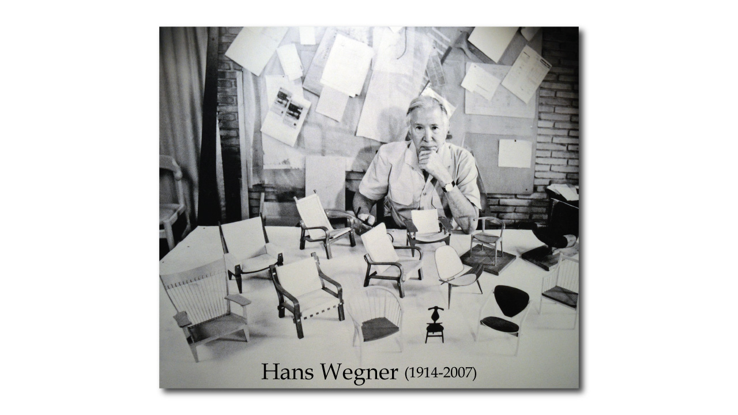
Notes:
Hans Wegner (1914-2007)
Let’s fast forward about 500 years and take a look at a prolific designer who was an expert at converting his plans into tangible objects.
This is Hans Wegner, a Danish furniture designer who started out as a carpenter and cabinet maker. He made his first chair when he was 17. Over his lifetime he designed over 500 different chairs, with over 100 put into mass production.

Slide 19
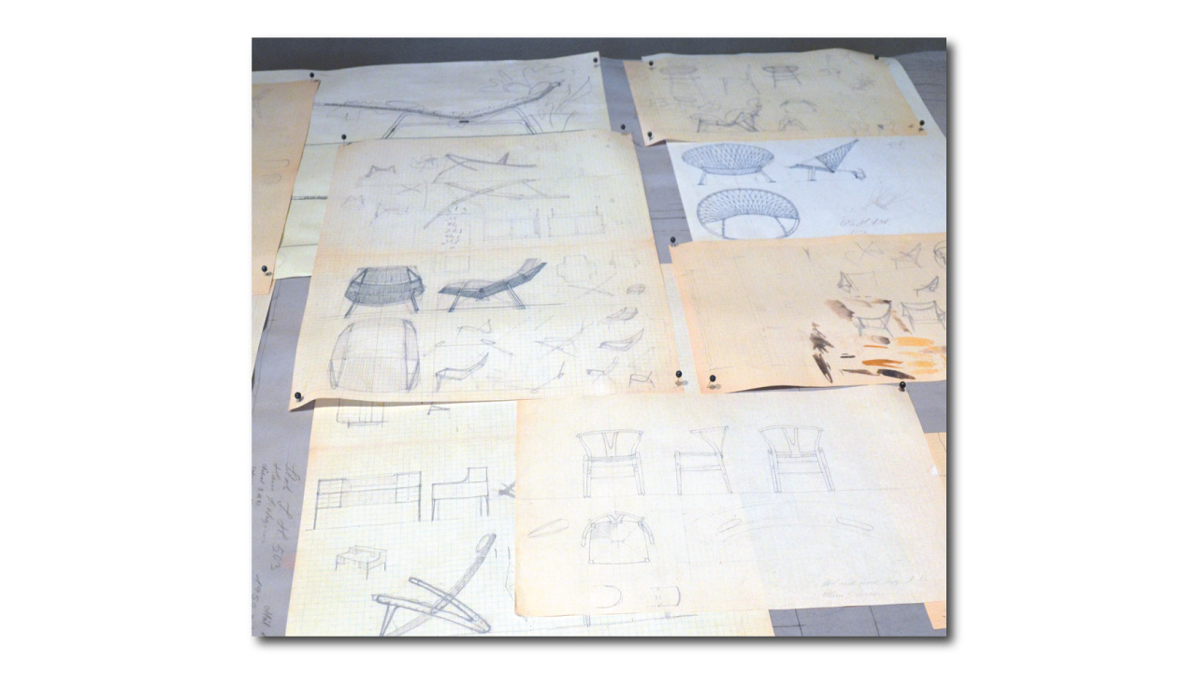
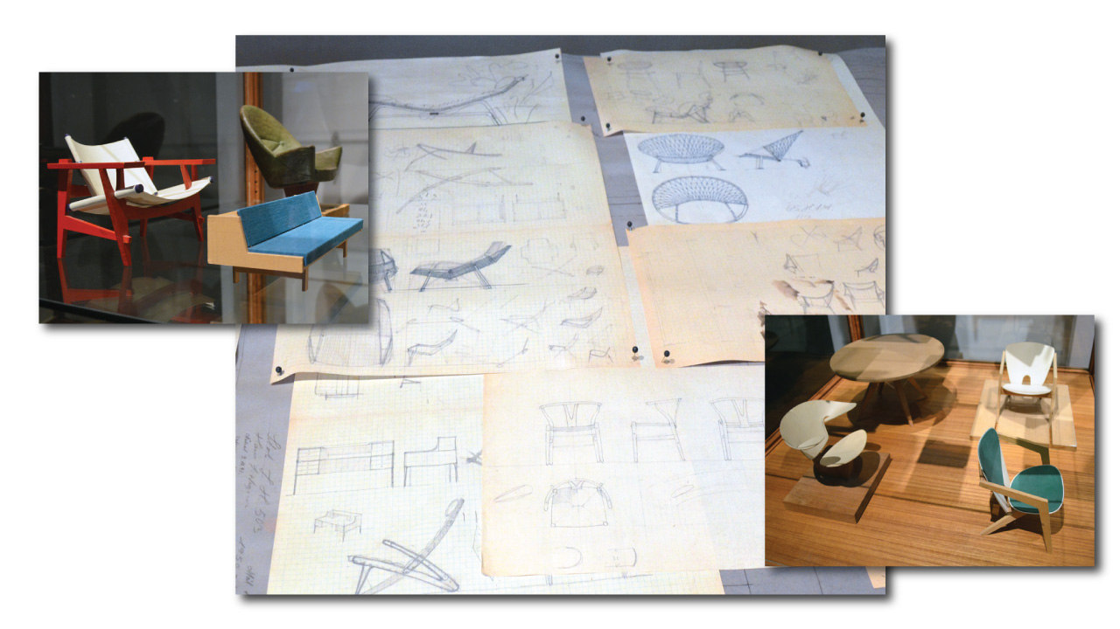
Notes:
Han Wegner
Like da Vinci, he would start with sketches. Then he would build scale models to study the form in 3D. Each of the models you see here are about 2 to 3 inches in length.
I was able to see a collection of these at the Design Museum of Denmark in Copenhagen last summer. The detail and the craftsmanship is amazing.

Slide 20
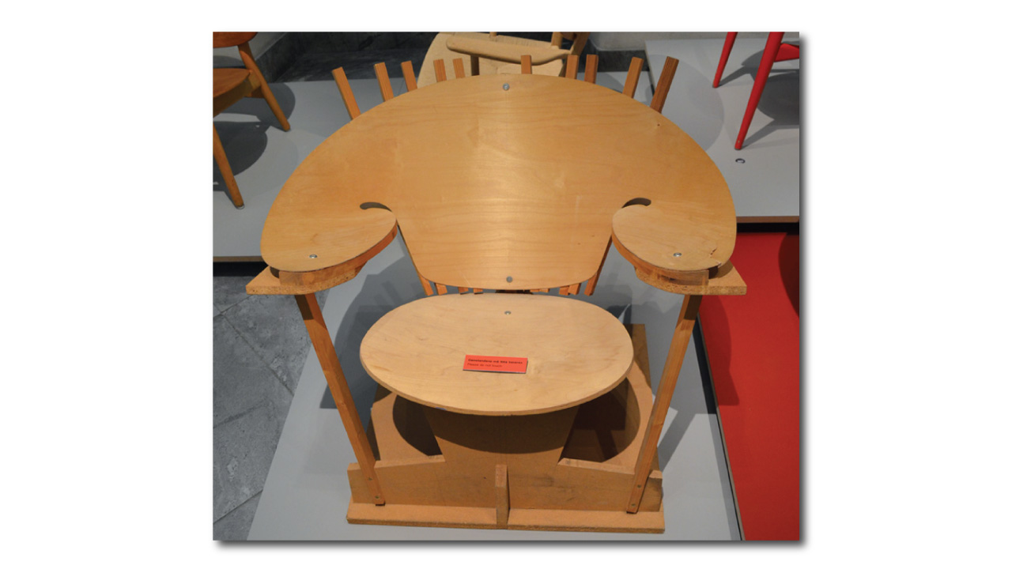
Notes:
Han Wegner
He would then make a full-scale prototype using the desired materials before going into the manufacturing process. In the museum exhibit there are over 100 of these prototypes on display. Notice the way that the wood is bent to make the arm rests flow out from the back of the chair. How would you begin to design such a chair?
Our virtual worlds that we design are filled with furniture and other representations of physical objects. But we are free from the constraints of physics. Wegner didn’t have that luxury. His designs required him to understand forces, materials, gravity, and human anatomy. Since many of his chairs were meant to be mass-produced he also needed to consider the manufacturing process. How much raw material is required and how much does it cost? How long does it take to cut the pieces and assemble them together? It’s not enough to sketch a chair; it must also be built.

Slide 21
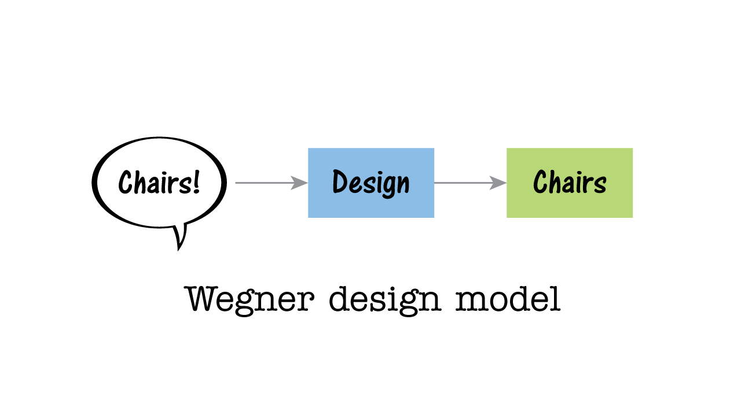
Notes:
Han Wegner Design Model
A simplified model of Wegner’s design process would look like this. A client (sometime Wegner, himself) would request a chair with some requirements. A design would be created that explained how to efficiently manufacture and mass-produce the chairs.

Slide 22
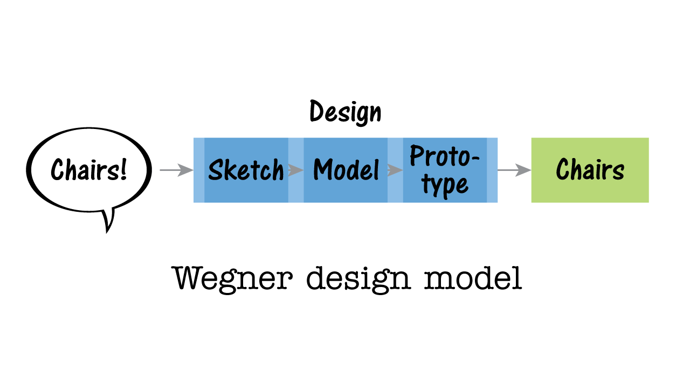
Notes:
Han Wegner Design Model
The design would involve sketches, models, and prototypes. Think of each element as a different view of the same plan.
The process is linear, with each step informing the next. There is no need to model if the sketch isn’t promising. There is no reason to build a full-sized prototype if the model isn’t promising.
This is a very formal and disciplined approach to design. It works great for chairs and other physical objects. When dealing with real-world materials the costs rise steeply with each phase of production. You don’t want to manufacture hundreds of chairs and then find out you made a mistake.
The digital worlds that we create have the advantage that they can be copied and distributed for relatively nothing. Unlike Wegner, we aren’t restricted by the physical constraints of gravity, stresses, and material properties. This can be quite liberating, but it allows us to be sloppy with our designs. I’ve often seen designs rushed into production with little overview because time was running out. “The customers can test it.” “We can patch it later.”

Slide 23
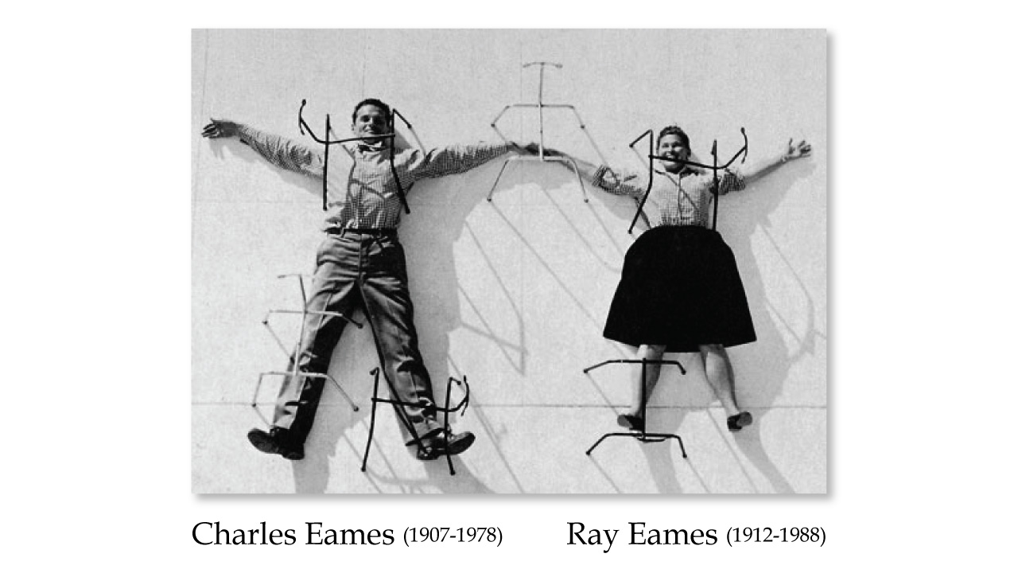
Notes:
Charles and Ray Eames
Here are Charles and Ray Eames, who were contemporaries of Wegner. (Here they are doing their own unique take on the Vitruvian Man.)
Charles started out as an architect in the 1930’s . He married Ray, a painter, in 1941 and the two of them worked together closely as designers in their studio in Los Angeles.
Charles and Ray Eames pioneered a deeply human approach to design. Instead of simply designing objects to make their client money, they wanted to understand the customer as a person. This human-centered approach was evident in all of their work.

Slide 24
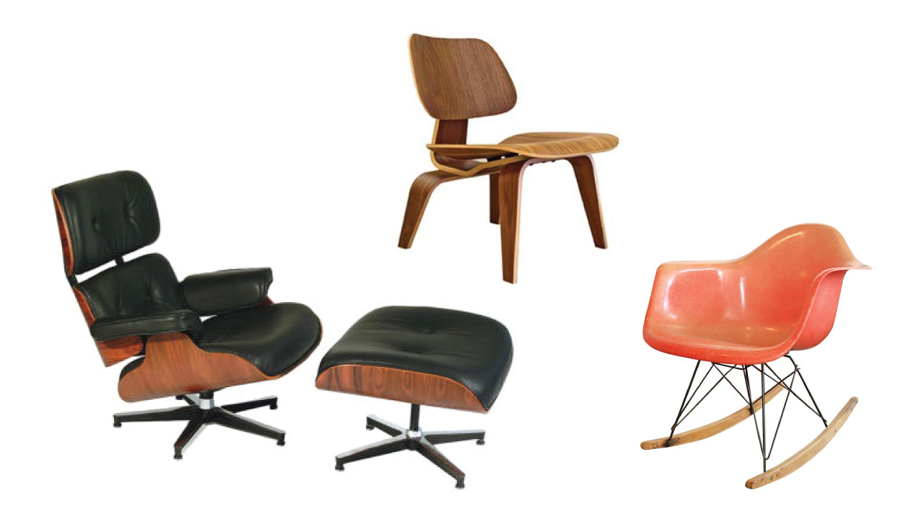
“What works is better than what looks good. The looks good can change, but what works, works.”
-Ray Eames
Notes:
Charles and Ray Eames
1950s – Furniture design
Their studio, the “Design Office”, started out making chairs. Here are a few of the many chairs that the Eames designed and produced. They experimented with numerous materials: molded plywood, fiberglass, wire mesh, cast aluminum. They weren’t attempting to make art pieces or high-end furniture, but were trying to make affordable quality furniture for the average consumer. They designed stadium seats, airport seats, school desks.
Unlike Wegner, they didn’t devote their lives to chairs and furniture. They continued to grow as designers and their design careers were both wide and deep. They were enamored with the design of all things, including buildings, interiors, furniture, rugs, toys, stage and movie sets, urban planning, industrial products, exhibitions, photography, films and graphics.
The Eames are my role models for “Designers” that clearly focused their energy to understanding the top-most level of the design hierarchy.

Slide 25
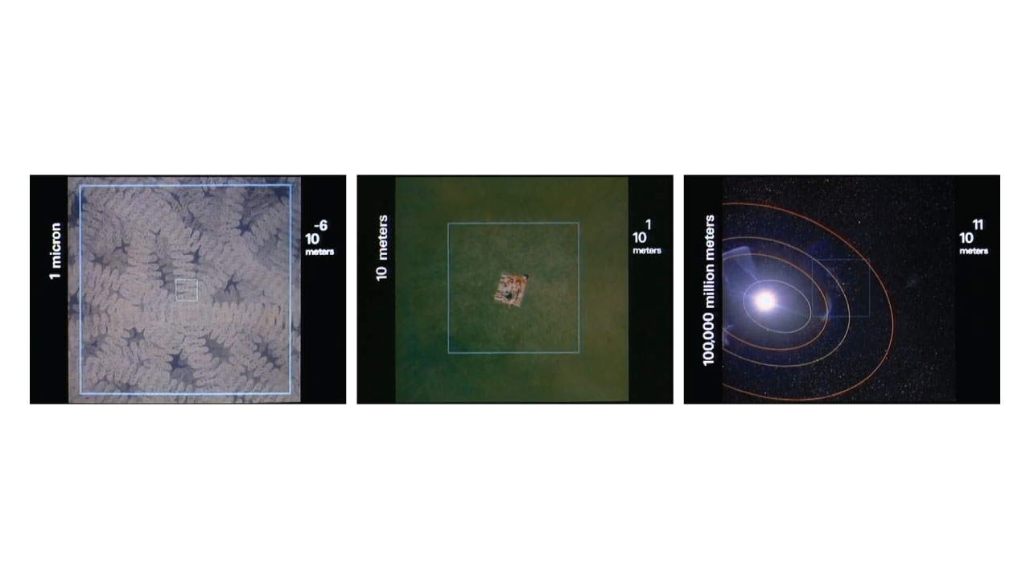
Notes:
Charles and Ray Eames
Even if you have never heard of the Eames then you might know their other work. For instance, they did the original “Powers of 10” film. (This was one of Will Wright’s inspirations for Spore.)
[1968 “Prototype”, 1977 “Final”]
Reference: https://www.youtube.com/watch?v=0fKBhvDjuy0

Slide 26



Notes:
Charles and Ray Eames
The Eames house. (1949)
Here is the Eames house that they designed together. It is located in the Pacific Palisades in Los Angeles. It’s a simple rectangular form, but notice the care taken with the placement, texture and color of every object. The interior design was Ray’s doing; she was meticulous with her designs, whether she was painting or putting a collection of objects on a shelf.

Slide 27

“The extent to which you have a design style is the extent to which you haven’t solved the design problem.”
-Charles Eames
Notes:
Charles and Ray Eames
Ray worked with Eero Saarinen (an architect and close friend of Charles’, who, among other things, designed the St. Louis Gateway Arch) on the design of the IBM plaza for the 1964 World’s Fair in NY.
IBM wanted to educate fairgoers about the wonders of computers. Charles, who loved technology, was more than happy to design the exhibit. Both he and Ray were fascinated by the power of multimedia to communicate ideas. His sales pitch to them was that he wasn’t a computer expert, so was therefore qualified because he understood the audience IBM was trying to reach. (A technique called “selling ignorance”.) IBM essentially gave him a blank check and let him do what he wanted.
IBM didn’t hire the Eames Office for its expertise, which would necessarily be limited; quite the opposite. They hired the Eameses for their process of discovery, of admitting that they knew little, and taking that "beginner’s mind" approach to finding design solutions.

Slide 28

Notes:
Charles and Ray Eames
Inside the IBM dome, the 15 minute multimedia presentation Think was shown on fourteen large and eight small screens, illuminating the workings of computer logic.
It consisted of synchronized slides, film, and a live narrator who was elevated up in front of the screens. A still picture doesn’t do it justice, so let me give you a glimpse of it:
[Reference: https://www.youtube.com/watch?v=2UZYG33D2B4 from 3:00 to 4:30.]

Slide 29





Notes:
Eames design model
Here is Charles’ “design process” diagram. I’ll go over it in a moment, but first I wanted to point out how Charles is applying design techniques to his own studio. He is turning his designer’s eye inward and applying it to himself. This is an important idea, and I’ll come back to it again at the end of this presentation.
Area 1 represents the interests of the Eames studio.
Area 2 represents the interests of the client.
Area 3 represents the concerns of society as a whole.
Area 4 is the overlap: where “the designer can work with conviction and enthusiasm”.
The areas are not static, they grow and develop as each one influences the other.
Note the shift in the way that this diagrams makes designers think about projects. Design can be much more than an assembly line where an idea goes in and a plan comes out. People, and their relationships to each other and world they live in, are the key elements for a successful design. It’s not just about taking the client’s money and giving them what they ask for.

Slide 30

“We don’t make art; we solve problems.”
-Charles Eames
Notes:
As a creative unit Charles and Ray’s biggest contribution was conceptual: They showed that "design" could be an art of manipulating ideas, not just materials. They were master communicators, not fabricators. "We don’t make art; we solve problems" was a favorite maxim of Charles, which still sounds perfectly contemporary in the 21st century, 50 years after he said it.
Terms like "Design thinking" and research strategies, de rigueur now thanks to firms like IDEO, owe a debt to the Eames.
The Eames Office was at the cutting edge of defining the human-centered multidisciplinary design process. Their work presents a finely integrated model that is as relevant today as it was fifty years ago.
Reference: Communicating Technology, Michael JG Turri. (http://www.stonetronix.com/gdc-2015/Eames-Essay.pdf)

Slide 31

David Kelley (1951 - )
Notes:
Design Companies
“Design thinking is a human-centered approach to innovation that draws from the designer's toolkit to integrate the needs of people, the possibilities of technology, and the requirements for business success.” —Tim Brown, president and CEO of IDEO (founded 1991)
David Kelly, Founder
IDEO is the modern successor of the Eames Office. They originally started in Palo Alto and now have offices around the world. They are best known for their industrial designs, but they also do interaction design. They are a “pure” design house, in the sense that don’t do any manufacturing; that is the client’s responsibility.
Here you see some of their workspaces they used for prototyping. Of particular interest to me was the “Toy Lab” which is like a candy store for a game designer. Shelves are filled with thousands of items like gears, lights, dice, cards and fabrics. (Interestingly, they don’t call the people who work in the Toy Lab “designers”. Rather, they prefer to be called “inventors”.)

Slide 32

Notes:
IDEO designed products
Even if you are not familiar with IDEO you might be aware of some of the products they designed.
Original Apple mouse; toothpaste tubes that get all the toothpaste out; upgraded grocery carts and desks for students; immunization shots with no needles or syringes.

Slide 33

Notes:
IDEO studio
These are photos show the “design culture” at IDEO. Every room is filled with Post-It Notes. The environment is highly collaborative and everything moves fast.
Teams are at the heart of each project. The “lone genius” can hamper innovation and creativity. Teams should:
Come from widely divergent disciplines
Be empowered to go get whatever is needed
Merge fun and project
Be as small as three or large as a dozen
Have clear, tangible goals (seemingly unreachable), serious deadlines
Be passionate
Team members should be “crazy” characters. Consider these characters for team
membership: visionary, troubleshooter, iconoclast, pulse taker, craftsman, technologist,
entrepreneur, cross-dresser (formal training different from what they do).
[Reference: Creative Confidence, David Kelley]

Slide 34








Notes:
IDEO brainstorming
Brainstorming is art form at IDEO. They practice it continuously and have a set of rules to keep it productive and focused.
Defer judgment - There are no bad ideas at this point. There will be plenty of time to judge ideas later.
Encourage wild ideas - It’s the wild ideas that often create real innovation. It is always easy to bring ideas down to earth later!
Build on the ideas of others - Think in terms of ‘and’ instead of ‘but.’ If you dislike someone’s idea, challenge yourself to build on it and make it better.
Stay focused on topic - You will get better output if everyone is disciplined.
Be visual - Try to engage the logical and the creative sides of the brain.
One conversation at a time - Allow ideas to be heard and built upon.
Go for quantity - Set a big goal for number of ideas and surpass it! Remember there is no need to make a lengthy case for your idea since no one is judging. Ideas should flow quickly.
Reference: https://openideo.com/blog/seven-tips-on-better-brainstorming

Slide 35


Notes:
IDEO design model
1) Understand and observe: Understand the market, the client, the technology, and
the perceived constraints on the problem. Observe real people in real-life situations to
find out what makes them tick, what confuse them, likes and dislikes and latent needs not
addressed by current products or services. Go to the source not the “experts” inside an
organization. Inspiration comes from observation.
2) Synthesize: All information from Step 1 is collected in the project room. This
room becomes the key tool for translating the information into opportunities for design.
Photographs, diagrams and drawings are all mounted on the wall to prompt discussion
and illustrate key insights. The room becomes a tool for sorting and recording the ideas
that develop.
3) Visualize: Be visual is a primary rule of IDEO brainstorming. Visualize new to the
world concepts and the customers who will use them.
4) Prototype: Prototypes shape your ideas. Prototyping is the shorthand of innovation.
A series of quick iterations (fail early and fail often, but learn from those failures
Don’t get attached to the first, what counts is moving the ball forward, achieving
some part of the goal, not wasting time
Reference: The Art of Innovation, Tom Kelley.

Slide 36


Notes:
d.school
One of David Kelley’s frustrations was trying to find designers that would understand the IDEO way of “design thinking”. His experience was that most design schools were too focused on specializing their designers and teaching them rigid design patterns. He wanted more holistic designers. So he worked with Stanford to create the d.school in 2004. (Formally, the Hasso Plattner Institute of Design.)
The d.school is interesting in many ways. Primarily, the school offers no design degree. Their philosophy is that every discipline needs designers. So the school is open to everyone: engineers, programmers, lawyers, doctors, and marketers. They are teamed together to work on real world problems, often with aggressive deadlines.

Slide 37

Notes:
Rolls-Royce
What can we learn from high end design? Consider, for example, the job of an interior designer at Rolls Royce. They have been making luxury cars since 1907. They have developed a meticulous design process that is completely focused around a very discriminating customer base. Obviously, they must be doing something right.
“A Rolls-Royce is not bought, it is commissioned.”
[Brief overview of company history.]

Slide 38



Notes:
Rolls-Royce hood ornament
This attention to artisan level detail and craftsmanship is exemplified by the hood ornament – The Spirit of Ecstasy. Each one is cast and polished by hand. To protect it, it retracts into the front grill when the car is locked.

Slide 39

Notes:
"A fascination and respect for the traditions and abilities of the artisan, opens up authentic possibilities denied to those vehicles with engineering origins firmly rooted in methods of mass production.“
A Rolls-Royce takes 6 months to build, a Toyota takes 13 hours.
The “Bespoke” program at Rolls-Royce allows the customer to directly design the look of the car. Although the mechanical elements of the car are off-limits to the customer’s customization (you can’t change how the brakes work), all of the cars styling (paint, materials, accessories, etc.) can be hand-picked. Think of buying a Rolls-Royce as buying a million dollar suit, tailored to your exact specifications. Then an army of some of the world’s finest craftsmen and women hand-assemble it just for you.
“Just clapping on standard footrests is never an option. The customer’s inside leg was measured and shoe size noted so that special foot rests could be fabricated and perfectly positioned”.
(Reference: http://rishadm.blogspot.com/2010_01_01_archive.html)

Slide 40

Notes:
Rolls-Royce design model
A “Bespoke” customer is allowed to become the designer and is indirectly given access to a team of artisans. This design model is interesting in that the client, the designer and the customer are all the same person.
At first glance, this model seems foreign to game designers. It would be as if one of your players sat down with you and told you what he or she wanted in the game. Your team still controls the engine and content pipeline, but you have to cede control over the look and purpose of all the assets. When the game is finished it is a unique one-off creation that belongs exclusively to that player.
But if you think about it, this model is similar to how Minecraft works and may explain one reason for its success. Minecraft doesn’t allow you to manipulate the engine, but the content is under the player’s control, and the resulting world is unique and tailored for that player’s use.

Slide 41

Notes:
Rolls-Royce Holdings plc
Designing the styling on your own car is relatively safe. The worst that can happen is that you would lower your car’s resale value. But what about the design processes of large-scale complex systems? You wouldn’t want the passengers of an airplane to design the engines.
Rolls-Royce split into two companies 1973. One for cars (Rolls-Royce Motor Cars) and one for aircraft and marine engines (Rolls-Royce Holdings plc). Try to imagine what it would take to design an engine like this. It’s hard enough to design a chair. Where would you start?

Slide 42

Notes:
Rolls-Royce plc model
Here’s the model they use!

Slide 43

Notes:
Rolls-Royce Holdings model
Here is my simplified flow chart. Not surprisingly, the design process is very strict and regimented. (It uses the “Design Research Methodology”.)
Reference: http://www.academia.edu/2067301/A_methodology_for_computational_design_tool_research

Slide 44

Notes:
DRed softward (Decision Rationale editor)
Each step of the process must be thoroughly documented.
This is a screenshot from the Decision Rationale editor (DRed). The program tracks design decisions over time and logs the thought process, along with all the experimental data collected during testing.
Reference: https://www-edc.eng.cam.ac.uk/projects/designrationale/
Design rationale is an explanation of why an artefact is designed the way it is, and not designed in any of the many other ways typically considered and rejected.
The Decision Rationale editor (DRed) software tool has been continuously developed since 2002, with support from Rolls-Royce plc, together with the UK EPSRC and Technology Strategy Board. It is owned and controlled by Rolls-Royce plc. Example projects created using DRed v3, and a history of public presentations related to Dred: https://sites.google.com/site/robbracewell/
Imagine this level of tracking in your game designs!

Slide 45

Notes:
Rational model
If you start researching design models for large scale projects you will find many examples. The point here is not to teach you these models, but to simply show that in many design fields there are formal processes and designers have created models to describe them.
This is the Rational model which is used in a lot of software companies. It tends to work better for iterative design problems than new design problems where the goal may not be known at the outset.
The rational model assumes a single design tree of decisions which must be traversed in a linear manner to find the best design hiding among the leaves. As a designer works through each successive decision, the final design comes into focus as various alternatives are eliminated on the way to the final goal. The designer can back-track if a particular line of design decisions dead-end in an unsatisfactory outcome. The rational model is manifested in the Waterfall software development process. However, for large and/or complex design projects, design decisions are frequently not limited to design alternatives, but spawn entirely new designs, adding new dimensions to the tree.
The primary flaw in the rational model is that it is not possible to know the design goal in advance. This assumption underpins much thinking in requirements methodologies. If the goal is not known at the outset, then it is not possible to use a single decision tree to arrive at a final design. Moreover, it is typically not feasible to articulate every single design alternative within a clean decision tree.
The rational model of design is natural for engineers.
The rational model is misleading and does not reflect what real designers do or what the best designers emphasize is the core of a good design process
The bad model is important in terms of avoiding bloated products and schedule/budget/performance disasters
The rational model persists in spite of critiques and inadequacies. Contracts and the model simplicity are major factors in its persistence.
Reference: The Design of Design, Frederick P. Brooks.

Slide 46

Notes:
Design Models
The Waterfall model.

Slide 47

Notes:
Design Models
Boehm’s Spiral model
The spiral model is the most promising of alternative models that have been proposed for the rational/waterfall models.
Why do we make models like these? How does it apply to a game designer’s job? You are probably not making mission critical design decisions. But don’t get distracted by the details. The real value of a model is to communicate effectively. It helps organize a team and is an invaluable aid for teaching.
With this in mind, I started thinking about design models for game studios I have worked at. Like the Eames’ diagram I showed earlier, I wanted to apply the design process to itself.

Slide 48

Notes:
Blizzard North model
When I started at Blizzard North I was a programmer and there were no designers. Or, more precisely, the studio believed that everyone they hired was a designer. Instead of having a centralized design department, the design tasks were shared across the entire studio.
This model works for small studios and it can be empowering for the employees. But as team size grows it is easy to see how it can quickly turn to chaos. What if two people disagree? Even worse, what if those two people don’t even realize they disagree?

Slide 49

Notes:
Blizzard North model
Over two years I gradually started doing more design and less programming. As the studio started to understand the value of the design process I became the first full-time game designer there.
The company culture had already been fixed, so I never felt like design was a dominant part of the studio’s development process.

Slide 50

Notes:
Stone’s model
This made me wonder what my preferred method of design would be. Here’s my current view of how I would like the design process to work.
A polite request comes in. The entire studio discusses ideas that achieve the goal. Design collects all those ideas and turns them into a plan. This plan describes a prototype that will be created to prove out existing ideas and help generate others. The plan is flexible and can change as more information becomes available.
Notice that the designers are not responsible for generating the ideas (although they can contribute, along with the rest of the team). Their primary job is converting those ideas into clear, documented plans.
Of course, there is the “dream”…and then there’s the reality.

Slide 51

Notes:
EA model
My ideal model works well for a mid-size team, but doesn’t quite hold up to the realities of working in a large corporate studio.
Prototypes quickly morph into production code
Ideas (frequently from executives or producers) are communicated directly to implementers, bypassing a check by design.
The corporation has its own agenda, which can trump the team’s vision.
When working in an online situation the customers will also be making demands, which may need to be met immediately (i.e., a serious bug is discovered).
The important part about all of these diagrams is not that you should be doing things the way that I’m describing here. Every studio is different, with different clients, design methods, and customers.

Slide 52

Notes:
Your design model
As a designer you should consider turning your design eye onto yourself and the studio around you.
So I’m going to give you some homework. Diagram out your studio’s design model. This is not the same as an org chart! It’s not about who reports to who, but about the way ideas flow through your studio and become plans, and those plans become shipping code. Think about the parts and the relationships between them. What is your personal role in the process? How does it compare to your ideal design flow?
Feel free to share your diagrams with me. I would love to do a talk at a future GDC about them. (Don’t worry. I’ll keep your name and studio confidential if you wish!)

Slide 53

Notes:
Reference
David Kelley’s Creative Confidence
Frederick Brooks’ The Design of Design
William Lidwell’s Universal Principles of Design
Dominique Forest (ed.), The Art of Things
Edward Tufte’s books

Slide 54

Notes:
Thank You
May all of your designs be strong, useful, and beautiful!

