Slide 1
Stone
Librande
@StoneLibrande

Slide 2
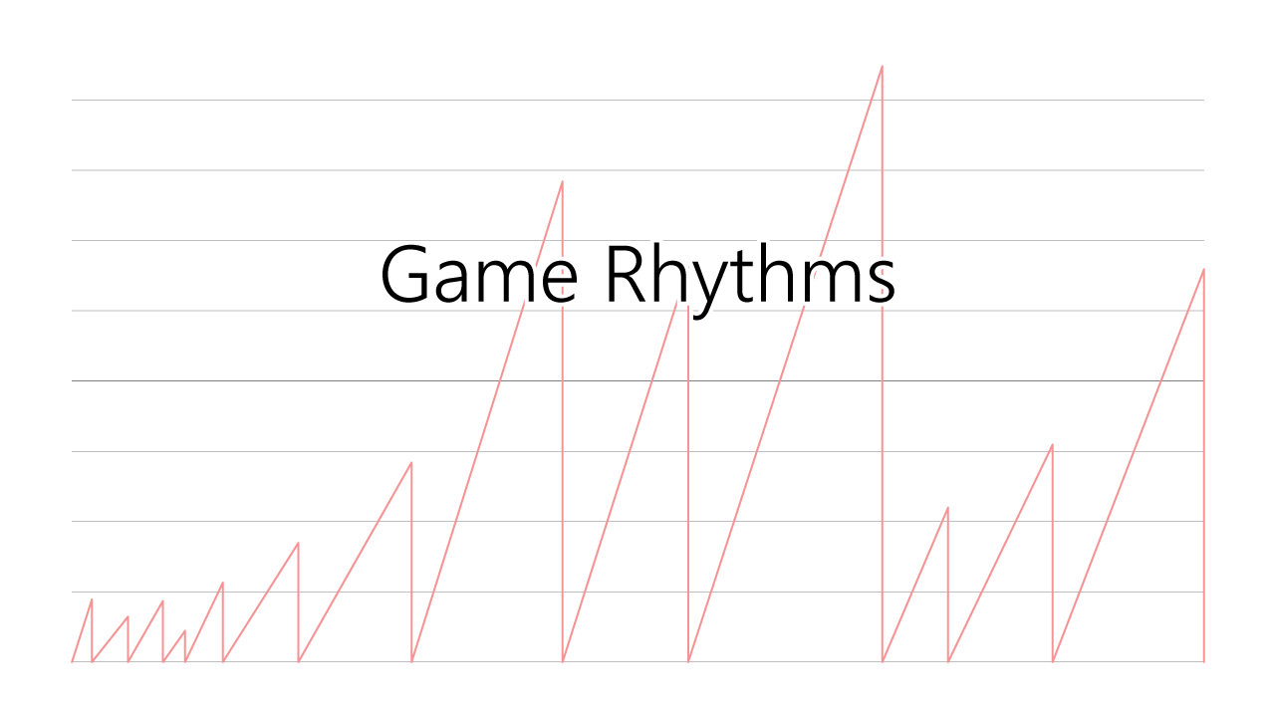
Notes:
1 Introduction
Thank you.
I’d like to spend 5 minutes talking to you about heartbeats and games.
Not about the heartbeat of the person playing the game…
…but of the game itself.
The underlying rhythms present in all games.

Slide 3
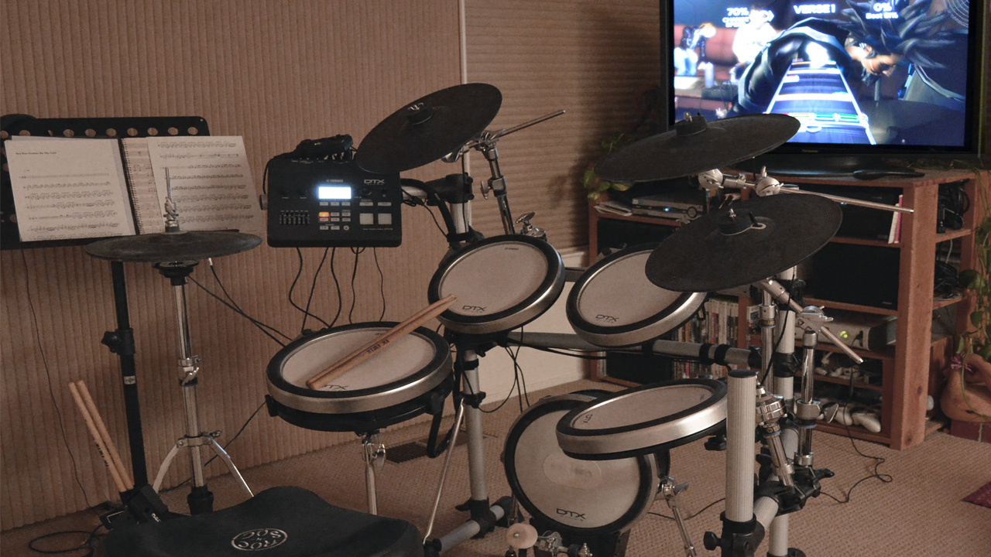
Notes:
2 Rock Band
Before talking about game rhythms…
…let me first tell you a brief story about a rhythm game.
As you can see by my upgraded controller, I was pretty serious about Rock Band drumming.
At some point I realized I should learn to play real drums instead of pretending.

Slide 4
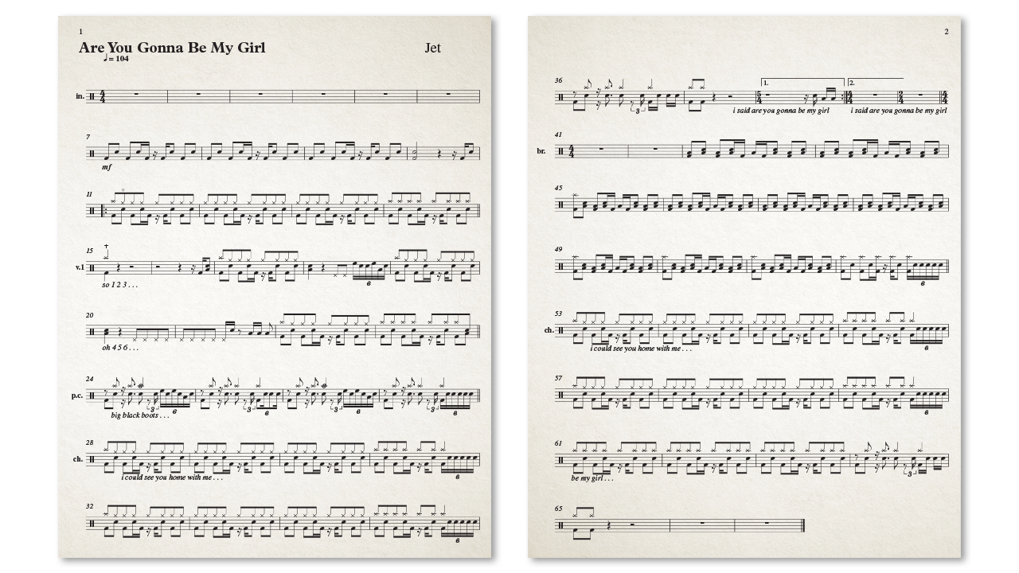
Notes:
3 Drum Music
I found an instructor and started taking lessons.
After teaching me the basics he assigned me a full song.
Without any prior experience, I thought the notation was difficult to read.
So I decided to fix it…in my own way.

Slide 5
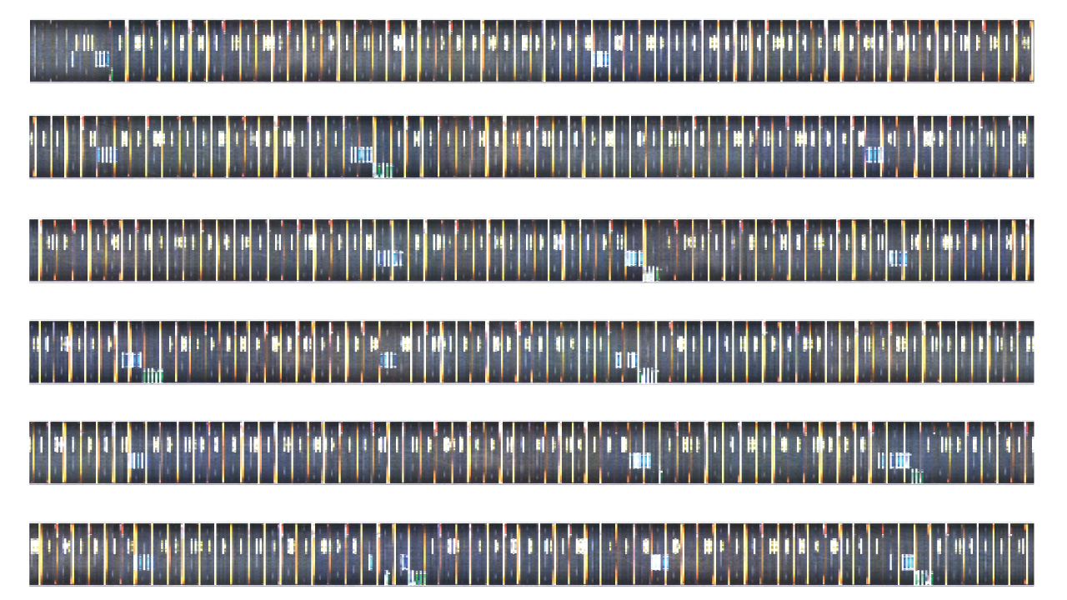
Notes:
4 Slit Scan
I recorded a video of the song in Rock Band and ran it through a “slit scan”.
This is a process that grabs the bottom row of pixels from each frame and stacks them next to each other…
…flattening Rock Band’s perspective grid into a top-down view.

Slide 6
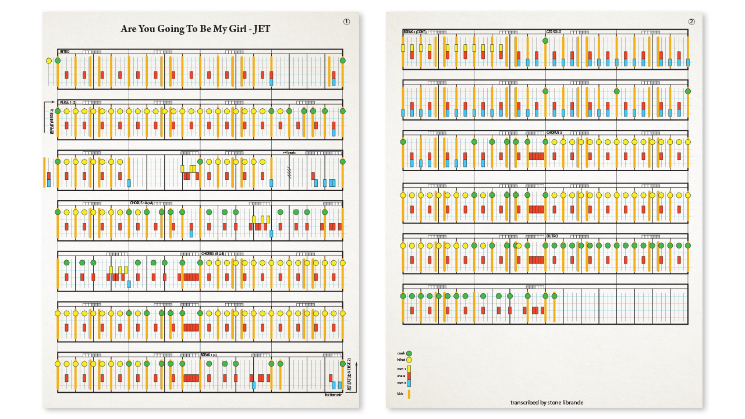
Notes:
5 RB Drum Music
I cleaned up the raw output and was excited to show my instructor how I had “modernized” traditional drum notation…
…and it made it much easier to read.
He just shook his head and said, “Why are you wasting your time doing this?”
“You could be spending all that time learning to read drum notation.”
That was a little sad.

Slide 7
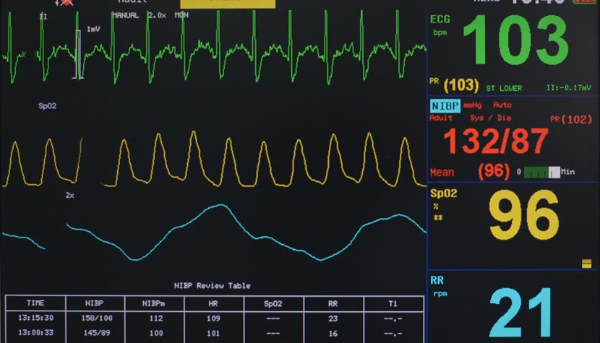
Notes:
6 Heart EKG
But all that time spent analyzing and notating a Rock Band song…
…made me wonder if I could use this process on other games.
Could I find a notation system that would allow me to see rhythms in other games…
…in the same way an EKG allows a doctor to visualize heart beats?

Slide 8
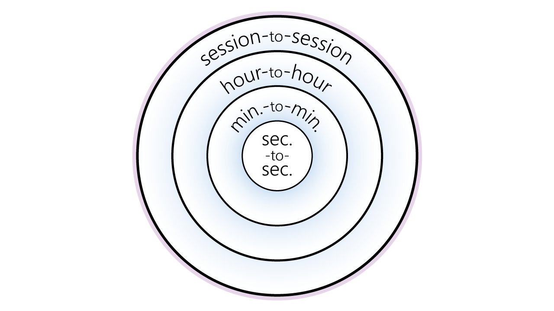
Notes:
7 Game Onion
One common timing visualization for games is called the “Game Onion”.
This is a way of organizing player activities into nested rings based on time periods.
This is helpful, but I find the circular shape to be suboptimal…
…since it makes it difficult to actually measure time.

Slide 9
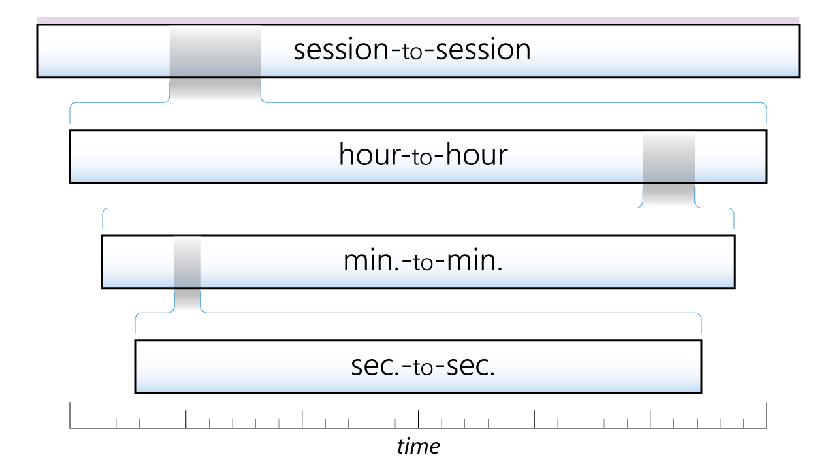
Notes:
8 Game Onion (flat)
I prefer to flatten the rings out into horizontal tracks…
…similar to a standard timeline.
This lets me zoom in and out at the various time scales…
…while still keeping the overall sequencing relationships intact.

Slide 10
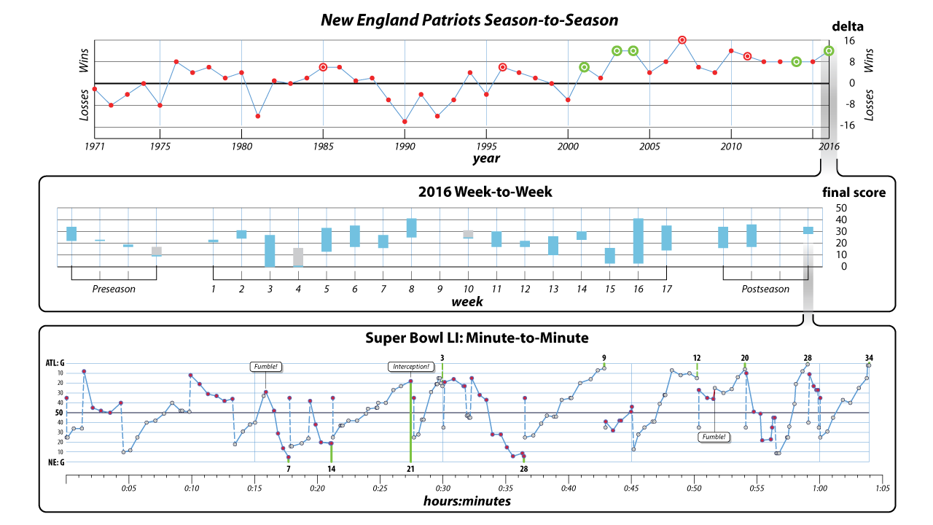
Notes:
9 Super Bowl (game time)
Here’s a real world example:
This is the heartbeat of the New England Patriots football team:
Season-to-season at the top.
Week-to-week for the 2016 season in the middle.
Minute-to-minute at the Super Bowl last month.

Slide 11
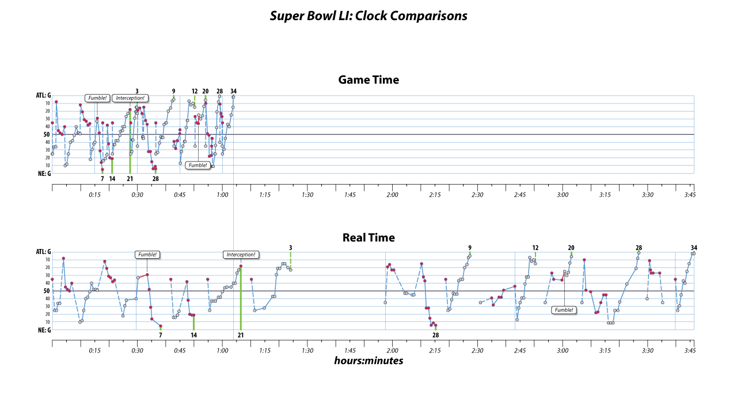
Notes:
10 Super Bowl (real time)
I was curious to see the difference in rhythm of the Super Bowl game using the game clock of 1 hour…
… versus the real-time clock of about 4 hours.
Here you can see the gaps created by timeouts, the halftime show, and commercials.

Slide 12
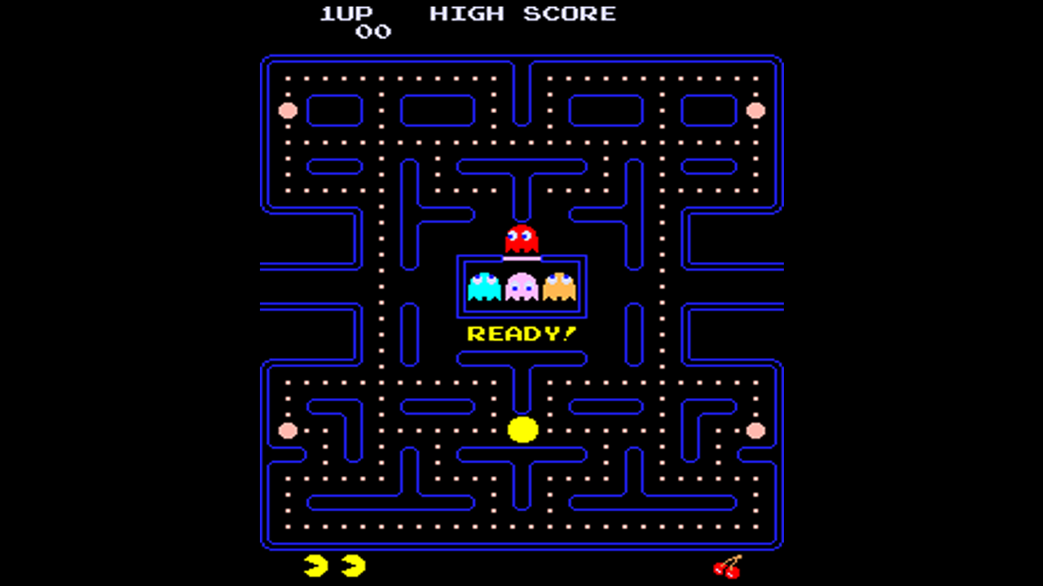
Notes:
11 Pac-Man Screen
Let’s apply this same technique to the video game Pac-Man.
I chose this game because it’s relatively simple…
…and has a strong rhythmic pattern.
I hadn’t played it in over 20 years, so I downloaded an emulator and started recording my games.

Slide 13
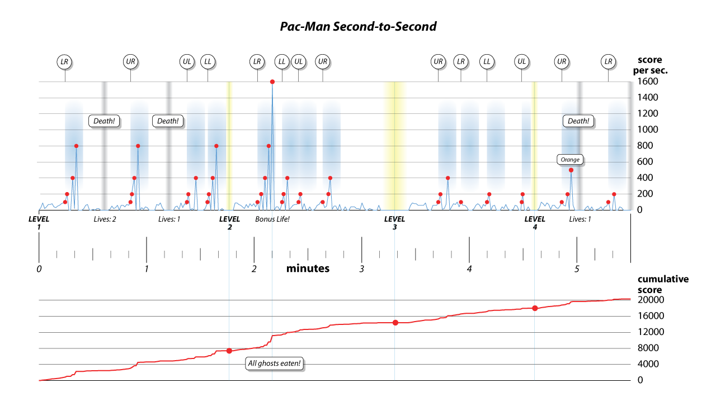
Notes:
12 Pac-Man Game
Here is the second-to-second diagram showing one of my early 5 minute games.
Points per second, which is a rough approximation of the player’s excitement level, is along the vertical axis.
Notice the peaks.
That’s when the ghosts turn blue and you can combo them for bonus points.

Slide 14
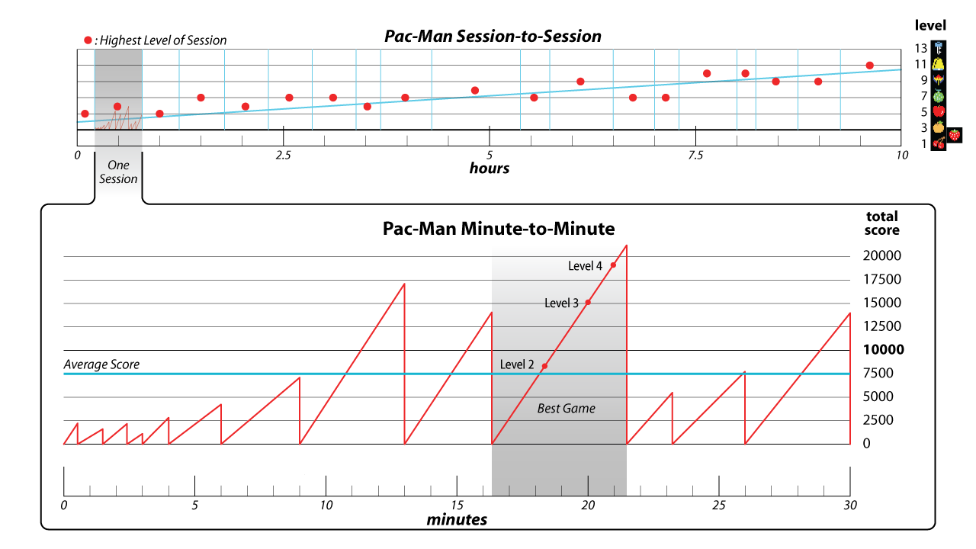
Notes:
13 Pac-Man Sessions
But Pac-Man isn’t about just one game; it is a series of games over time.
At the minute-to-minute scale you play multiple games and slowly learn patterns.
At the session-to-session scale, it’s not about the most points.
Achieving higher levels becomes the motivating driver.

Slide 15
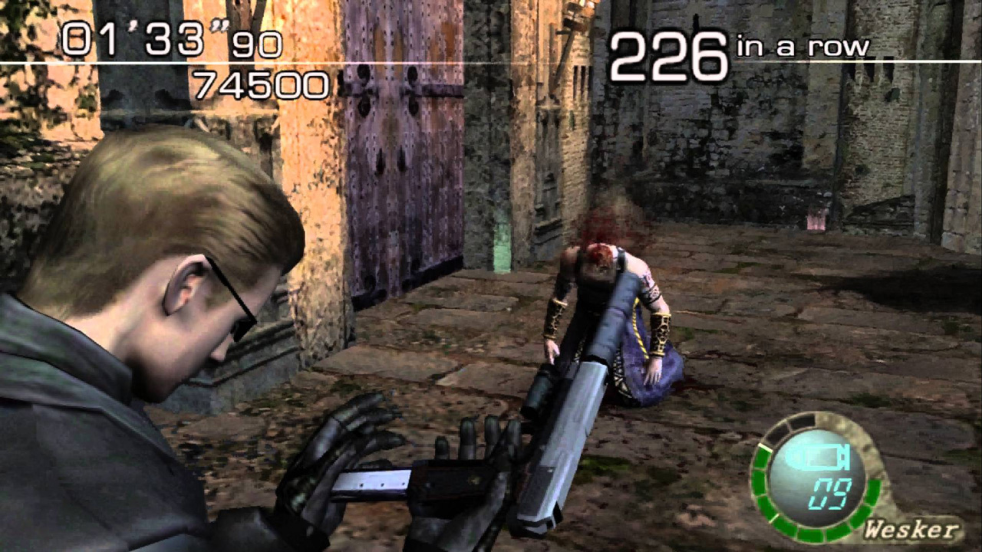
Notes:
14 RE4 Screen
Let’s do a similar analysis of a completely different game: Resident Evil 4.
This is a third person horror game that I played obsessively and analyzed for the ETC’s “Well Played” journal.

Slide 16
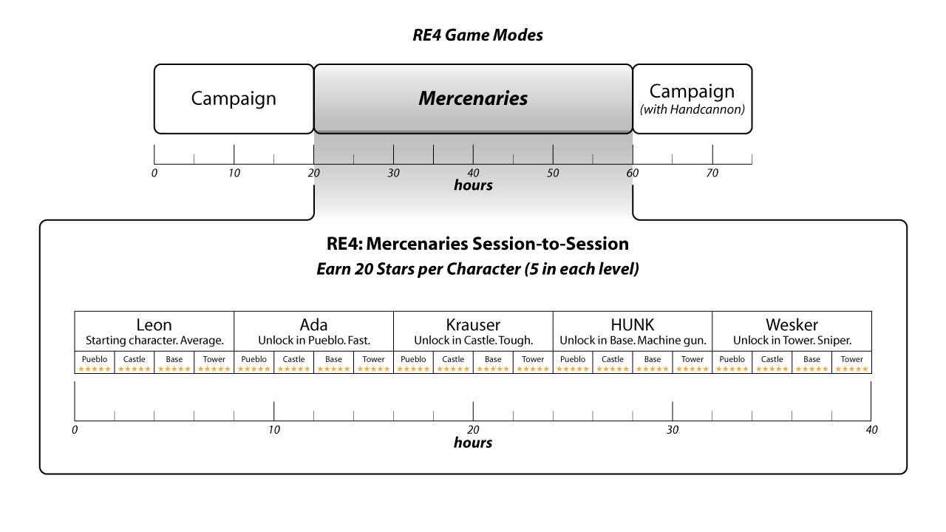
Notes:
15 RE4 Modes
The primary mode of the game is the campaign.
But I had a lot more fun with the Mercenaries mini-game.
In this mode you try to earn 5 stars on 20 different challenges…
…using 5 unique characters on 4 custom maps.

Slide 17
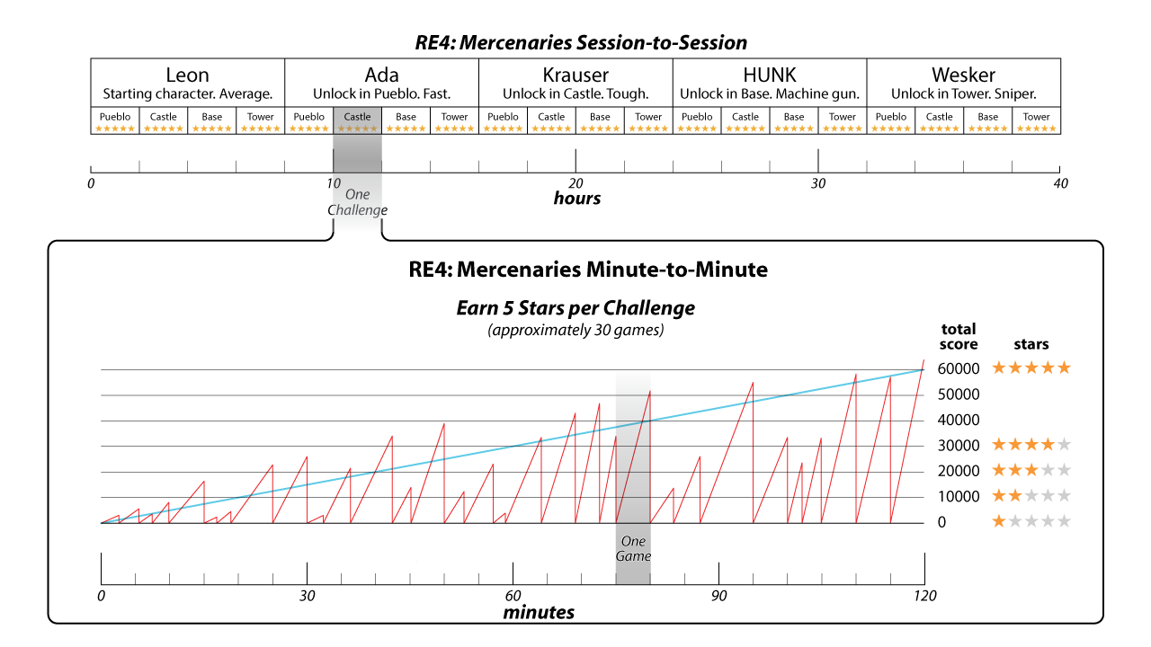
Notes:
16 RE4 Sessions
It usually took me about 2 hours to beat each challenge with 5 stars.
In the beginning you die quickly, but with practice your score increases.
Notice how the scoring system makes it relatively easy to get to 4 stars…
…but it takes a lot of extra work to get to 5.

Slide 18
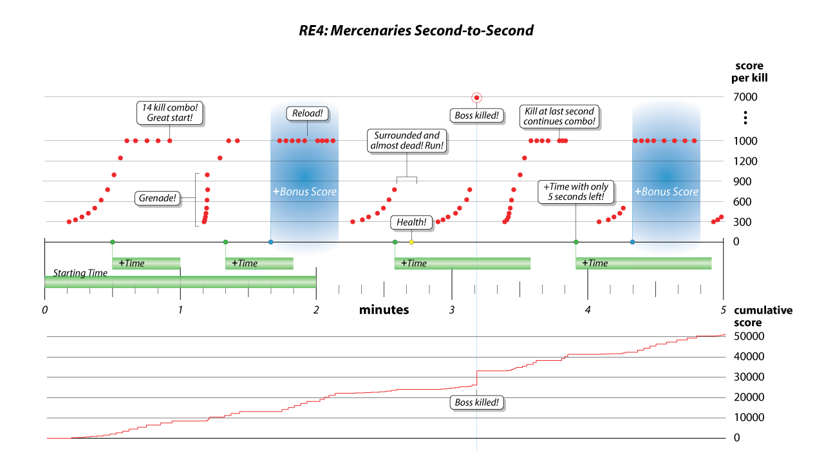
Notes:
17 RE4 Game
An individual game might last about 5 minutes.
The blue areas are when you collect a power up that multiplies your score for a short time.
You score also increases if you kill enemies quickly and grow your combo multiplier.

Slide 19
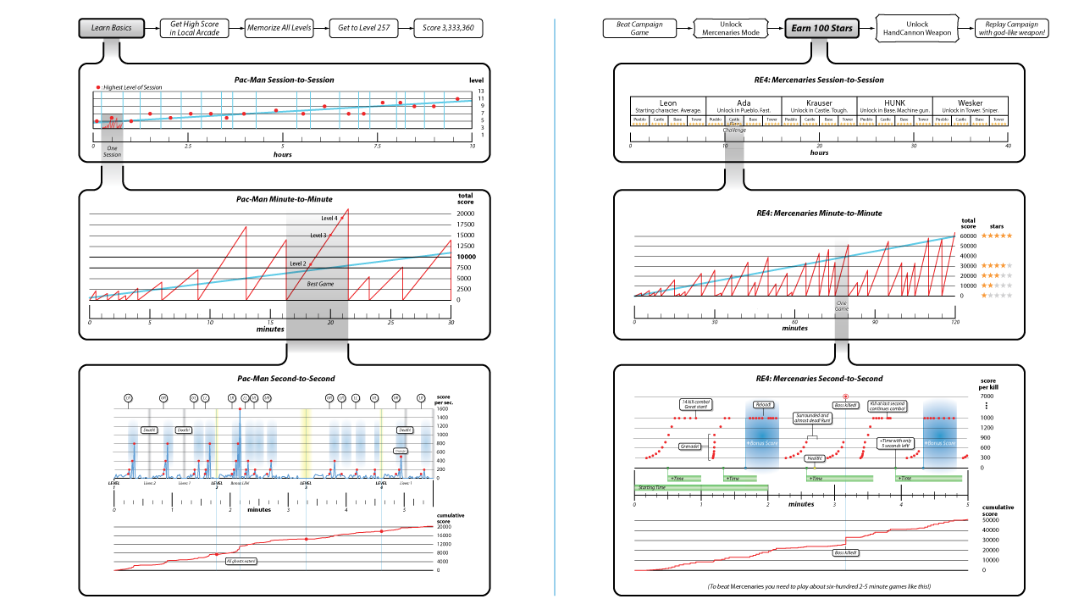
18
Notes:
18 Side-by-Side
Even though Pac-Man and Mercenaries are completely different thematically…
…it’s interesting to note that they share several common low-level rhythms.
The session-to-session growth caused by pattern memorization.
And the bursts of excitement that occur when you collect a bonus item.

Slide 20
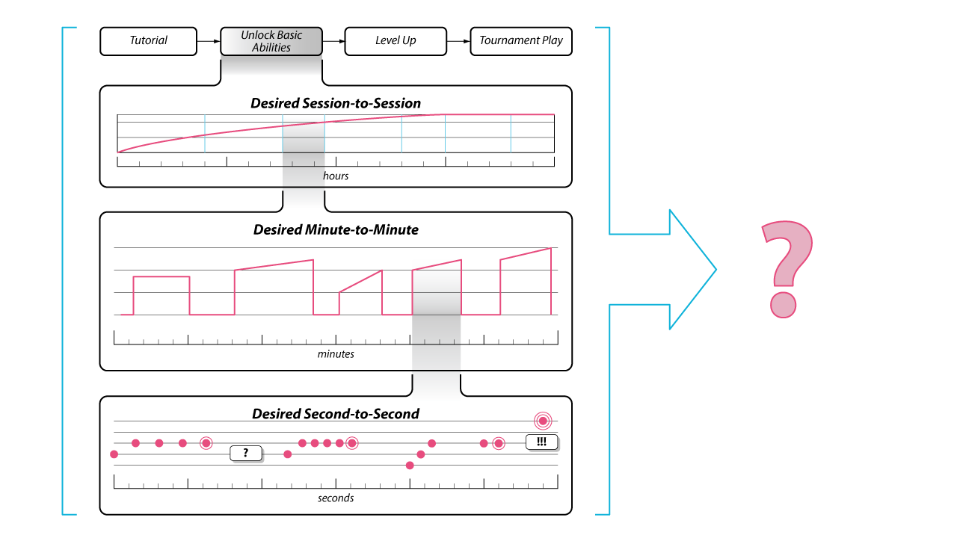
Notes:
19 Prototype Timing
I think this visualization technique is interesting for analyzing existing games.
But I’m more interested in using it for games in development…
…by mapping out the timings first, then tuning the game appropriately to match the desired rhythms.
I hope to give another talk about that in the future.

Slide 21
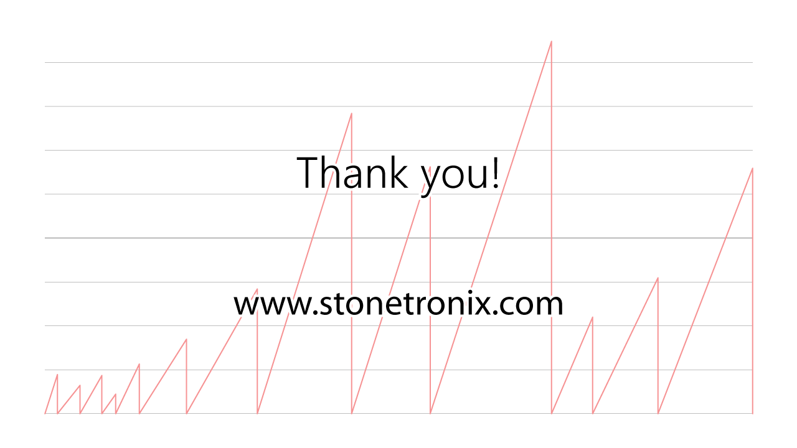
Notes:
20 End
I know that’s a lot of information to cram into 5 minutes.
These slides are available on my website if you would like to review them at your own rhythm.
Thank you.

Slide 22
Stone
Librande
@StoneLibrande

