Slide 1
Well Played: Armada d6
Eric Zimmerman and John Sharp
Stone Librande
Lead Designer, SimCity
Notes:
Intro
Drew Davidson started up Well Played so that designers could critique and review games from a designer’s perspective.

Slide 2
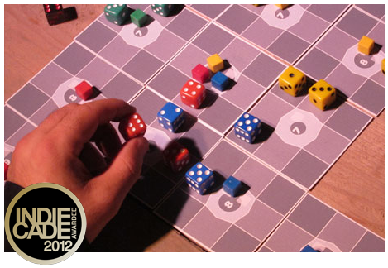
//Game Design Award Winner
This award honors the unique quality of gameplay that engages us with an experience or subject in that way only games can.
Notes:
Game Design Award Winner
First off, congratulations! Armada d6 was the winner of the Game Design Award.
But if the journey is effortless then I would say that it wasn’t a game. For instance, let’s play a game called “Sit in Your Chair”. Hooray, you all won! But could you really consider that a game?

Slide 3
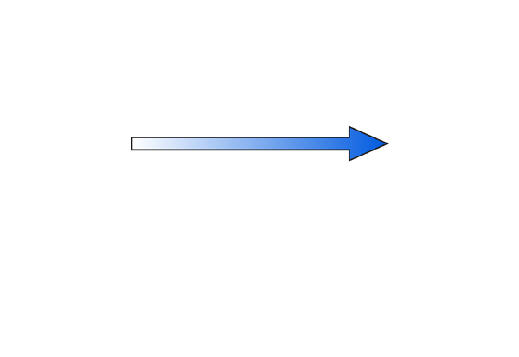
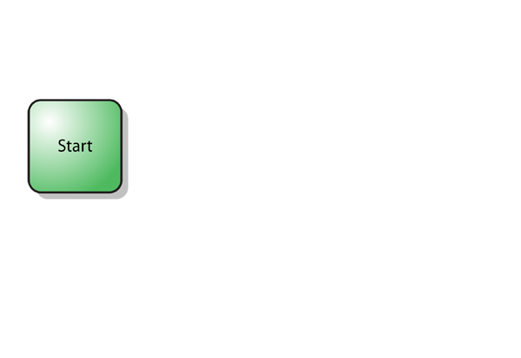
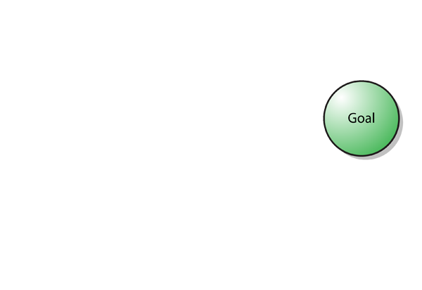
Game Fundamentals
Notes:
Fundamentals of Game Design
Earlier this year at GDC I gave a talk about the fundamentals of game design. I won’t be going into detail about the method, but I wanted to use it as a framework for analyzing Armada d6. Here’s the 3 minute overview.
The first of the fundamentals is that every game has a start state and a goal state.
But if the journey is effortless then I would say that it wasn’t a game. For instance, let’s play a game called “Sit in Your Chair”. Hooray, you all won! But could you really consider that a game?

Slide 4
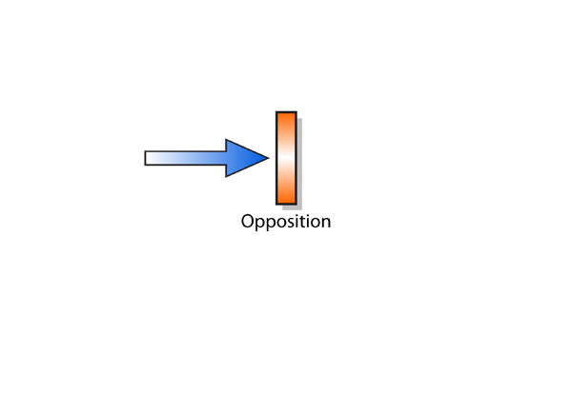
Game Fundamentals
Notes:
Fundamentals of Game Design
You need some opposition. But you can’t have opposition that completely prevents the player from reaching his or her goal. Let’s play another game: The first person to stand on the their chair and touch the ceiling wins. This game is also not very enjoyable.

Slide 5
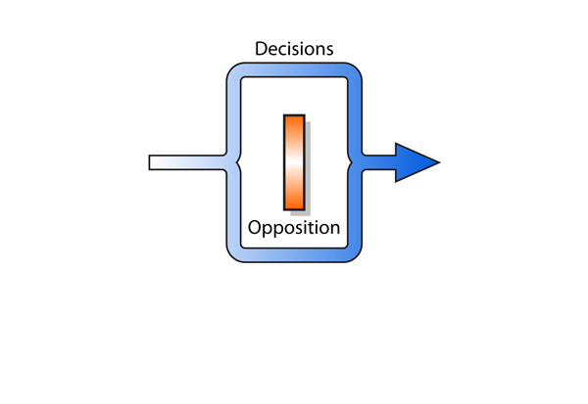
Game Fundamentals
Notes:
Fundamentals of Game Design
Decisions allow the player to find ways around the opposition and continue towards the goal.

Slide 6
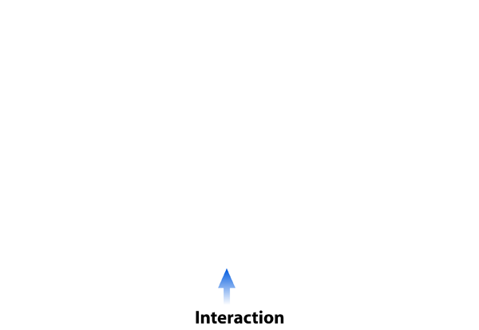
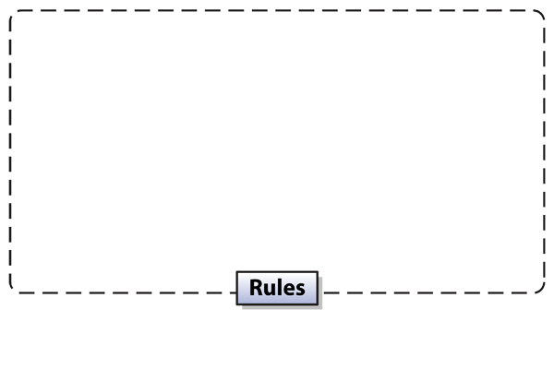
Game Fundamentals
Notes:
Fundamentals of Game Design
Rules define the start, goal, opposition and decisions.
Interactions set the game in motion. This is the act of the player’s input into the game and how the game outputs back to the player.

Slide 7
Game Fundamentals
Notes:
Fundamentals of Game Design
But just knowing that these parts exist won’t help you make a better a game. This model describes all games, even the terrible ones. This diagram might help you determine what is a game and what isn’t, but I don’t see a big need in the world for someone to be able to point at different systems and say, “This one is a game, but that one isn’t”.
What is important is that you can use this diagram to isolate the different parts of a game. Don’t think of a game system as a set of binary features. (i.e., This element either exists in the game or it doesn’t.) Instead, think of a game system as a series of sliders. A low rating means that part of the game is weak, while a high rating means that part of the game is perfect. Your goal as the designer is to push these sliders to the right and make each of the fundamental elements as elegant and balanced as possible.
So let’s see how Armada d6 scores…

Slide 8
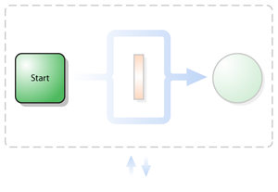
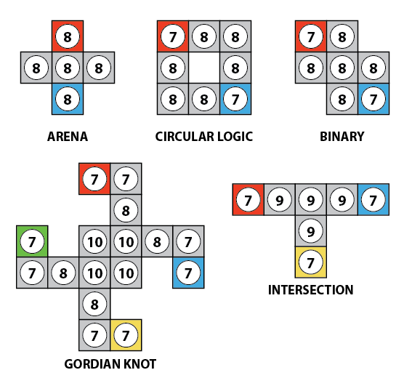
Start
Customized maps
Length tuned by total monuments
Game dynamic changes with number of players (2-4)
Notes:
Start
It’s often overlooked, but the starting conditions can be just as interesting as the goal.

Slide 9
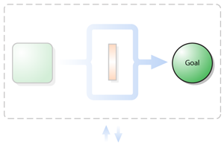
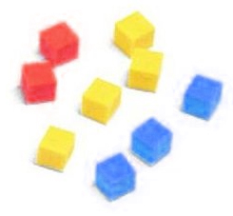
Goal
Place all your monuments
Distance to goal is clear to all players
Can’t go backwards
Moving forward is rewarded
Notes:
Goal
How do you win?

Slide 10
Sub-Goal
Place one monument:
Match ship numbers to planet
Increase Dominance
Gain Advancement:
Place monument
Increase Research
Notes:
Sub-Goal
What are you doing each turn?

Slide 11
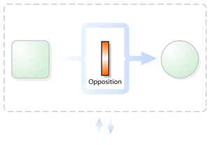
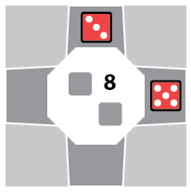
Opposition
Environment:
Limited ships
Limited ship slots around planet
Limited monument slots
Matching planet number with ships
Distance to target
Notes:
Opposition
Environment

Slide 12
Opposition
Opponent:
Kill with ships
Block with ships
Take monument slots
Take advancement cards
Notes:
Opposition
Opponent

Slide 13
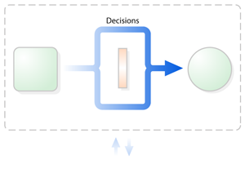
Turn Decisions
Three base actions per turn:
Reconfigure
Move/Attack
Deploy
Construct
Research
One free special action per ship
Notes:
Decisions
Looking for interesting decisions. Not too many, not too few. Each one is valuable throughout the game.
Could be hard to remember number of actions, especially with a lot of ships and specials.

Slide 14
Strategic Decisions
Dominance vs. Construction
Research vs. Ship actions
Attacking is always good
Notes:
Decisions
Strategic decisions

Slide 15
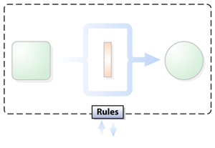
Rules
Easy to learn
3 pages + clear illustrated examples
A few buried rules and exceptions
“Relocation cannot be used to make it impossible for a player to win without using another Relocation advancement.”
Simple rule set allows for emergent complexity
Notes:
Rules
Easy to read and well formatted rulebook.

Slide 16
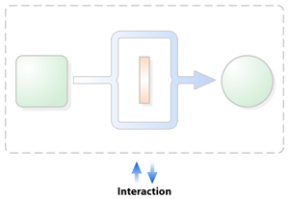
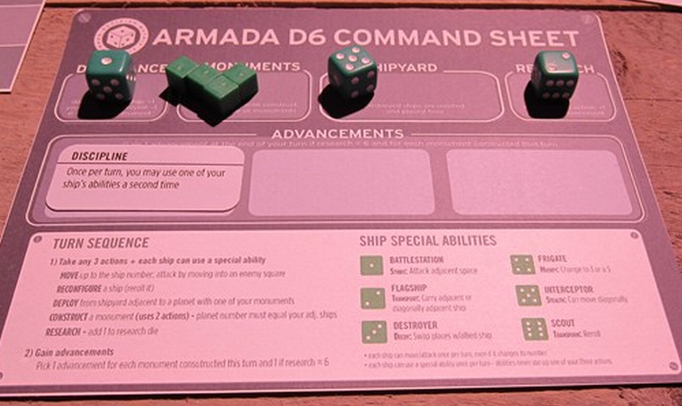
Interaction
No hidden information
Play mats clearly show state of game
Shared advancement cards
Dice numbers clear at all time
One number, Multiple features
Speed, Attack, Special power
Notes:
Interaction
How does the player interact with the game and how does the game “talk back” to the players?

Slide 17
Interaction
Combat odds easy to calculate
1d6 + ship value
Low roll wins (attacker wins ties)
Advancement combos to discover
25 unique permanent advancements
Bonuses for construction, combat, deploying, movement, etc.
Evolving personality (“Hunger” + “Faith”)
Notes:
Interaction

Slide 18
Live Game Play Example
Notes:
Live Game Play
(Not sure if there will time or space. Possibly use webcam to project image on screen.)

Slide 19
Final Thoughts
Lunch game hit
But went over an hour
Didn’t pass the “wife test”
Too much emphasis on attacking
Conflicted on theme
Abstract vs. Space theme
Futuristic vs. Ancient archaeological find
Notes:
Final Thoughts

Slide 20
Final Thoughts
Will definitely buy it when it finds a publisher
Will probably make my own copy in the meantime
(With Eric’s permission, of course!)
Congratulations again on the Game Design Award!
Notes:
Final Thoughts

